Slide 1
CACEIS Human Capital Valuation Framework
From raw HR records to an AI-ready valuation layer
8185.0
Latest monthly headcount
46.0
Female representation
89.4
2024 review completion rate
3.39
2024 average performance score
Objective: shift HR data from cost tracking toward capacity, capability, performance, well-being and value creation.
Data foundation: workforce snapshots, performance reviews, training records, absenteeism logs, and P&L/FTE history.
Deliverable logic: reproducible KPI pipeline + exploratory insights + AI prototype direction.

Slide 2
Framework
Seven KPIs grouped around business value, not only cost
Workforce capacity: monthly headcount to monitor operating scale and resilience.
Inclusion: female representation to track talent mix and fairness at workforce level.
Performance governance: annual review completion rate to measure managerial coverage.
Performance quality: mean rating and high-performer share to capture contribution quality.
Capability investment: completed training hours and certification incidence.
Learning effectiveness: training satisfaction and perceived on-the-job impact.
Well-being and efficiency: absence days per employee plus NBI/FTE and personnel cost/FTE.

Slide 3
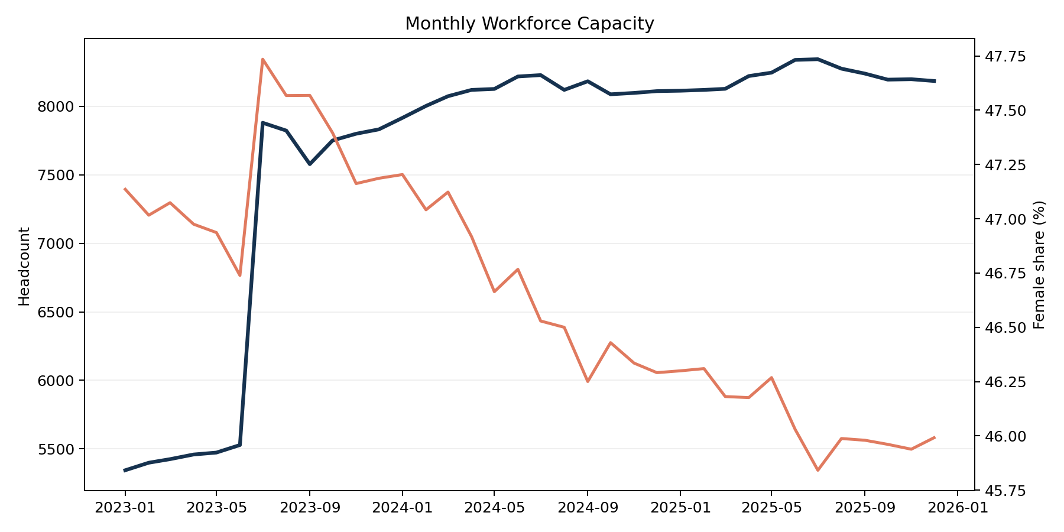
Data Pipeline
Cleaning, standardization and metric assembly
Ingestion: load 8 structured Excel sources across HR, training and finance.
Normalization: trim column names, harmonize anonymized employee IDs, standardize dates and numeric fields.
Entity layer: workforce snapshot becomes the reference grain for headcount, gender mix and country segmentation.
Event layer: performance, training and absenteeism are transformed into employee-year or employee-event facts.
Aggregation: KPI tables and charts are exported as CSV/PNG for notebook and presentation reuse.

Slide 4
Governance And Ethics
Controls required before any human-capital AI layer
GDPR: retain anonymized IDs only, keep purpose limitation explicit, and restrict outputs to aggregated insights for decision support.
Data quality: track missing IDs, mixed date formats, duplicated employee-review records, and country-specific schema differences.
Bias mitigation: monitor KPI differences by country and gender, and avoid using protected attributes as decision variables in downstream models.
Human oversight: position the prototype as an augmentation tool for HRBP and managers, not an automated decision engine.

Slide 5
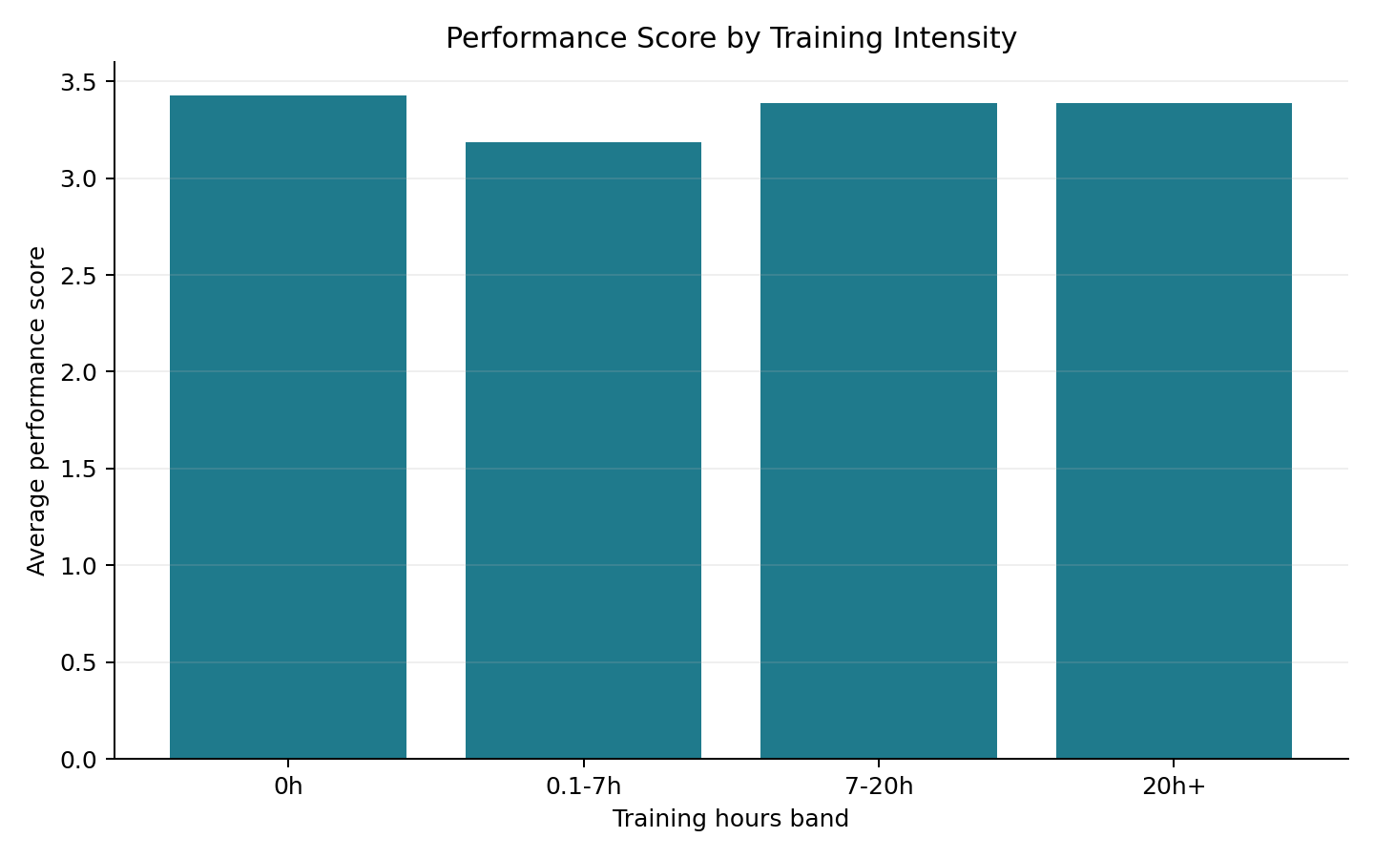
AI Prototype Direction
Techniques aligned with the available data
Descriptive layer: KPI monitoring with threshold-based alerts for review coverage, absence spikes and training gaps.
Predictive layer: simple risk models for absenteeism concentration and missing review completion.
Segmentation layer: clustering of employees or entities by training intensity, performance and well-being signals.
Copilot layer: retrieval-augmented assistant that explains KPI movements and recommends follow-up actions with traceable evidence.

Slide 6
Insight 1
Scale stabilized after sharp growth, with a consistent inclusion baseline
Headcount moved from 7916 at the first 2024 snapshot to 8185 in the latest snapshot.
Female representation in the latest snapshot stands at 46.0%, suggesting stability but still room for balance improvement.
France and Luxembourg dominate the European footprint, so management practices in those geographies will drive most KPI shifts.

Slide 7
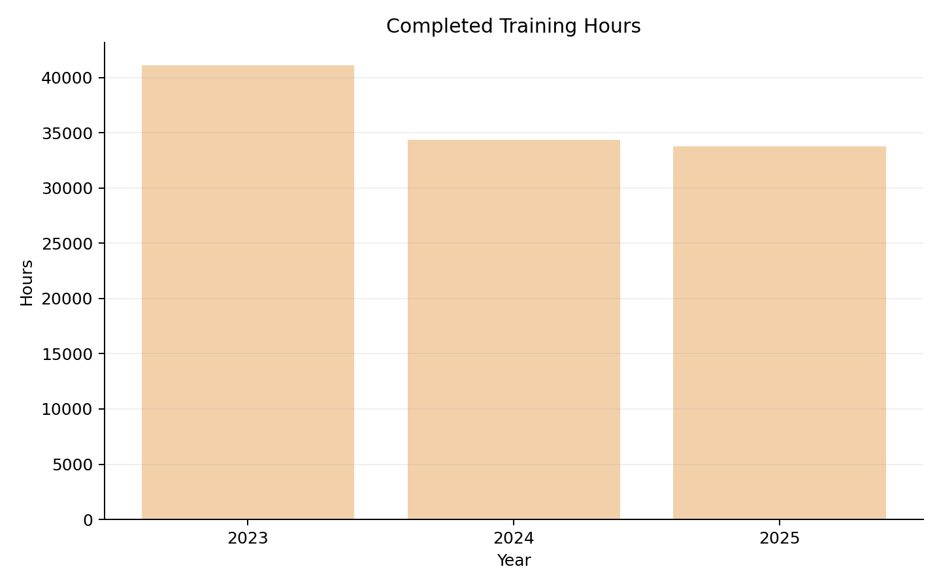
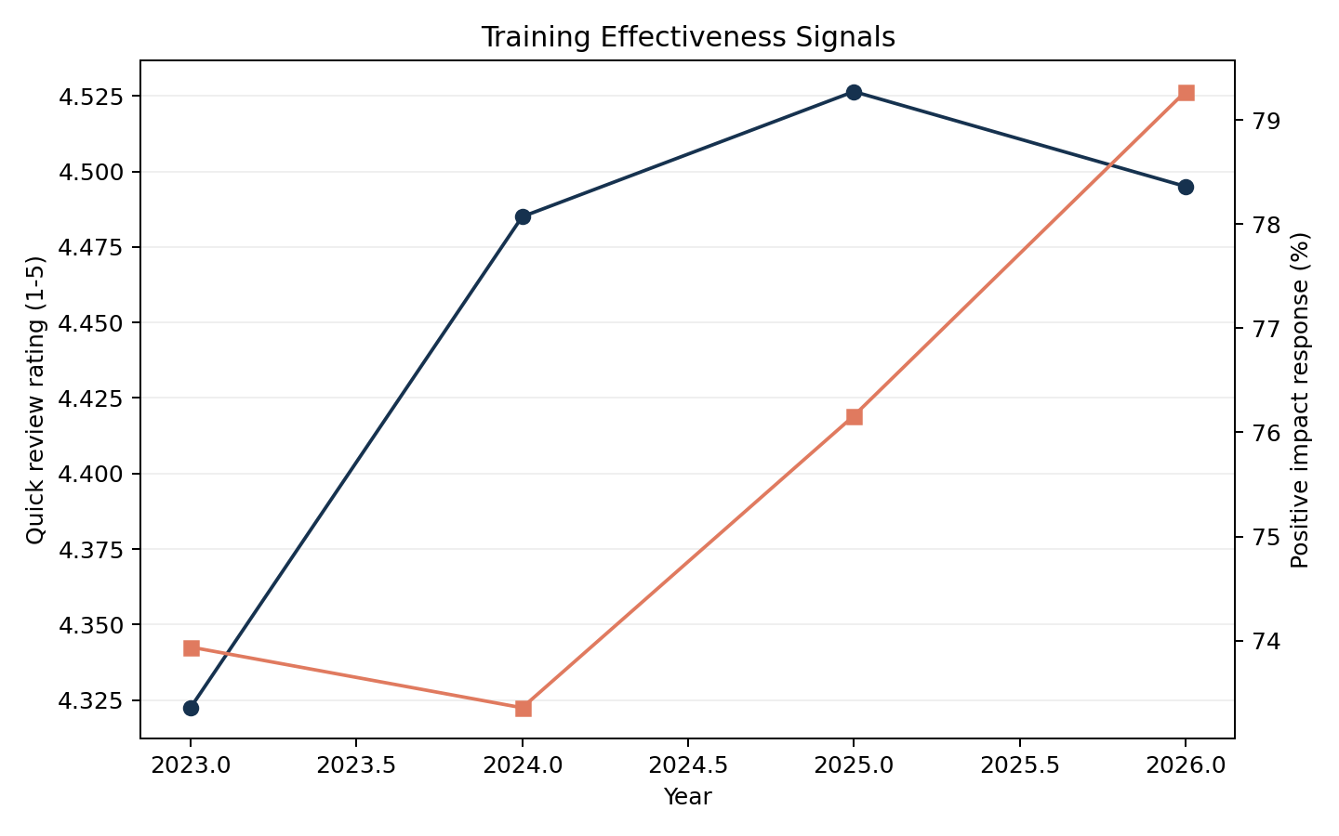
Insight 2
Capability signals are strong: large training volume and high learner satisfaction
Completed training reached 33760 hours in 2025 across 1539 employees.
Post-training satisfaction remains high at 4.53/5, while delayed impact feedback shows 76.2% positive responses.
This makes training one of the strongest candidates for the final AI use case because the signal is rich, repeated and linkable to employees.

Slide 8
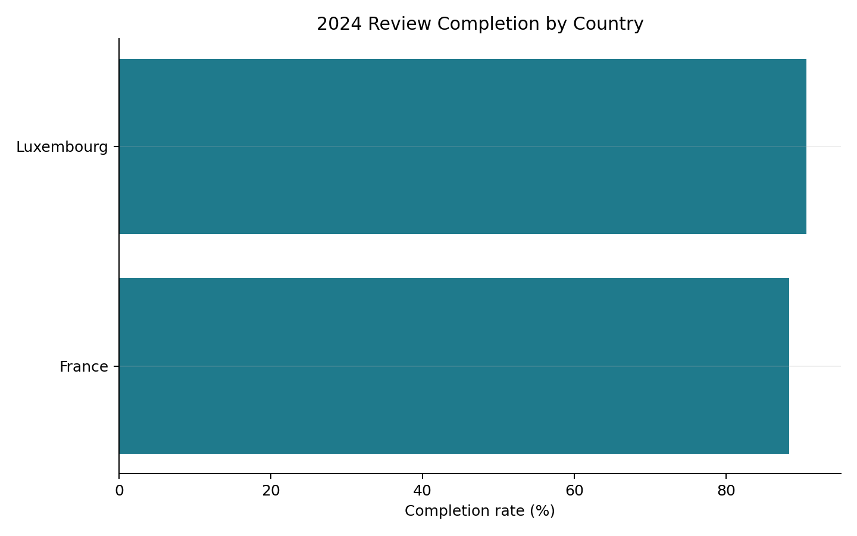
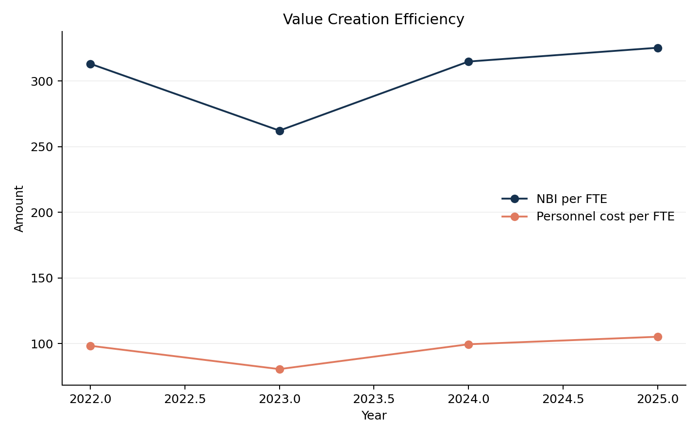
Insight 3
Performance coverage is solid, and efficiency per FTE continues to improve
Weighted 2024 review completion is 89.4%, which is strong enough for KPI-driven managerial accountability.
2025 net banking income per FTE reaches 325, while personnel cost per FTE is 105.
The strategic opportunity is to connect capability and well-being signals to these business efficiency outcomes in the final prototype.

Slide 9
Implementation Assets
What is included in the technical submission
Notebook: `deliverables/CACEIS_Human_Capital_Implementation.ipynb` with KPI logic and exported analysis tables.
Pipeline script: `technical_implementation/generate_caceis_deliverables.py` to fully reproduce outputs.
Reusable assets: CSV KPI tables and PNG charts in `deliverables/tables/` and `deliverables/figures/`.
Next step for the final prototype: promote these tables into a dashboard and add interpretable risk scoring.

