Slide 1
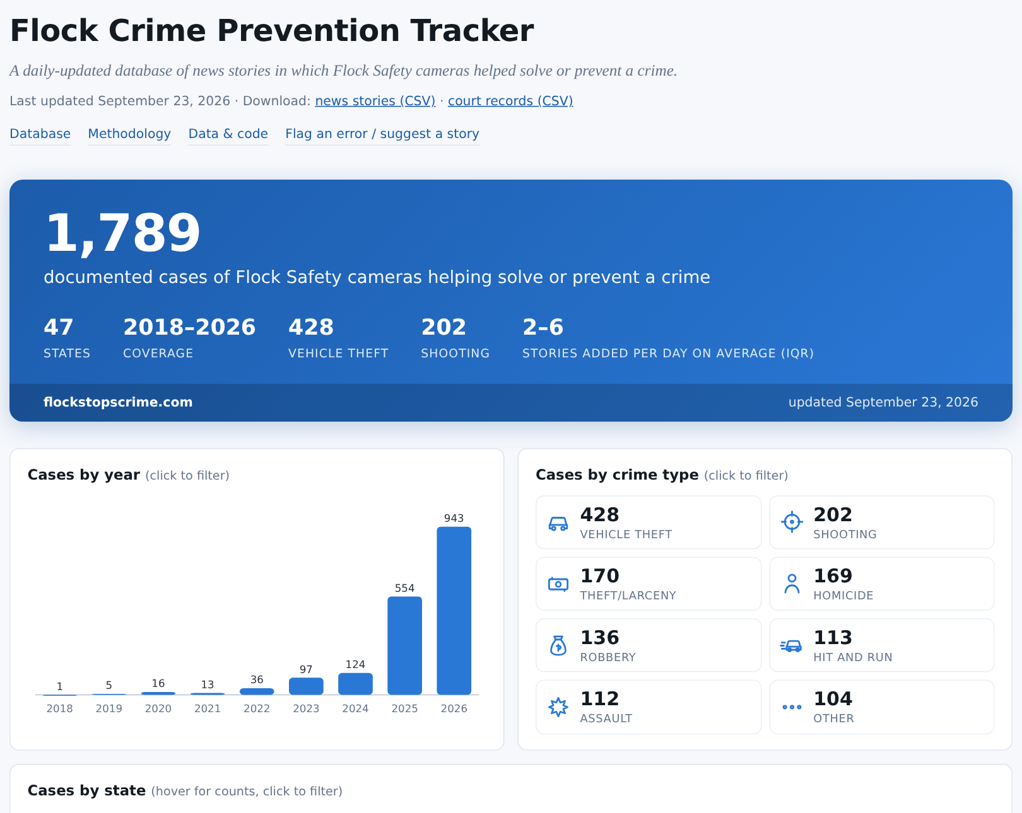
VIBECODING 101
How to Build a Real Website with Claude Code
A case study: flockstopscrime.com, the Flock Crime Prevention Tracker
For beginners. No prior coding needed.
Notes:
This deck uses one real project to teach the vibecoding workflow. Everything described happened: the facts come from the project's git history, commit messages, and docs. Sample prompts are illustrative reconstructions, not verbatim.

Slide 2
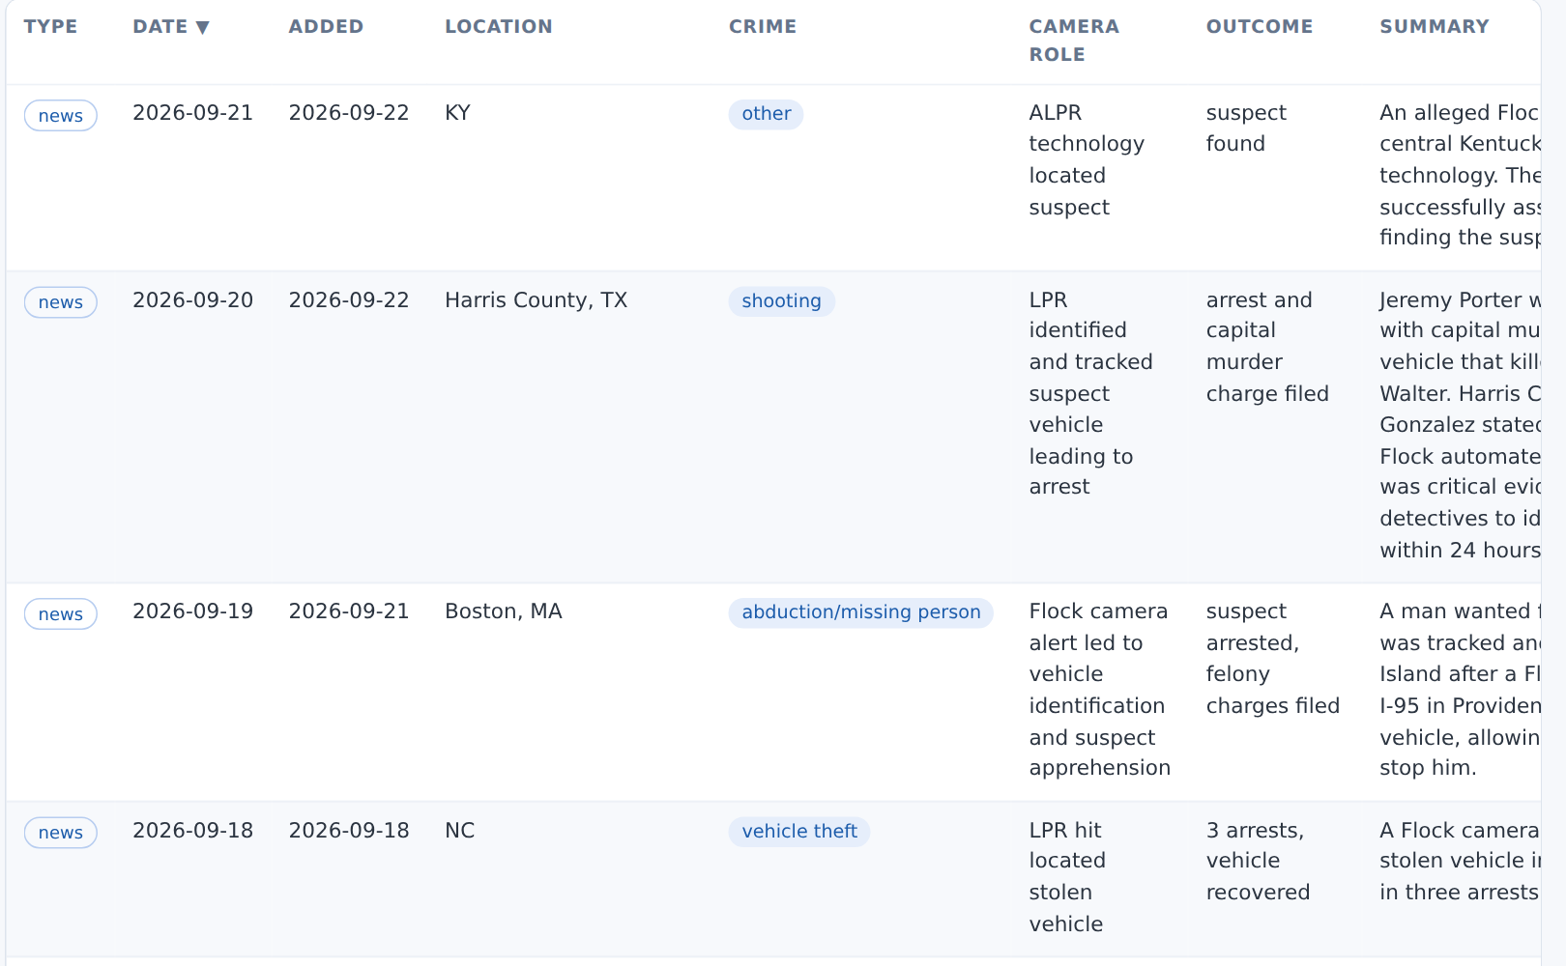
What we built
A daily-updated public database, built mostly by describing it in plain English
1,789
47
documented cases on the site
states covered
337
~2,650
commits since Aug 12, 2026
lines of Python Claude wrote
It finds news stories, has an AI decide which qualify, removes duplicates, and republishes the site every morning, without anyone touching it.
Notes:
Counts as of Sept 23, 2026. 1,789 = news stories plus court records. 250 of the 337 commits were made by the automated daily bot, not a person.

Slide 3


What is “vibecoding”?
You describe what you want. Claude writes, runs, and fixes the code.
You do
Claude Code does
Decide what the site is for
Set the rules (what counts, what doesn't)
Look at the result and react
Approve or reject changes
Writes and edits files
Runs commands and tests
Reads error messages and fixes them
Commits and pushes to GitHub
Lesson: You are the editor, not the typist. Your judgment is the scarce input.
Notes:
Claude Code is an AI agent that works inside a code project. It can be used from a terminal, a desktop app, or the web at claude.ai/code. The web version runs in a cloud container attached to a GitHub repository, so a beginner needs no local setup.

Slide 4






The toolkit
Everything here is free or cheap, except the AI calls
Claude Code
GitHub repository
GitHub Actions
The agent that writes the code. Used via claude.ai/code in the browser.
Stores the code and the data. Every change is saved as a commit.
Free scheduled robot. Runs the update script every day at 6:30am ET.
GitHub Pages
Anthropic API
Free data sources
Free hosting for the finished site, plus a custom domain.
The site itself calls Claude (Haiku 4.5) to read and classify articles.
GDELT news API, Google News RSS, CourtListener court records.
Notes:
You do not need to know how to set any of these up. Ask Claude Code to walk you through each one. The one thing you must do yourself is paste secrets (like the API key) into GitHub's secret settings. Never paste them into chat or code.

Slide 5
1
Start with a plain-English spec
Day 1 (Aug 12): the pipeline, site, and daily workflow arrived in one commit
✓
Say what it is for
EXAMPLE PROMPT (illustrative)
Who uses it, and what question it answers.
Build a website that tracks news stories where Flock Safety license-plate cameras helped solve or prevent a crime.
Each day: search news sources, use Claude to decide if each article qualifies, pull out date, city, state, crime type and outcome, and merge duplicate stories.
Store it in a CSV. Publish a searchable table on GitHub Pages. Run it daily with GitHub Actions.
✓
Say what counts
Inclusion rules are the heart of a data site.
✓
Say where data lives
A CSV file is easy to read and to fix by hand.
✓
Ask for a plan first
Have Claude explain its design before it builds.
Lesson: Be specific about the goal and the rules. Let Claude pick the technology.
Notes:
The first commit in the repo, 'Flock camera crime tracker: pipeline, site, daily workflow,' contains the whole first version. The prompt shown is a reconstruction of the kind of request that produces it.

Slide 6




How the site works
Four steps, each one a short Python file Claude wrote
Discover
→
Classify
→
Dedupe
→
Publish
Pull candidate articles from GDELT and Google News
Claude reads each article: does it qualify? Extract the fields
Merge stories about the same incident into one row
Rebuild the site from the CSV and deploy it
fetch.py
classify.py
dedupe.py
build_site.py
Everything is stored in data/stories.csv. The website is regenerated from that one file, so fixing the data fixes the site.
Lesson: Ask Claude to split the job into small, named steps. Small pieces are easier to debug.
Notes:
A beginner does not need to read this code. But knowing the four steps lets you give precise instructions, like 'the dedupe step is missing syndicated copies.'

Slide 7
2
Let a robot run it every day
GitHub Actions runs the pipeline at 6:30am ET, commits the new data, and redeploys the site
Daily update
New stories, every morning
Court records update
Weekly CourtListener sweep
Feedback triage
Runs when a reader files an issue
Deploy
Redeploys when data is edited by hand
Lesson: Ask Claude to “make this run on a schedule with GitHub Actions.” The git history becomes a free audit log.
Notes:
The 87 non-bot commits include the maintainer's direct edits and commits Claude Code made during sessions. Many were attributed to the maintainer's account because Claude Code commits as the user.

Slide 8



3
Things will break. That's normal.
Three real failures from the first three days, and how each was fixed
Missing API key
Blocked by a firewall
Corrupted data file
The first daily run happened before the API key was set. Every article failed, and all 650 were wrongly marked “already seen.”
The GDELT news API rejected requests that did not look like a web browser.
Two jobs edited the CSV at once. Git merge-conflict markers were saved into the database.
Fix: Reset the cache. New rule: never mark an item done if it errored; stop at once if the key is missing.
Fix: Send a normal browser user-agent string.
Fix: Repair the file. Add validate_data.py, which checks the data before every commit.
Lesson: Paste the error into Claude. Then ask for a guardrail so the same class of bug can't recur.
Notes:
Sources: commits f5c2ded (error handling), 9b066a6 (GDELT user-agent), and f4a237b (conflict-marker corruption). The key habit: after the fix, ask 'how do we prevent this from happening again?' That question produced the data validator, which now runs before every commit.

Slide 9
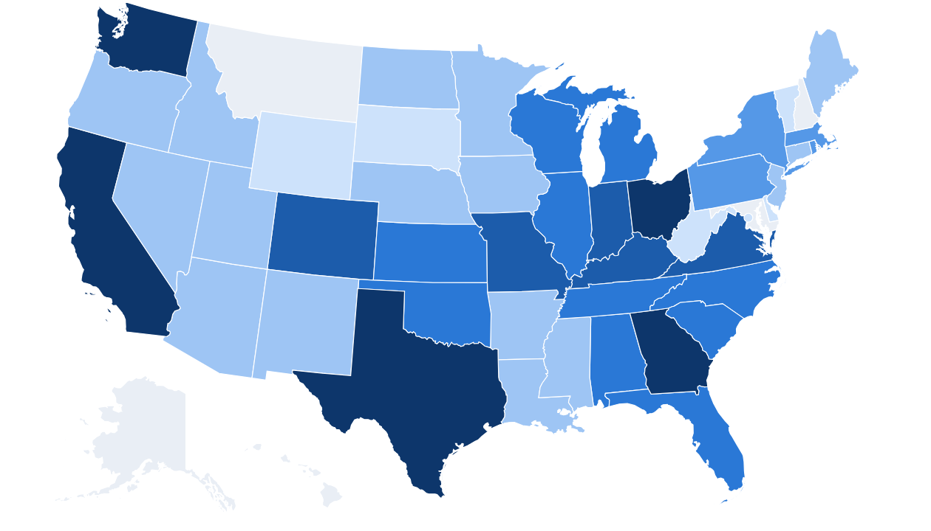
4
Improve the design in small requests
Most of the site's look was built in about 20 small commits over Aug 14–15
Add navigation, sortable columns, and shareable filter links
Swap the amber accent for blue that passes contrast checks
Add a clickable state map and crime-type tiles
Stack the charts neatly on phones
Make link previews show today's stats
Show thousands separators on every number
Lesson: One change per request. Look at the result in a browser. React. Repeat.
Notes:
Each bullet is a real commit, e.g. 26794e7 (nav, charts, sortable columns), 49bb981 (blue accent passing 4.16:1 contrast), 0709396 (map and icon tiles), 921e018 (mobile layout), 4727256 (daily link-preview image), 8b4189a (thousands separators). Claude Code can also take screenshots of the site to check its own work.

Slide 10
5
Make Claude check its own work
“Adversarial reviews”: fresh Claude instances told to break the database, not defend it
Removed
Vendor press releases, missing-person cases with no crime, unresolved cases
Merged
Duplicates. One Ohio car chase appeared 8 times via syndication
Restored
17 good stories wrongly rejected because the article text was hidden behind JavaScript
Lesson: AI makes confident mistakes. Ask a second, independent Claude to hunt for them, then verify.
Notes:
Source: docs/adversarial-review-protocol.md and commits 7abc304 (894 -> 774), fc917c1 (780 -> 714), 59342b1 (1918 -> 1607), 552cedc (17 restored). Reviews check both directions: wrongly included rows AND wrongly excluded ones. The database shrank twice. Accuracy, not size, was the goal.

Slide 11




6
Ask for a code review
One review pass (Aug 19) found ten real bugs the site had been living with
A date read as record numbers
A hidden injection hole
A reader wrote “on 8/15/2026.” The triage bot looked up records 8, 15, and 2026.
Text in a reader's issue could end a block early and change the bot's outputs.
Hand edits never went live
Whole websites silently dropped
Only the daily job redeployed the site. Manual fixes sat unpublished.
The URL cleaner made every article on some sites look identical, so new ones were skipped as duplicates.
Lesson: Every so often, ask: “Review this codebase for bugs, and explain each in plain English.”
Notes:
Sources: commit 25a49da ('Fix ten issues found in the pipeline code review') and 0102d8f (URL canonicalization bug). Claude Code has a built-in /code-review command. You do not need to understand the code to ask for a review; you need to insist on plain-English explanations.

Slide 12



7
Open a feedback loop to readers
Readers flag errors with a form; Claude checks the claim; the maintainer decides
→
→
→
Reader files a form
Claude triages
Human decides
Fix ships
“Flag an error” or “Suggest a story” link on the site
Checks the claim against the data and the sources; posts a verdict
Maintainer asks Claude Code to apply accepted fixes
Commit references the issue; site redeploys
Real examples
Odessa was in Missouri, not Texas (#7). Nine copies of one article on nine hostnames merged (#16). A missed Sacramento homicide added (#25). The dedupe step was hardened after follow-up coverage kept slipping through (#21).
Lesson: Give the AI bot read-only power. A human approves every change to the data.
Notes:
Source: commit 2eefd60 ('Triage has no code/data write access; the maintainer applies accepted corrections'). Each reader report became a fix to one row AND, where possible, a fix to the pipeline so the same kind of error stops recurring.

Slide 13


Prompts that work
Habits drawn from this project
Do
Avoid
“This row is a duplicate of 412. Merge them, then find why dedupe missed it.”
“Explain what you'll change before you change it.”
“Add a check that fails loudly if this happens again.”
“Take a screenshot of the page on a phone-sized screen.”
“Make it better.” (Better how?)
Ten unrelated changes in one message
Accepting a fix without asking why it broke
Trusting AI-extracted data without spot-checking sources
Notes:
The 'fix the instance, then fix the cause' pattern appears throughout the history: e.g. #16 merged nine syndicated copies AND closed both dedupe gaps that let them in; #24 dropped two press releases AND closed the filter gap.

Slide 14




Watch out for
You are still responsible for what gets published
Secrets
API keys go in GitHub's secret settings. Never in code or chat.
Confidential data
A spreadsheet shared in confidence was committed by mistake and had to be purged from history. Tell Claude what must stay private.
Costs
Every article the site classifies is a paid API call. Set a spending limit.
Accuracy
The site repeats claims from news reports. Say so on the site, as this one does.
Lesson: Claude does what you ask. Tell it what it must never do, too.
Notes:
Source for the confidential-data example: commit 393fc2b. The fix also added the folder to .gitignore so it cannot be committed again. The README's 'Caveats' section is a good model for public data disclaimers.

Slide 15
Your first project: a checklist
Make a GitHub account and an empty repository
Ask for a plan, then say “build it”
1
4
Free. Takes five minutes.
Read the plan. Push back on anything unclear.
Open claude.ai/code and connect the repository
Ask it to publish on GitHub Pages
2
5
No software to install.
You now have a live site.
Write a one-paragraph spec
Iterate one change at a time
3
6
Purpose, rules, where the data lives.
Look, react, repeat. Ask for reviews.
Notes:
A good first project is small and personal: a reading list, a tracker for something you already collect, a page summarizing a dataset. Scheduled jobs and AI classification can come later.

Slide 16
The takeaway
Claude writes the code.
You supply the judgment.
Start with a clear spec. Change one thing at a time. Treat every error as a request for a guardrail. Have a second Claude check the first.
flockstopscrime.com · github.com/CharlesFainLehman/flock-crime-tracker

