Slide 1
















The Design and Use
Of Tournament Trees for SCA Lists
by Bartholomew Hightower of Canterbury

Slide 2

The Design and Use
Of Tournament Trees for SCA Lists
by Bartholomew Hightower of Canterbury
Shields from scrap masonite
6” wide.
6”

Slide 3
The Design and Use
Of Tournament Trees for SCA Lists
by Bartholomew Hightower of Canterbury
Shields from scrap masonite
6” wide.
3/8” holes.

Slide 4
The Design and Use
Of Tournament Trees for SCA Lists
by Bartholomew Hightower of Canterbury
Shields from scrap masonite
6” wide.
3/8” holes.
Paper devices glued on.

Slide 5
The Design and Use
Of Tournament Trees for SCA Lists
by Bartholomew Hightower of Canterbury
Shields from scrap masonite
6” wide.
3/8” holes.
Paper devices glued on.
Names written on the back.

Slide 6
The Design and Use
Of Tournament Trees for SCA Lists
by Bartholomew Hightower of Canterbury
Shields from scrap masonite
6” wide.
3/8” holes.
Paper devices glued on.
Names written on the back.
Extra “simple” shields for
latecomers and non-device
participants.

Slide 7
The Design and Use
Of Tournament Trees for SCA Lists
by Bartholomew Hightower of Canterbury
Shields from scrap masonite
6” wide.
3/8” holes.
Paper devices glued on.
Names written on the back.
Extra “simple” shields for
latecomers and non-device
participants.
The tree is made from 2x2s
Perhaps 7’ tall.

Slide 8
The Design and Use
Of Tournament Trees for SCA Lists
by Bartholomew Hightower of Canterbury
Shields from scrap masonite
6” wide.
3/8” holes.
Paper devices glued on.
Names written on the back.
Extra “simple” shields for
latecomers and non-device
participants.
The tree is made from 2x2s
Perhaps 7’ tall.
Steel or brass bars through
holes drilled in the wood
at regular intervals and
decorated to suit.

Slide 9
The Design and Use
Of Tournament Trees for SCA Lists
by Bartholomew Hightower of Canterbury
Shields from scrap masonite
6” wide.
3/8” holes.
Paper devices glued on.
Names written on the back.
Extra “simple” shields for
latecomers and non-device
participants.
The tree is made from 2x2s
Perhaps 7’ tall.
Steel or brass bars through
holes drilled in the wood
at regular intervals and
decorated to suit.
With some sort of stand
- parasol stand
- plywood/plumbing fixture
- plank cross

Slide 10
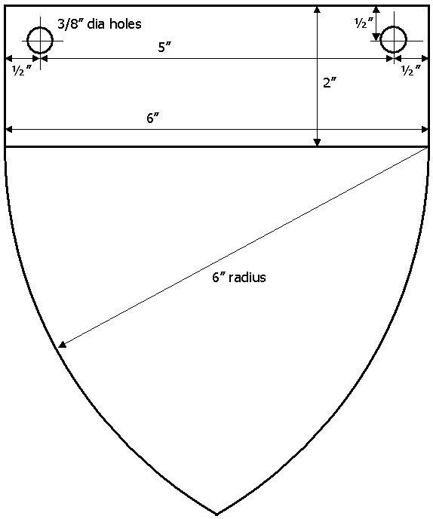
Shields from ¼” masonite
6” wide.
3/8” holes spaced 5” apart.
Devices glued or painted on.
Names written on the back.
(drawn to scale)

Slide 11
Usage Example:
Double Elimination Tournament

Slide 12
Green balls signify
the ‘no-loss’ bracket.
(everybody starts in the
‘no-loss’ bracket)

Slide 13
In the first round of our
example tournament, Bart
fights Angus and wins.
(Whee!)

Slide 14
Then Lynnette fights
Rebecca and wins.

Slide 15
The losers move right…

Slide 16
The losers move right…
… and the winners move left

Slide 17
The round continues
and the green balls
signify who is fighting
next.

Slide 18
The round continues
and the green balls
signify who is fighting
next.

Slide 19
Other participants
know when they
are fighting next
and with whom.

Slide 21
Even if the device isn’t
recognizable, the herald knows
who is fighting because he/she
is looking at the names written
on the backs of the little shields.

Slide 23
Green Ball
(no-loss bracket)
Red Ball
(one-loss bracket)
In the second and subsequent
rounds, the upper and lower
brackets are differentiated.

Slide 24
Losers in the red
bracket disappear

Slide 25
And the entire red
bracket is completed
before the green
bracket starts.

Slide 26
And the entire red
bracket is completed
before the green
bracket starts.

Slide 27
It’s important for the
red bracket to go first
so that space can be made
for the losers from the
green bracket.

Slide 28
After the red bracket
has finished, the
green bracket fights,
in pretty much the
same way.

Slide 29
After the red bracket
has finished, the
green bracket fights,
in pretty much the
same way.
Except that losers in
the green bracket
move over to the
other side…

Slide 30
After the red bracket
has finished, the
green bracket fights,
in pretty much the
same way.
Except that losers in
the green bracket
move over to the
other side…
…instead of being
removed.

Slide 31
Losers are shifted
down as they move
into the red bracket.

Slide 32
Losers are shifted
down as they move
into the red bracket.
This is needed so that
fighters in the red
bracket don’t end up
with a rematch of a
green bracket pairing…

Slide 33
Losers are shifted
down as they move
into the red bracket.
This is needed so that
fighters in the red
bracket don’t end up
with a rematch of a
green bracket pairing…
… at least, not right away.

Slide 34
The size of the downward offset
is determined by the number
of matches in the green bracket,
divided by 2, applied in a
circular fashion.

Slide 35
The size of the downward offset
is determined by the number
of matches in the green bracket,
divided by 2, applied in a
circular fashion.
In this case, because there
are 4 matches in the green
round, the offset is …

Slide 36
The size of the downward offset
is determined by the number
of matches in the green bracket,
divided by 2, applied in a
circular fashion.
In this case, because there
are 4 matches in the green
round, the offset is …
… 4/2 = 2

Slide 37
The size of the downward offset
is determined by the number
of matches in the green bracket,
divided by 2, applied in a
circular fashion.
In this case, because there
are 4 matches in the green
round, the offset is …
… 4/2 = 2
and the last two wrap back
around to the top.

Slide 38
‘lonely’ shields get
‘sucked up’ as needed
(only as far as necessary)

Slide 39
‘lonely’ shields get
‘sucked up’ as needed
(only as far as necessary)

Slide 40
Then the process begins again.

Slide 41
As the tournament
continues, more ‘red’
bouts are fought than
green.

Slide 42
As the tournament
continues, more ‘red’
bouts are fought than
green.
This ensure both that the
‘green’ fighters get a little
more rest between fights
(an advantage they’ve
earned)…

Slide 43
As the tournament
continues, more ‘red’
bouts are fought than
green.
This ensure both that the
‘green’ fighters get a little
more rest between fights
(an advantage they’ve
earned)…
… and that both brackets
finish about the same time.

Slide 44
Again, as matches are fought
in the green bracket, losers
shift right and down.

Slide 45
Again, as matches are fought
in the green bracket, losers
shift right and down.
In this case, the offset is
1, because there are
2 matches on the green
side, divided by two…

Slide 46
Again, as matches are fought
in the green bracket, losers
shift right and down.
In this case, the offset is
1, because there are
2 matches on the green
side, divided by two…
…which gives 2/2 = 1

Slide 47
Again, single shields are
moved upward as needed…

Slide 48
Again, single shields are
moved upward as needed…
… and the process continues

Slide 49
Remember:

Slide 50
Remember:
Losers in the red bracket
get sent to Never Never Land

Slide 51
Remember:
Losers in the red bracket
get sent to Never Never Land
Losers in the green bracket
get sent “down and to the
right.”

Slide 52
Remember:
Losers in the red bracket
get sent to Never Never Land
Losers in the green bracket
get sent “down and to the
right.”
The downward offset is
given by:
#_matches_in_green_bracket / 2

Slide 53
Here, the offset is 1/2 = 0

Slide 54
Here, the offset is 1/2 = 0
(by integer truncation)

Slide 55
The tree is nice for several
reasons:

Slide 56
The tree is nice for several
reasons:
Enhanced heraldic display.

Slide 57
The tree is nice for several
reasons:
Enhanced heraldic display.
Less paperwork during the
tournament.

Slide 58
The tree is nice for several
reasons:
Enhanced heraldic display.
Less paperwork during the
tournament.
Fighters know when to prepare
– and for whom.

Slide 59
The tree is nice for several
reasons:
Enhanced heraldic display.
Less paperwork during the
tournament.
Fighters know when to prepare
– and for whom.
The populace has an idea
of how the tournament
is progressing.

Slide 60
The tree is nice for several
reasons:
Enhanced heraldic display.
Less paperwork during the
tournament.
Fighters know when to prepare
– and for whom.
The populace has an idea
of how the tournament
is progressing.
And the ‘scoreboard effect’
enhances overall excitement.

Slide 61
Plus, at the end of the
tournament…

Slide 62
Plus, at the end of the
tournament…
… the tree
can be used to …

Slide 63
Plus, at the end of the
tournament…
… the tree
can be used to …
honor the winner

Slide 64
Plus, at the end of the
tournament…
… the tree
can be used to …
honor the winner
and acknowledge the
participants

Slide 65
Usage Example:
Single Elimination Tournament

Slide 66
As you might imagine,
a single elimination tournament
is much easier than a the
double elimination version.

Slide 67
As you might imagine,
a single elimination tournament
is much easier than a the
double elimination version.
Order is less important, but
it’s still a good idea to work
from top to bottom

Slide 68
As you might imagine,
a single elimination tournament
is much easier than a the
double elimination version.
Order is less important, but
it’s still a good idea to work
from top to bottom

Slide 69
As you might imagine,
a single elimination tournament
is much easier than a the
double elimination version.
Order is less important, but
it’s still a good idea to work
from top to bottom

Slide 70
As you might imagine,
a single elimination tournament
is much easier than a the
double elimination version.
Order is less important, but
it’s still a good idea to work
from top to bottom

Slide 71
As you might imagine,
a single elimination tournament
is much easier than a the
double elimination version.
Order is less important, but
it’s still a good idea to work
from top to bottom.
Shields still move up as needed.

Slide 72
Vivat!
As you might imagine,
a single elimination tournament
is much easier than a the
double elimination version.
Order is less important, but
it’s still a good idea to work
from top to bottom.
Shields still move up as needed.
But no sideways shifting is
needed.

Slide 73

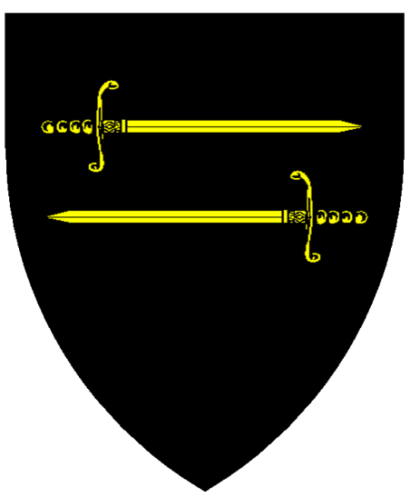



Usage Example:
Five Weapons Tournament

Slide 74
There are five stations on the tree, one for each weapon type.

Slide 75
Shields that meet at
each station fight a bout in that weapon style.
For example, Landalf and Grania would fight pole axe…
…while Bart and Angus would fight greatsword.

Slide 76
Shields on the left move ‘up’.

Slide 77
Shields on the left move ‘up’.
Shields on the right move down

Slide 78
Shields moving off the ‘up’ side go onto the ‘down’ side

Slide 79
Shields moving off the ‘up’ side go onto the ‘down’ side
Shields moving off the ‘down’ side go into a queue
queue

Slide 80
Shields moving off the ‘up’ side go onto the ‘down’ side
Shields moving off the ‘down’ side go into a queue
Shields moving off the queue go back to the ‘up’ side
queue

Slide 81
All together, the process forms a circle
When the shields all get back to their original places…
… then each contestant will have fought twice in each weapon style…
…and the tournament is over.

Slide 82
In each round, the winner of each bout gets a poker chip

Slide 83
In each round, the winner of each bout gets a poker chip
On which they write their names

Slide 84
Then the chips all go into a sack…

Slide 85
Then the chips all go into a sack…
… the shields move…

Slide 86
Then the chips all go into a sack…
… the shields move…
… and the process begins again

Slide 87
At the end of the tournament, the one with the most chips wins!
Yay!

Slide 88
One last item:
If there are 10 or fewer people in the tournament, then it is important that you run the stations in more than one pass.

Slide 89
It is ESSENTIAL that the queue have AT LEAST ONE shield.
Otherwise, many people could end up fighting each other twice on the same weapon style.

Slide 90
When everyone has fought one set of weapon styles, you switch to the other set,
And all else is unchanged.
Have fun with it!

