Slide 1
Meme Caption Categorization
Charles Fauman

Slide 2
Timeline
Overview
Preparation
Methods
Results
Demo

Slide 3
Overview

Slide 4
Input/Output
Input: A small piece of text approximately 1-4 short pieces of information about the same subject
Output: the argmax of the % match to how well this text falls under each of the image categories

Slide 5
Preparation

Slide 6
Data Collection
I took a little over 1000 captions from each of 40 of the top meme categories from https://memegenerator.net/memes/popular/alltime
The caption for each meme is embedded in the html, meaning that I do not have to do ocr on the images.

Slide 7
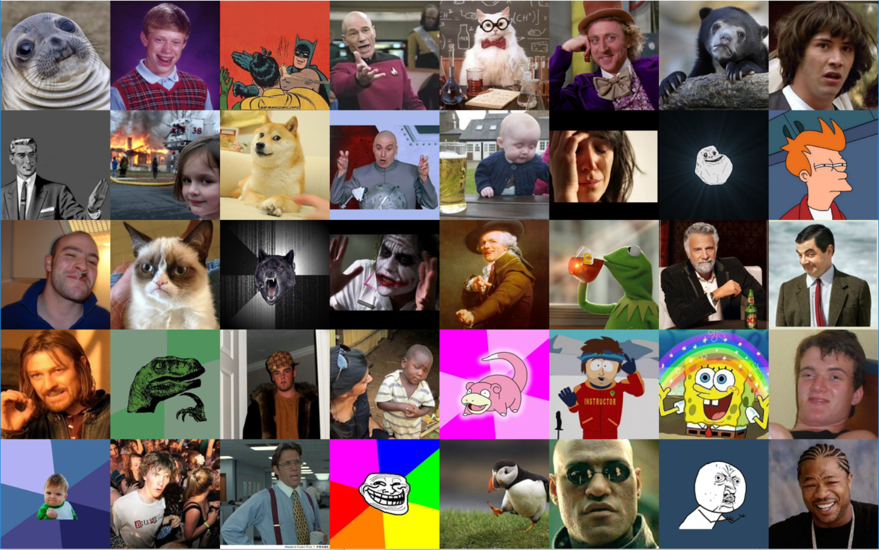

Slide 8
Data Cleaning
spell correct the text and make unicode consistent
get treebank tokens
get part of speech tags
get lemmas and sentiment for tokens

Slide 9
Methods

Slide 10
Data Vectorization
split the data into train/test with a .8/.2 split. About 33,000 memes training, 8,000 memes testing
Find word2vec word embeddings of length 50, with a min count of 2
reformat the train and test data to an n by 50 by 98 matrix:
n: number of meme captions
50: number of tokens per sentence (truncated or zero-filled)
98: 50 (word embeddings) + 45 (POS tags) + 3 (sentiment: pos/neg/neu)

Slide 11
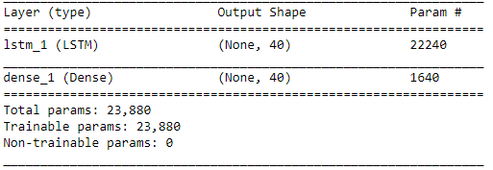
System Architecture
Keras Network with the following layers:
LSTM with .6 recurrent dropout, 98 input, 40 output
Fully connected dense with softmax activation with 40 input, 40 output

Slide 12
Results

Slide 13
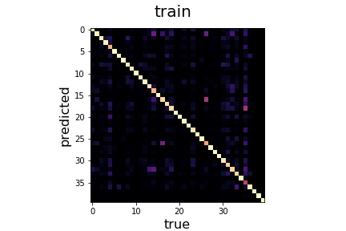
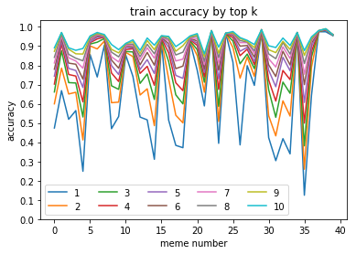
Results: Train Data
k | mean | std. dev | max # | max | min # | min
top 1 top 2 top 3 top 4 top 5 top 6 top 7 top 8 top 9 top 10 | 0.638 0.735 0.788 0.824 0.851 0.873 0.891 0.906 0.919 0.931 | 0.245 0.190 0.151 0.124 0.100 0.082 0.067 0.055 0.045 0.037 | 38 38 38 38 38 38 38 38 38 38 | 0.975 0.984 0.984 0.984 0.986 0.987 0.988 0.989 0.990 0.990 | 35 35 35 35 35 35 35 35 21 21 | 0.124 0.259 0.381 0.499 0.607 0.700 0.754 0.809 0.845 0.860

Slide 14
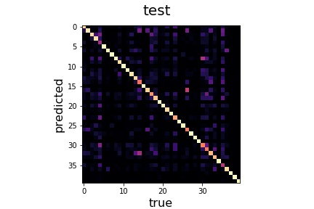
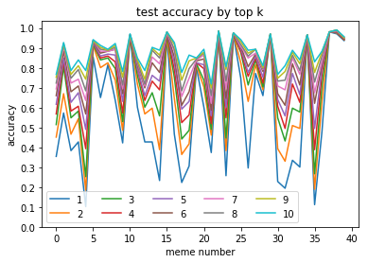
Results: Test Data
k | mean | std. dev | max # | max | min # | min
top 1 top 2 top 3 top 4 top 5 top 6 top 7 top 8 top 9 top 10 | 0.568 0.658 0.709 0.749 0.779 0.807 0.830 0.848 0.865 0.879 | 0.283 0.234 0.205 0.173 0.149 0.129 0.111 0.099 0.084 0.074 | 37 37 37 37 22 22 22 38 38 38 | 0.981 0.981 0.981 0.981 0.981 0.985 0.985 0.990 0.990 0.990 | 4 4 4 35 4 4 21 21 21 21 | 0.102 0.184 0.252 0.388 0.490 0.568 0.621 0.660 0.699 0.718

Slide 15
Demo

