Slide 1

Working with…
stix-shifter
Video Series

Slide 2
Episodes
Introduction to stix-shifter
Command Line Interface (CLI)
Queries
Data Sources
Building a stix-shifter connector

Slide 3
Introduction to stix-shifter
Episode 1

Slide 4
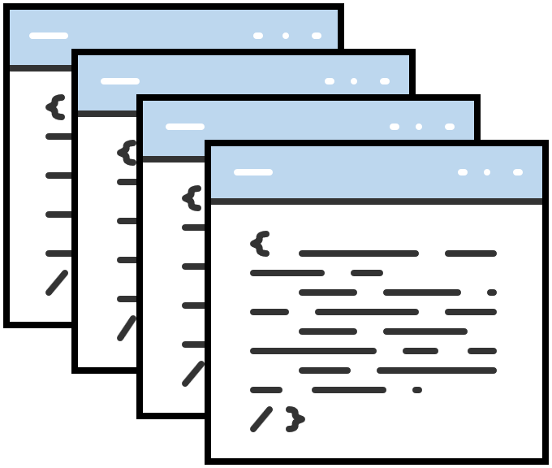
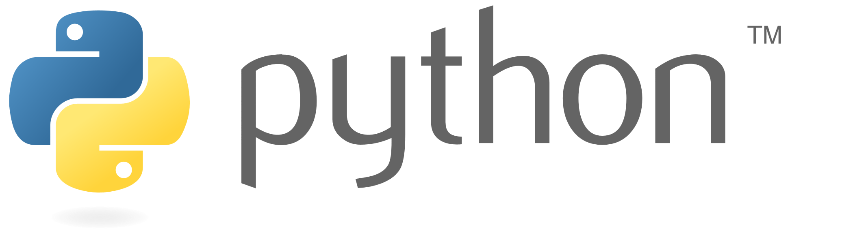
What is stix-shifter?

Slide 5
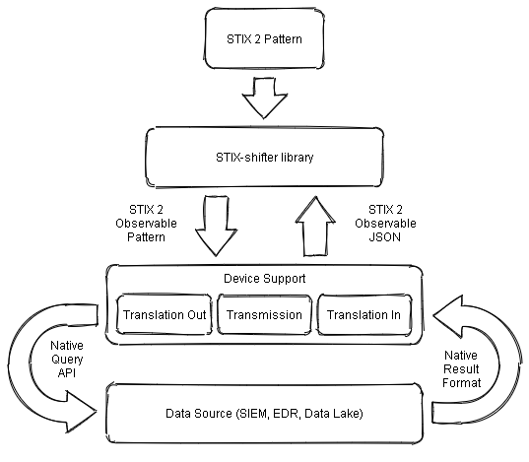
What can I do with stix-shifter?
As a CLI tool:
Script searches for orchestration flow.
Enrich Indicators of Compromise(IOCs) or artifacts for SEIM.
Integrate workflows between multiple tools.
Create cross platform playbooks.
As a Library it:
Add query or enrichment functionality.
Provide a common way to query data
Provide a standard way to integrate with your product.
Stix-shifter architecture

Slide 6

Data stays where it is. Allowing software to connect and query products that house data repositories.

Slide 7
Condensed history of Structured Threat Information eXpression (STIX 2™)
Governance of STIX was transitioned to Organization for the Advancement of Structured Information Standards (OASIS), an international standards consortium in 2015
STIX 2.0 was standardized in 2017 and is currently maintained by the OASIS Cyber Threat Intelligence (CTI) technical committee (TC)
The Open Cybersecurity Alliance (OCA) is an OASIS Open Project
Notes:
.

Slide 8
Open Cybersecurity Alliance (OCA)
“The Open Cybersecurity Alliance (OCA) brings together vendors and end users to create an open cybersecurity ecosystem where products can freely exchange information, insights, analytics, and orchestrated response. OCA supports commonly developed code and tooling and the use of mutually agreed upon technologies, data standards, and procedures.”
Launched in October 2019
Over 25 partner organizations
Initial interoperability projects
OpenDXL Ontology (McAfee)
Stix-shifter (IBM)
Source: ("Open cybersecurity alliance unveils first open source language to connect security tools," 2020)

Slide 9
Why use stix-shifter instead of native queries?
stix shifter adds value when using native APIs by normalizing data sets and repositories

Slide 10
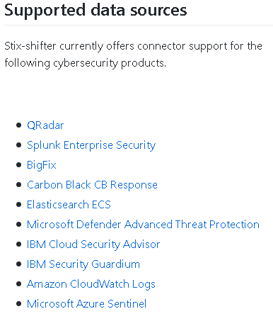
stix-shifter connectors
Bridge / interpreter
2 way communication
Connect to other products that support stix-shifter

Slide 11
Why use stix-shifter
Preventative
Enrich IOCs and artifacts
Triage alerts
Information to vulnerability and risk management
Response
Facilitating information sharing
Enrich IOC's and artifacts
Strategic
Support business decisions
Informing resource prioritization

Slide 12
What's next?

Slide 13
Episodes
Introduction to stix-shifter
Command Line Interface (CLI)
Queries
Data Sources
Building a stix-shifter connector

Slide 14

Thank you

Slide 15



Created by
Roseann Guttierrez
https://www.linkedin.com/in/rguttierrez/
@D1g1talAv3ng3r
Roseann.guttierrez@ibm.com

Slide 16
Resources – stix-shifter
GitHub
https://github.com/opencybersecurityalliance/stix-shifter
Overview
https://github.com/opencybersecurityalliance/stix-shifter/blob/develop/OVERVIEW.md
Supported STIX objects and properties
https://github.com/opencybersecurityalliance/stix-shifter/blob/develop/adapter-guide/supported-mappings.md

Slide 17
Resources – Open Cybersecurity Alliance(OCA)
Website
https://opencybersecurityalliance.org/
GitHub
https://github.com/opencybersecurityalliance/
Open cybersecurity alliance unveils first open source language to connect security tools. (2020, March). OASIS | Advancing open standards for the information society. https://www.oasis-open.org/news/pr/open-cybersecurity-alliance-unveils-first-open-source-language-to-connect-security-tools

Slide 18
Resources – STIX2
OASIS Cyber Threat Intelligence (CTI) Technical Committee (TC) wiki
https://wiki.oasis-open.org/cti/FrontPage#Open-source_APIs_and_tools
STIX2 Introduction page
https://oasis-open.github.io/cti-documentation/stix/intro
STIX2 User Guide
https://stix2.readthedocs.io/en/latest/guide.html
STIX History Archive
https://stixproject.github.io/

