Slide 1
Volunteer Internship- August 2016 Stem-Cell And Brain Research Institute - Inserm U1208
Principal figures of the time-frequency analysis of LFP signal of the MCC around the task choice from the dual-task experiment
Charles Gaydon
Notes:
The aim of the analysis performed was to study the power spectrum of lfp signals obtained from a double-tasked experiment described in Stoll and al. 2016 (see file CJT_TaskSchema_Timings.pdf). As the importance of saccade and oculomotor activity in decision making as been highlighted in the past decade, we try to isolate and study the signal around the saccades occurring around the event 160, which is the task choice.
Cod of the experiment from which the data is taken : 'HDRKNOPMW2_4439‘ . We used the event data (cod and timestamp), oculomotor data already cleaned from artefacts and lfp data brought to the same sampling rate as the oculomotor data, all thak sto the work of Maeva Gacoin.
Here are the results for the MCC. Analysis were also performed on LPFC with less distinct differences in condition, as expected since it is the case for the ERP. Analysis were also performed around the event Reward/Time-Penalty and are shown at the end.

Slide 2
Event-centered trials – Event 160

Slide 3
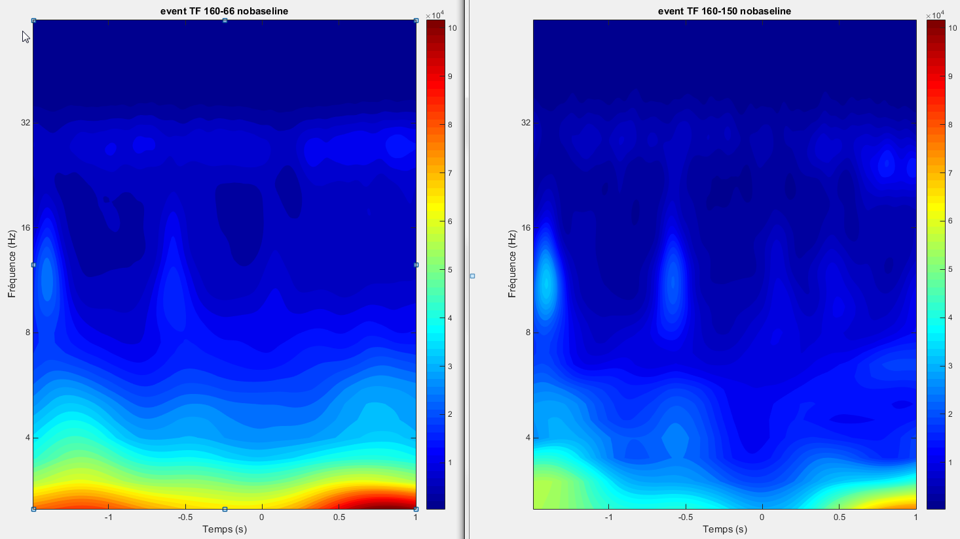
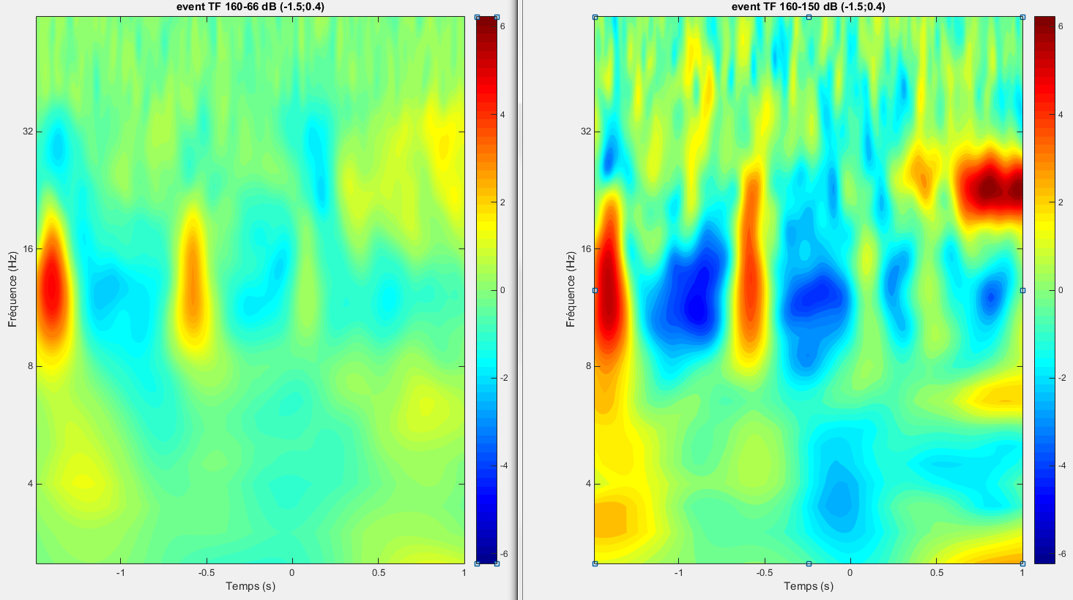
Notes:
We look at the difference of powerspectrum between two conditions : 160-66 (Work, on the left) et 160-150 (Check, on the right), without (up) and with (down) a decibel baseline normalization, for the first MCC electrod of our data.
Condition 160-66 : 384 trials ;
Condition 160-150 : 43 trials (which explain a less smooth figure).
The trials are centered around the event 160 . The power scale is the same between two conditions.
The baseline goes from -1.5s (Signal to change apparition) to 0.4s. Indeed, the average time of choice is 0.41 as observed by Maeva Gacoin. Then, this normalization should enable to see local quick power variation with less influence of the next event.
The unit of the down figure is decibel, as for all the baseline normalized TF figure that will be plot.
We find similar patterns of power evolution between the two conditions, especially in the 8-16Hz band, but they seem to be more intense in the Check condition (on the right).
Looking to the raw data show that the variation are not even a period long and can’t be named “oscillations”. Raising the number of cycle of the wavelet (to 12 for example) could fix that issue. But the variation in power translate a variation in the signal so it may not be necessary.
Method : Morlet’s wavelet of 7 cycle. And as in all the following TF analysis, frequency step is 0.5Hz and time step is 0.01s.

Slide 4
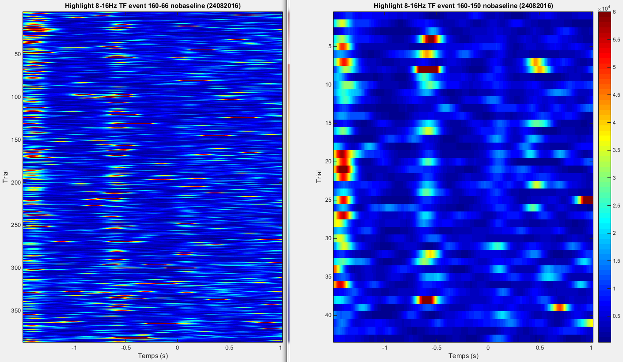
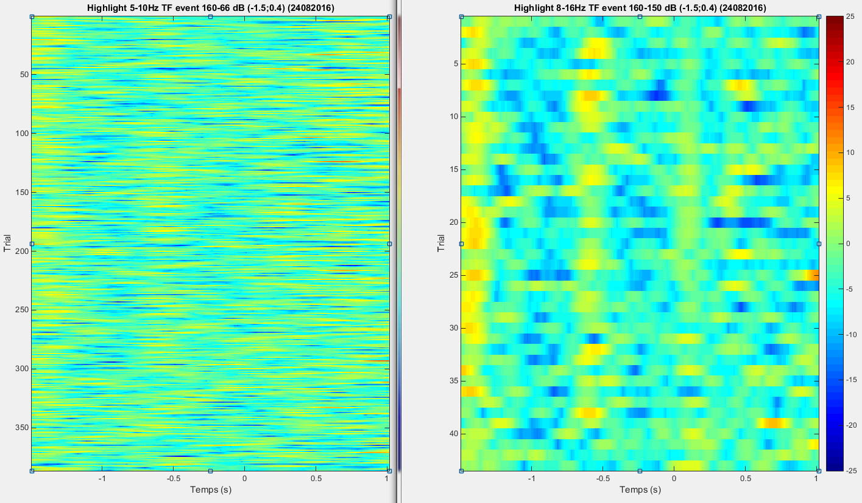
Notes:
We look at this particular frequency band 8-16Hz that show great changes in intensity.
We show the averaged power response between 8 and 16Hz for each trial. The results are obtained with the same parameters as given in the precedent slide, with the function TF_highlight_burst. The aim is to highlight individual burst of power in a particular frequency domain. We see that for this frequency band there are different well defined high intensity times : just after (about 0,15s after) the signal to change apparition (-1,5s) and disparition (-0,7s), and after the Lever are shown (0s).
Note that for the not normalized powerspectrum the scale superior boundary is here set to 60000 (max were 100000 and 200000) , cause there were some outsider trials.

Slide 5
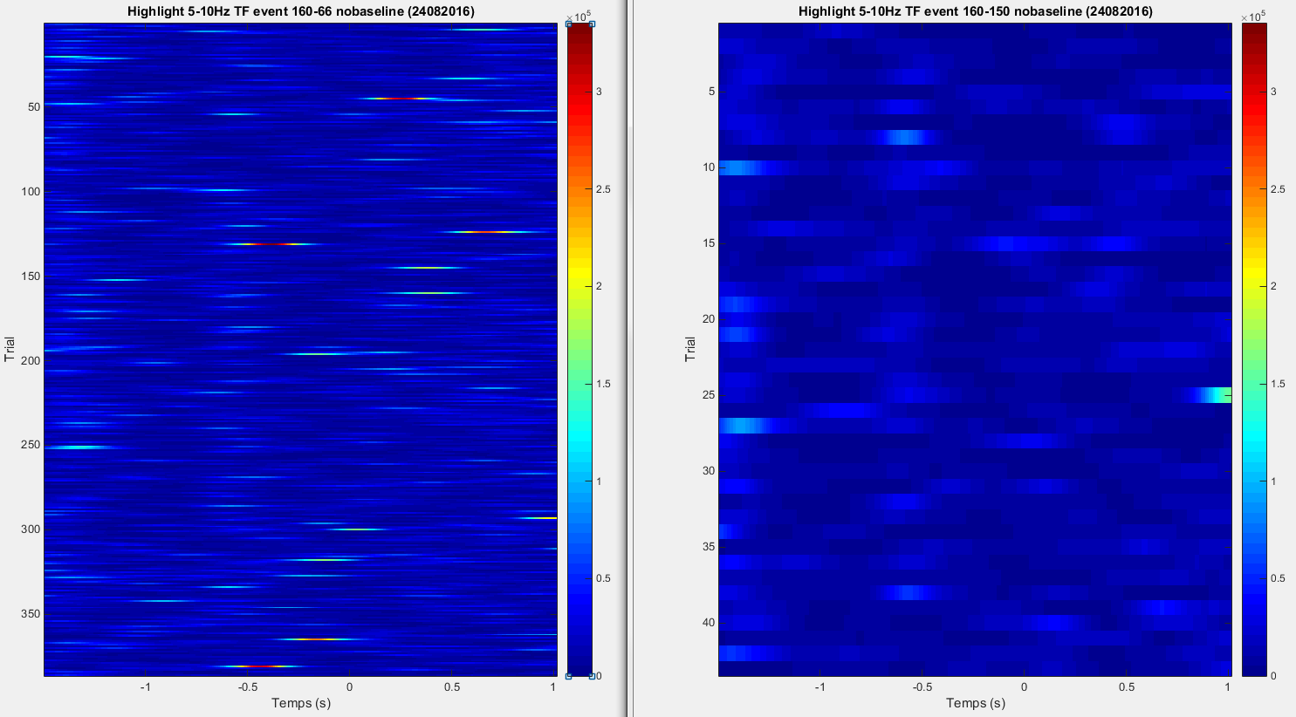
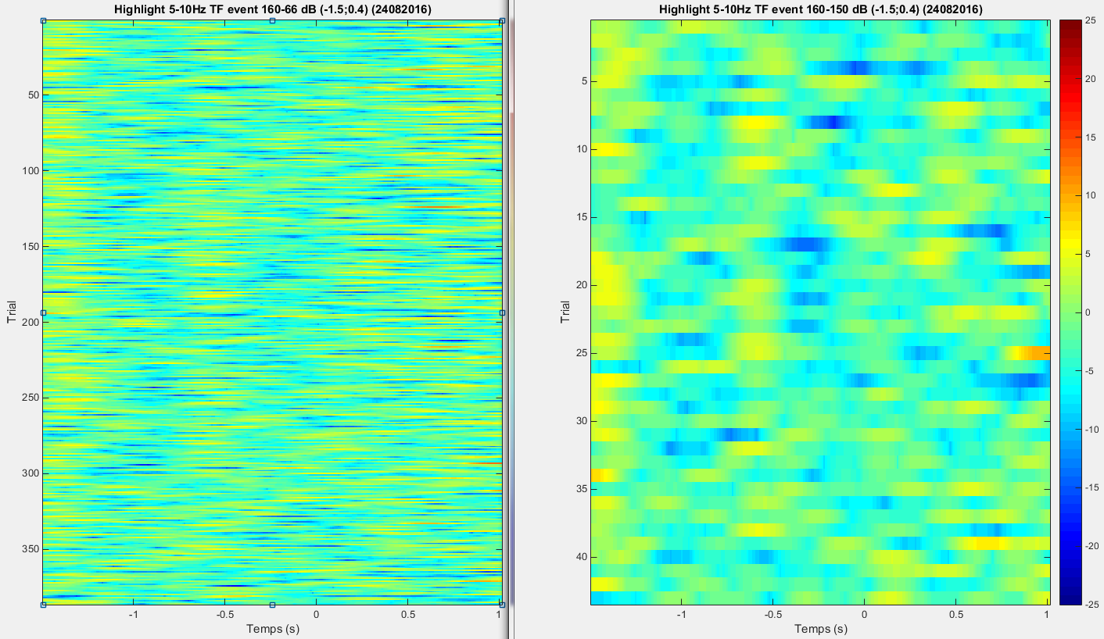
Notes:
We show the averaged power response between 5 and 10 Hz for each trial as a comparison.

Slide 6
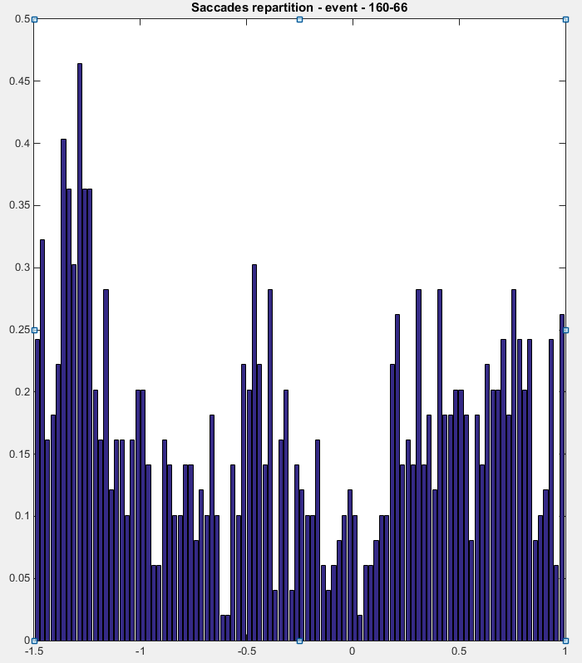
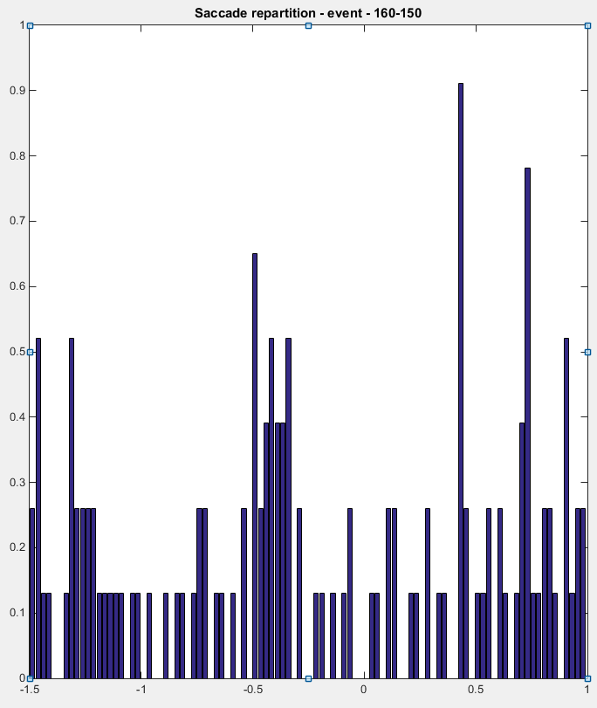
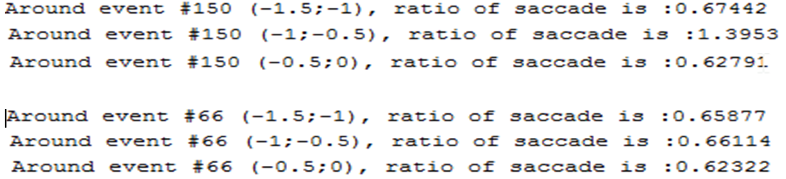
Notes:
What happens in the oculomotor activity of the primate at these specific time ? Let’s see the saccade repartition around the event for the two conditions.
The burst of power are simultaneous to a local high frequency of the saccades that can be seen on the histograms. We see that when an event occurs, there is a short period without saccade (see -0,7s and 0s) and then the high rate of saccade is about 0,15s after : the rate of saccades seems to « oscillate ».
Computing the number of saccade found in some temporal area, divided by the number of trials, gives the result below. The -0,5;-1 difference appears clearly, but a shorter time window should be used for the other, as there is a lack of trials for condition 160-150.
Double the ratio to obtain a saccade per second value than can be more easely understood.

Slide 7
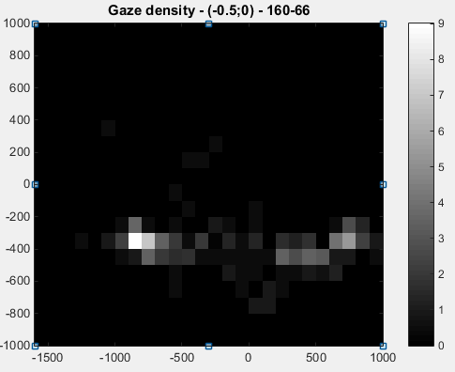
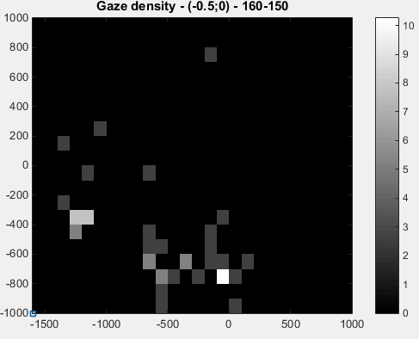
Notes:
We make a gaze density map, in percentage of the total end of saccade.
Surprisingly, for the 160-66 condition (Work), the end of the saccade occuring between -0,5s and the appearance of the Lever (i.e. where the primate looks at) are precisely localised, far from the center of the screen, on the left and on the right (but more on the left where the Check lever will appear).
The gaze wanders in the 160-150 condition (Check) and eparse fixated points are numerous, even if there is way less trials in this condition (39, versus 222 for Work) !
Hence, the nature of the saccade between the two conditions appears different. We will then define saccade-centered trials to see if a TF analysis reveals some differencies.

Slide 8
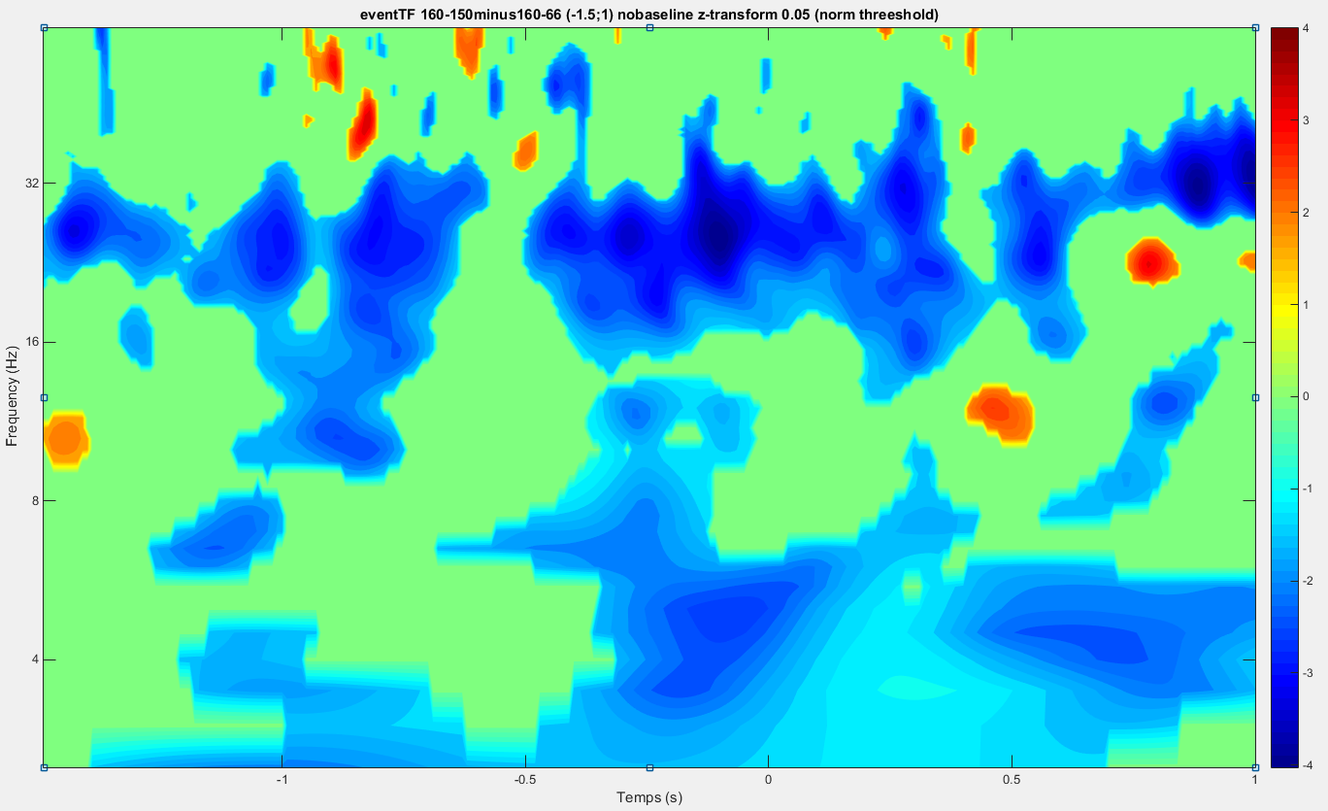
Notes:
With a non-parametrical method based on 300 re-sampling (explained in the help of the TF_multiplot function), we z-transform the difference between the condition to hihligh the significant one :
Negative values mean that the Work condition is significantly more powerfull than the Check condition, which seems to be the case for the 16 to 32Hz frequency band.

Slide 9
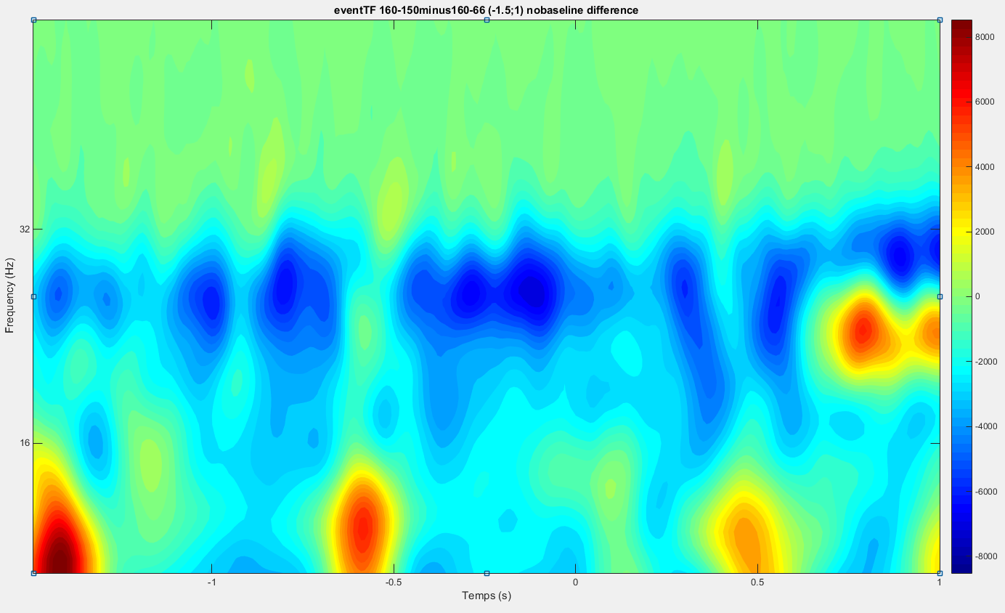
Notes:
Here the simple difference (without re-sampling and z-transform) between the two conditions shows that between 16 and 32Hz the spectral power is more intense for the Work condition. (4 to 10Hz removed because the values were too important).
A thing we see is that the global power seems to be balanced between the different frequency band : around -0,5, when there is a 8Hz burst, there is less 28Hz power, etc.

Slide 10
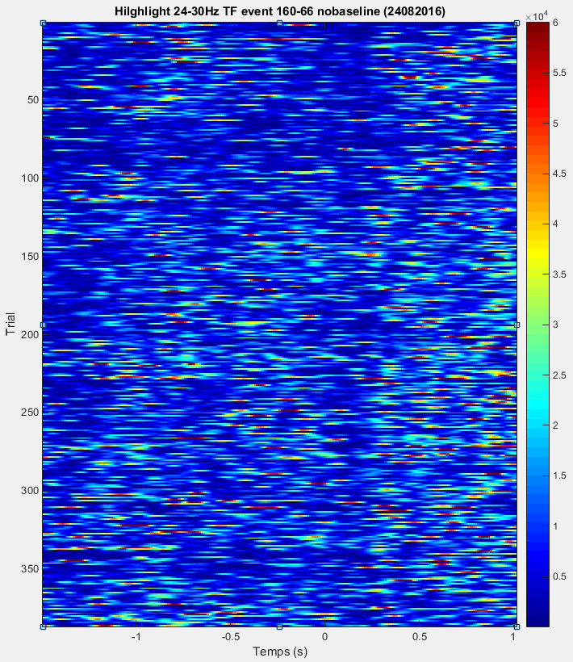
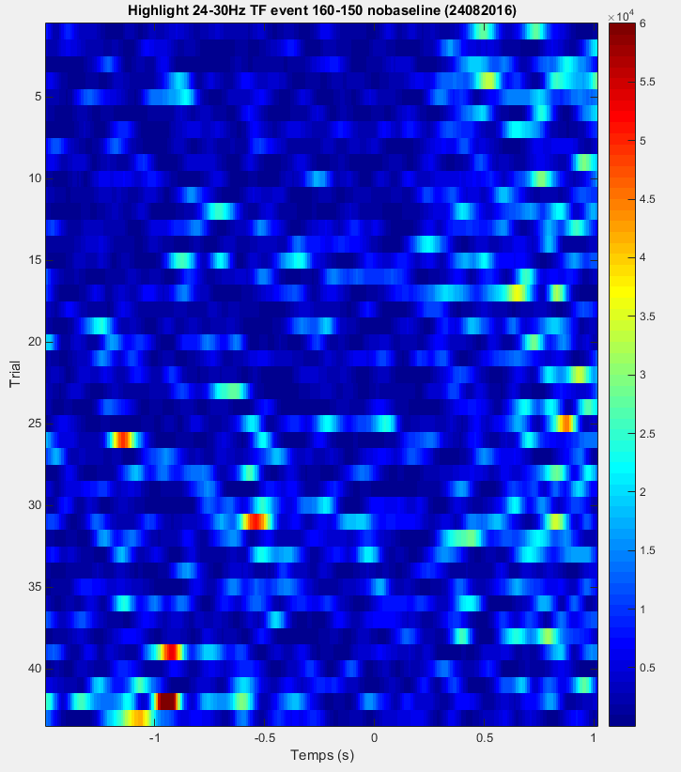
Notes:
The comparison showed against a difference in the 16Hz to 32Hz band, that we couldn’t see clearly on the simple time-frequency figure of each condition. Let’s see the individual trials averaged for the band 24Hz-30Hz, without baseline normalization (as it seems that it is not abolutely necessary).
Once again the z scale max is artificially set to 60000 (max were 100000 and 80000).
We see less activity burst in the 300ms after the saccades.

Slide 11
Saccade-centered trials – Event 160

Slide 12
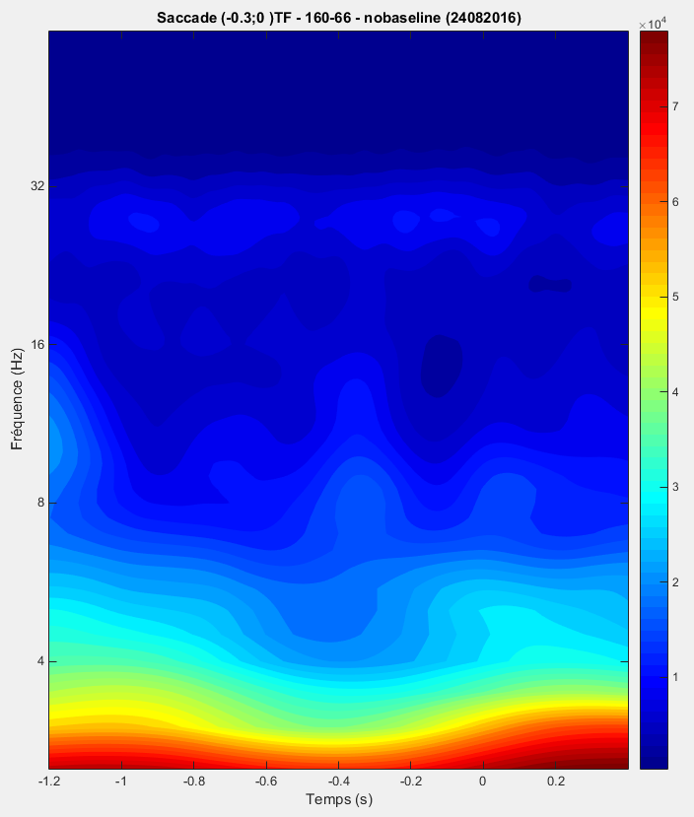
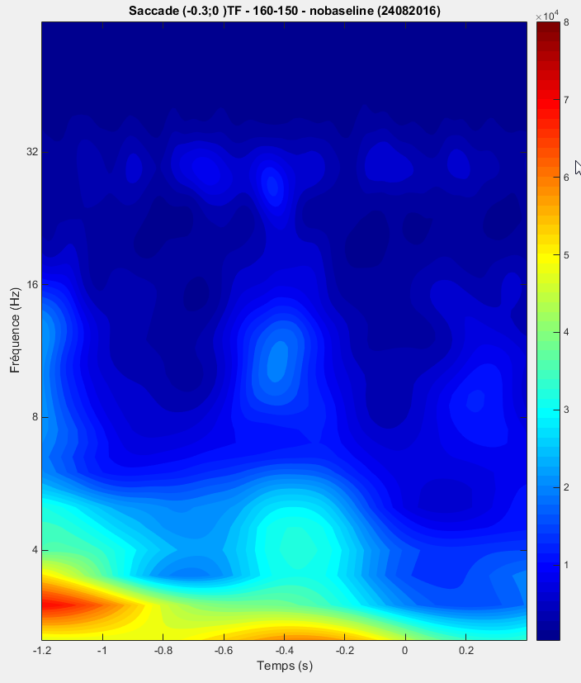
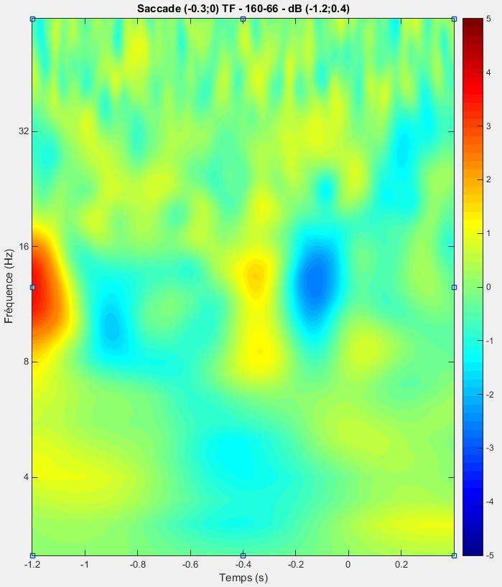
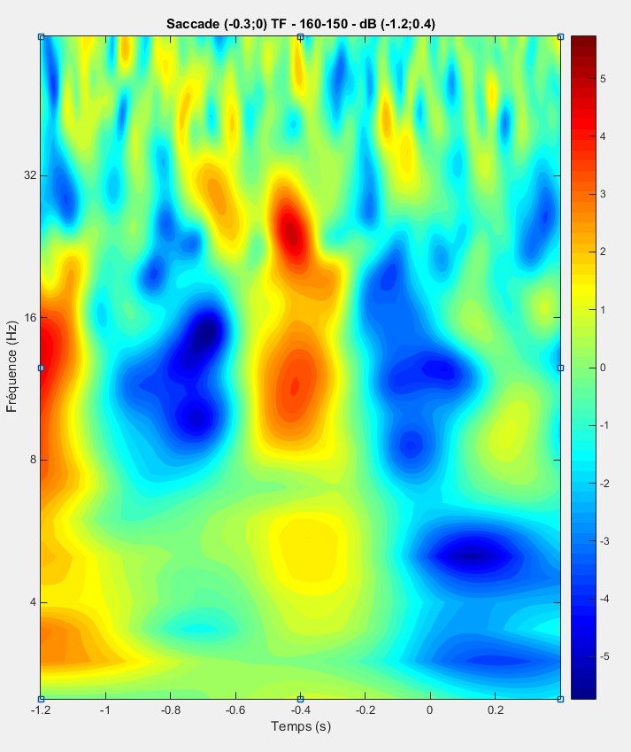
Notes:
The nature of the saccade between the two conditions appears different. We define saccade-centered trials to see if a TF analysis reveals some differencies.
We select only the last saccades by taking the in the 0,3s before the Lever appearence (160). We don’t « isolate » the saccades by eliminating the ones which have another saccade in a near neighborhood since we have way less trials on the 150 condition.
The time boundaries chosen are -1,2 and 0,4 around the saccad : -1,2-0,3 = -1,5 (Signal to Change appearance) ; 0+0,4 = 0,4 (mean time of choice).
Same convention as before, exept the baseline boundaries are now -1,2 ; 0,4.
We see interesting variation of the intensity that is time-locked with the event. The patterns are similar but more intense for the 160-150 (Check condition), once again.
It is to note that Stoll and al. 2016 highlighted the fact that a check choice is predictable during the few trials before the actual decision. Here we took every saccade for the 160-66 (Work) condition but it would be interesting to compare the check condition with only the Work trials that occur after a Check, as the uncertainty would be minimal. Here the pattern for 160-66 could be linked to the Check decision…

Slide 13
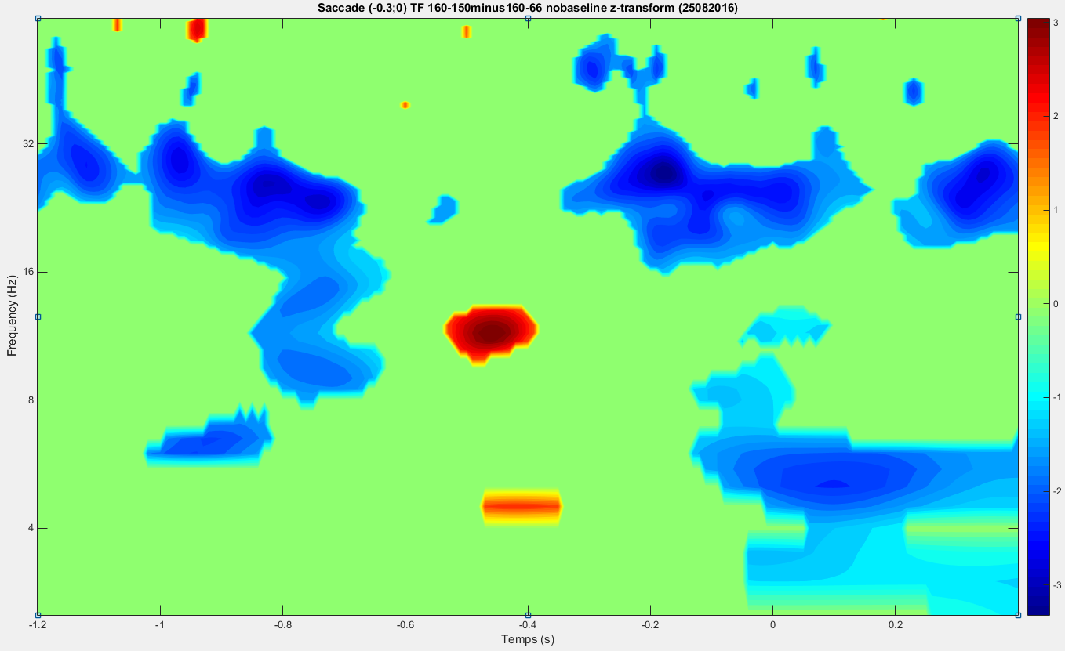
Notes:
Still, let us observ the difference between the two conditions. Same as before with the event-centered trials, we z-transform the difference between the condition to hihligh the significant one, with a non-parametrical method based on (this time) 600 re-sampling (explained in the help of the TF_multiplot function).
Negative values mean that the Work condition is significantly more powerfull than the Check condition.
This figure looks a bit like the one with the event-centered trials, with less significant negative zones, but with two zones of higher intensity for Check at -0,4. These zones appears for both type of trials (as the saccades are near the event) but the difference is more intense when we are saccade-centered.

Slide 14
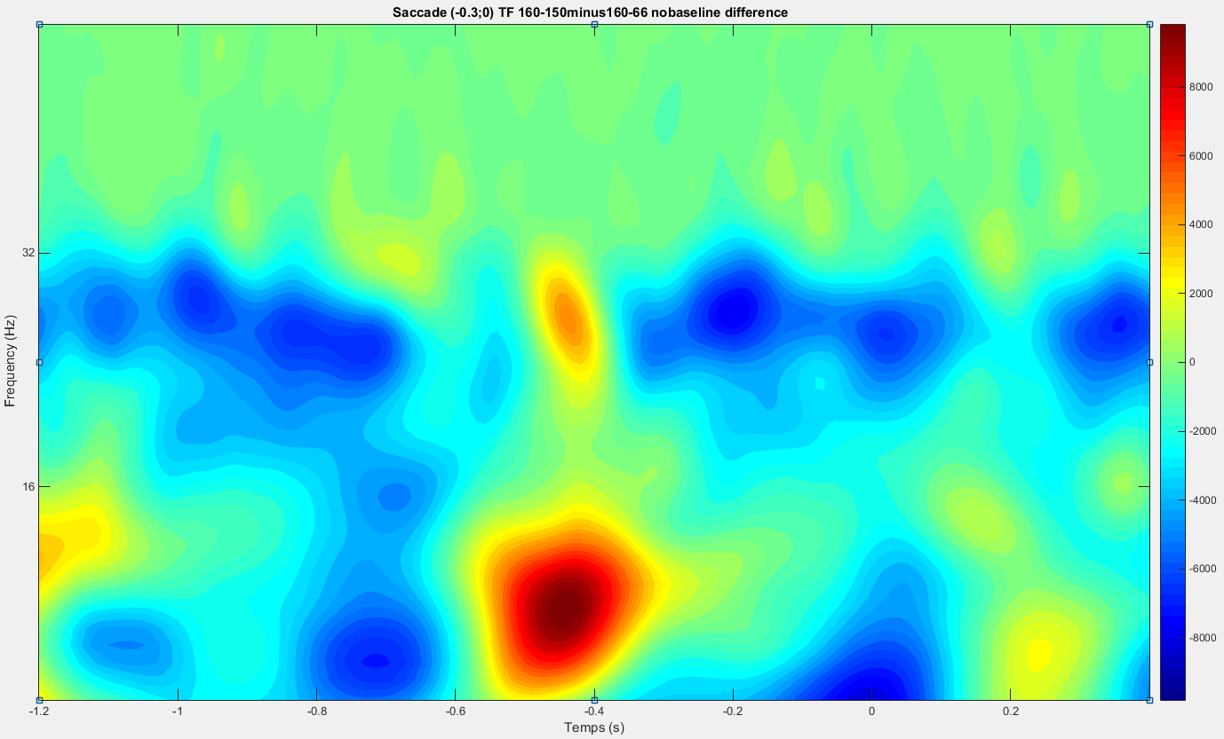
Notes:
Here the simple difference (without re-sampling and z-transform) between the two conditions, that enable us to see clearly where the intense zones are : (between 4 and 6 HZ and 8 and 16 Hz).

Slide 15
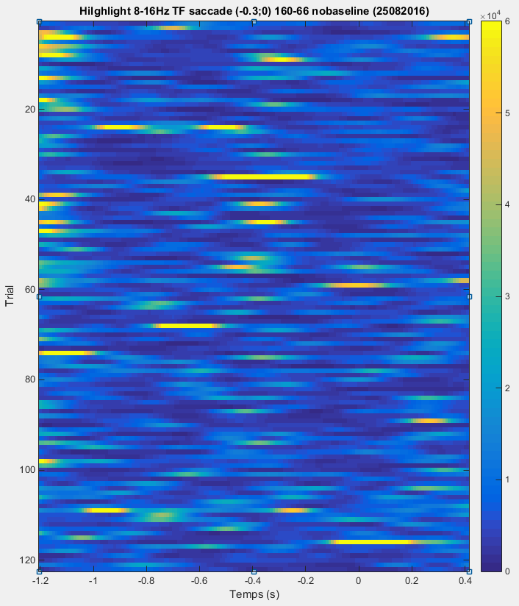
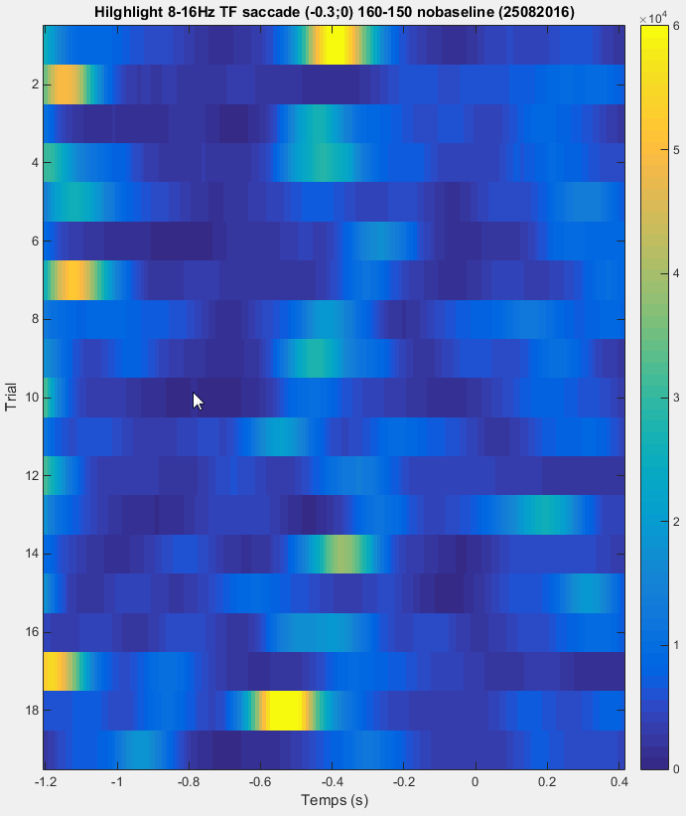
Notes:
Let us look at the individual trials in the spectral band 8-16 Hz as before to see if they are temporally aligned.
It doesn’t seem to be the case. The alignment were linked to the event and not to directly to the saccade.

Slide 16
Event-centered trials – Events (1)65

Slide 17
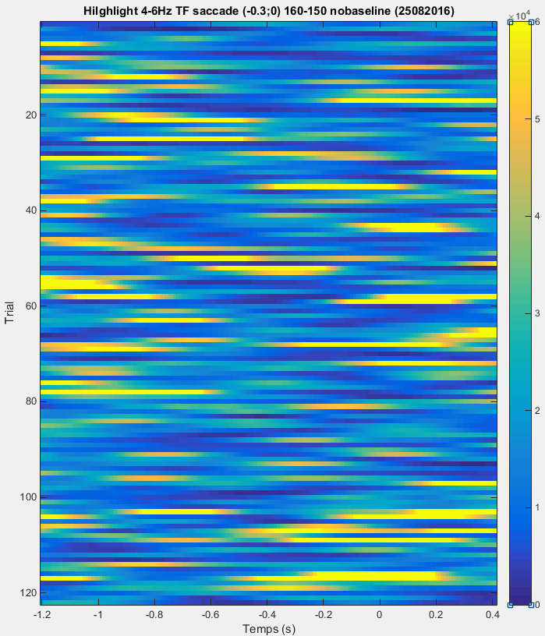
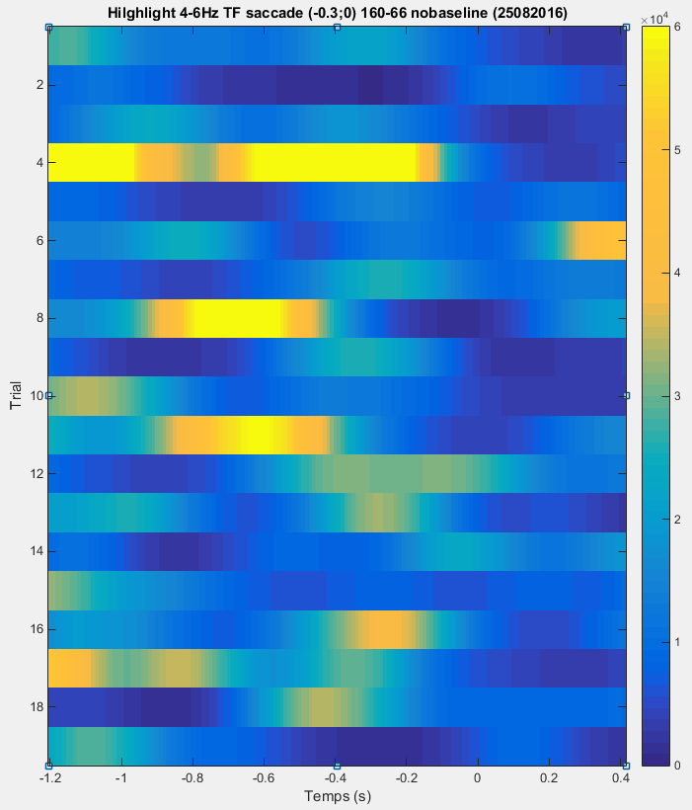
Notes:
Let us look at the individual trials in the spectral band 4-6 HZ as before to see if they are temporally aligned.
Once again the z scale max is artificially set to 60000 .
Nothing apears clearly.

Slide 18
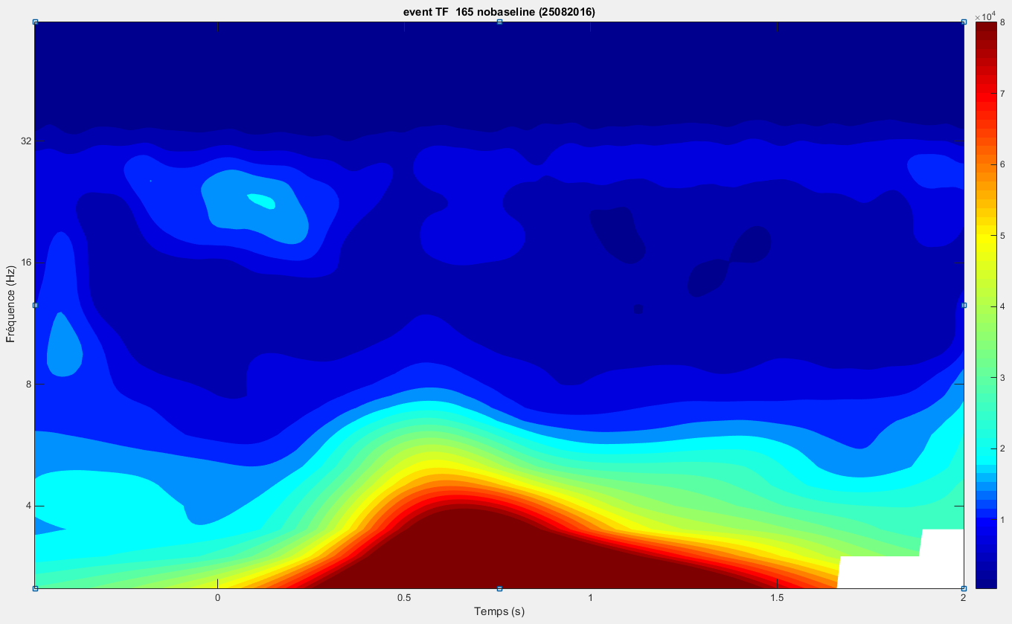
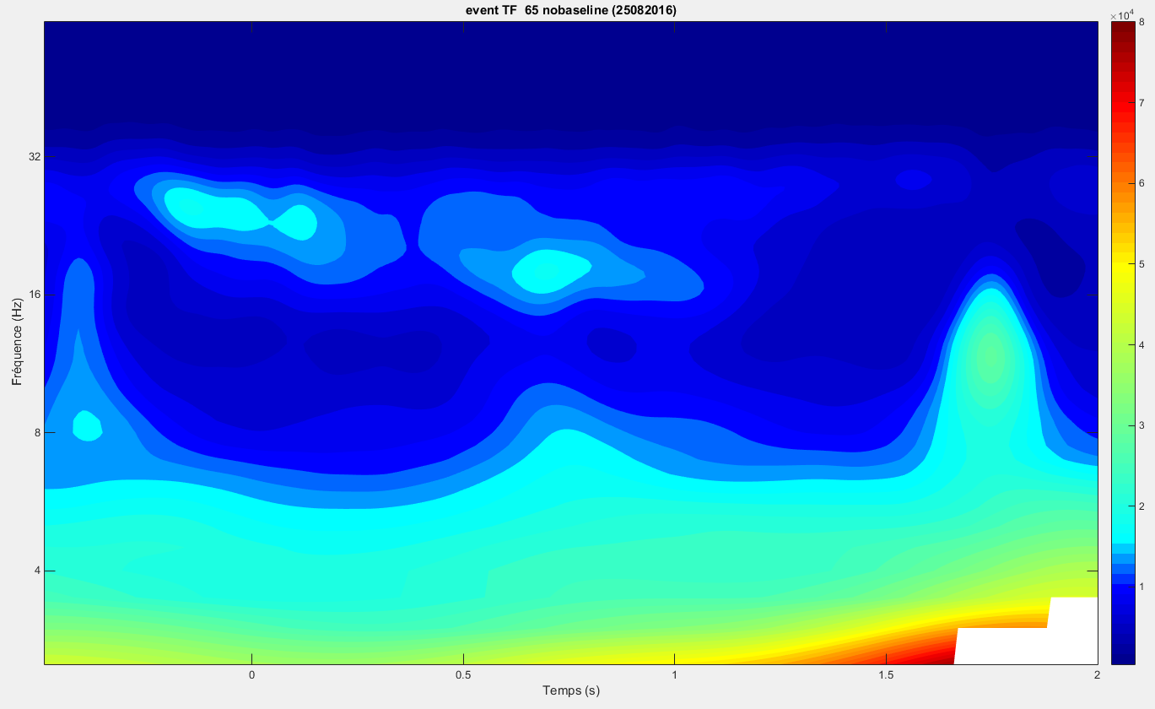
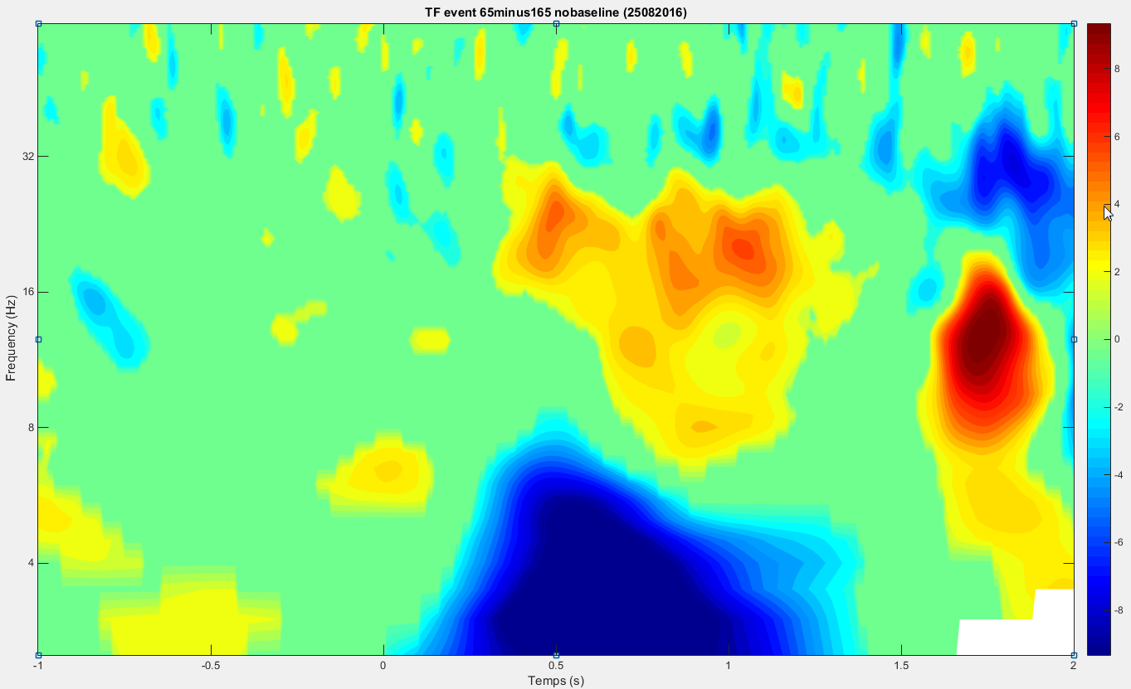
Notes:
We look at the difference of powerspectrum between two conditions : 165 (no reward, on the left) et 65 (reward, on the right), without (up) baseline normalization, for the first MCC electrod of our data.
We see a difference at 1,8s after the event.
Then (down) we show the significant differencies like we did for the task choice event. We see a significant but not really strong difference in the Beta between 0,4s and 1,5s after the event. A positive value means that the power response after a Reward is more intense than without.

