Slide 1
What is SExtractor?
Astronomical image → source catalog
Source extraction may be seen as a science-oriented kind of astronomical image compression
General-purpose source extraction
  Minimal assumptions about object shapes
  Sub-optimum in many cases
2-pass engine:
  Sky background/variance modeling
  Thresholding, segmentation, measurements
Designed from scratch to work with huge images
  FIFO stacks for pixels and detection lists
E.BERTIN / TERAPIX

Slide 2
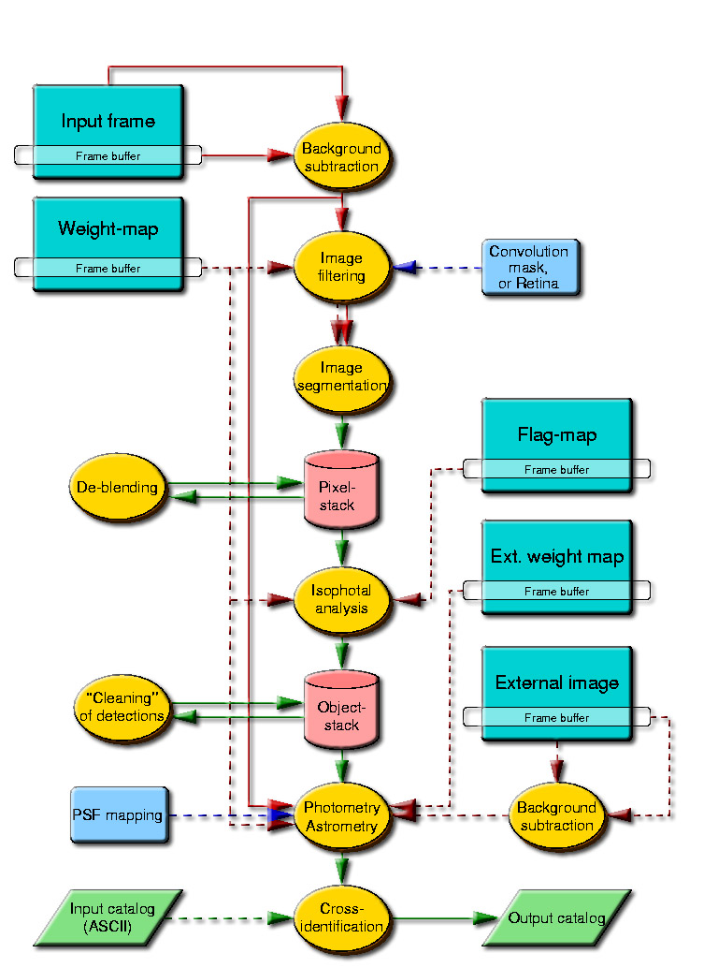
SExtractor: Overview
E.BERTIN / TERAPIX

Slide 3
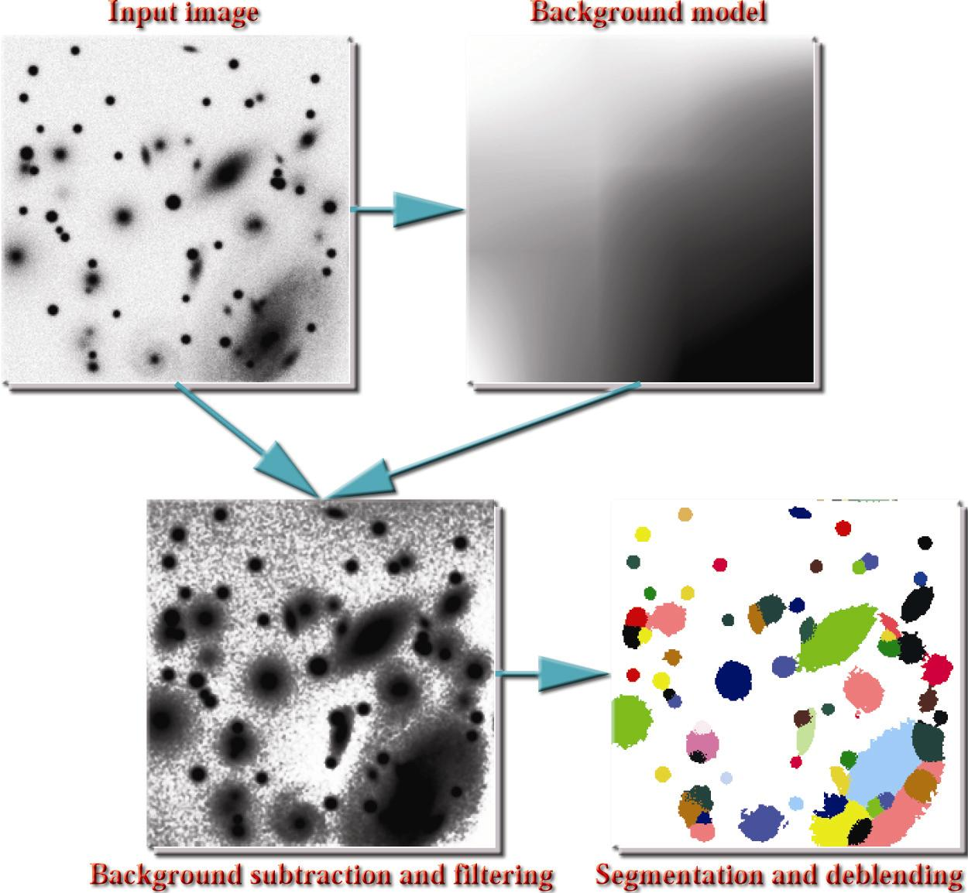
Detection basics
The traditional approach involves
  Sky background subtraction
  Image filtering
  Detection itself: thresholding and/or image segmentation
  Merging and/or splitting of detections
E.BERTIN / TERAPIX

Slide 4
Background subtraction
One wants to separate sources from the underlying sky background, but:
  The background is often far from homogeneous (halos from bright stars, flat-field residuals), and it varies from exposure to exposure,
  The practical definition of the background itself is ambiguous, especially in crowded fields.
One must rely on the crude assumption that the background is much “smoother” than the light distribution of the overlying sources.
E.BERTIN / TERAPIX

Slide 5
Background subtraction (2)
The standard procedure consists of estimating the background in a regular grid of background meshes (“background map”), and interpolating these values to create a smooth image of the background.
  The background map has to be filtered to avoid oscillations of the interpolation around bright sources (the background map is under-sampled with respect to the source signal).
  Image borders are less reliable.
The background level is estimated locally from the histogram of pixel values.
  The histogram is strongly skewed.
E.BERTIN / TERAPIX

Slide 6
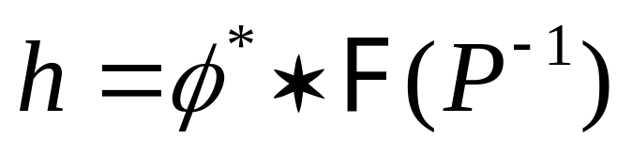
Image filtering
Increase the contrast of sources with respect to the background noise.
Linear or non-linear
  Linear filtering: for an isolated profile φ (x) superimposed to a (wide-sense stationary) background noise with spectral power P (υ), the optimum filter is the convolution with the matched filter
  In most cases (CCD images with local background subtracted), the noise spectrum can be considered as “white” on source scales: P (υ) = cste
E.BERTIN / TERAPIX
Notes:
Add a picture about the effect of filtering on a typical astronomical image

Slide 7
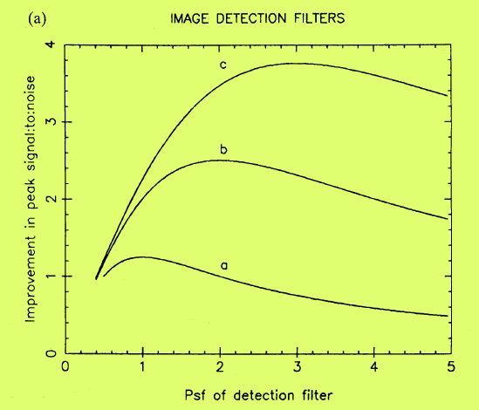
Image filtering (2)
Limitations:
  In principle the matched filter is efficient only for a single profile. In practice, with astronomical PSFs, its efficiency degrades only slowly with scale (low-pass filter).
  Sources are not isolated. Filtering has a tendency to blend close neighbours.
Irwin 1985
E.BERTIN / TERAPIX

Slide 8
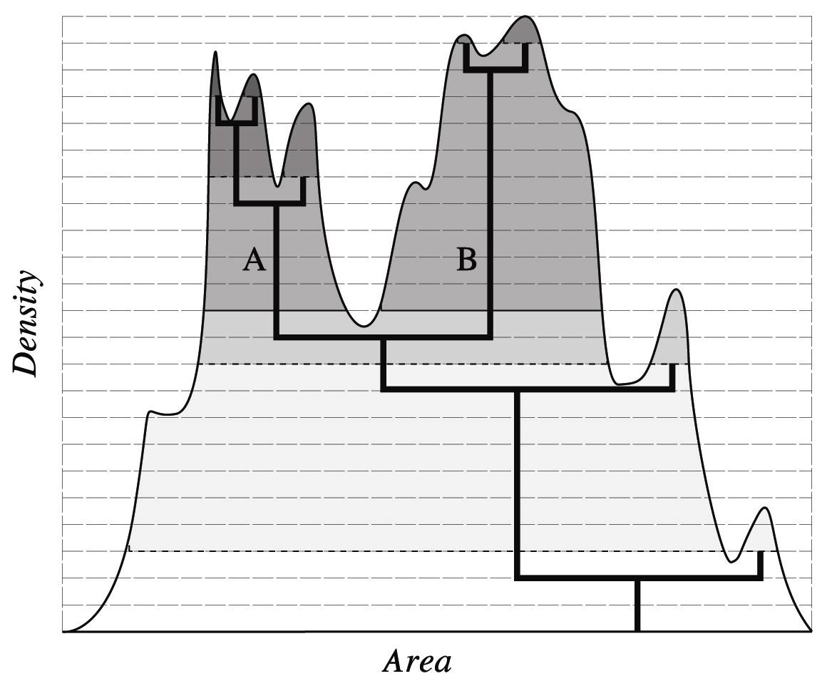
Deblending with multithresholding
E.BERTIN / TERAPIX

Slide 9
Configuration for a typical survey: detection
Background modeling
  Mesh size: a good comprise with our wide-field instruments is somewhere in between BACK_SIZE 100 and BACK_SIZE 300
  Background-filtering: BACK_FILTERSIZE 3
Image filtering
  Use the Gaussian convolution kernel with FWHM the closest to the average PSF FWHM: FILTER Y and FILTER_NAME gauss_3.0_7x7.conv for instance.
Detection
  The detection threshold is expressed in units of standard deviation of the unfiltered image, therefore one must integrate the noise autocorrelation function over the convolution kernel to obtain the desired detection reliability. With the typical sampling and PSF FWHMs of ground-based imagers, DETECT_THRESH 0.6 to DETECT_THRESH 1.5 is fine.
  As images are smoothed prior to segmentation, one can use a small minimum area for detection, DETECT_MINAREA 3 for instance.
Deblending and “cleaning” of detections
  At high galactic latitude: DEBLEND_MINCONT 1e-3
  CLEANing: leave CLEAN Y and CLEAN_PARAM 1.0
E.BERTIN / TERAPIX

Slide 10
Optimizing SExtractor performance
Execution speed
  Current rule of thumb: ~1Mpix/s per GHz at high galactic latitude
    Turns out to be I/O-limited in some cases: might be useful to use different devices for reading and writing data
    In crowded fields, limited by source-density: 500+ extractions/s per GHz
  Compile with the right optimization options
    Avoid gcc if a more efficient compiler is available (e.g. Digital or Intel compilers)
    On Linux, better use the RPM archive from TERAPIX
  SExtractor is not parallelized yet
  Avoid memory-swapping
    Memory usage can go out of control in large, crowded fields!
E.BERTIN / TERAPIX

Slide 11
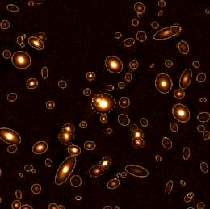




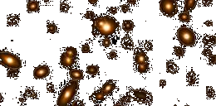
Memory usage: SExtractor FIFO stacks
OBJSTACK
PIXSTACK
BUFSIZE
E.BERTIN / TERAPIX

Slide 12
Known bugs and limitations
Memory leaks
  Small memory leak (a few kilobytes) in the preference-handling section
    Troublesome only when SExtractor functions are used in a library
Memory usage is not optimized in check-image functions
  Avoid unnecessary check-images in production mode
No handling of MEF files and more than 2 input images
  Make the software less sensitive to possible bugs
  MEF files will be supported “sometime in the future”
E.BERTIN / TERAPIX

Slide 13
Recent improvements
Stars: PSF measurement/fitting
  Already in there (experimental)
  Processing speed is good (>>100 detections/s)
  Deals with variable PSFs, both undersampled and oversampled
  Excellent photometric/astrometric results but requires changing the detection engine
Galaxies
  Petrosian magnitudes
  Fitting of galaxy parameters
  Automatic tuning of the star/galaxy separation
Mapping of the background noise autocorrelation function
  Automatic tuning of detection parameters
Parallelization of the code
Interfacing
  Handle MEF for input and output
  Make it possible to use SExtractor as a library
  Add support for XML-compliant configuration files, logs and catalogs
E.BERTIN / TERAPIX

Slide 14
Photometric measurements
Isophotal magnitudes: pixel values are integrated within a given isophote
  Fast and simple
  Consistent with the idea that sources are uniquely defined by a list of pixels
  Reasonably robust to contamination by close neighbours
  Fairly efficient in terms of signal-to-noise
  Strongly biased against faint and low-surface brightness sources
  Unless the limiting isophote is very low, or a Monte-Carlo model is available for comparison, should be used for rough magnitude estimates only
E.BERTIN / TERAPIX

Slide 15
Photometric measurements (2)
Aperture magnitudes: pixel values are integrated within a circular aperture
  Fast and simple
  Unbiased against faint or low surface brightness sources
  Contamination by close neighbours can be strong
  Rather inefficient in terms of S/N
  Can be used whenever the data are meant to be compared with external measurements
    Photometric calibration of standard stars (e.g. Landolt)
    Colour measurements
E.BERTIN / TERAPIX

Slide 16
Photometric measurements (3)
Adaptive aperture magnitudes: pixel values are integrated within a circular or elliptical aperture which is automatically scaled to the object
  Needs 2 passes through the data
  Weakly biased against faint or low surface brightness sources
  Contamination by close neighbours must be dealt with
  Fairly efficient in terms of S/N
  Supposed to provide a kind of “all ground photometry” with typical accuracy ~ 0.1 mag.
    Large galaxy samples
    OK for stars at high galactic latitude
    Caution needed for low surface brightness stuff
E.BERTIN / TERAPIX

Slide 17
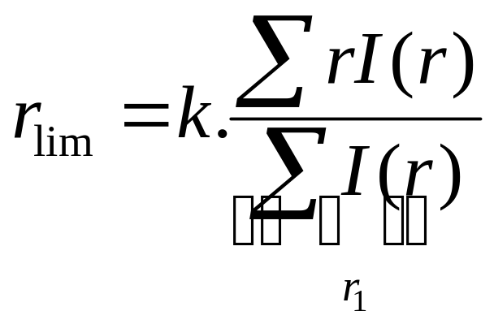
Adaptive aperture photometry
Kron magnitudes (Kron 1980)
  Scale the aperture with the “1st order radial moment” r ₁ :
  Efficient even for faint objects
E.BERTIN / TERAPIX

Slide 18
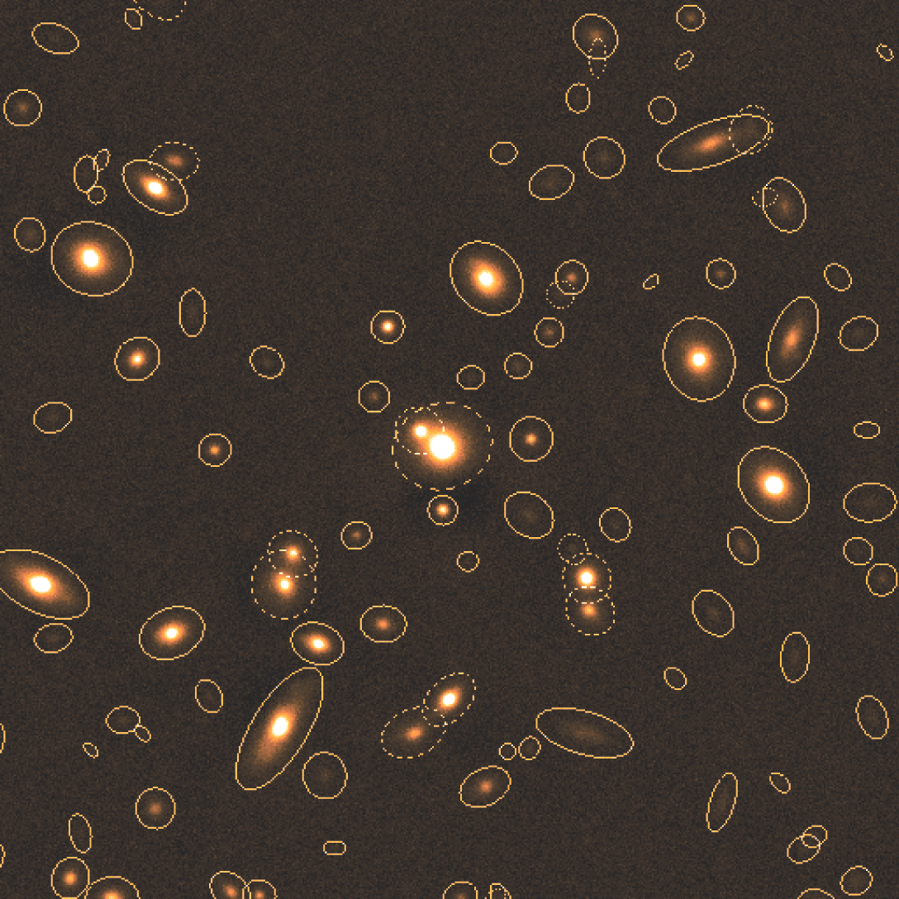
Adaptive aperture photometry (2)
Kron elliptical apertures drawn by SExtractor around galaxies from a distant cluster
E.BERTIN / TERAPIX

Slide 19
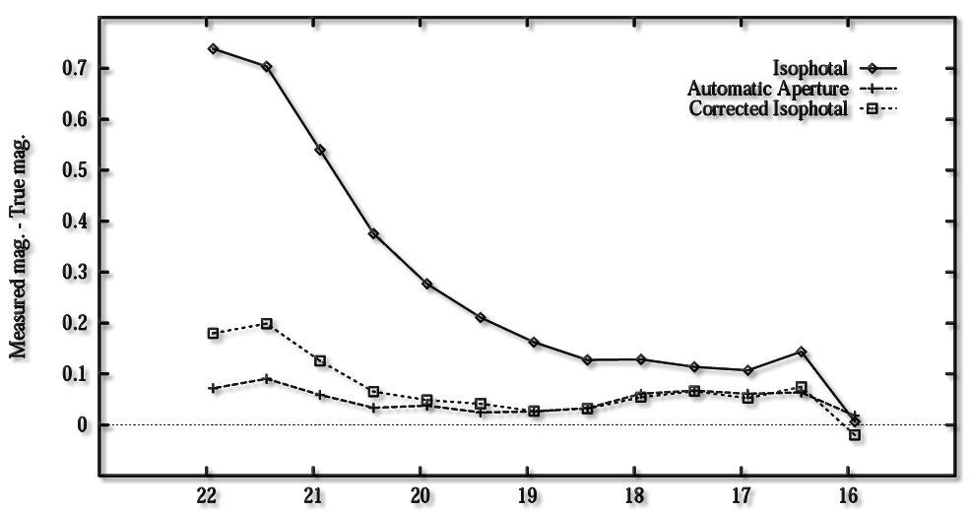
Adaptive aperture vs isophotal photometry for faint galaxies
Relative performance of isophotal and adaptive aperture magnitudes in SExtractor
E.BERTIN / TERAPIX

Slide 20
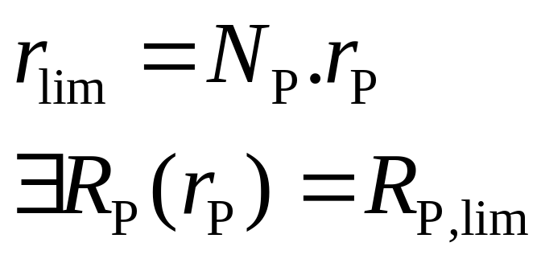
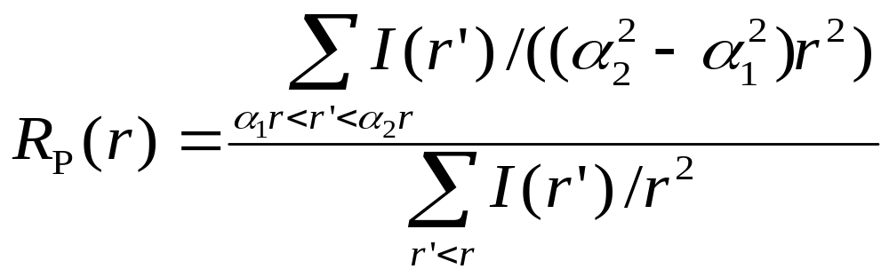
Adaptive aperture photometry (3)
Petrosian magnitudes (Petrosian 1976)
  Find the radius where the local surface brightness is a given fraction of the average surface brightness within the enclosed disk, and use it to scale the aperture.
  The most accurate for resolved galaxies with good S/N
  Used by SDSS
E.BERTIN / TERAPIX

Slide 21
Photometric measurements (4)
Profile fitting
  Linear process for flux only
  Point-sources
    Need a PSF model
      Identification of suitable point-source prototypes
      Take into account PSF variations over the field
      Handle under-sampling in some cases
      Analytical vs tabulated models
    Identify groups of stars in the image for simultaneous fitting
    Proceed iteratively to fainter and fainter stars
    Pixel weighting:
      Sky noise-limited: all pixels have equal variance. The flux measurement of the fitted profile is equivalent to a profile-weighted aperture photometry
      Star photon noise-limited: variance is proportional to the pixel values above the background level. The flux measurement of the fitted profile is equivalent to integrating through a large aperture
    Handle non-stellar objects
E.BERTIN / TERAPIX
Leiden 2002-10-29

Slide 22
Photometric measurements (5)
  Galaxy profile fitting
    3 to 7 more free parameters to fit
    A PSF model is also needed
    Computationally expensive!
E.BERTIN / TERAPIX

Slide 23
Automatic star/galaxy classification
Mandatory for deep imaging surveys at high galactic latitude. Number density of galaxies = number density of stars at V~20 at high b
In the optical domain: based on shape
  Multi-dimensional analysis in shape parameter space
  Priors concerning the relative number of objects at a given magnitude must be taken into account
E.BERTIN / TERAPIX

Slide 24
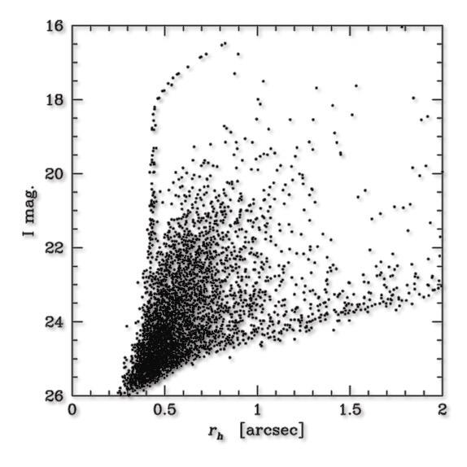
2 dimensional parameter-space for star/galaxy separation
r_{h} – magnitude diagram in a deep I-band reduced CCD image
E.BERTIN / TERAPIX

Slide 25
Automatic classifiers
FOCAS: Bayesian, based on a simple PSF model assuming that extended objects have the same profile as the PSF, but with larger FWHM.
SExtractor: Artificial neural network trained on simulated ground-based images
E.BERTIN / TERAPIX

Slide 26
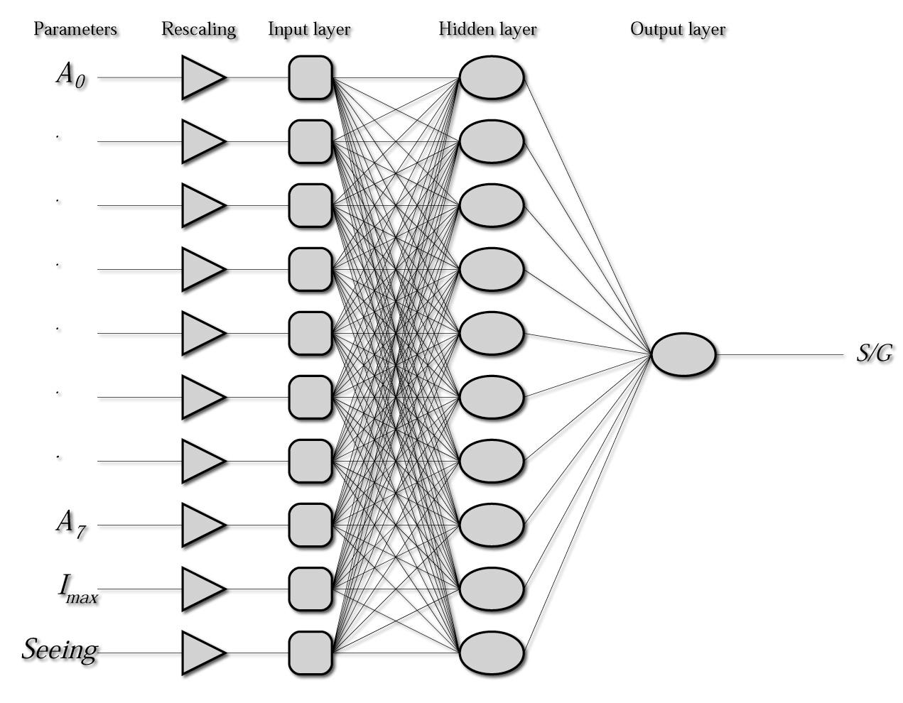
SExtractor’s neural network classifier
E.BERTIN / TERAPIX

Slide 27
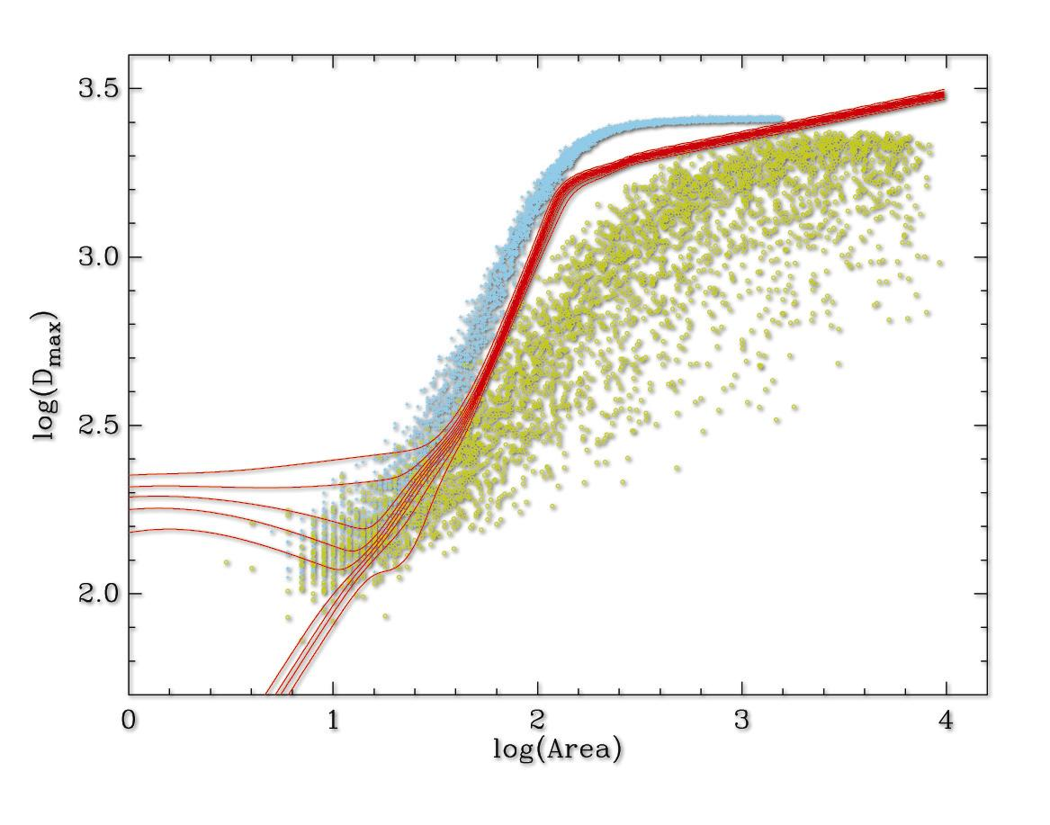
Automatic neural network classification
E.BERTIN / TERAPIX

Slide 28
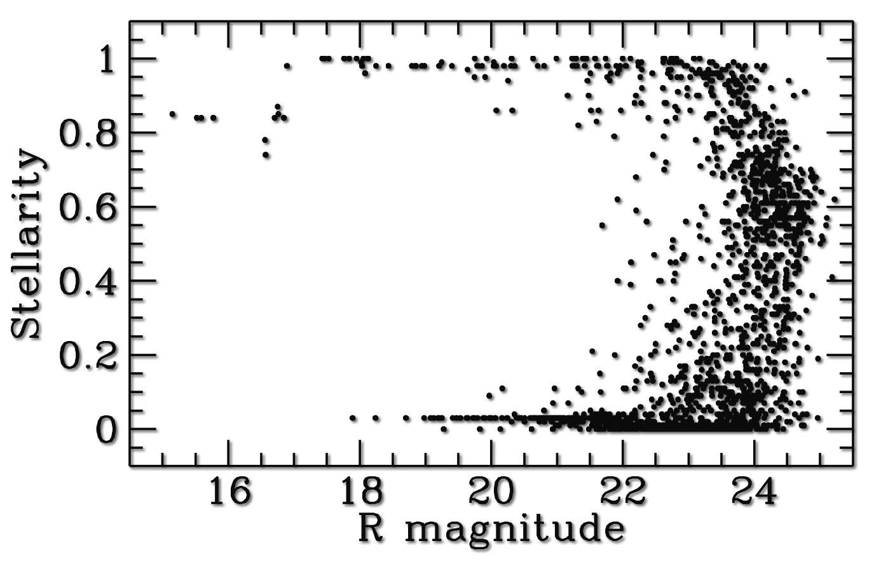
Stellarity parameter as a function of magnitude
E.BERTIN / TERAPIX

