Slide 1
SyllabusLink
Syrus Yeung
Jake Sagaser
Xavier Perches

Slide 2
Tools

Slide 3
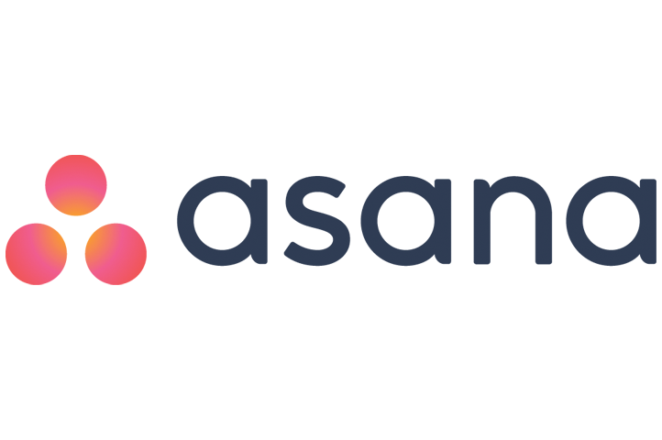
Asana - Project Tracker
Difficulty - 1/5
How much we used it - ⅗
How effective it was - 4/5

Slide 4

Github - Version Control
Difficulty - 3/5
How much we used it - 5/5
How effective it was - 5/5

Slide 5
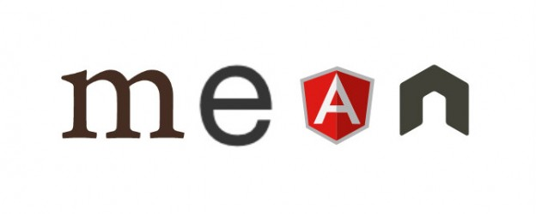
MEAN stack - MongoDB, Expressjs, Angularjs, Nodejs
Difficulty - 5/5
How much we used it - 5/5
How effective it was - 5/5

Slide 6

Google Calendar Api
Difficulty - 3/5
How much we used it - 3/5
How effective it was - 5/5

Slide 7
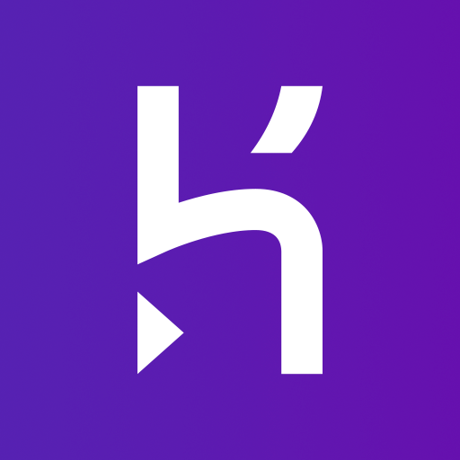
Heroku
Difficulty - 1/5
How much we used it - 3/5
How effective it was - 5/5

Slide 8
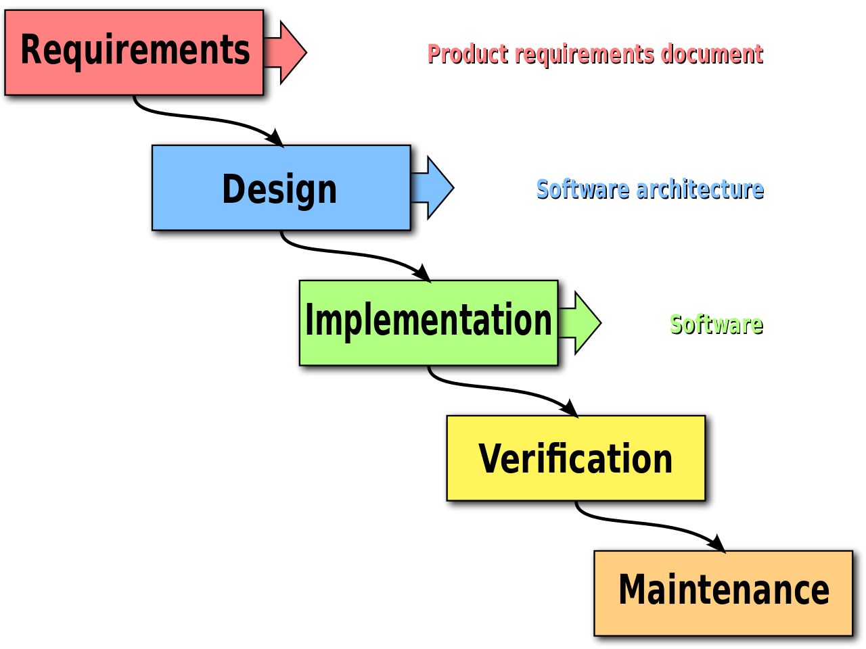
Methodology
Waterfall
Not effective because of the scope of the project
Didn’t allow us to get where we wanted to be

Slide 9
Challenges
Original scope of project was large for number of members
Wanted to implement too many user stories
Communication
MEAN Stack, HTML, Google API, Javascript
No previous knowledge for any group member
Google authentication posed problems, especially for use in creating events on the calendar
NODE.js google user authentication documentation is in alpha
Ran into issues that were open issues on Stack Overflow but with now answer
Little to no documentation on what we wanted to do with MEAN stack

Slide 10
DEMO

