Slide 1
GITHUB
Kasasira Charles Derrick

Slide 2
Version Control System

Slide 3
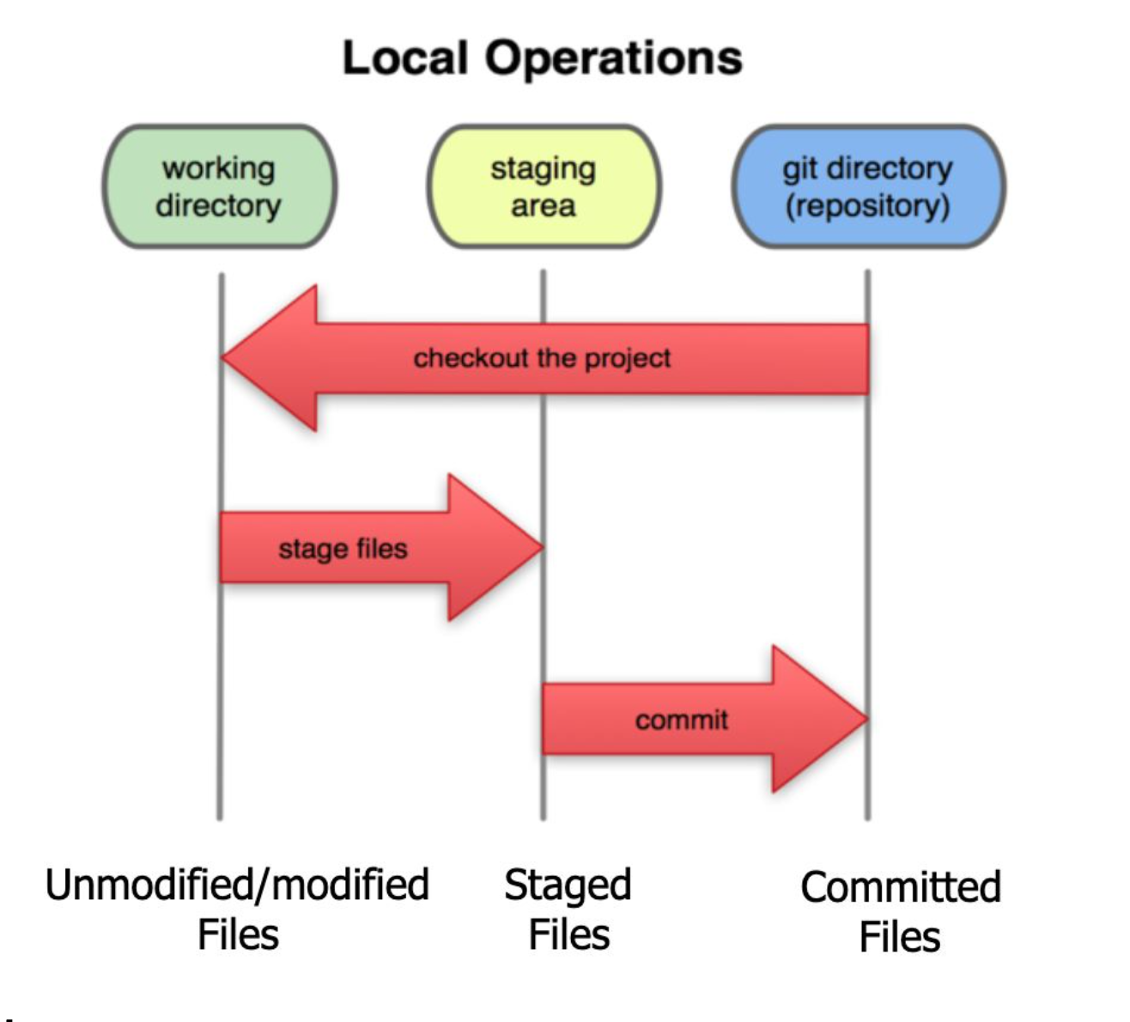
Git Local Operations

Slide 4
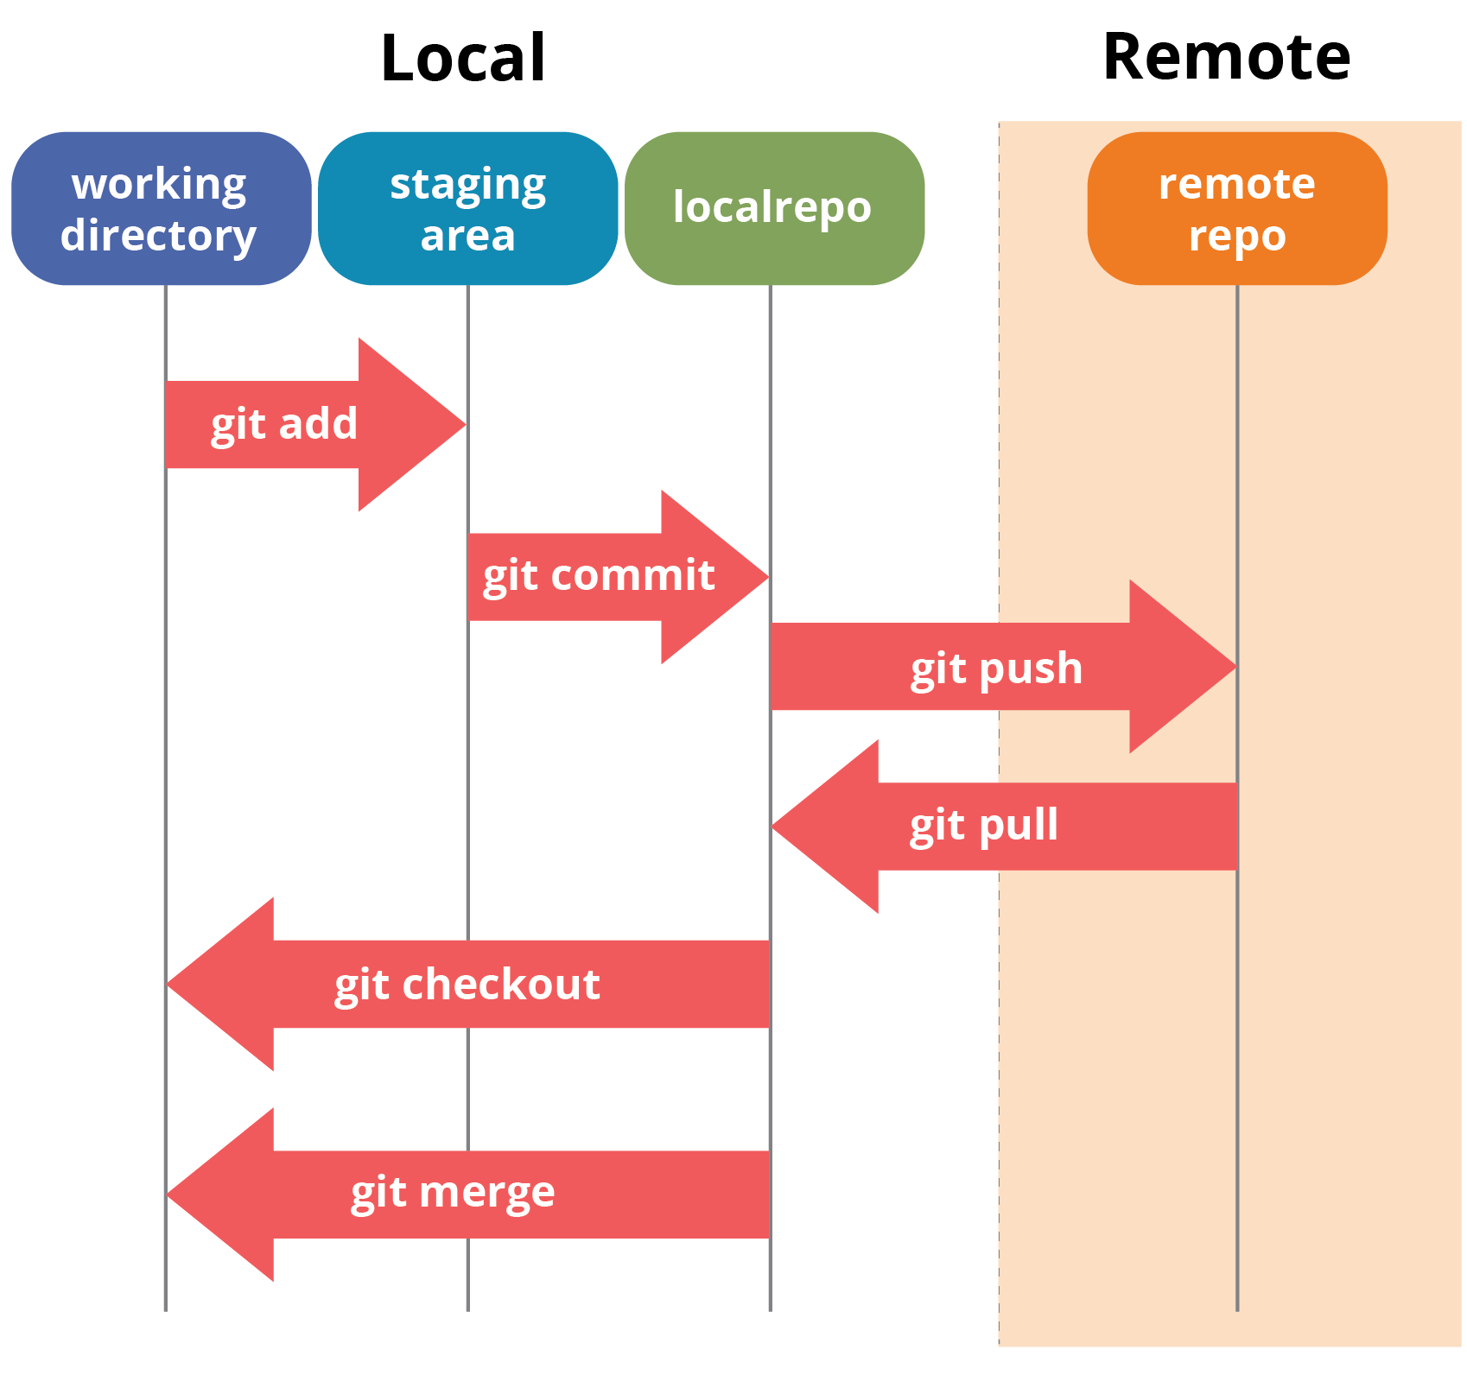
today

Slide 5
What is Github
GitHub is hosting service for Git repositories based on a distributed version control system.
It's an online database that allows you to keep track of and share your Git version control projects outside of your local computer/server. Unlike Git, GitHub is exclusively cloud-based.

Slide 6
Git and GitHub
Git is a version control system(vcs) while GitHub is a software where you can host your repositories commonly shortened for repos and it basically provides a GUI for git operations.

Slide 7
GitHub alternatives
BitBucket
GitLab
Beanstalk
Buddy

Slide 8
Repositories
A repository is a container for a project tracked by git.
Two types of repositories
Local repository: an isolated repository stored on your computer, where you can work on the local version of your project
Remote repository: generally stored outside of your isolated local system on a remote server. You can share your project code, see other people code and integrate it into you local version and also push changes to the repository.

Slide 9
Branches
A branch can be interpreted as an individual timeline of your project commits.
A GitHub branch is used to work with different versions of a repository at the same time.

Slide 10
Commits
At GitHub, changes are called commits. Each commit (change) has a description explaining why a change was made.

Slide 11
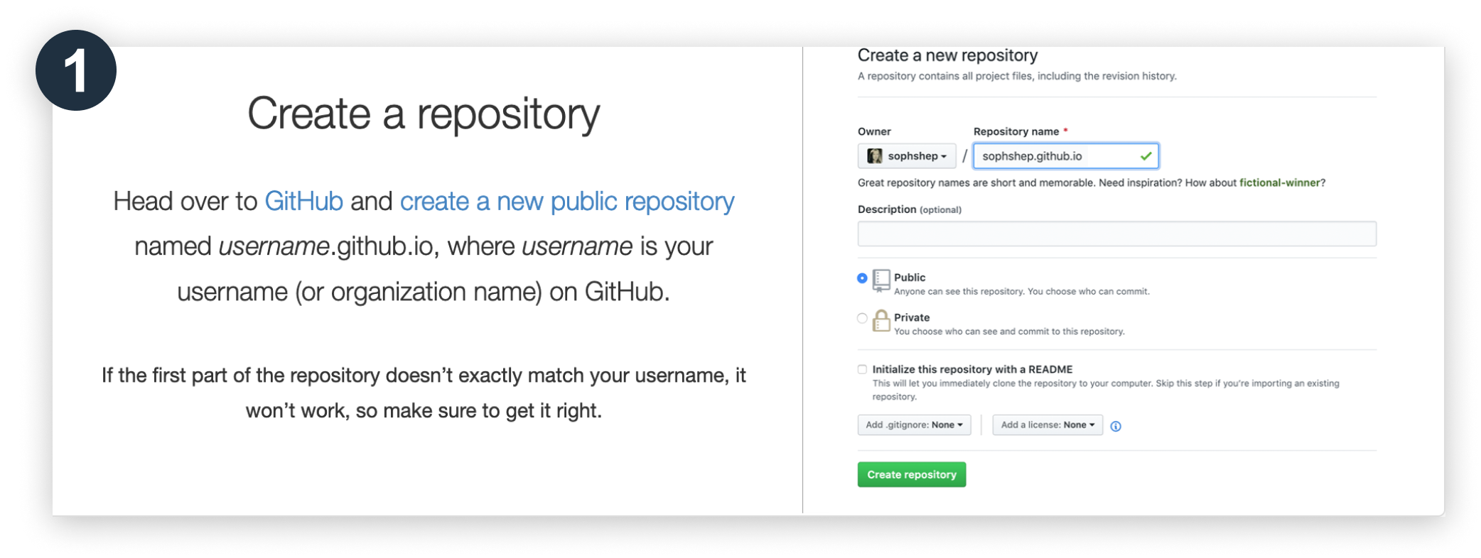

Slide 12
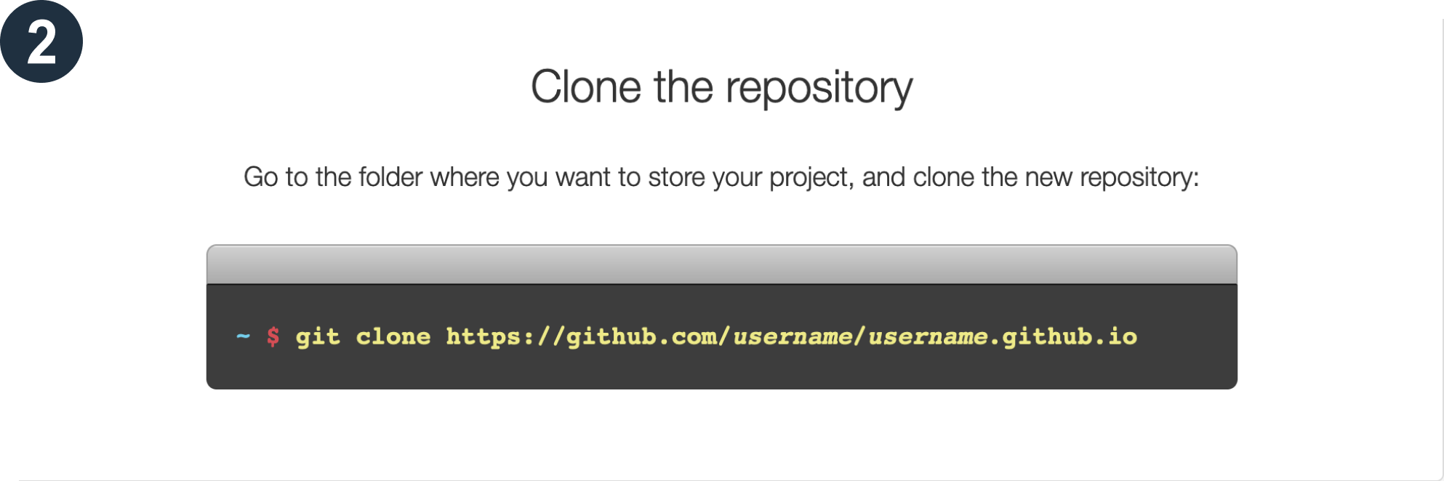

Slide 13
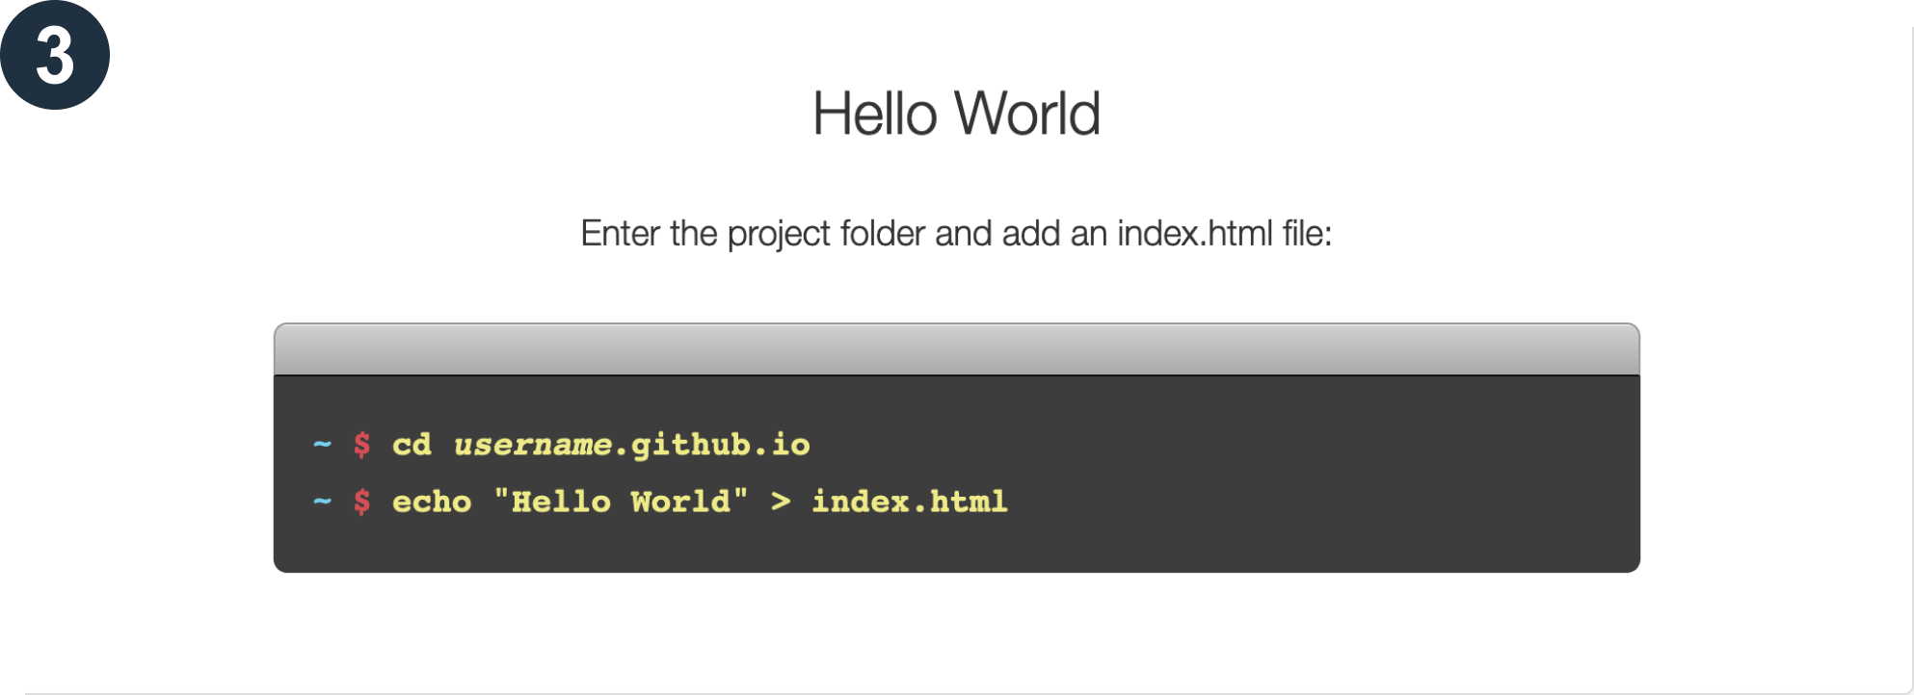

Slide 14
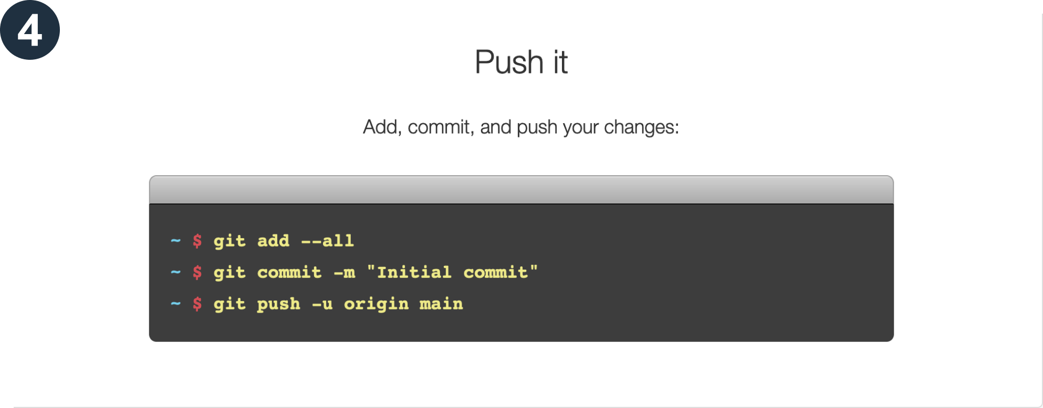

Slide 15
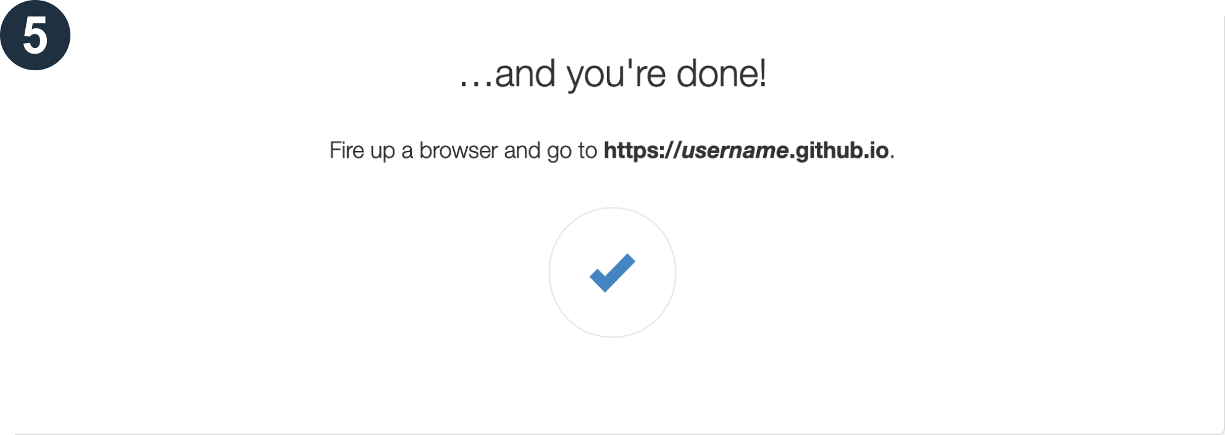

Slide 17
COLLABRATION
Issues
Forking
Pull Requests

Slide 18
Forking
A fork is a copy of a repository that sits in your account rather than the account from which you forked the data.
Once you have forked a repo, you own your forked copy. This means that you can edit the contents of your forked repo without impacting the parent repo.

Slide 19
Pull Request
Pull Request let you tell others abot changes you’ve pushed to a Github Repository. Once a pull request is sent, interested parties can review the set of changes, dicuss potential modifications, and even push follow-up commits if necessary.

Slide 20
Creating a Pull Request
There are two main ways of creating a pull request
Pull Request from a forked repository. (OS)
Pull Request from a branch with a repository. (organisations, personal).

Slide 22
Markdown

Slide 23
Rules of Markdown

