Slide 1
Privacy Computing of Differential privacy
吴海董 221050007

Slide 2
TABLE OF CONTENTS:
INTRODUCTION
DEFINITION
APPLICTION
CONCLUSION

Slide 3
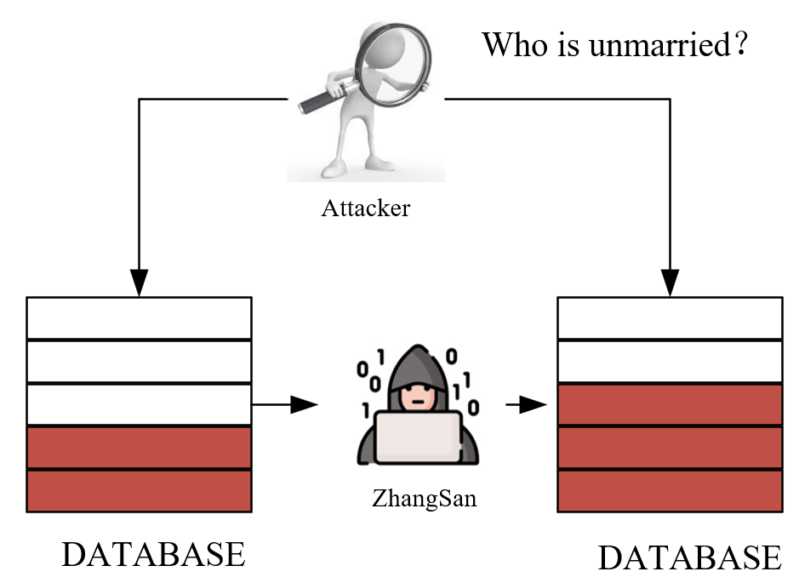
一、INTRODUTION
Who is unmarried?
Zhang San ！！

Slide 4
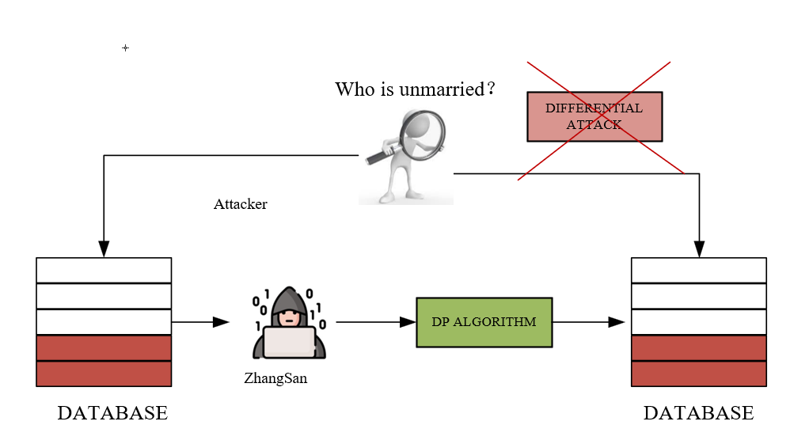
一、INTRODUTION
What differential privacy needs to do is to make the attacker's knowledge not change due to the emergence of these new samples

Slide 5
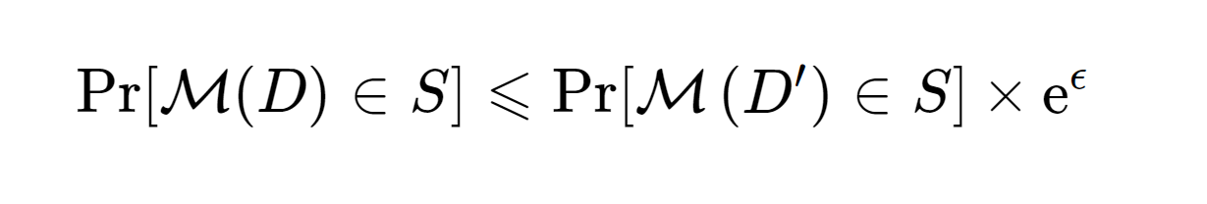
二、DEFINITION
ϵ−DP：For adjacency datasets D, D′ that differ only by one record. Apply a randomization algorithm (mechanism) M to these two data sets, for all S⊆Range(M), if there
Algorithm M satisfies ϵ−DP

Slide 6
三、APPLICATION
The DP in Apple's Emoji
The position protection by DP in Xiao Mi's Phone

Slide 7
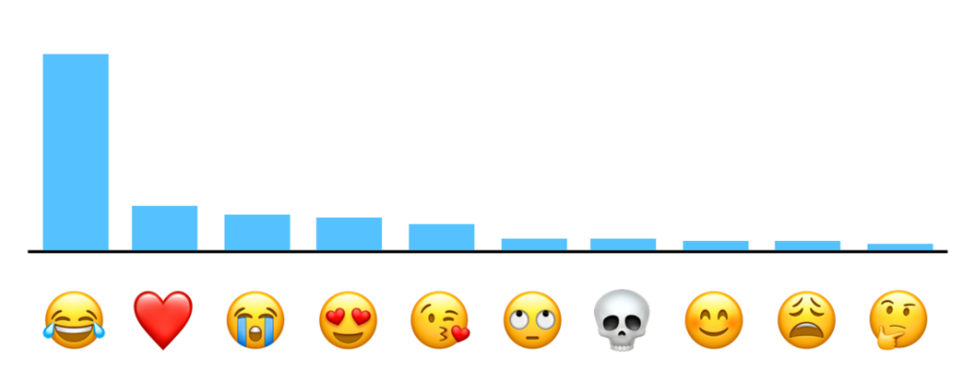
三、APPLICATION
The DP in Apple's Emoji
Apple adds noise to stats on emoji usage to protect persenal privacy and provide better service
Utility and Privacy

Slide 8
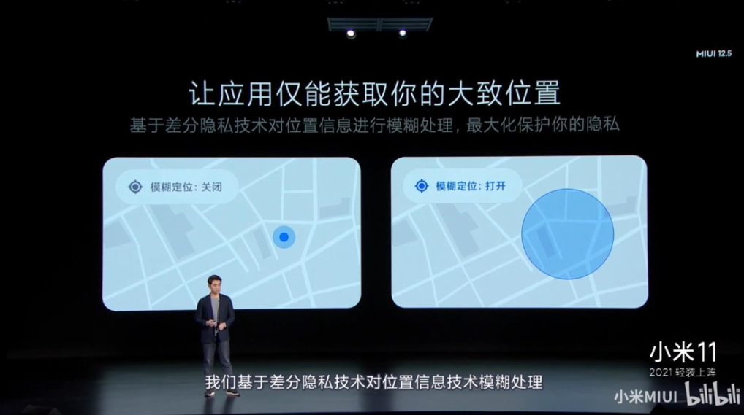
三、APPLICATION
The position protection by DP in Xiao Mi's Phone
Xiaomi phones protect personal
location privacy by blurring location

Slide 9
四、CONCLUSION
People pay more and more attention to the protection of privacy, so differential privacy becomes more and more important.
More Utility and More Privacy

Slide 10
THANK YOU!

