Slide 1
Project Proposal
Group 12
Zhiyuan Liang & Kaiyuan Xu & Weijia Lin & Xinyi Wang

Slide 2
Snake Game AI
Motivation from CS181’s Pacman AI

Slide 3
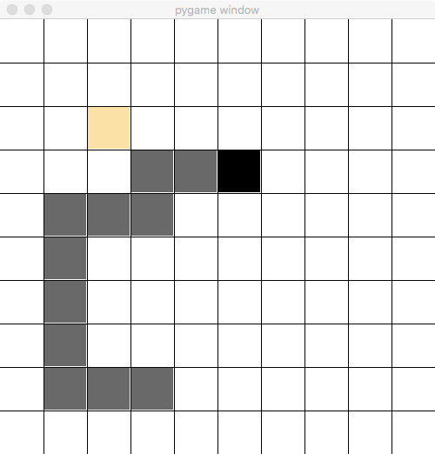
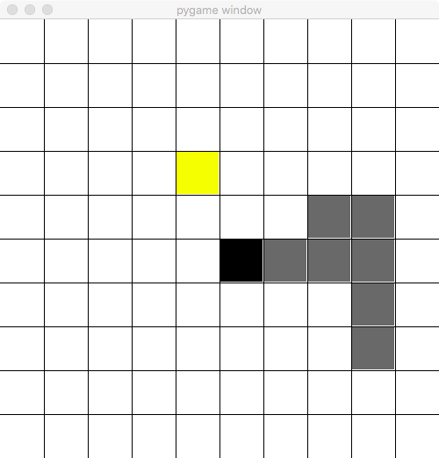
What we have done…
Framework
GUI & ASIIC Art
Interface for AI agent
…
We have implemented a random-valid-action agent for testing.

Slide 4
AI agent will know…
Map size
The location of food
Pose of the snake

Slide 5
How AI agent works…
Receiving information
Making decision
Game engine moves the snake
Receiving new information
Making decision
…

Slide 6
What we are going to do…
Astar agent
RL agent
More methods to consider
…

Slide 7
THANK YOU

