Slide 1
How to Land an Internship
CSS Workshop Series 2019

Slide 2

About Me
4th year undergrad, Honours CS
Interned at the Federal Government of Canada, National Defence (Summer ‘18)
Will be returning full time starting this summer
Previously Brave Control Solutions (Summer ‘17) via Co-op
2x Apple WWDC Scholarship Winner
Teaching, Research assistant, CSS

Slide 3
Disclaimers
Most of this presentation applies to internships / interviews at big tech companies eg. Google, Amazon, Microsoft etc.
Therefore some advice I will give may seem overkill
Most of this info has been passed on to me by successful grads, and through my own experience
For each section I’ll give you my personal opinion, the good and bad

Slide 4
Please ask questions at any time!

Slide 5
Overview
What is an internship?
Internships vs. the UWindsor Co-op program
Finding internships
How to apply
How to actually get an interview
How to pass the interview
The internship prep checklist

Slide 6
What is an internship?

Slide 7
What is an internship?
Internship (USA) AKA co-op placement (Canada)
Paid, fixed term employment for a company doing (hopefully) CS related work
Typically 4 months, can also find 8 or 12 month placements
Why tho?
Learn skills you simply won’t at school
Learn about the industry, what you love and hate
Easiest way to secure a good full-time job after grad

Slide 8
My Take
The Internship game is like a ladder
It is difficult to get hired (or even intern) somewhere like Google without experience, although possible
Each completed internship under your belt drastically helps
Interviewers spend a lot of time talking about your internship experience
Almost everything I’ve done on the job was new to me
Git, JS / Web frameworks, Testing, Jira

Slide 9
So where does Co-op fit in?

Slide 10
Internships vs. the Co-op Program
Co-op helps place you, mostly in Windsor positions
They augment your internship hunt by enrolling you in a Co-op 101 course
You will learn resume writing, interview skills, and do a few assignments
In Canada, companies hire interns in-part because of tax writeoff
Therefore, many smaller companies require Co-op program enrollment
This doesn’t apply to many big Canadian companies, American, or full time jobs
Examples of Co-op placements:
IBM, Stats Can, Hiram Walker, various local tool & die shops

Slide 11
Co-op Application Process
You apply via the Co-op website with resume, cover letter etc
A few big name companies may show up, most are external links (not thru Co-op!)
Co-op arranges an interview, if the company likes you
Most interviews locally will not involve coding (Nice?!)
Then on “Ranking Day”, each company will rank you, and you will rank them
An algorithm then matches you with a company, you must take it

Slide 12
My Take
A lot of jobs listed via Co-op are simply not CS oriented
Customer support at a local call center, desk clerk, Excel / Word jobs etc.
The ‘Co-op’ version of an ideal resume will not take you very far
Actual interview skills (coding stuff) are never mentioned
Co-op is a great way to get your first placement, and a good backup option
If you’re aiming for Google-esque job, remember to keep climbing the ladder!

Slide 13
Finding an Internship

Slide 14
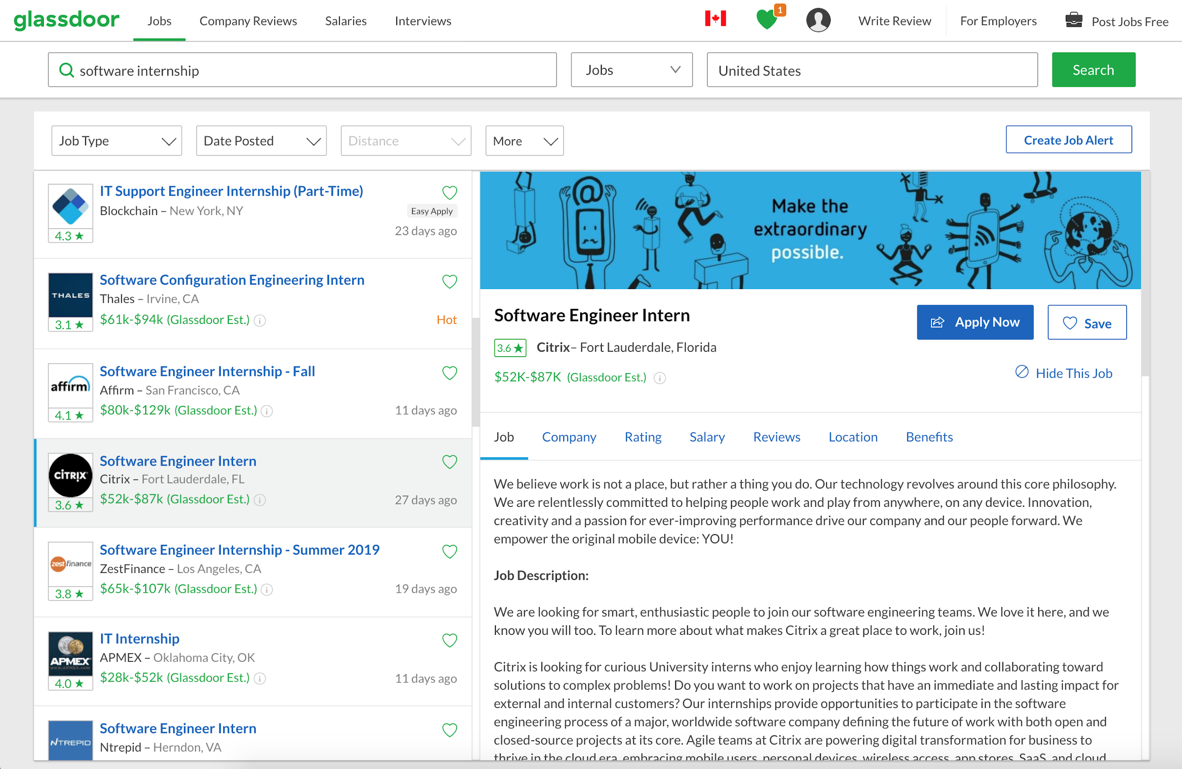

Slide 15
Finding an Internship
Glassdoor.com (Bookmark it right now!)
Intern.supply
LinkedIn Jobs
Indeed
Co-op job search (if registered)
Go right a company’s website, Careers tab
Anything that says “Internship” is fair game

Slide 16
When Do I Start Applying?
For next summer...
August - September!
Winter placements are usually July / Aug / Sept
Fall would be May - July ish
Don’t let Co-op mislead you, big tech companies hire in Fall on rolling basis

Slide 17
Which Internships Are Good?
Figure out what interests you career wise (AI? Web dev? Money?)
Look for Software Engineer (Internship) positions if you want to be coding
May also try Software Engineer in Test, who writes testing code
Can definitely apply for any I.T. / miscellaneous CS related job
Read Glassdoor reviews to see what people think about company

Slide 18
Worth Mentioning
Some of the big companies have internships specifically for 1st/2nd years
Google Engineering Practicum
Microsoft Explorer
Facebook University
Many big tech companies have diversity based internships and scholarships, (eg. for women in tech, underrepresented groups etc)
You can try reaching out to a recruiter directly (LinkedIn?)

Slide 19
How To Get An Interview

Slide 20
How to Get An Interview
You need to impress the recruiter!
You generally only submit a 1 page resume, that’s it!
Recruiter will look at your resume for 10-20 seconds, then make YES / NO
They are most concerned with:
Previous internship experience
Skills, programming languages and frameworks you know
Projects you have done (put your Github link!!)
Where you go to school and when you graduate
We are going to hold a workshop entirely on resume writing.

Slide 21
My Take
For big tech companies:
You NEED to emphasize experience, more than anything!
You NEED at least 1 or 2 projects on resume. Use anything relevant, spice it up
Don’t get discouraged, vast majority will reject you!
I applied to over 100 internships in 2017, got about 4 or 5 interviews
Your best chance is developing skills and projects outside of class, and applying to jobs that are looking for these skills!

Slide 22
Continued
I started off with nothing to put on my resume
Now I have too much for 1 page
For me, WWDC Scholarship was a turning point, recruiters took notice
The takeaway:
Try to get into any extra endeavour that you can!
Research, TA, open source, societies, scholarships, dev meetup, conferences ...

Slide 23
Brief Resume Advice
1 page
Use a template
Use point form, with action words (eg. developed, designed, deployed)
Brag about relevant accomplishments, quantify everything!
List all CS related work experience / personal projects with tech stack!
https://www.careercup.com/resume
https://www.sharelatex.com/templates/cv-or-resume/awesome-cv

Slide 24
How To Pass the Interview

Slide 25
The Internship Interview
Most big tech companies have the following procedure:
A HackerRank interview, done online and w/ time limit ~ 1 hr.
A phone interview in a shared Google Doc, ~ 1 hr.
Potentially 1 or 2 more phone interviews
Potentially 1 onsite interview (in person), usually not for internships
These are all technical interviews, and take years of practice to nail
Each of these will give you tricky questions, you will need to know data structures!

Slide 26
Stage 1: The HackerRank
Go to HackerRank.com, Leetcode.com, etc. This is exactly how it will be!
Problems are usually drawn directly from these sites!
The goal is to pass all the test cases within the time limit
Most I have done are Leetcode Easy or Medium
Cracking the Coding Interview book is the goto book for interview problems

Slide 27
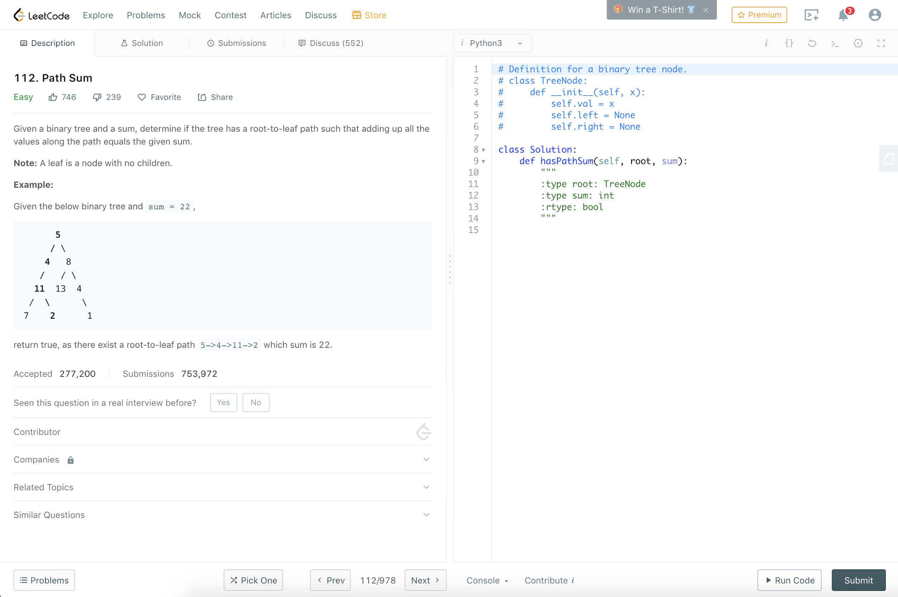

Slide 28
Stage 2: The Phone Interview
Each company is a bit different
Will usually be another HackerRank, except you talk the interviewer through it
Usually ask a warm up question, then a harder one
In general:
Verbalize your ideas, let the interviewer guide you before writing code
Consider complexity and correctness before writing anything
Ask as many questions as you can to clarify the problem 110%
Then… Write code for them, explain what you are typing
When finished, explain complexity of your solution eg. O(n^2)

Slide 29
Continued
This is obviously a simplification, it is easier said than done
You need as much exposure and practice solving these types of problems as possible
We are going to hold several workshops on all different types of questions
I will walk you thru questions I’ve actually been asked, and how to answer

Slide 30
Stage 3 (Optional): The Onsite
The company may fly you to their office, and conduct a similar interview
All expenses paid trip is pretty sweet, would recommend
This would be a full day of interviews
Same questions, but often you answer on a whiteboard, in front of an engineer
Sometimes involves more intricate questions (eg. system design, conceptual)
For full time interviews, onsite usually always happens

Slide 31
My Take
Start applying ASAP, do as many interviews as you can for experience
Leetcode and Cracking the Coding Interview
Come to our workshops on interview prep skills
It took me 3 years of practice to be able to pass consistently
Don’t get discouraged!
Look at Glassdoor interview reviews, people post problems they were asked!
A referral can go a long way!

Slide 32
Internship Prep Checklist

Slide 33
Checklist
Do a Leetcode or HackerRank question every day
Read Cracking the Coding Interview
Work on new skills / projects for your resume
Look for experiences / awards / opportunities to decorate your resume
Keep trying!

Slide 34
Final Remarks
Email me directly if you have any questions! -- rorsethj@uwindsor.ca
Come talk to me if you want info about the Government Co-op or WWDC Scholarship
Send me your suggestions for upcoming workshops!
Keep an eye out for next workshop announcement!

Slide 35
Thanks!

