Slide 1
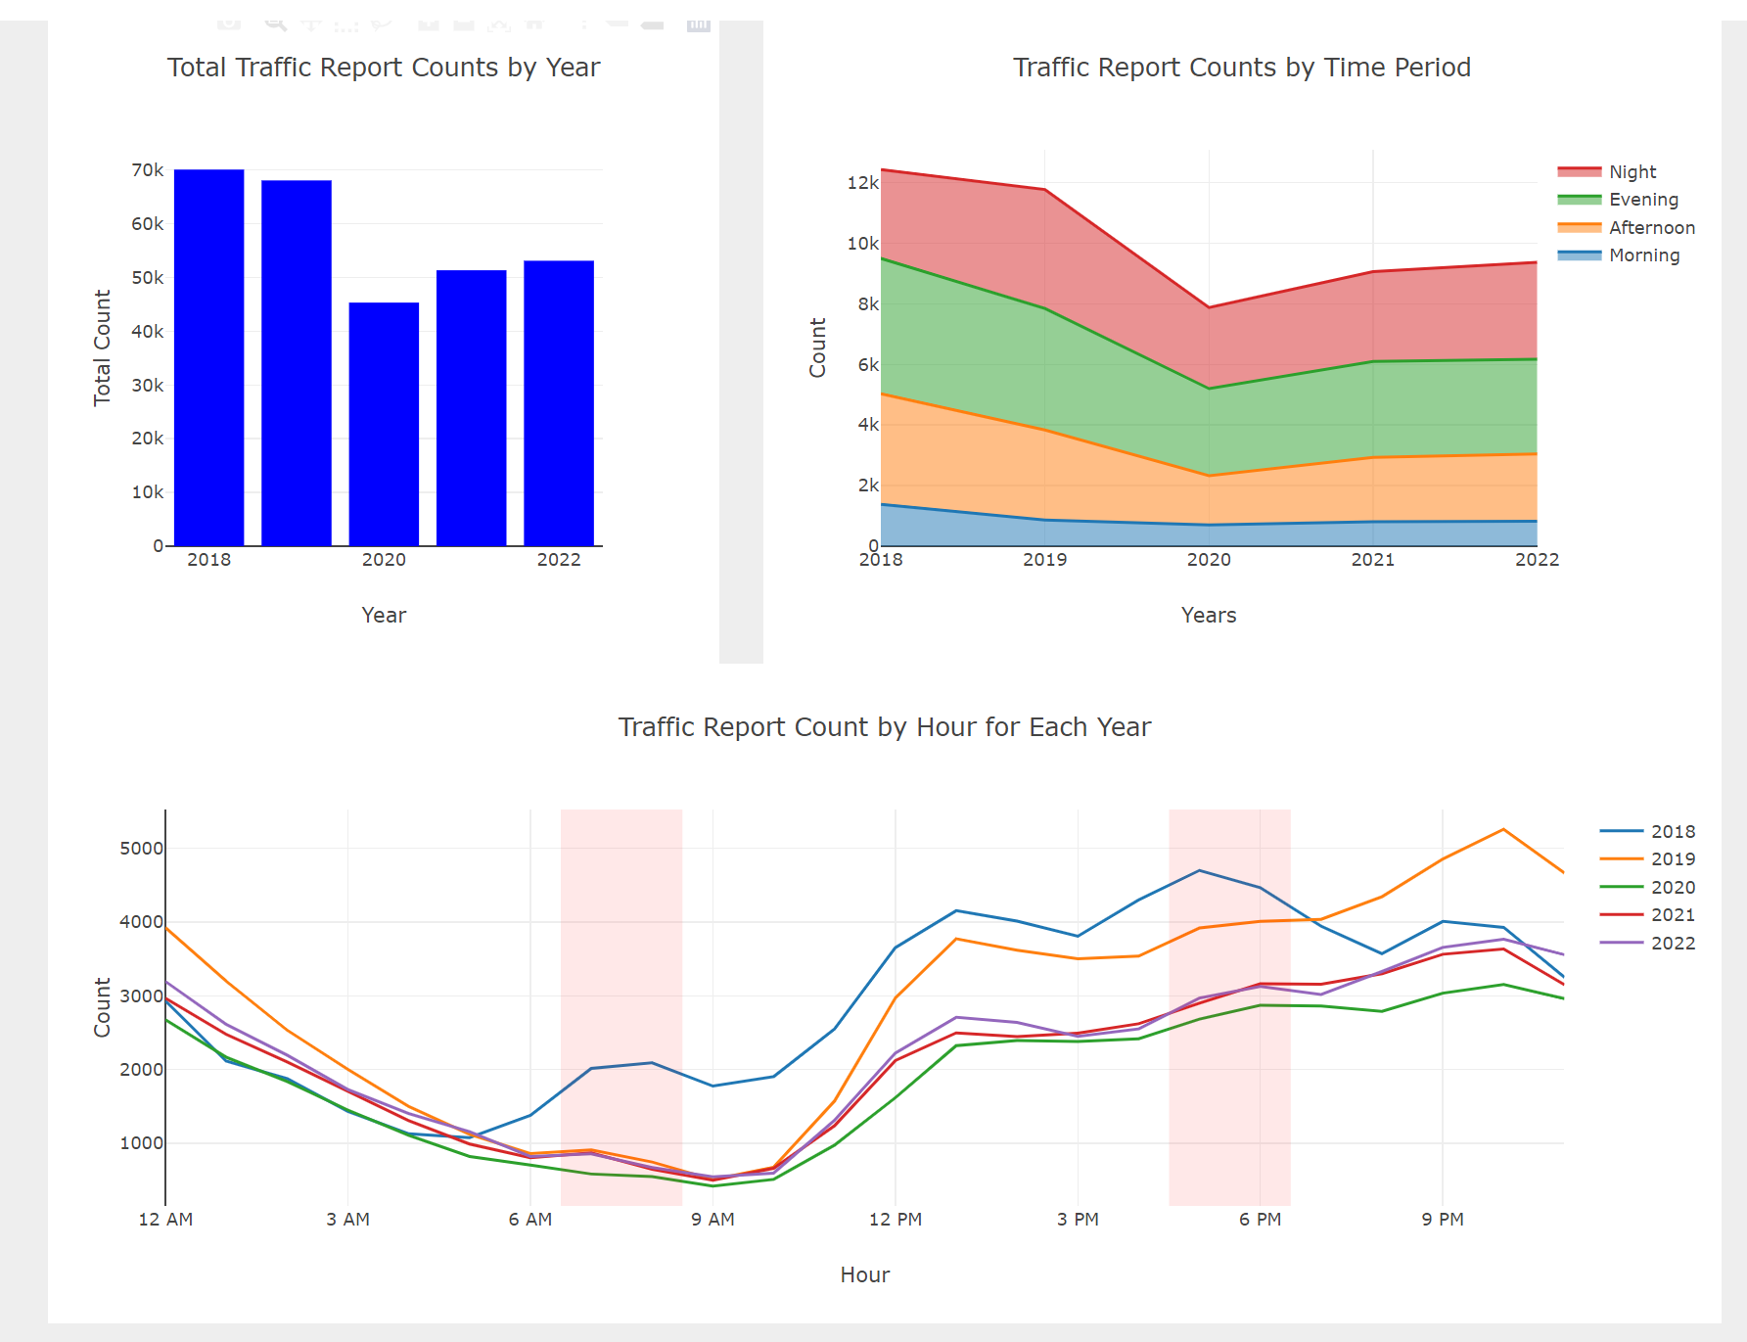
Investigate the relationship between incident frequency and time of the day

Slide 2
Both the plots are same, just the size is different

Slide 3
Observations
Investigate the relationship between incident frequency and time of the day:
The frequency of incidents is significantly lower during morning commute hours. In contrast, it tends to be higher during the evening rush hour. Moreover, incidents are significantly more frequent during nighttime
In a span of 5 years, incident frequencies show the following trends across time periods: low during evening, gradually increasing in the afternoon, further rising in the evening, and reaching their highest point at night.
Checking out a bar chart that shows the total incidents over 5 years, you can see that in 2020 and 2021, there were fewer accidents because of the pandemic

