Slide 1
TrafFic Safety Enhancement
Transportation and Traffic Safety Enhancement in Austin, Texas

Slide 2
Project Scope and Objectives:
Introduction:
Transportation and Traffic Safety Enhancement in Austin, Texas
Proposal Objective:
Comprehensive plan to enhance transportation and traffic safety in Austin, Texas.
Primary goal: Mitigate the financial burden of traffic incidents.
Project Approach:
Analyzing historical traffic data to identify trends, patterns, and correlations.
Data-driven insights will guide targeted improvements.
Team Members:
Charles Quinn
Jackie Larios
Sujatha Angajala
Joshna Rence

Slide 3
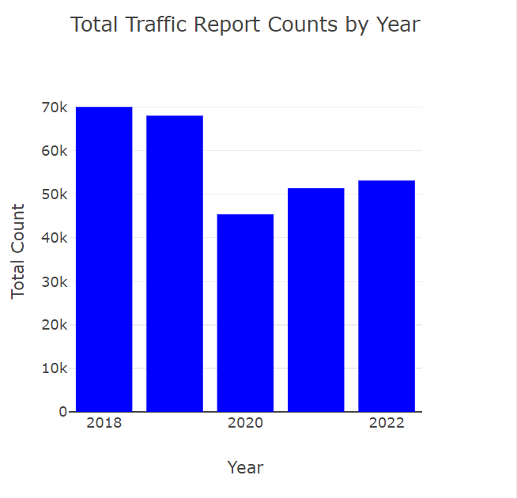
Total incidents over 5 years
The number of accidents in 2022 decreased by 30% compared to 2018
Fewer accidents occurred in 2020 and 2021 due to the pandemic and lockdown measures
No of incidents in 2022 is lowered compared to 2018,2019

Slide 4
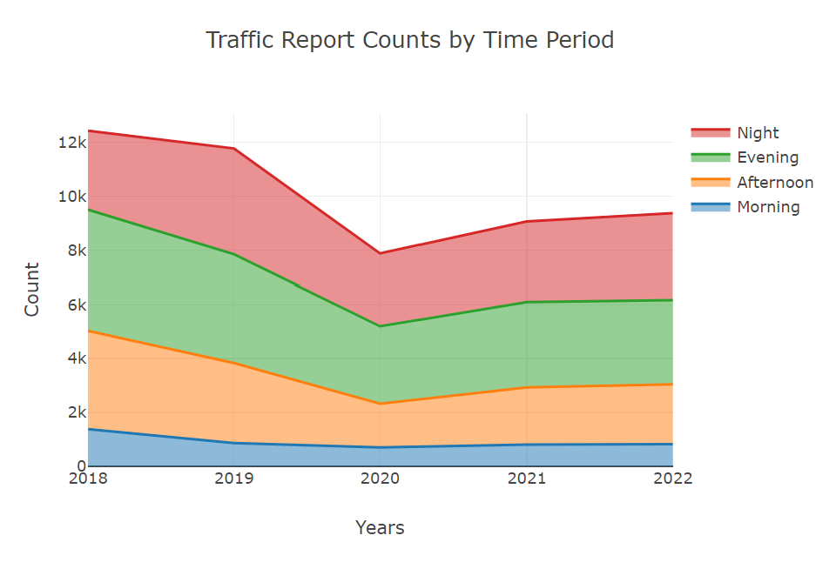
Trends across time periods
Low incidents during the evening.
Gradual increase in the afternoon.
The frequencies of the incident in the evening and at night are somewhat similar
The trend is consistent across all the years.

Slide 5
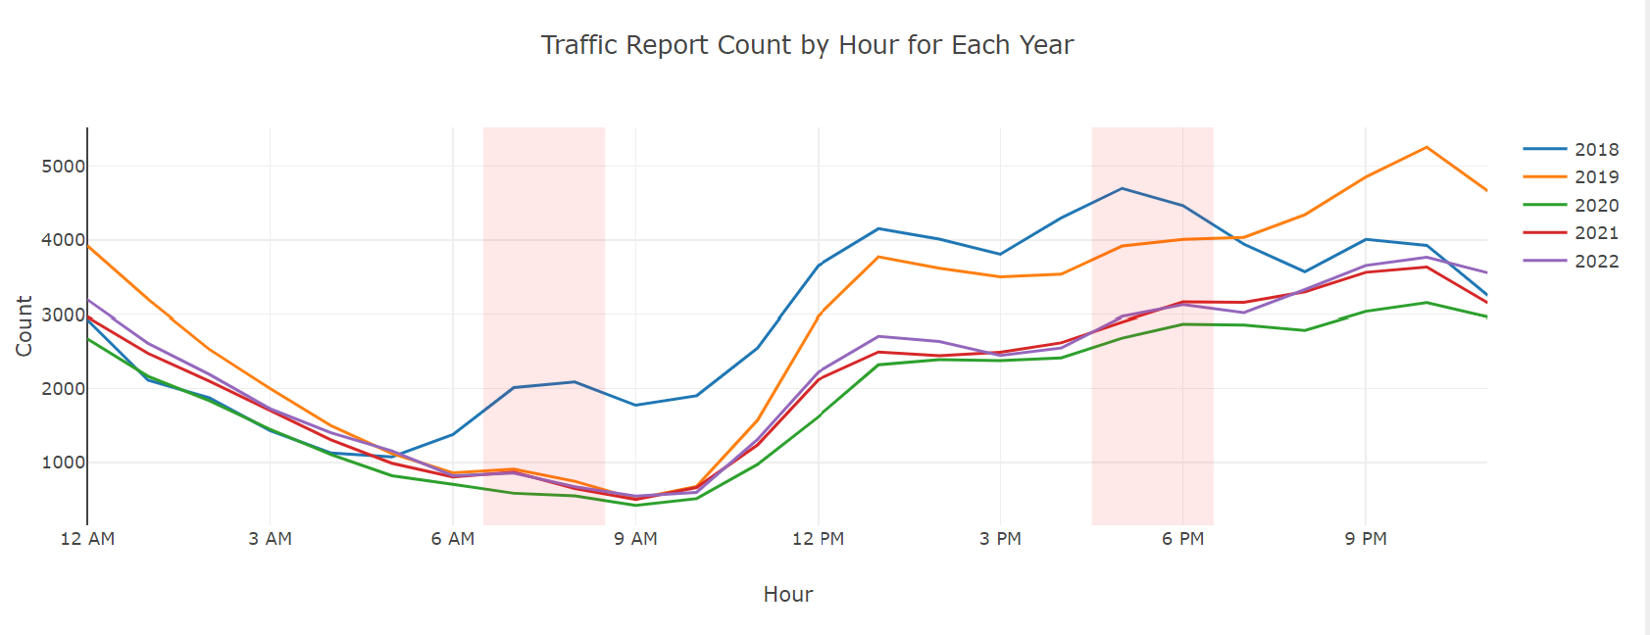
Incident Frequency Patterns
Significantly fewer incidents occur during the morning commute hours because people are more alert and less fatigued during that time
Accidents are gradually increasing after 10 AM
More frequent incidents occur during nighttime due to poor vision while driving, with drunk driving potentially contributing as well

Slide 6
Observations
Investigate the relationship between incident frequency and time of the day:
In 2022, there were 30% fewer accidents compared to 2018. The years 2020 and 2021 had fewer accidents due to the pandemic and lockdowns. The number of incidents in 2022 was lower than in 2018 and 2019. Evening hours had fewer incidents, while afternoons saw a gradual increase.
Incidents in the evening and at night were somewhat similar. This trend stayed the same over the years. Fewer accidents happened during morning commutes because people were more alert. After 10 AM, accidents started increasing gradually.
More accidents occurred at night, likely because of poor visibility and possibly drunk driving. This shows that the time of day influences accident rates, highlighting the need for safety measures.

Slide 7
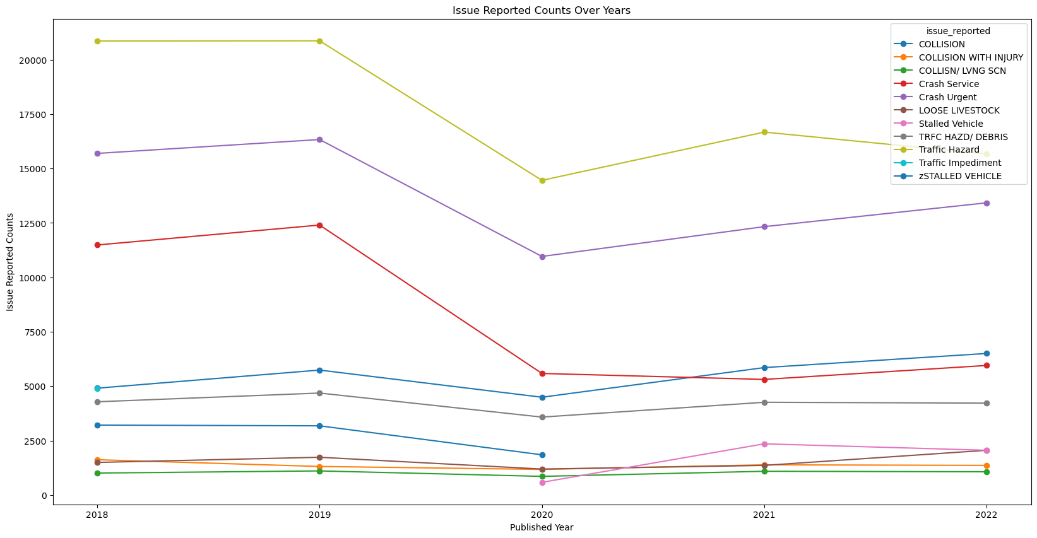
Incident Frequency Patterns
Main problems: pedestrians, stalled vehicles, debris, inoperative traffic signals.
During COVID-19: all reported problems decreased.
Remote work, closed schools/offices contributed.
Increase in collisions noticed.
More people in Austin → higher traffic, more accidents.

Slide 8
Evaluation of incident types over time
1.It's interesting to see that the main reason for reported issues is related to problems on the road, like pedestrians, stalled vehicles, debris in the roadway, and / or inoperative traffic signals.
2. During the years when COVID-19 was affecting us , all types of reported problems went down a lot, which makes sense because more people were working and studying from home, and places like schools and offices were closed.
3.After the COVID-19 situation got better, there's a noticeable increase in collisions. This could be because more people are moving to Austin, which is causing more traffic and accidents.

