Slide 1
TrafFic Safety Enhancement
Transportation and Traffic Safety Enhancement in Austin, Texas

Slide 2
Project Scope and Objectives:
Introduction:
Transportation and Traffic Safety Enhancement in Austin, Texas
Proposal Objective:
Comprehensive plan to enhance transportation and traffic safety in Austin, Texas.
Primary goal: Mitigate the financial burden of traffic incidents.
Project Approach:
Analyzing historical traffic data to identify trends, patterns, and correlations.
Data-driven insights will guide targeted improvements.
Team Members:
Charles Quinn
Jackie Larios
Sujatha Angajala
Joshna Rence

Slide 3
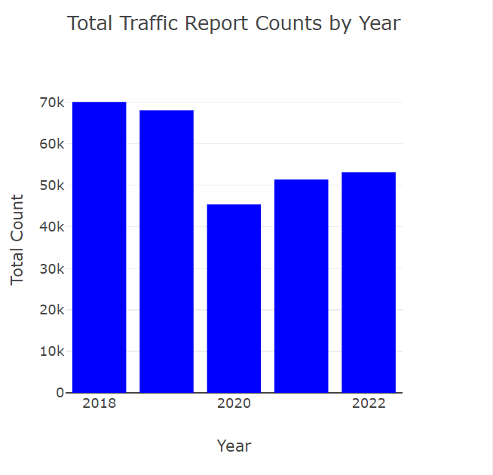
Total incidents over 5 years
Fewer accidents in 2020 and 2021 due to the pandemic.
The frequency of accidents gradually decreased over the years

Slide 4
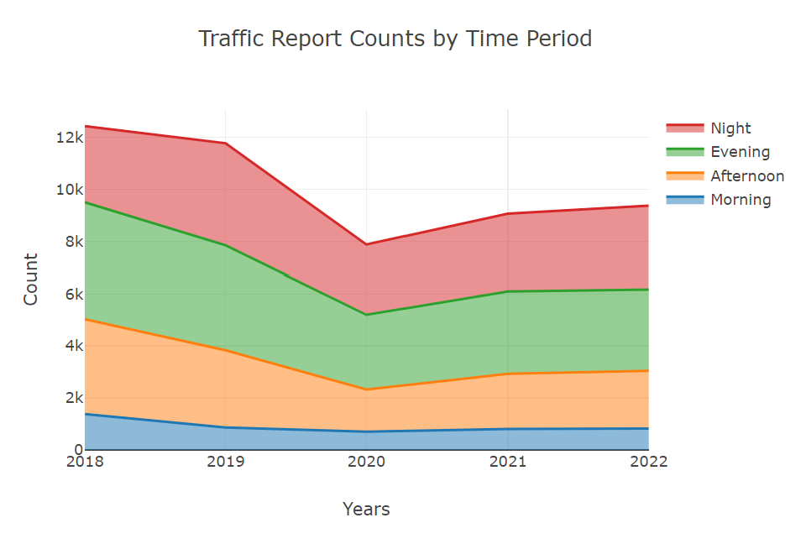
Trends across time periods
Low incidents during the evening.
Gradual increase in the afternoon.
Further rise in the evening.
Peak frequency reached at night.

Slide 5
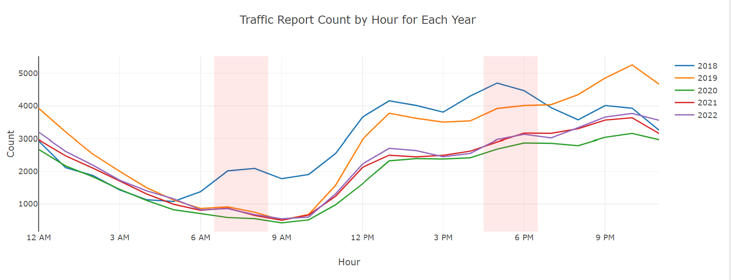
Incident Frequency Patterns
Significantly lower incidents during morning commute hours.
Higher incidents during evening rush hour.
More frequent incidents during nighttime.

Slide 6
Observations
Investigate the relationship between incident frequency and time of the day:
The frequency of incidents is significantly lower during morning commute hours. In contrast, it tends to be higher during the evening rush hour. Moreover, incidents are significantly more frequent during nighttime
In a span of 5 years, incident frequencies show the following trends across time periods: low during evening, gradually increasing in the afternoon, further rising in the evening, and reaching their highest point at night.
Checking out a bar chart that shows the total incidents over 5 years, you can see that in 2020 and 2021, there were fewer accidents because of the pandemic

Slide 7
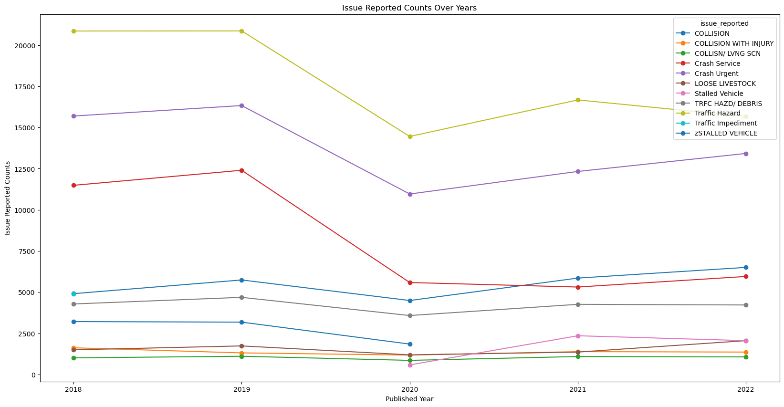
Incident Frequency Patterns
Main problems: pedestrians, stalled vehicles, debris, inoperative traffic signals.
During COVID-19: all reported problems decreased.
Remote work, closed schools/offices contributed.
Increase in collisions noticed.
More people in Austin → higher traffic, more accidents.

Slide 8
Evaluation of incident types over time
1.It's interesting to see that the main reason for reported issues is related to problems on the road, like pedestrians, stalled vehicles, debris in the roadway, and / or inoperative traffic signals.
2. During the years when COVID-19 was affecting us , all types of reported problems went down a lot, which makes sense because more people were working and studying from home, and places like schools and offices were closed.
3.After the COVID-19 situation got better, there's a noticeable increase in collisions. This could be because more people are moving to Austin, which is causing more traffic and accidents.

