Slide 1
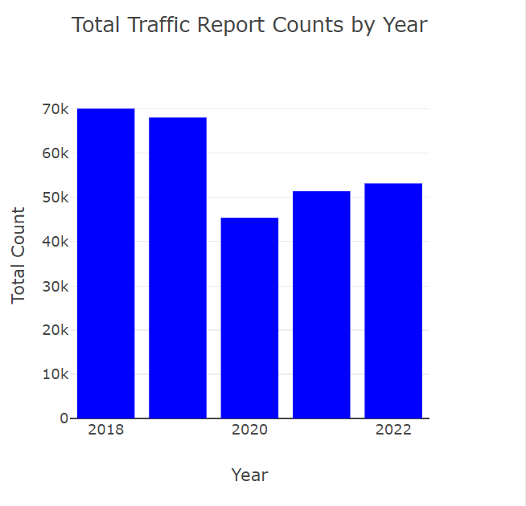
Total incidents over 5 years
The number of accidents in 2022 decreased by 30% compared to 2018
Fewer accidents occurred in 2020 and 2021 due to the pandemic and lockdown measures
No of incidents in 2022 is lowered compared to 2018,2019

Slide 2
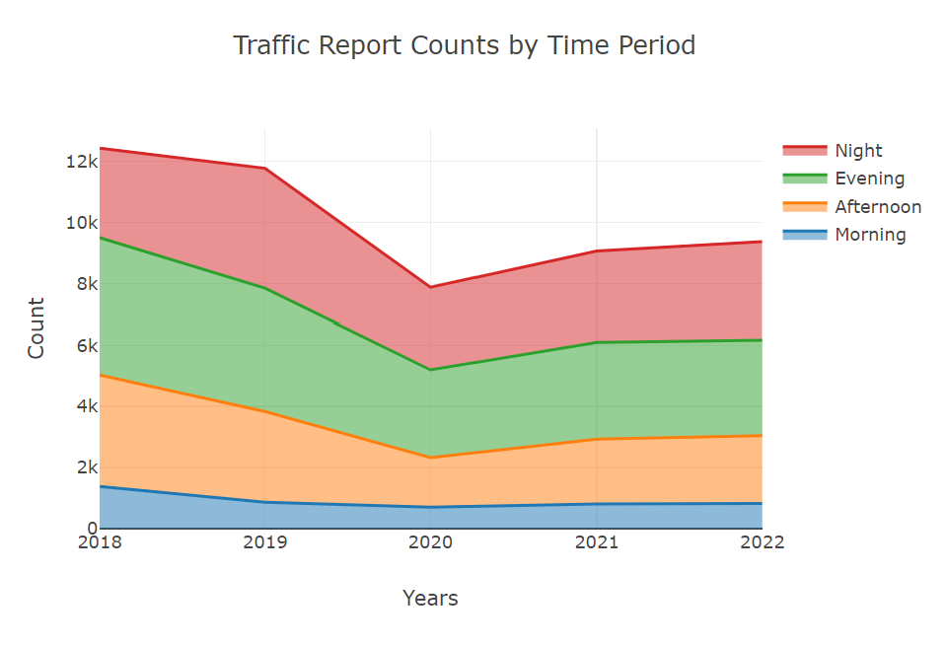
Trends across time periods
Low incidents during the evening.
Gradual increase in the afternoon.
The frequencies of the incident in the evening and at night are somewhat similar
The trend is consistent across all the years.

Slide 3
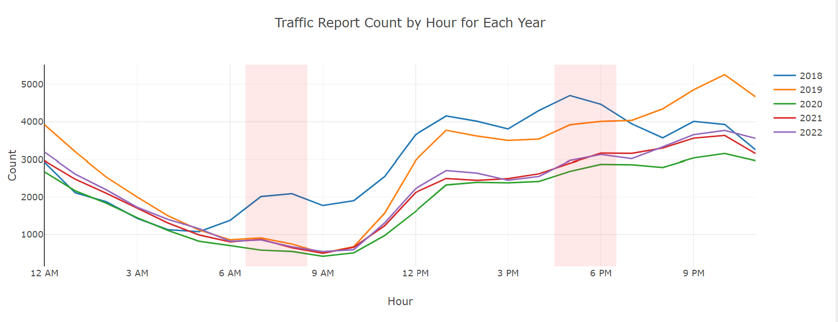
Incident Frequency Patterns
Significantly fewer incidents occur during the morning commute hours because people are more alert and less fatigued during that time
Accidents are gradually increasing after 10 AM
More frequent incidents occur during nighttime due to poor vision while driving, with drunk driving potentially contributing as well

Slide 4
Observations
Investigate the relationship between incident frequency and time of the day:
In 2022, there were 30% fewer accidents compared to 2018. The years 2020 and 2021 had fewer accidents due to the pandemic and lockdowns. The number of incidents in 2022 was lower than in 2018 and 2019.
Evening hours had fewer incidents, while afternoons saw a gradual increase.
Incidents in the evening and at night were somewhat similar. This trend stayed the same over the years. Fewer accidents happened during morning commutes because people were more alert. After 10 AM, accidents started increasing gradually.
More accidents occurred at night, likely because of poor visibility and possibly drunk driving. This shows that the time of day influences accident rates, highlighting the need for safety measures.

