Slide 1
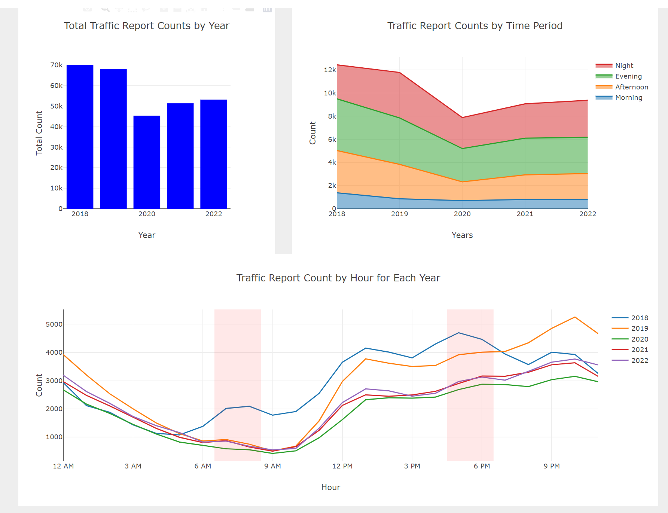
Investigate the relationship between incident frequency and time of the day

Slide 2
Both the plots are same, just the size is different

Slide 3
Observations
Investigate the relationship between incident frequency and time of the day:
The frequency of incidents is significantly lower during morning commute hours. In contrast, it tends to be higher during the evening rush hour. Moreover, incidents are significantly more frequent during nighttime
In a span of 5 years, incident frequencies show the following trends across time periods: low during evening, gradually increasing in the afternoon, further rising in the evening, and reaching their highest point at night.
Checking out a bar chart that shows the total incidents over 5 years, you can see that in 2020 and 2021, there were fewer accidents because of the pandemic

Slide 4
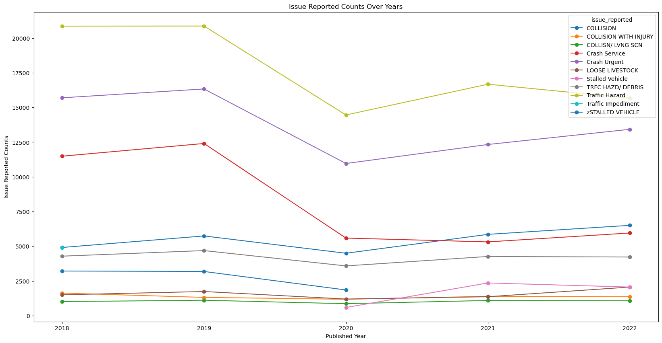
Evaluation of incident types over time
1.It's interesting to see that the main reason for reported issues is related to problems on the road, like pedestrians, stalled vehicles, debris in the roadway, and / or inoperative traffic signals.
2. During the years when COVID-19 was affecting us , all types of reported problems went down a lot, which makes sense because more people were working and studying from home, and places like schools and offices were closed.
3.After the COVID-19 situation got better, there's a noticeable increase in collisions. This could be because more people are moving to Austin, which is causing more traffic and accidents.

