Slide 1
LawnBuddy
Charles Patterson
Temple University

Slide 2
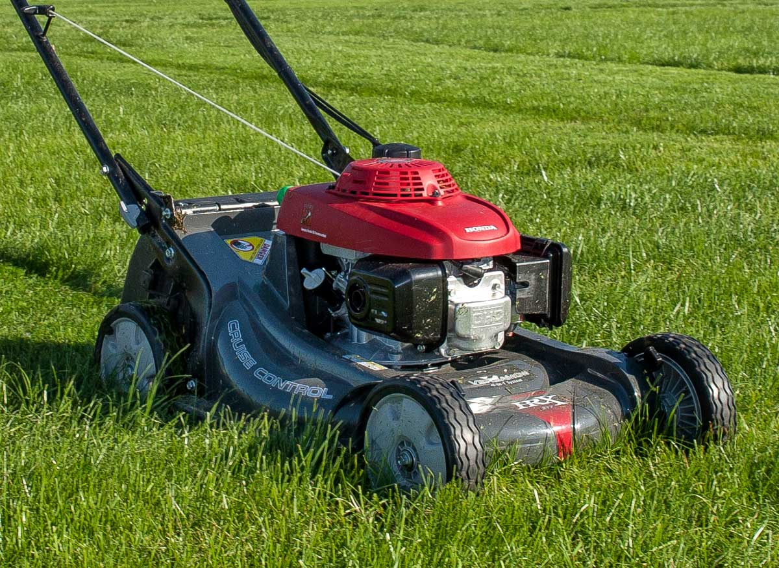
Lawn Care and Maintenance Issues
Customer
Not centralized
Not competitive
Quality Assurance
Price negotiation
Vendor
Poor outreach
Expensive marketing
Job locations

Slide 3

Solution: LawnBuddy
Centralized database
Customers
Upload
Specialize their needs
Find new vendors
Confirm the job
Review the job after completion
Vendors
Bid on lawn prices per square foot
Reach more customers
Eliminates the need for marketing
Increases market competition, benefitting customers greatly

Slide 4






Technologies

Slide 5
Development Process
Development Overview
Next Steps and Obstacles
Hours invested: ~45
Substantial reading
Testing
Design Pattern
State
UI upgrades
Database algorithms
Multiplicity of roles
Vendors can act like clients; vice-versa

Slide 6
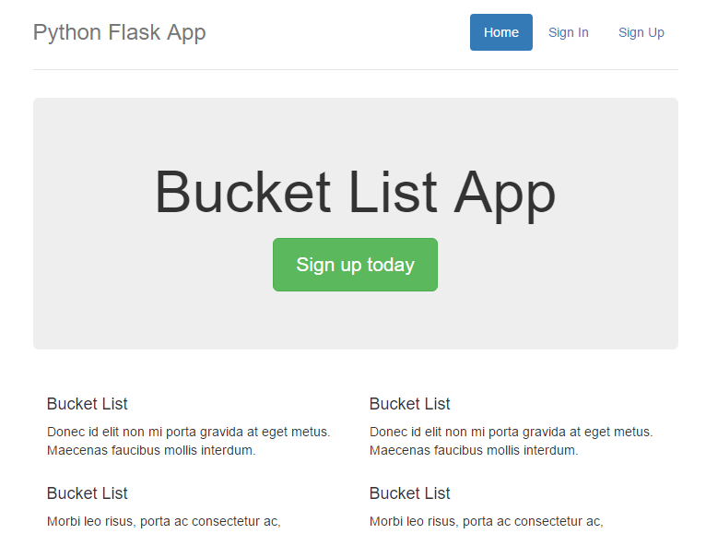

Slide 7
DEMO

