Slide 1
AI Superstream: MLOps
https://learning.oreilly.com/live-events/ai-superstream-mlops/0636920064958/0636920064957/

Slide 2
ML OPs
The foundational work needed to keep ML System updated, running and serving users
Data scientist works closely with the software engineer
Directed Acyclic Graphs to level up the deployments and containerization help to create great MLOPS
Interesting : Multiple Machine Models
Problems :
  Training Data may be out of Date then when you create the data
  look at different models
  Different tools to optimize the systems
At level 2 of the MLOPs Maturity and Experimentation
  Automated Training where you start saving time and you could start saving time.
Manual Process – No urgency around MLOps since there is no expectation to do – could be a prediction every every second and/or the data does not come in frequently
  May not get to prediction server , but only get to a dashboard and print out results
AI/ML products are expensive to build and business expect them to be around for a long time – Experimentation is the key to extending the lifetime of an AI/ML

Slide 3
ML OPs
Experimenting is driven by monitoring
  could be a technical decision
  could be a business decision
Very hard to improve performance
Model Drift –The model’s predictive power over time as result
  Happen to changes in environment/data
  Could happen slowly or quickly
  overdue on experimentation
Culture of continuous experimentation
  Become an advocate of experimentation
  Lead by Example As a leader make sure your team is prioritizing experiments as well
  Solicit improvement ideas from other Users/ Other Industries / etc...
  Empower with tools/skills/experimentation
  Set of small incremental improvements
  Celebrate success
  Experiment methodology should be simple and transparent

Slide 4
ML OPs
Common Pitfalls
  Deploying Production – Struggling with this step will stop experimentation from happening
  If in production and either random or model drift is continuously happening then you are focusing on fires
  Monitoring performing inconsistently can also affect experiments overall
Themes
  When experiments don’t work – make sure you set the right goals and focus on right objects increase success
    communicating that you are trying to improve and sometimes it does not work
  Don’t focus on the features start with the goal and then the features and experiment will run

Slide 5
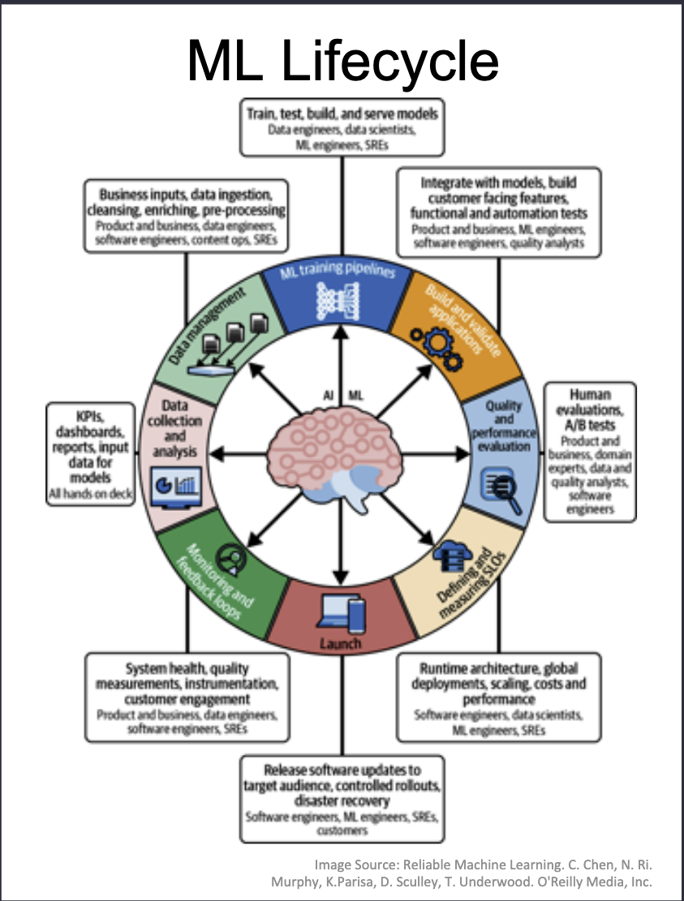
ML OPS

Slide 6
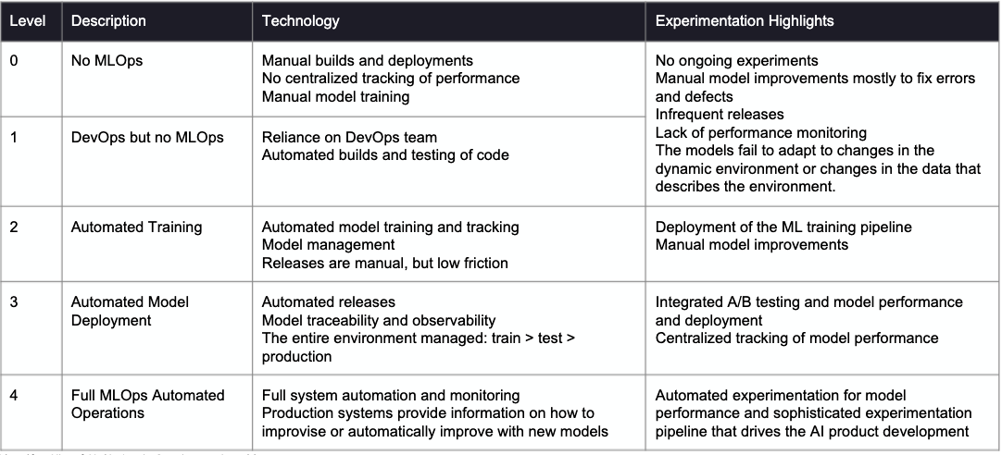
MLOps Maturity and Experimentation

Slide 7
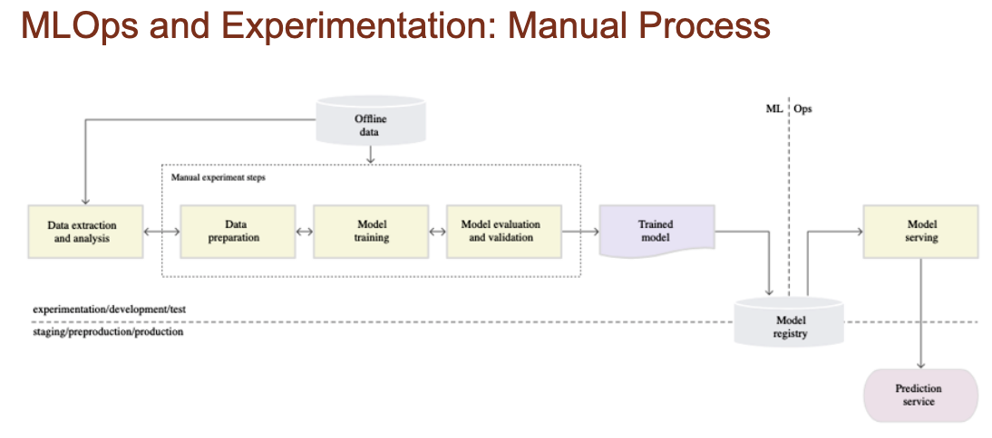
Experimentation and Manual Process

Slide 8
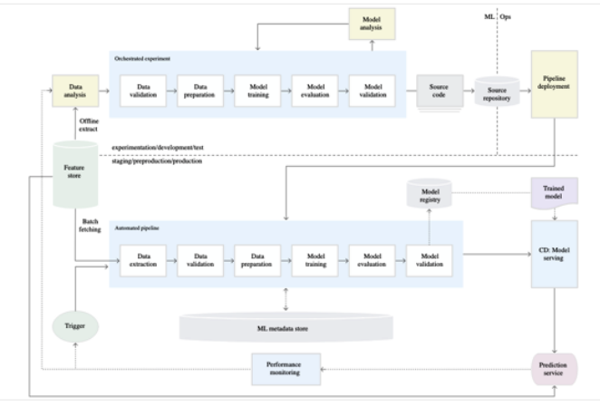
MLOps and Expermientation

Slide 9
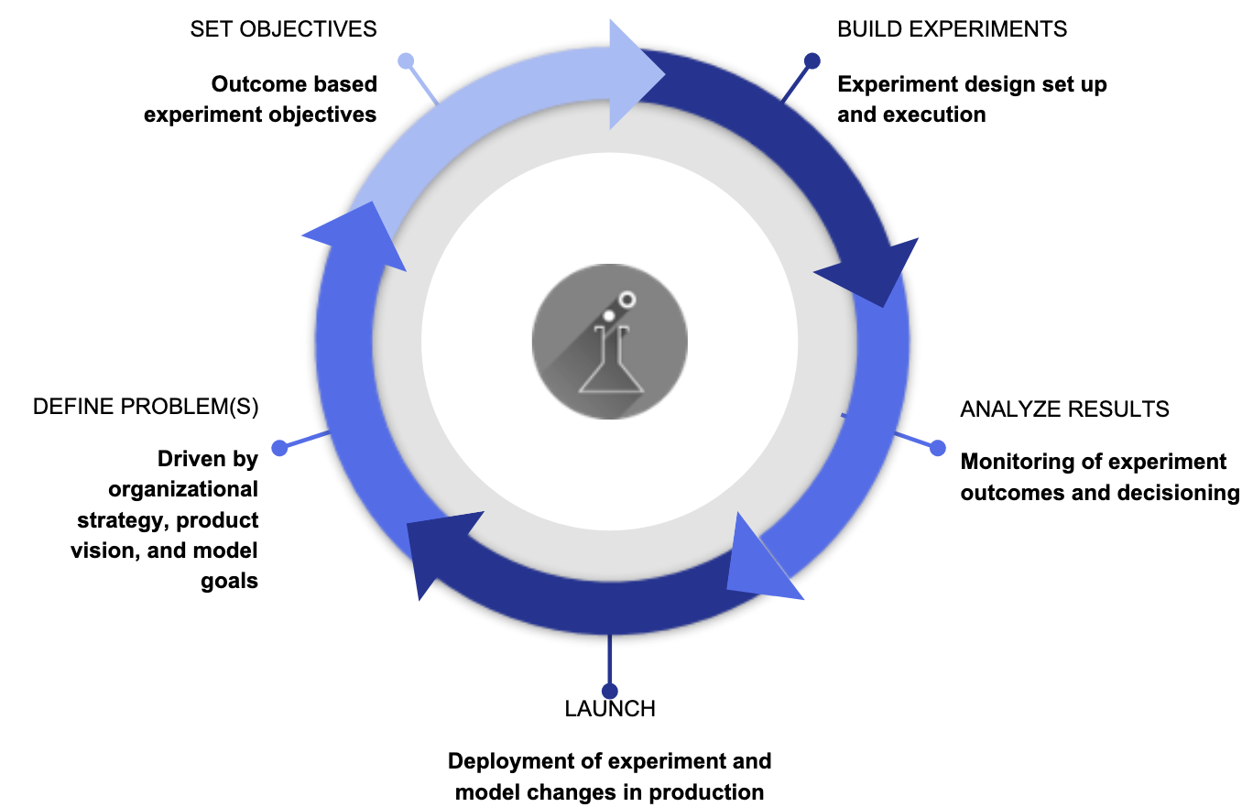
ML OPS and Experimentation

Slide 10
What can ML OPS Learn from SRE Mindset
Preemptive Risk Discovery
  If anything is not automated then there is risk.
  If there are quality control issues then there is lack of monitoring
  Tools to verify the code and data – Continuous Integration
  Academic Toolchain – Dangerous since the ecosystem is fragile ( experimentation ) where corporations are sturdy
Key problem of continuous integration verify the code is correct and the business logic is correct
Start with DevOps / Data Automation / Platform Automation / ML Ops
  ML Engineering – Platform automation / MLOps
  DevOps – Microservices / Containers
  Data – Reproducible Data
Rule of 25 – 25 DevOps / 25 Data / 25 Models / 25 Business – There are no silver bullet
  There will be trade offs
  Business – Clearly define the problem you are going to solve
Monitoring Data Science for Software Systems – Lot of different things you are measuring ( Data Drift, Model Accuracy , CPU, Disk IO, Latency ) make it easier to diagnose the root cause.

Slide 11
What can ML OPS Learn from SRE Mindset
Quality Control Systems
  Reproducibility – Codespaces – build a container image and have a configuration with the right plugins / environment and compute and storage
Access to GPU
  Machine Learning Codespaces
AI Coding Assistant
  Copilot – Better you get at understanding how the tool will respond to the question
Continuous Integration & Deploy
  Github Actions
Want the same environment that you are deploying in
  Can you have Codespaces, AWS Cloud 9, Google Cloud Shell and have a docker file that will go into production
  GPU on demand
  Pre-train Models
Adopt them all can dramatically change how you adopt results.

Slide 12
What can ML OPS Learn from SRE Mindset
Github Action continuous and Delivery
  replace install, test, deploy should be identical to production since you are using a docker file
  gitrepo triggers github actions that trigger the actions and the build a container which is immutable and identical to what you did locally
    Goes right into production
    Should make the workflow simple
  Data Science Tool chains
    Notebooks
      Not Designed for production , but for experimentation and reproducability
      Start with a notebook is a bad idea
      Be in the environment that you are working : presentation /
    God Tools
      Basically does everything. A way of building software that assumes you have a lot of computing power
      Want Computer systems that barely use anything
        Docker is opposite of a God Tools
    Voodoo Tools
      A tools that does not have reproducible or idompotance
Over optimize on one thing taking away something from something else

Slide 13
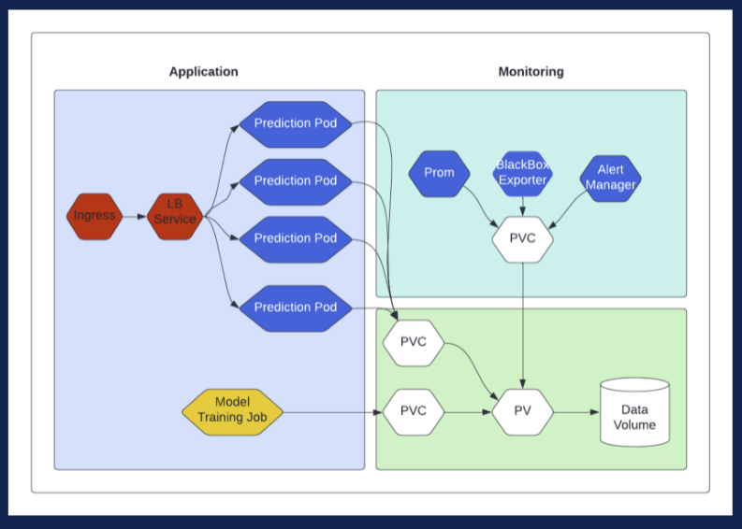
Deployments and Metrics of Machine Learning Models with Kubernetes and Prometheus
Ingress – Request coming from the world into the kubernetes cluster.
  Keeps the cluster safe from the outside world
  Has access to a load balanced set of pods which has 4 prediction pods
Prediction pods hold a docker container that contains the application
Model Train Jobs
  A scheduled or adhoc job
  Used for retraining a model
Monitoring Stack
  Alert Manger
  Black Box Exporter
  Graphical interface to show how the
  GUI ( ex . Graphania )
  Can start/restart pods
All code is written in GO

Slide 14
Deployments and Metrics of Machine Learning Models with Kubernetes and Prometheus
Namespaces – Can have a collection of pods
  kubectl create namespace application
    namespace/application created
  kubectl create namespace monitoring
    namespace/monitoring create
  kubectl get namespaces – Show all namespace with name, status, age
Configuring Volumes
  kubectl get stoarageclass hostpath
  Read/Write Once – Only one node ( all pods ) can access it at once
The model training Application – Load the Model Training Application
  var tree base.Classifier
  rand.See(44111342)
  var dataset = “date/iris_dataset.csv” // loaded from the persistent volume claim
  iris,err := base.ParseCSVToInstances(dataset, true) ; if err != nil { panic(err) }

Slide 15
Deployments and Metrics of Machine Learning Models with Kubernetes and Prometheus
  Once the training has happen – Model used by the prediction APIs when they start up.
    var modelFile =”/data/model.bin”
    fmt.Print(“Saving to %s\n”, modeFile)
    err = tree.Save(modFile); if err != nil { panic(err) }
Exercise : Create a classifier and wrap It up in docker and deploy on kubenetes
The Prediction Application – Use the model to make a prediction via an HTTP API
  Example
    func SetupHttpRequestHandlers() {
      handlers.LoadInstance()
      handlers.LoadClassifierModel()
      fmt.Print(“Starting Prediciton ApI Server on %s”,
      r := muxNewRouter()
      r.Use(prometheusMiddleware)
      r.Path(“predict”).HandlerFunc(handlers.MakePrediction).Method(“POST”) // Need json input
      srv :=&http.Server(Addr: host, Handler r)
      srv.ListenAndServer() }
    An Service that will make the prediction sent from the post – Run in the pod and the load balancer can address the running api pods and get a response
  Have 3 endpoints
    heartbeat to know the application is working
    metrics
    prediction endpiont

Slide 16

Deployments and Metrics of Machine Learning Models with Kubernetes and Prometheus
The code load in the the model then waits for api calls
  Take in the request and it is put into the model.
  The output prediction is returned
Metrics – What is being valiated
  HTTP Response time for request – Are there any issues with the environment
  Prediction success counter
  Prediction failure counter
Deployment
  replica count – How many pods are running
    rolling update (sibling of replicas ) – strategy Calls the training application which copies the new model into the docker container of the api
    The existing pods can be brought down and the new ones brought or they can be updtaed
  Argo CD – CI for kubernetes
Monitoring the System – Use help to install the Prometheus system.
  Prometheus – Black Box Exportor get metics for all four pods

Slide 17
Deployments and Metrics of Machine Learning Models with Kubernetes and Prometheus
scaling
  Rondavue – Design Pattern
    Use multiple models as they came on board and returns them back to the calling program

Slide 18
Consumable MLOps tools for a robust deployment
Differences between mlops and devops
  Deployer persona matters
    What are Data Science good at
      Understanding and cleaning the data
      Train and evaluate model
    What is mlops ask of a data scientist
      version model
      deploy model
      monitor model
    Software engineer works best for devops because of best practices in software engineering
      Software engineer → DevOps engineer
    Data Scientist live by a different set of rules
      Have to be a detective and think about fairness and evaluate data
      experimentation which is complete tension of deployment
      80% of the models don’t make it into production
      Areas not well defined is testing an fairness and interoperability of the model

Slide 19
Consumable MLOps tools for a robust deployment
What kind of tools should we be using
  reproducability – The older versions are still around
  Open source allows you to know the price. Usually it free
  Diversity of opinions
What Pieces do you to integrate
  Deployed model and cron job
  Components
    Where will your model reside – locally or on a cloud
      Docker can containerize a model and have a rest api point to access it.
    artifact management
      Experimenting Tracking – Track the whole experiment ex. hyperparamters, versions – Guild AI, ML Flow
      Data Versioning – Save the data each time you train your model. Dolt ( git for you data )
      Model Versioning – Mel Flow , Help give context to the model, Sharing the model with a team.
    Model Deployment – Take your model from your local environment to other infrastructure. Can rollback, api points Tools – Seldon, Vetiver,
    Orchestration – Scheduling Retraining , Rescheduling, Work of Directed Acyclic Graphs, coop flow, airflow
    Model Monitoring – Looking at the statistical methods performance – Jennifer, Selden look at at data drift, and explainability
Model Cards – Really a deliberate way to write it down. – Tools AI Fairness 360, fair learn

Slide 20
Site Reliability
Quality is how well the model performs
  Ons some specific function – Is it a reocmmendation, quality, text prediction
  for relevant slices – How do we measure it across different subsets of the data
  Over time – The world will change or people will change the model and it could fail.
Model quality is a reliability problem
  Correct end to end functioning of a complex systems
  Everything works.: Infrastructure, Statistics, Networking, System performs for the user
ML Reliability as quality measure and why is that a problem.
  Reliability Engineering – Make sure the infrastructure is reliable over time.
  Don’t have consistent, systematic, continuous quality
  Model quality metrics are not comparable across different models ( Fraud, recommendation )
  Correctness is affected by the model and infrastructure
  Who cares about SRE : Model Developers, SRE, Leaders ( ML is expensive and they need to know it is working consistency )
  Define model quality and measure it.

Slide 21
Site Reliability
What causes poor quality
  Most had a system cause
  Most common systems causes were distributed system causes
    Nothing to do with Machine Learning
    Some changed configuration A, but did not change configuration b
  Do the simple stuff
Product availability defined by quality
  Service level indicator – Quality is the only true end to end
  If model quality is bad and used to be good
    Change the model definition
    New trained model on new (broken) data
    Old trained model and world changed
If model quality is good then everything is working well enough
Build in reliability or redundancy
  Analyze the whole system to find structural weaknesses
  Measures failures and key system contributors to these failures
  Design automatic mitigations to make the system resilient to common problems

Slide 22
Site Reliability
Practical next steps
  Measure model quality continuously for relevant slices
  Measure data quality continuously Watch for data processing pipelines for changes in the distribution
    ex. stop Spanish processing – Notice geography is important
    joining, clean data may introduce issues.
  watch underlying systems – infrastructure
Site Reliability people meet the service level objectives.
Tools: Start ask model developers what are your quality metrics.

