Slide 1
Data Exploratory

Slide 2
Data Exploration
Exploratory Data Analysis – EDA
Most machine learning algorithms are not able to deal with missing values; hence, data needs to be converted into a clean version that is ready to be modeled
Data cleaning refers to the process of eliminating irrelevant or noisy values that can cause us to misunderstand the data.
Steps in Data Exploration
  Step: Data Cleaning includes several important phases such as
    removing outlier
    possibly deleting duplicates
    possible dropping outliers
    Getting rid of irrelevant data
    imputation – Procedure of using alternative values in place of missing data

Slide 3
Data Exploration
  Data Exploration
    Visualization and Statistics are the central point
    looking for relationships between different variables
    discover relationships between different variables
    discover data related problems
    Steps:
      Univariate Analysis
      Multivariate Analysis
  Feature Engineering
    Apply tools to gain insights
    Create/Remove Variables
  At then end if we detect data problem we should apply data cleaning again
  If we convert existing features or create new ones then we need to back to the data discovery phase to test where the new features are useful

Slide 4
Data Cleansing-1: Handling with Variable Type
After creating a dataframe
  head() – use to observe what the data looks like
  describe() – statistics on the data
  info()
Variable Types
  Numerical Variables can into Discrete and Continuous
    classification – discrete
    regression – continuous
  Qualitative data is obtained by dividing the data into non-numerical groups
    Gender can be converted into categorical data by
    Types
      Nominal No numeric value
      Ordinal Category Data that has a number
      Binary

Slide 5
Data Cleansing-1: Handling with Variable Type
Continuous Variables
  Infinite number of different values
  most common in real life dataset
  Examples: Speed, distance, weight, height, expenditure, salary
  Two Types
    Interval
      Has an uncertain starting point
      From this stating point the scale is divided into equal intervals with “no absolute 0”
      Show both order and difference
        Example temperature
          The different between 10 and 15 celcius is the same as 20 and 25
          No absolute zero point
          The absence of absolute 0 means that comparison is subject ot subjective interpretation
            20 is not twice as hot as 10
    Ratio --the quantitative relation between two amounts showing the number of times one value contains or is contained within the other.
      Have a starting point so the ratio as well as the difference can be calculated
      All arithmetic operations can be applied makes this scale stronger than other variables
      show order, distance and a meaningful absolute a zero variable
        Age of 0 is not yet born and a 20 years old is twice as a 10 year old

Slide 6
Data Cleansing-1: Handling with Variable Type
Discrete Variables
  Countable numbers between any two variables
  Always numeric
    Not every variables that is an integer is discrete
  example: Customer Complaints
Categorical Variables
  Take limited values and represented by categories or groups
  Not counts, but data that can be put into groups
  Three Types
    Nominal
      represent category or groups so we are not able to sort and rank values
      ex. country of origin
      ordered does not make sense, gender, species

Slide 7
Data Cleansing-1: Handling with Variable Type
    Ordinal Variables
      categories are listed sequentially
      used for obtaining opinions such as a survey study.
      Example
        Who wins a contest – 1st , 2nd , 3rd
          Does provide any information about the difference between the places
        Education Level
    Binary Variables
      special type of categorical variable – Takes two variables
      usually categorical in nature
      Examples – ( male, female ), ( yes, no)
    In order to get summary statistics based on categorical variable with a slight modification in the describe function – .describe(include=[‘0’]
      Can computer: Count, Unique, Top, Frequency of Top
Pandas
  Use .columns to see all the columns in dataset without scrolling
  house_df.nunique().head(20)
  Make use of a categorical variable in Machine Learning by converting to an integer

Slide 8
Changing the Variable Types
Might need to change a continuous variable or categorical variable into a discrete
  Continuous into discreet
    Sale price>USD200.000 is labeled as 1 or high
    USD200.000>Sale price<USD150.000 is labeled as 2 or medium
    Sale price<USD150.000 is labeled as 3 or low
    create function to encapsulate the three bullets above and then house_df['sale_discrete'] = house_df['SalePrice'].apply(discretization)
Changing the Variable Types

Slide 9
Data Cleaning 2: Handling with Missing Variables
Potential Reasons why we have missing values
  Duplicate entries for the same credential during data collection
  Errors happen during data entry process such as having inappropriate values in the data set
  Structural problems in data – Integer values stored as text
Three types of missing data
  Missing Completely at random – No pattern exist in the data
  Missing at Random – There exist a pattern in the missing data, but it has nothing to do with outcome
  Missing not at random – There exist a clear pattenr that affect the outcome
Not easy to find all missing data – Example Empty Strings
Pandas ways of finding missing data for isNull()
  .isnull()
  house_df.isnull().sum()*100/house_df.shape[0]
  (house_df.isnull().sum()*100/house_df.shape[0]).sort_values(ascending=False)[:20]
  indices=np.where(np.isnan(house_df.LotFrontage))[0].tolist()

Slide 10
Data Cleaning 2: Handling with Missing Variables
Handling Missing Data
  Ignoring row with missing values
    Delete the rows may mean losing information
      Each observation provides some information
    For larger sizes it is safer than smaller sizes
  Finding rows with proper values
    Most common method
    for Balanced Data the mean may be appropriate and inbalanced data the median
      based on distribution of the data
  Techniques
    Filling with 0
    Filling with randomly selected value
    Filling with central tendency measures, i.e., mean, median or mode
    Filling with interpolation
  Run predictive models that impute the missing data.
    Prediction results provide us important insights about the missing values and using this information,
      imputing missing values can be very effective and increase the accuracy.

Slide 11
Data Cleaning 2: Handling with Missing Variables
Once we decide to fill the missing value with one imputation technique it can only be applied to continuous values
Filling in a missing value for lot percentage
  house_df['LotFrontage'].isnull().sum() which produce 259
  house_df["LotFrontage_imputed"]=house_df["LotFrontage"].fillna(house_df["LotFrontage"].mean())
    What was the expense of using mean to get rid of the values –
    Run the describe before and after to get the summary statistics
Filling in the GarageYrBlt_imputed
  house_df["GarageYrBlt_imputed"]=house_df["GarageYrBlt"].fillna(house_df["GarageYrBlt"].mean())
  Here they varied widely
  May want to try interpolation
    Average of the before and after the missing values
      meaningful sequence of observations and a trend in the order data
      useful for time series analysis
        unsorted data may erroneous
    house_df.LotFrontage.interpolate(method ='linear', limit_direction ='forward')

Slide 12
Data Cleaning 2: Handling with Missing Variables
Can use two strategies
  Create a new category for missing values such or other or unknown
  Substitute a suitable category
    ex. use most common category
Useful Pandas Tools
  house_df.GarageType.value_counts()
  house_df.GarageType.isnull().sum()

Slide 13
Detecting and Dealing with Outliers
Outlier – Deviates so much frm the other observations as to arouse suspicions that it was generated by a different mechanism
Likely application areas
  Fraud detection,
  Medical diagnosis,
  Severe weather prediction,
  Fault and Damage Detection
  Intrusion Detection Systems
Reasons outliers emerge
  Human Error
  Fraudulen activity
  Data Generating Process
  Natural Deviation s in population.

Slide 14
Detecting and Dealing with Outliers
Sometimes we might want to get rid of them and sometimes they might be the central focus of our analysis
Why outliers can be seen as bad
  Distort the characteristics
    Example Mean
  Some machine learning models are sensitive to extreme values
Why outlier can be seen as good
  Anomaly detection – Outliers are searched for here
  Weather prediction – Early warning of severe weather
Store information about the abnormal dynamics of the data which in turn that affect the process
Should know the characteristics of the data and the requirement of the model to make a decision about dealing with the outliers

Slide 15
Detecting and Dealing with Outliers
Histograms
  provide the occurrence of observations
  which observations show up more or less ( shows the distribution of the data )
    The outliers show up on the far left and the far right.
On a Matplotlib the is a Box-Whisker Plot if the quartiles is 25, 75 * 1.5 then it is an outlier
  plt.boxplot(house_df['SalePrice'],whis=0.75)
  plt.title("House Price with whisker of 0.75")
Z-score
  A scaling technique by which we have a dataset with the mean 0 and standard deviation of 1
  converts data considered to be normally distributed into the standard normal distribution
    If the data does is not normally distributed
  Then you can measure how far it is from the mean.
  The bigger the z score the farther away from the mean
  The scaled values indicate how many standard deviations the data is away from the mean

Slide 16
Detecting and Dealing with Outliers
from scipy.stats import z-score
zscores = zscore(house_df["SalePrice"])
for num.py we can also have np.where
Ex. if zscore = 1 then it means we are looking for outliers > 1 standard deviation
Before using z-score the variable should be free of missing variables
tukey
  Also know as t6he IQR Method
    75% Quartile * 1.5
    q75, q25 = np.percentile(house_df['SalePrice'].dropna(),[75 ,25])
    IQR = q75 - q25
  The bottomline: The more the threshold value, the lower the number of outliers. Again, it is completely judgmental process to decide the threshold value. It is between you and data

Slide 17
Fixing the Outliers
Fixing the Outliers
  Excluding outliers from the dataset
    Easiest Way, but lose data from the dataset
    Outliers arising from measurement error or a problem in the data collection process, we must remove them.
      If subtracting outliers does not make any significant changes in later stages, we can remove them.
      However, in order to make sure, we must perform our analysis both with and without outliers.
  Classifying outliers
    limit outliers the effect on our analysis would be limited
    common way is using winsorizatin
      Can be one way or two way
        One way either limit the lowest or highest distribution
        adjust the values of extreme points to a percentage
    winsorize a variable using scipy's .winsorize() which implements two side winsorization
      At least two parameter one for the lowest percentage and the other for the highest percentage
        To make it a one way set one of the percentages to 0
    winsorizing= winsorize(np.array(house_df['SalePrice'].dropna()), (0.10, 0.10)) ; winsorizing
    is the transformation of statistics by limiting extreme values in the statistical data to reduce the effect of possibly spurious outliers

Slide 18
Fixing the Outliers
The biggest drawback of the winsorizing is to lose information because we somehow manipulate the sale price variable
  Use the describe
Pay attention to the central tendency measure of the winsorized data and raw data, this is quite different. So, it is up to you to decide if it is a big deal in your analysis. If not, feel free to apply winsorizing.
The scaling helps us not only in dealing with the outliers,
  detecting abnormal or near-normal distributions.

Slide 19
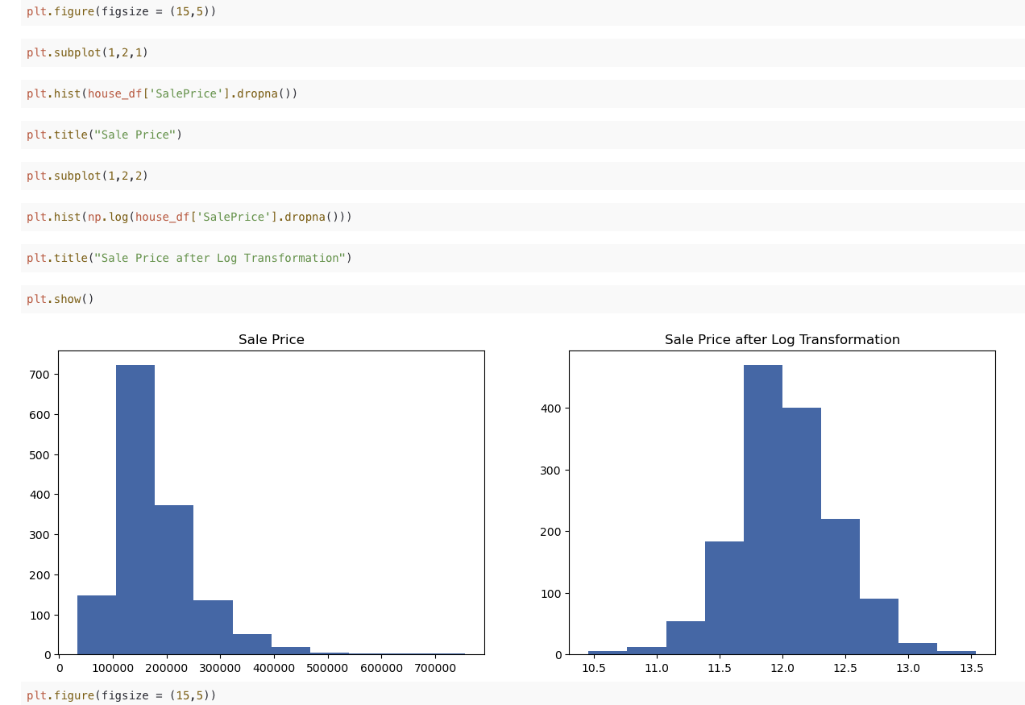
Transforming the outliers
Transforming the outliers
  The scaling helps to not only deal with the outliers,
  but detecting abnormal or near normal distributions
  Usually apply monotonic transformations which do
  not change the relative order
  Log Transformation and Sqrt are the most use
  Narrows the range of values so that the impact of outliers on the
  entire data decreases

Slide 20
Univariate Analysis
Data Exploration includes
  Examining the properties of the variables
  Discovering relationships between variables
  Exploring useful features that can help us explain our target variables
  Checking if our assumptions are in the data.
Data Exploration is the process where we apply statistics and visualization techniques to uncover hidden information in data
  Along the way we discover use features and ask the right questions
Question we are trying to address are:
  How many variables do we have?
  How many observations we have in the dataset?
  What are the types of the variables?
  Is there any missing data or outlier?
  Which type of distribution the variable has?
  What is the descriptive statistics of the variable?

Slide 21
Univariate Analysis
Checking mean, standard deviation, minimum, and maximum value give us an initial idea about the characteristics of the variable.

Slide 22
Visualization with Univariate Data
Univariate – visualization of continuous variables
  Can accomplish several different tasks
    checking and verifying distribution
    detecting outliers
    identifying patterns
  histogram is the tool that data scientists use to understand the distribution
  normal distribution because many models and statistical tests assume the data to be normally distributed
  Example
    plt.figure(figsize=(18,15))
    plt.subplot(3, 3, 1)
    plt.hist(house_df["SalePrice"])
    plt.title("Histogram of Sale Price")
2. Univariate visualization of categorical variables
  example
    plt.figure(figsize=(10,6))
    sns.countplot(x="Neighborhood", data=house_df,order = house_df['Neighborhood'].value_counts().index)
    plt.xticks(rotation=90)
    plt.show()

Slide 23
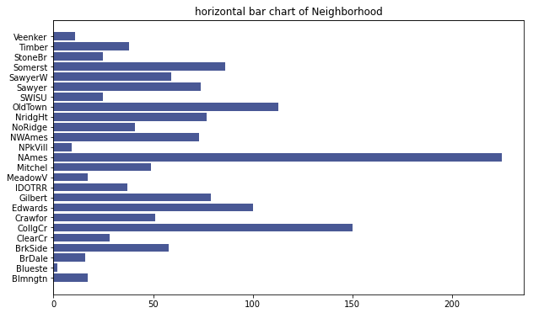
Visualization with Univariate Data
Another way of doing the same thing
  plt.figure(figsize=(10,6))
  plt.barh(house_df.groupby("Neighborhood")["Neighborhood"].count().index,
  house_df.groupby("Neighborhood")["Neighborhood"].count())
  plt.title("horizontal bar chart of Neighborhood")
  plt.show()
The graph on the right shows the different number of observations per category
  Treat with caution in classification problem – imbalance data
  A classification data set with skewed class proportions

Slide 24
Multivariate Analysis
bivariate case – Studying two variables at a time
  In this example we will study the following
    continuous-continuous,
    continuous-categorical,
    categorical-categorical.
Tools that can be used are
  Scatter plot
  Correlation matrix and heatmap
  groupby() function
  barplot
  t-test
  cross tabulate
  Implot
  Categorical Plot
Examining two variables at a time reveal important information about interaction
  observations show positive slope, indicating that these two variables are positively correlated
  One of the most informative ways to look at the relationship between two continuous variables is to draw scatter plot
There is another type of outlier value that can be referred to as a two-dimensional outlier value that represents unusual combinations of values

Slide 25

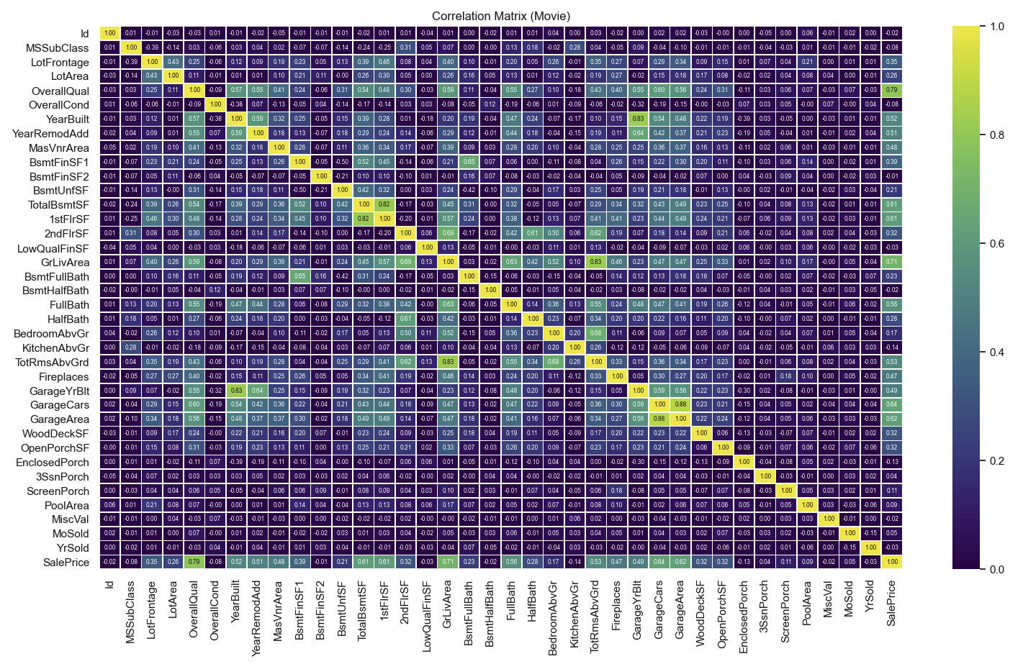
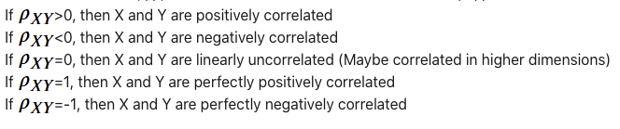
Multivariate Analysis – Correlation
two common ways to run a correlation analysis, which are correlation matrix (pandas) and heatmap (seaborn).
The correlation coefficient (r) is a numerical representation of the linear relationship between two continuous variables
Correlation can be thought of as a normalized version of covariance
  measures both strength and direction of the linear relationship between two random variables.
sns.heatmap(corr_house, annot=True, fmt='.2f', annot_kws={"size": 6}, linewidths=.5, vmin=0, vmax=1, cmap='viridis')
Not easy to detect high correlation bgy looking at a correlation table including many variables like ours
  Use stack that helps us to pivot a level of the custom tables returning a Data Frame
  corr_house=corr_house.corr().stack().reset_index()
  corr_house.columns = ['Variable-1','Variable-1','Correlation']
  corr_house.sort_values(by='Correlation')

Slide 26
Multivariate Analysis – Bivariate Analysis of the Continuous and Categorical Variables
In analyzing continuous and categorical variables pair, we usually look at some statistics of the continuous variable for each value of the categorical value
  Observing different values between categories implies that categorical variable has some important information about the continuous variable.
  .groupby – Checking a single statistic at a time may not be a best option.
  To check all the values at a time use house_df.groupby("Neighborhood")['SalePrice'].describe()
Can use boxes, bars or any other kind of char to viualize the difference between the continuous variable and the categorical variable
Example
  plt.figure(figsize=(12,5))
  plt.subplot(1,2,1)
  sns.barplot(house_df["Utilities"], house_df["SalePrice"])
  plt.title("Average Sale Price")
  ​plt.subplot(1,2,2)
  sns.barplot(house_df["Utilities"], house_df["LotArea"])
  plt.title("Average Area")
  ​plt.show()

Slide 27

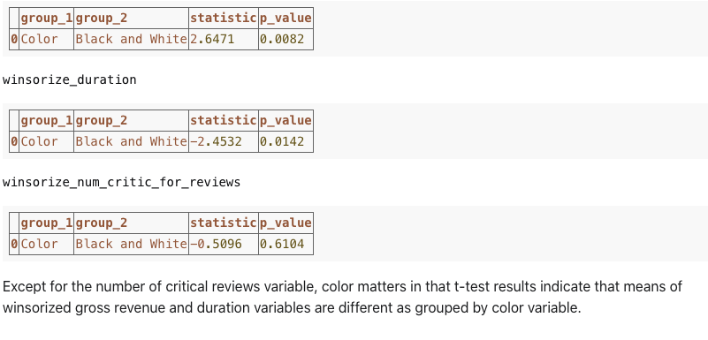
Multivariate Analysis – Bivariate Analysis of the Continuous and Categorical Variables
statistical way to check if there is a change in a variable depending on a change in another variable
  called the T-Test
  We can use this test to potentially falsify our null hypothesis. When that happens, it is said that we “reject the null.” This indicates that means of samples are different.
  Question: Is the population of number of customers higher with campaigns on average than without it?
movies = movie["color"].unique() ; grup_movie = movie.groupby("color")
pd.options.display.float_format = '{:.4f}'.format
for var in ["winsorize_gross", "winsorize_duration", "winsorize_num_critic_for_reviews"]:
comparison = pd.DataFrame(columns=['group_1', 'group_2','statistic', 'p_value'])
print("{}".format(var),end='')
for i in range(0, len(movies)): for j in range(i+1, len(movies)): ttest = stats.ttest_ind(movie[movie["color"]==movies[i]][var],
  movie[movie["color"]==movies[j]][var]) group_1 = movies[i] ; group_2 = movies[j] statistic = ttest[0] p_value = ttest[1]
comparison = comparison.append({"group_1" : group_1 , "group_2" : group_2 , "statistic": statistic , "p_value" : p_value}, ignore_index=True)
display(comparison)

Slide 28
Multivariate Analysis – Bivariate Analysis of the Continuous and Categorical Variables
A side note about a target variable
  A variable that we try to understand and explain – the center of discovery analysis
  For the house dataset it is house price
    understand if there is some information in our dataset to help use estimate the behavior of the sales price
    bivariate analysis, we can look at the correlation coefficients of the sale price variable with other fixed variables to understand how other variables are related to our target
    As we'll see in the next lesson, one of the important things in a data science project is to feed our models with as few variables as possible, by losing as little information as possible

Slide 29
Feature Selection – Transforming Features
Feature Selection
  Converting existing variables (Log transformation, scaling and so on)
  Imputation
  Creating new variables
  Choosing features
Reasons to transform variables
  Machine learning models can only work with numerical variables.
    categorical variables with text values should be converted to numerical values if possible.
  Some machine learning models only require us to use normally distributed target variables.
  Some machine learning models are very sensitive to the magnitude of the values.
    So, we may need to limit the values of the variables within a range – `normalizing` our variables.
  We may want to convert variables into a different unit of measure
    to help us understand our intuition and understand the data.
Feature engineering is the process of selecting or changing existing variables and creating new variables to be used in our models

Slide 30
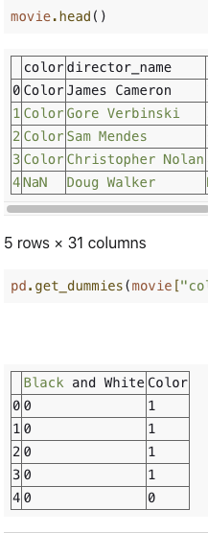
Working with Categorical Variables
Convert categorical to numerical – one hot encoding
  pandas get_dummies
  Returns one dummy variable for each category
  Example
    To the right show how get_dummies works
    Returns one dummy variable for each category
  drop_first parameter of the .get_dummies() method to True
    Otherwise you face the dummy trp
  movie= pd.concat([movie, pd.get_dummies(movie["color"])], axis=1)

Slide 31
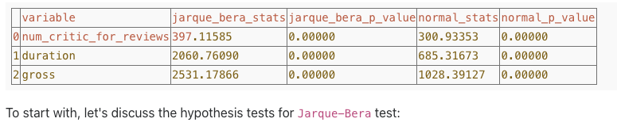
Working with non-normal variable
Transform into distributed – square root, inverse, log of the variable
  Not an easy task even with the tools
However, applying transformations like log transforms may not only helps us to get rid of outliers, but also changes the distribution of the variables to which they are applied.
how that there are normally distributed? The answer is: Formal statistical test. Two of the most well-know statistical tests are Jarque-Bera and Normal Test
Example
  from scipy.stats import jarque_bera
  from scipy.stats import normaltest​
  pd.options.display.float_format = '{:.5f}'.format
  ​variables = ['num_critic_for_reviews', 'duration' , 'gross']
  distribution_tests = pd.DataFrame(columns=['variable', 'jarque_bera_stats', 'jarque_bera_p_value', 'normal_stats', 'normal_p_value'])
  ​for variable in variables:
  jb_stats = jarque_bera(np.log(movie[variable]))
  norm_stats = normaltest(np.log(movie[variable]))
  distribution_tests = distribution_tests.append({"variable": variable, "jarque_bera_stats" : jb_stats[0] , "jarque_bera_p_value" : jb_stats[1] , "normal_stats": norm_stats[0] ,
  "normal_p_value" : norm_stats[1] }, ignore_index=True)
  distribution_tests

Slide 32
Feature Selection – Normalization and Standardization
Some statistical techniques (such as PCA, which we will see in the next lesson) and machine learning models assume that all the properties have the same range of values (for instance, all features have a minimum of 0 and a maximum of 1) or show regular statistical properties.
2 Solutions
  Normalization is the rescaling of a variable to the range [0,1] (including 0 and 1). For this purpose, we will use the .normalize () method from the preprocessing module of the SKLearn library.
  Standardization is the rescaling of a variable with an average of 0 and a standard deviation of 1. Note that we do not apply the maximum value for the variable in standardization. To implement standardization, we will use the .scale () method from the 'preprocessing module of the SKLearn library.
from sklearn.preprocessing import normalize
  movie["norm_winsorize_gross"] = normalize(np.array(movie["winsorize_gross"]).reshape(1,-1)).reshape(-1,1)
from sklearn.preprocessing import scale
  ​movie["scaled_winsorize_num_critic_for_reviews"] = scale(movie["winsorize_num_critic_for_reviews"])

Slide 33
Feature Selection – Normalization and Standardization
4. 1.4. Facilitating the Understanding of Variables
  It is common practice to transform variables to easily understand and interpret them
    The variable is feet, but others are years then transform
  Time series – convert to different time such as quarterly, weekly
  Recode a variable that fits the terminology of a research question

Slide 34
Feature Selection : Creating new features
Creating new features
  Combining two or more highly correlated variables
    Many models assume that the features are correlated with the target variable (or result) but not correlated with each other.
  To create a new feature, two highly correlated variables can be averaged or one can be subtracted. Three or more highly correlated variables can also be combined using a statistical method called "Principal Components Analysis / PCA"
  Interactions of variables
    that the relationship between target variable and feature depends on the value of an another feature, you may want to create a feature that represents the interaction
    , we can multiply our is_married indicator with the sadness feature while creating the interaction
  Many models assume that the relationship between a feature and a target variable is linear. Sometimes, though, you may want to include a nonlinear variable in relation to the result.
    o capture the nonlinear shape when the model is good, it may be helpful to create square or higher level feature by squaring a feature, cube it, or multiplying it by another.

Slide 35
Feature Selection – The curse of dimensionality
Curse of dimensionality
  As the data size increases, samples become too dispersed in space.
    he density of the points or the distance between them is very important for many problems
    As the data population grows the density and distnace information becomes meaningless
  By increasing the dimensions the search space is increased
  If we have 20 features we say the size of our data is 20, but event with two different values we have 2^20 combinations
Three serious problems
  Time required for processing data can increase exponentially
  development of the model takes time to develop[
  Makes it harder and sometime impossible to visualize data

Slide 36
Feature Selection
When choosing a feature,
  we want to preserve those features that have the highest correlation to the result,
  prioritize features that bring something unique to the table
Goals
  Create a set of features that are easy to understand, predictably powerful and minimize overfitting
Filtering Methods
  Give each feature a score which can help determine if the value should be retained
  Filtering
    Variance threshold for each feature with variances above a limit are held
    The correlation of each feature with the result
    Good for selecting for features that are likely to be related to the target variable
      Easy to calculate and are perfectly clear
      but generate list of extra features since inter-feature relationships are not considered
    Can be used during the data preprocessing state before the algorithm is started

Slide 37
Feature Selection
Wrapper methods
  select sets of features
  Different sets are created and evaluated in terms of predictive power of the model
  Forward Passes
    algorithm begins with no feature and adds features 1-by-1, always adding the feature that results in the highest increase in predictive power and stopping at some predetermined threshold
  backward passes
    the algorithm begins with all features and drops features 1-by-1, always dropping the feature with the least predictive power and stopping at some predetermined threshold.
  Forward and backward pass methods are considered "greedy" because once a feature is added (forward) or removed (backward) it's never again evaluated for the model.
  Wrapper methods are good at selecting useful sets of features that effectively predict the outcome. For larger sets of features, however, wrapper methods can be computationally intensive.

Slide 38
Feature Selection
Embedded methods
  select sets of features, but do so as an intrinsic part of the fitting method for the particular type of model you're using
  This may involve regularization, where a "complexity penalty" is added to the fitness measures typically used to assess the predictive power of a mode
  Embedded methods provide the benefits of wrapper methods but are less computationally intensive
  Different types of models will use different embedded methods
Dimensionality reduction methods
  useful when we have a lot of features, and applying the techniques we mentioned above might be computationally very expensive
  Principal Component Analysis
Principal Components Analysis
  PCA is a complexity-reduction technique that tries to reduce a set of variables down to a smaller set of components that represent most of the information in the variables.
  At a conceptual level, PCA works by identifying sets of variables that share variance and then creating a component to represent that variance.
  Losing variance in exchange for a smaller set of features can be worthwhile
  Some model types (such as regression) assume that features will be uncorrelated with each other, and high levels of interfeature correlation create unstable solution
    Solutions with fewer features are easier to understand and are more computationally efficient. Solutions with fewer features are also less vulnerable to overfitting.

Slide 39
Feature Selection
  . PCA also works best when the variables involved range from weak to moderately strong correlations. Correlations of 0, or correlations greater than .7 or .8, create problems.
    Correlations near 0 mean there is no shared information
    Correlations that are too high can result in components that are unstable
      change a lot in response to very small changes in the data or components made up of variance from only 1 or 2 variables
    A few very high or very low correlations are fine. It is when we have a variable with mostly very high or very low correlations with other variables that problems can occur.
  used for the purpose of destroying the addiction structure and reducing the size.
    . It is a multivariate statistical method that enables recognition, classification, size reduction and interpretation.
  tries to find the strongest pattern in the data
  Often the variety of data can be captured with a small size set selected from the entire size suite
  Since the noise in the data is weaker than the patterns, these noises can be removed as a result of size reduction
  The purpose of PCA is three-fold:
    Dimension reduction
    Prediction
    Visualization

Slide 40
Feature Selection
  The p dimensional space created from the principal components has three features
    They are not correlated.
    The first main component is the variable that most explains the total variability.
    The next major component was the variable that most closely describes the remaining variability
  Rotation – Ask what it is
    In summary, in PCA, we seek the appropriate coordinate system as follows:
    The direction in the largest change of data is selected as the 1^st axis
    The direction that is perpendicular to the previous 1^st axis and the largest change in the data is selected as the 2^ND axis,
    The direction that is perpendicular to the previous 1^st and 2^ND axis and the largest change in the remaining data is selected as the 3^rd axis, t
    As such, the new axis is always the direction with the largest remaining change
  PCA is a very useful method in dimension reduction.
  PCA represents multidimensional data approximately and with less dimensional data.
  PCA finds perpendicular-greatest-variance-directions for the original data and displays the original data in this coordinate system.
  PCA can be used for visual display and analysis of multidimensional data.
  PCA, as machine learning, can reduce the size of data - slightly varying PCA features can be insignificant for modeling, thereby speeding up modeling-related computing.
  PCA can also be used for data compression.

Slide 41
Feature Selection
  Components
    data is projected into a lower dimension, say three, from a higher space,
      the three dimensions are nothing but the three Principal Components that captures most of the variance of your data. Variance here represents the information.
    Components are eigenvectors divided by square root of eigenvalues
      standardizes the components so that the amount of variance in each variable explained by a component can be compared between the components.
      dimension reduction purposes, components replace factor variables because all components of a particular solution together represent the entire shared variance of the variables.
    The benefit of PCA is that there are fewer components than variables, thus simplifying the data space.
      After PCA, we can use components exactly in any analysis as we use the variables.
    components are no longer features but a combination of them.
Why do we standardize components
  The principal components are supplied with normalized version of original predictors
    original predictors may have different scales
    StandardScaler, each feature of your data should be normally distributed such that it will scale the distribution to a mean of zero and a standard deviation of one.
    Performing PCA on un-normalized variables will lead to insanely large loadings for variables with high variance. In turn, this will lead to dependence of a principal component on the variable with high variance. This is undesirable.

Slide 42
Feature Selection
Feature Selection
  There are a few rules that guide us in choosing the number of components to hide.
  keep components whose eigenvalues greater than 1 add value (because they contain more information than a single variable)
  visualize eigenvalues by linking them with a line from the highest to the lowest in order. This is called the scree plot.
    After visual inspection, the analyst keep all components whose eigenvalues fall to the point where the slope of the line changes most strongly.A
    you can keep the components up to a point at which line gets flatter (also called "elbow").
  general rule of thumb, once the components can account for 80% of the total variance
  As PCA work with numerical variables,
    namely continuous and discrete. It does not necessarily mean that it performs well with discrete variables.
    So, PCA is designed for continuous variables.
      X=StandardScaler().fit_transform(movie_df)
      pca=PCA(n_components=16)
      exp_var=pca.explained_variance_ratio_
      cumsum_var=np.cumsum(np.round(pca.explained_variance_ratio_,decimals=4)*100)

