Slide 1
MagniMind Machine Learning

Slide 2
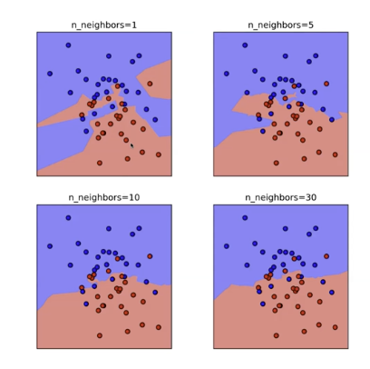
Slides – Overfitting
SciLearn
  Most machine learning algorithms have score, fit, predict, score
Nearest Neighbors
  use odd number for k-neightbors so you never have a tie.
Overfitting
  To complex of a model
  Number of dimensions is the number of features
  Look at the images to the right
    n = 1 – There are no training points that are wrong region
    n = 5 – some appear to be in the wrong region, accuracy has decreased
      Overfitting has been reduced.
      Am I underfitting
    n = 3 – Might be specialized enough, but we don’t know
    n = 30 – As the neighbors increase the border goes from irregular to smoother
  Some of the points could be outliers.
  As the number of neighbors for a point determination increases one color will dominate the board
  If you model reports a high accuracy on your training dataset then – strong indication of overfitting.

Slide 3
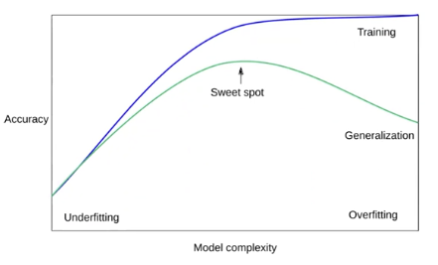
Underfitting
Using to simple of a model
Train you model and it fits perfectly to the training data
  The model is not general enough it is to specialized
Underfitting
  Data Model is unable to capture the relationship between the input and output
  variables accurately generating high error rate on both training and unseen data.
Options for reduce overfitting
  Collect more training data which can be divided into bigger training/data set
    Statistics – Law of large number the mean of the sample size gets closer to the population mean
    Training set is you sample from the population. Create a model that will work on the population
    With a bigger dataset you can worry less about overfitting
  Model Complexity – As model become more complex overfitting is a possibility
    Reduce the complexity of the model
    Use another Machine Learning Algorithm --Decrease the number of features.
      Add more variables then reduce error
      Spent a lot of time to determine the features so the model is general, but does not overfit
  Cross Validation since you are working only one the training set
  add and remove data from the dataset
Model Complexity – Make it fit the data better

Slide 4
Train Validate Test
When you are doing a training/test work the training model will become the test data
  Test Dataset – Representing the data that we want to predict.
  Called information Leakage
  The model is becoming specialized on both the test/training
  Fix – Create a validation set by using part of the training data
    The Test set will only be used when the model is ready for production
      Will be used multiple times, but not as much as if you only the training/test datasets
    Since it was part of the training set that is ok
Add Remove Some data from the training set
  will the model change completely
    Decision Tree models are known for this.
  If the points make a huge difference then the data is overfitted

Slide 5
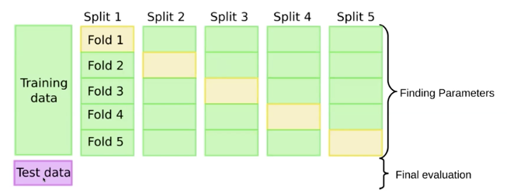
Cross Validation
Combine the Test Data into different folds and for each Split ( iteration) use a
different fold as the validation data
  If happy with results then run the final evaluation
Overfitting – If the standard deviation across these split is high for all splits
Cross validation is using the same model . but returns the scores.
In general use either 5 or 10 folds usually
cross_validation does help overcome overfitting

Slide 6
Example
Example
  from sklearn.datasets import load_breast_cancer
  from sklearn.model_selection import train_test_split
  from sklearn.neighbors import KneighborsClassifier
  from sklearn.preprocessing import scale
  cancer = load_breast_cancer
  cancer.keys()
  X = cancer.data
  y = cancer.target
  X = scale(X) – // For each column scale() does the Z-Score
  X_trainval, X_test, y_trainval, y_test = train_test_split(X,y, stratify=y) y is the dependent variable
    stratify – Make sure that each training dataset and testing sets has some of all the values
      Good for inbalanced dastasets
      Have equal rations of all results.
  np.unique(y, return_counts=True)

Slide 7
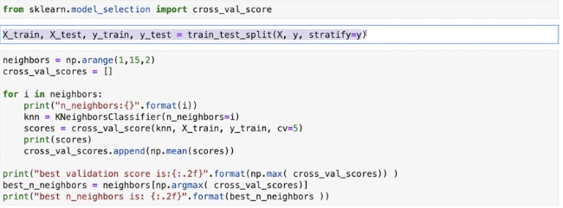
Example
Ex Cont
  knn1 = KneighborsClasssifier(n_neighbors=5)
  knn2 = KneighborsClassifier(n_neighbors=5)
  knn1.fit(X_train,y_train)
  knn1.score(X_val, y_val)
  For Knn1, knn2
    Overfitting if you see 1.0
    There were two values 7 percent and 2 percent
      If the difference is more than 5% than I would be worried about overfitting my test score and training score
      if score is decreased and test score is increase good heuristic for overfitting
Use a methodology there could be a better answer, since you are using the test dataset to make a decision
  Tomorrow you gut instinct will not be giving you a better result
For cross validation only get validation scores
Number of parameters increasing processing time. – Using cross values there are 14 parameters being trained 5 times.

Slide 8
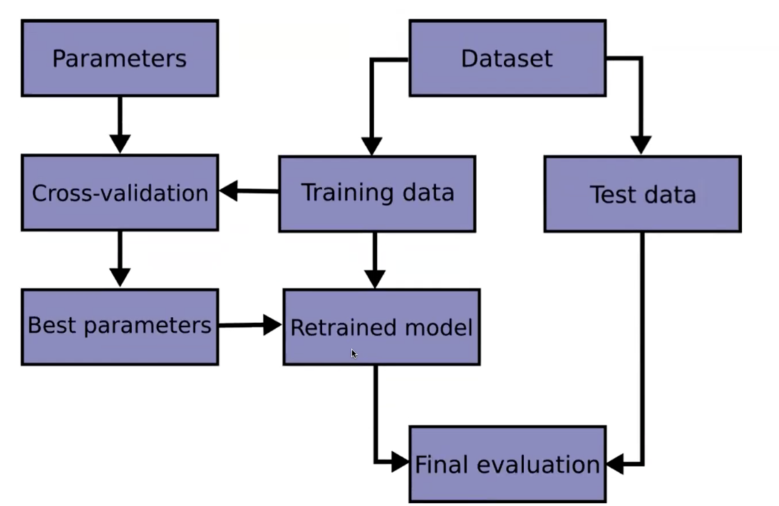
Workflow

Slide 9
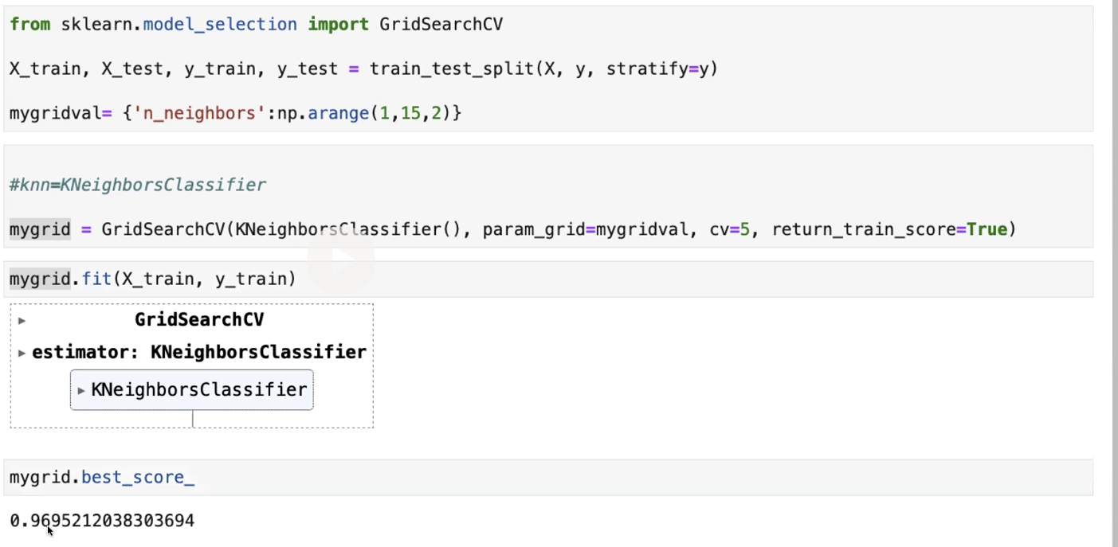
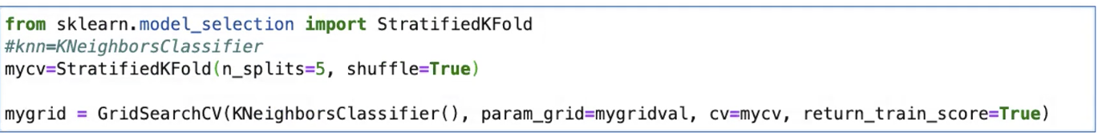
GridSearch CV
example
mygrid.best_params_
  Show a key n_neighbors with
  result = 3
  Stratificationfold – Takes class
  information into account to avoid
  building folds with inbalanced class
  distributions for binary or
  multiclass classification tasks
How you split the data will make a
difference
  percentage
  shuffle = true
  set the seed
Cross Stratification

Slide 10
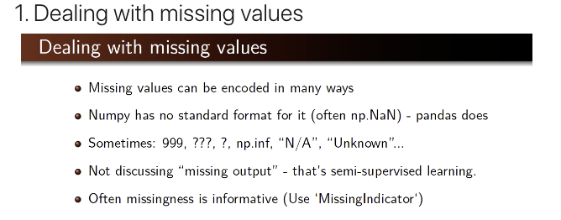
Preprocessing
Missing Values
  Encode in a number of ways
    If a feature was missing, while we're going to do
    imputation and we're going to try to fill in the missing
    values. It's often really useful information that's something
    was missing and you should record the fact and represent
    it in the dataset
  Missing values in the output and it become semi-supervised learning
  In pandas there are two Values
    None: None is a Python singleton object that is often used for missing data in Python code.
    NaN : NaN is a special floating-point value recognized by all systems that use the standard IEEE floating-point representation
    NaT
  Pandas functions for missing values
    isnull notnull fillna replace interoplate dropna,
    df.dropna(how='all'): Dropping rows if all values in that row are missing.
    df.dropna(axis=1): Drooping columns which have at least 1 missing value
    df.dropna(axis=0, how='any'): Dropping Rows with at least 1 null value
  Has to make a decision on whether to drop the data or not

Slide 11
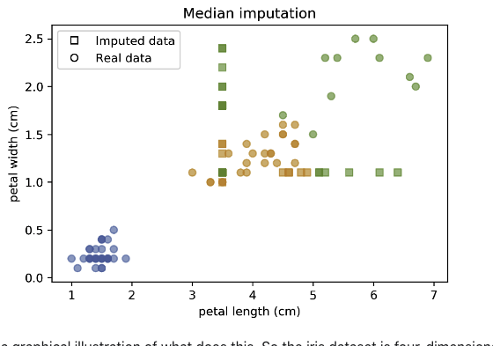
Preprocessing
Imputation Methods
  Mean/Median
  kNN Take the average of the nearest neighbors
  Regression Models Build a regression model to predict the value
What if the system is in production and it missing values where it should not.
Baseline – dropping columns
  I drop all columns that have missing values and then I can train logistic regression, which is sort of the model I'm going to use to tell me how well does this imputation work for classification. For my baseline, using a logistic regression model and 10 fold baseline, I get 77.2\% accuracy.
Mean and Median
  Inputer is the only transformer in scikit-learn that can handle missing data.
    Can specify the strategy, mean or median or constant and than call the method that transforms
Imputer is the only transformer in sciki-learn that can handle missing data which you can specify a strategy ( mean,median or constant)
Mean and medium graph –
  From the picture on the right – A lot of information was lost,
    The data is now in places where it should not have been before

Slide 12
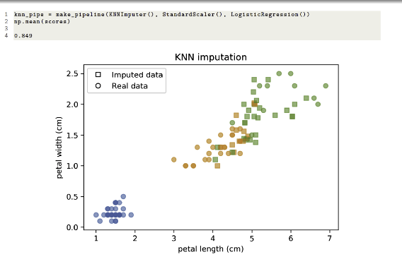

Preprocessing
KNN Imputation Code Graph
  The values were closer to their neighbors
Model driven Imputation
  Train regression model for missing values
  Iterate: retrain after filling in

Slide 13
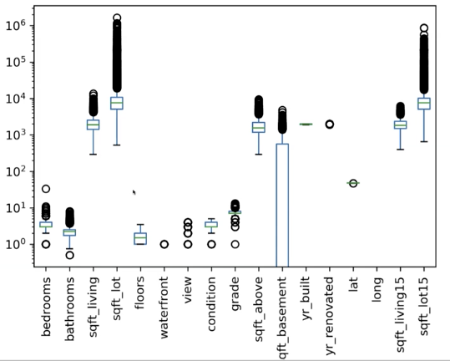
Preprocessing
Missing Values
  For example missing values with age
    Can take mean of all ages, but not best way
      Not the best answer need to look deeper into the answer
  Example – Some house prices are 0, the father could have given the son the child.
    Might be better to remove this row
  Can used education and group by ex. elementary and get an average of their ages
  Missing values does not mean there is a missing value in that cell
    Age cell could have a question mark.
  Don’t spend to much time on missing values, focus on the data that you have
Scaling / Normalizing
  For the Box plot on the right
    Compare floors ( small) and square ft for lot there is a big difference

Slide 14
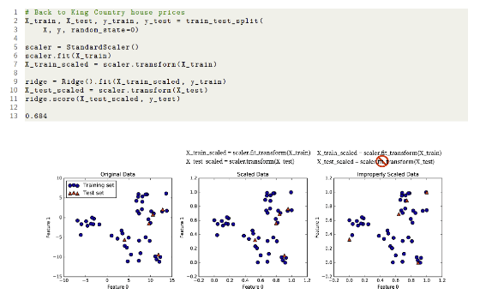
Preprocessing
Scatter plots are used to determine if a pair of numerical variables are correlated.
  Should not be used to show trends overtime
Ways to Scale
  MinMax – Another example is Grey Scale Values
  Robust Scalar – Computes the Median and quartiles
    Cannot be skewed by outliers
    A far away point would not affect it
  Normalizer – Scale each point so each feature has a euclidean length of 0
    Used when the direction of he angle
Sparse Data
  MaxAbsScaler – Only scaler don’t center
    Set the ,maximum values to 1 for each feature and scales
    Does not shift/center data
The fit will produce the standard dev and mean.

Slide 15
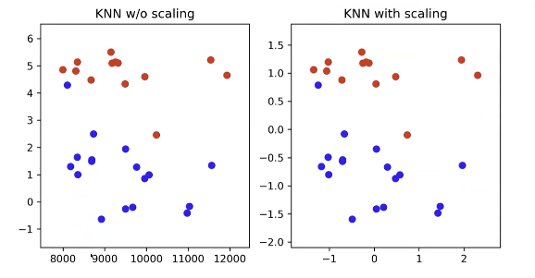
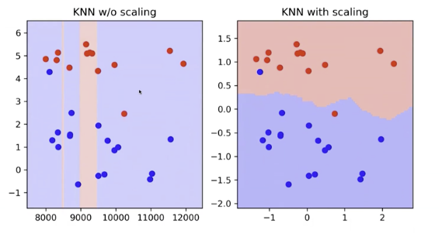
Preprocessing
An example of scaling on the right
  Note the values on the left and right hand side
  Note they are the exact same data points.
  Using Z-Score
Result of Scaling on KNN w/o scaling
  Bottom Picture
  Depends on the distance between data points
    Nearest usually
    The X and Y values are now closer so the y value
    will be considered
Any algorithm using distance has to use a normalized dataset
Use for KNN, SVC, Linear Regression, Lasso, Deep Learning
For Decision Trees scaling is not important

Slide 16
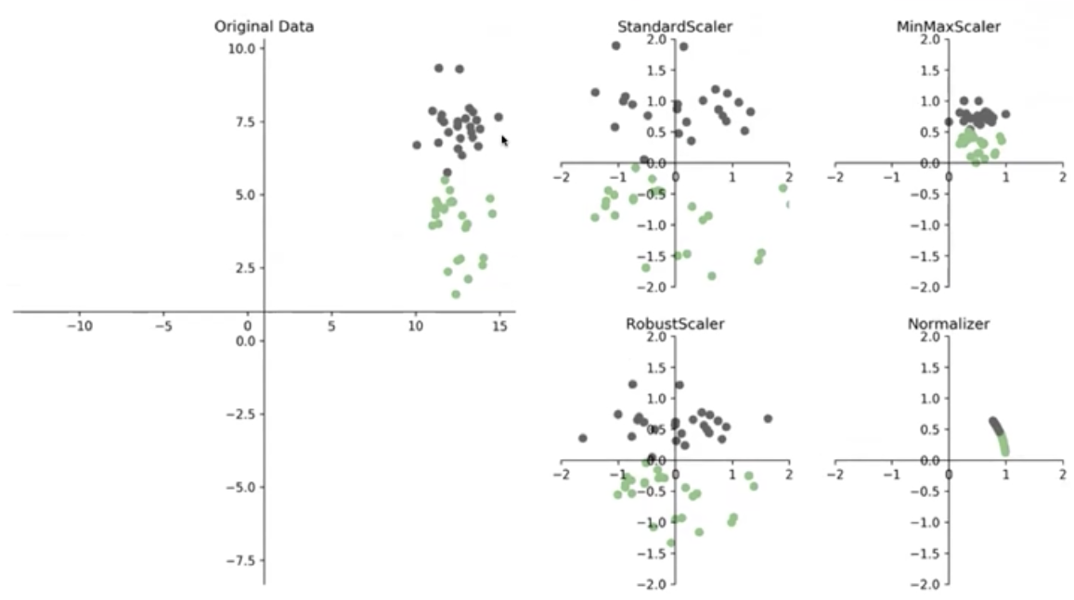
Preprocessing
Focus on the picture on the right
  Original Data is stretching along the Y Axis
  StandardScaler – Move to center and distribution is
  equal on both axis.
    Mean 0, Standard Deviation = 1
    Looks circular since Standard Deviation = 1
    mean – centered at 0
  MinMaxScalar
    Example Grades
    All the scores will be positive
    score = ( score - min ) / ( max - min )
    Used since zeros stay as 0 so you can work with sparse matrix
  Standard Scalar may not work since some of the data points may be negative
    Such grades some may take negative values
    Taking a group of number , turning them into a bag of words and create columns ( 1 col for each word ) where each cell is the count for the word
      Do it for many reviews and you get a huge matrix with lots of zeros and few non zeroes
      If you used standard scalar all the zeros would be a negative number.and you would need to score the entire dataset.

Slide 17
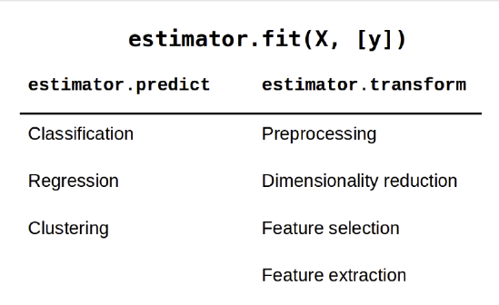
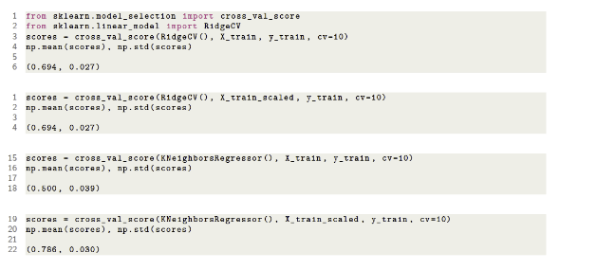

Preprocessing
Images

Slide 18
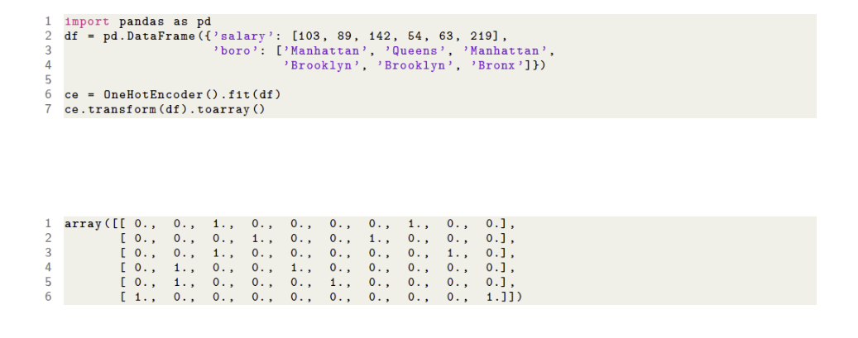

Categorical Values
One Hot Dummy Encoding
  get_dummies can select which columns to supply by using the column parameter
  Be careful sometime people will give you new categorical data and your model will have no knowledge of it.
Target Encoding
  For High cardinality categorical features ( based on number)
    Instead of 70 One hot variables one response encoded variable
  A single variable encodes the response should be done on whole dataset
  For regression mean response in zip code
  For binary classification – percentage for class 1
  For Multiclasss – One Feature per class
OneHotEncoder + ColumnTransformer

Slide 19
Preprocessing
Categorical Variables
  Transformation that you will do the most
    Machine Learning uses numbers so the categories most be changed into numbers
  Ex. ZipCode A code that is being used.
  Ex. Category, Martial Status
  Categorical – Taking number from a limited value set
  df[‘boro_ordinal’] = df.boro.astype(“category”).cat.codes
  One Hot Encoding – Create a columns where each value of a category has its own column where the 1 are for the columns value
    Your data frame could explode
Imputation, Scaling, Categorical variables – 3 keys transformations that we are going to do on the dataset --
When you make transformation on the dataset , train them on the dataset, not on the test dataset – Use Pipelines
  For scaling you need the mean/std for scaling it should come from the training dataset
    X = [ 2 4 6 9 0 ] and X_train = [ 2,4,6] and X_test = [9.0]
    mean(X_train), std_dev = std(X_train) – These are the two values that you will using
    X_train_scaled = (X_train-avg)/std ; X_test_scaled = X_test-avg)/std
With Grid Search and Cross Validation you do not need a Validation Dataset

Slide 20
Preprocessing
scalar.fit(X_train,y) – produces the metadata for transformations
scalar.transform(X_test, y_test) – Applies the transformation with the metadata
The system will not perform well if your training set is too small or if the sample is not representative of the mean or is polluted with irrelevant features
  Do not make the mode to simple ( underfitting ) or to complex (overfitting)

Slide 21
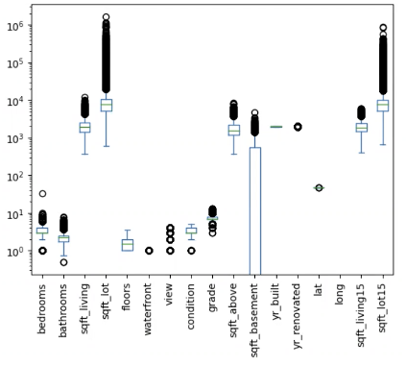
Preprocessing
data is a dataframe
  data[data.isin( [ np.nan, np.inf, -np.inf]).any(2) ]
  data[~data.isin( [ np.nan, np.inf, -np.inf]).any(2) ] // ~ is the not sign
  data[ ‘date’, ‘price’, ‘zipcode’], axis = 1 ] // drop columns
  X_train.bathrooms.quantile(q=.99) = 4.25 // Above this point all house have 4 bathrooms
Don’t forget .nunique
To get rid of outliers in a graph ax.set_xlim( X_col.quantile(q=.001), X_col.quantile(q=0.9999))
ax.scatter has the following parameters : alpha for transparency and s = .1 is the size of points
don’t forget ravel()
pandas plot uses parameter logy for log scaling on the y-axis
  gives an idea scales the data down
  If all the data is scatter need to standardize. See Example
NaT – Not a Timestamp
np.NaN not ‘NaN
Can use axis=’columns’

Slide 22
Preprocessing
Example
  From sklearn.impute import SimpleImputer
  myImputer=SimpleImputer(mssing_values=np.nan, strategy=’mean’)
    could be a list – missing vlaues
  myimputer.fit(X_train)
  myimputer.transform(X_train)
  myimputer.transofrm(X_test)
Sklearn generalization
  estimators – fit, score, predict
  transformers fit, transform
  Imputer and Scalar are transformers
Linear Regression works very well with large number of rows
Ridge Regression with enforcing that weights cannot take really large or small variables
if using distance based you need scaling

Slide 23
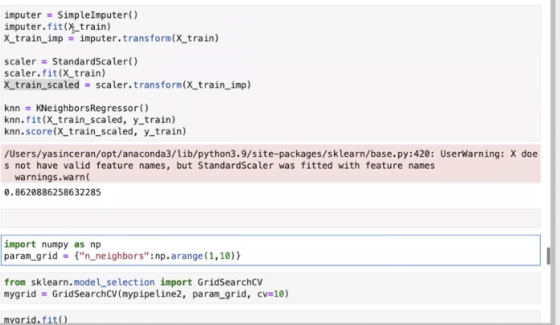
PipeLine
Example
  from sklearn.pipeline import make_pipeline
  make_pipeline(SimpleImputer(), StandardScalar(), kNeighborsRegressor())
    Expecting a list of transformers and 1 estimator
  mypipeline.fit(X_train, y_train) // Goes throught the pipeline will fit when the test data is input
  mypipeline.fit(X_train,y_train)
  mypipeline.score()
  mypipeline, mypipeline.steps
Example – GridSearchCV
  from sklearn.pipeline import Pipeline
  runs the pipeline for each iteration in the grid search
  .fit should have X_train, y_Test)
  my_grid.best_score_
  my_grid.best_value_

Slide 24
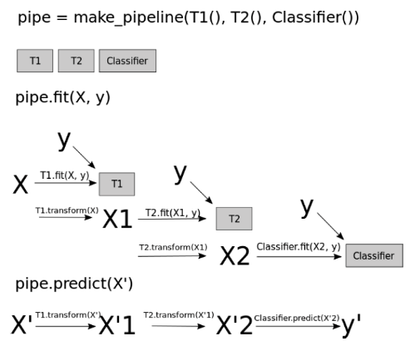
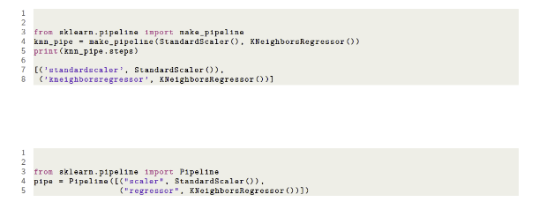
Pipeline
Pipelines can do the same workflow over and over again without human intervention.
Common Errors
  Ask about the first one
For the picture on the right
  T1 is an image and a scalar
  T2 any transformation of the data
We can simply pass the whole workflow to cross validation
Naming to the right – How to get and set the names
  default is lower class names

Slide 25
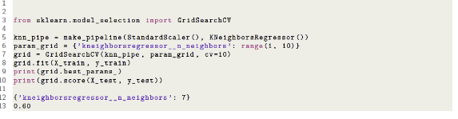
Pipeline
Pipeline and Gridsearch CV
  parameter grid – Need to specify the parameter name and step name
    multiple steps could have the same name
    format: stepname + 2 underscores + parameter name
      Using the format you can tune all parameters at once
      No leaking since all transformations are in the pipeline
Extra Notes
  Cross-validation is when you reserve part of your data to use in evaluating your model. There are different cross-validation methods
  Grid search is a method to perform hyper-parameter optimisation, that is, it is a method to find the best combination of hyper-parameters (an example of an hyper-parameter is the learning rate of the optimiser),

Slide 26
OneHotEncoder & ColumnTransformer
OneHotEncoder(handle_unknown=’ignore’, sparse_out=False)
  Sparse_out = False – Don’t make the data space
  ohe.fit(X_train) // Creates a code for each categorical variable,.
    Only create one hot encoding for variables in the training dataset if introduced in the test dataset it will cause an error or be ignred
  ohe3.transform(X_train)
The categorical variables are not giving the absolute weight, but a relative weight compared to other values of the category
  Don’t know the absolute intact on something
Column Mixed
  Column Transformer – A pipeline of pipeline
  categorical = df.dtypes == object // Get the columns that are datatype object
  numerical = ~categorical // Numerical gets all other columns which are not numerical
  Column Transformers contain a collection of pipelines
  Pipeline
    myreg.named_steps[‘preprocessor’].transformers_[1][1].named_steps[‘onehot’].get_feature_names_out(categorical_features)
  Can work on each column separately and it is easer to put the m together to run grid transformers
  The categorical information come in important when you want to show features in the plot

Slide 27
Question : What do you think do you think the coefficients are an indication of the important of the variable. No, if the variable is big number the coefficient is glint to be a big 1:18

Slide 28
Another example
dataframe.duplicated()
dups.any() – True if there are any duplicated rows
duplicate values might mean something
  Example a customer is looking and keeps coming back so the same data point appears many time
  Could be a good indicator of a pattern
When you see the thought process what is your thought process
  More than 10,000 immediately think linear regression
  Large number of columns not a good explainable interpretable model
    So many column – more complex – overfitting is a concern
    Too many columns increases the dimensionality
  Decide on which algorithm
    Small number of rows and large number of columns – Very good case for SVC
  Enough Data Points, but large columns – Lasso Regression – Eliminate columns with linear relationship
    removes highly correlated columns
  Large Number of Data points don’t spend time on Imputation start with a pipeline.
  Are you going to use the model in real time are you going to use batches – Speed is important in real time
  retraining the model after a while

Slide 29
Another example
Can use value_counts, nunique(), np.unique which give an array of all the values
Can also look for any character that is not a number or a . for a field that is assumed to be a numbr
Select Columns by using iloc or loc
X.replace({‘?’, np.nan})
Imputer can have most_frequent, median, constant
preprocess.transformers_[0][0] // preprocess is an instance of a
myparam_grid = { ‘preprocessor__num_inputer_strateguy:[‘mean’, ‘median’], ‘clf__n_neighbors’: np.arange(1,30,2)})
grid_search = GridSearchCV(clf, param_grid=my_param_grid, cv=5)
grid_search.fit(X_train,y_train)
grid_search.best_estimator_
grid_search.score(X_test, y_test)
Stop at 2:43

Slide 30
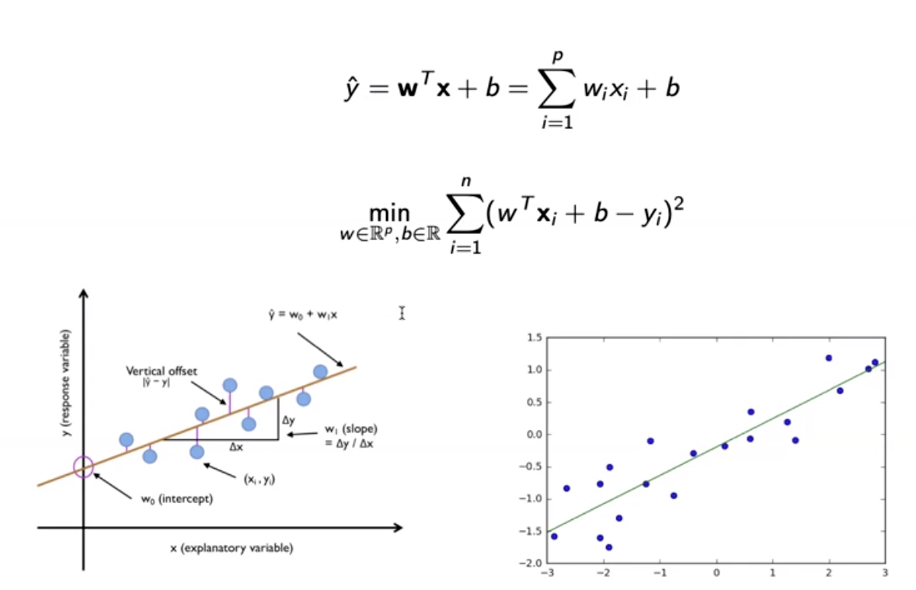

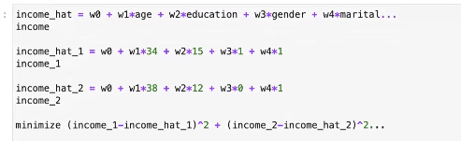
Linear Regression
Used tio predict target variables on a continuous scale
find the weight of the coefficients
  by minimizing the difference between the data points and the line
  Different linear model of regression share the same equation, but calculate weight and b differently
Training linear Regression
  Find the w that minimizes the Root Mean Square Deviation
  Normal Equation
    may be inefficient when the data size gets bigger
    May not work if X^{T} X is not invertiable
Sickit methods
  sklearn.linear.model.LinearRegression, SGDRegressor
Cab move the line up or down without changing the slope
  called y-offect or w0
hat means predicted and using the same coefficients , but different data
  error as close to possible as 0

Slide 31
Linear Regression
X = 2 * np.random.rand(100,1)
y = 4 * 3x + np.random.randn(100,1)
  np.random.randn(100,1) random noise
What if y and X were given can the intercept and w0 be estimated
  Observe the persons age ( w0 ) and income
  y = w * X W is vector and X is a vector [ w0, w1] * matrix X
    y = [4,3] * [1 X] // Example
  Y W * X
  Y * (inv X) = w * X * inv(X)
  Y * (Inv X) = w
  w = Y * ( inv X)
    For X being a square matrix
    For X not being a Square Matrix :
      y * X^ T = w X * X*T // X * X^T creates a square matrix so the inverse of the matrix can be done.
      y * X^T * Inv( X * X^T) = w * X * X^T * inv(X * X^T) // Reduce to 1 : X * X^T * inv(X * X^T)
      y * X^Transpose * inv(X * X^ T) = w // Will give you the coefficients of 4 and 3

Slide 32
Linear Regression
y = 4 * 3x is our equation
X_bias = np.c_(ones((100,1)),X) .// Create a bios columns and we have an array of a columns of 1 (bias) and a columns of weights
finding w_best = np.linalg.inv(X_b)
w_best = np.linalg.inv(X_b.T.dot(X_b).dot(X_b.T)).dot(y)
The noise term is always there
  As X gets bigger the matrix size will get larger and larger
  Taking the inverse is expensive
    being to careful solve the same problem
    The next one that we are looking at is gradient descent.

Slide 33
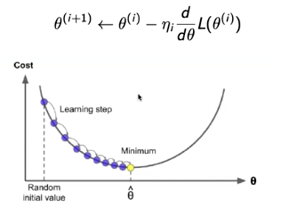
Linear Regression
Gradient Descent
  Tweak parameters iterative to minimize a cost function
  Initialize
    with random variables
  Then update
Minimize the difference between what we predict and what is the true label value
Example
  Wage = w0 + w1*Age + noise
  Goal estimate w0 and w1
  P1: Wage1hat ( first person’s predicted wage ) = w0 + w1 * Age1 // No noise since it is not estimated
  P2: Wage2hat ( section person’s predicted wage)
  Predictions are based on a specific [w0 w1]
  PN: Wage2hat = w0 + w1*AgeN // Use the same w0 and w1 for all people (P)
    Coefficient are not change from one person to another
    The predictions are based on a w0,w1 value
Called a parametric model since parameters are being estimated.

Slide 34

Linear Regression
MMSE
If we determine our parameters using different sets of people then what is the minimum squared error
  In search of w0 and w1 which minimized the distance between the true and target value
Gradient Descent Algorithm
  Example
    w_opt=3 – Is the w value giving MMSE
    If w = 4 .. then total squared error > MSME
    or
    w = 2 then total squared error > MSME
    Whether you move to the left or right ( See Graph on previous slide ) your total error will descrease
      The minimum w is the desired value
Algorithm
  Start from a random value
    The value is originally 0 – No 0 will absorb anything
  If to the left of the minimum increase you value, if to the right of minimum than decrease you value.

Slide 35


Linear Regression
    To determine the direction of movement :
      Take the derivative of your total cost function with respect to w
      Take the derivative of the loss function
        Increase or decrease by a small amount
        As the MMSE get smaller it means that you are getting closer
        tells whether you are moving up or down ( - ) is down and (+) is up
      Goal : Get as close to the optimum point as possible
      How wide should my step be – Learning Step
        wide steps danger you will jump over the optimal point and may not get the point
        smaller learning step – Take forever to the minimum point
    Another version as you get closer the minimum point your learning rate can get smaller and smaller
    May not find the minimum rarely , but will get close

Slide 36
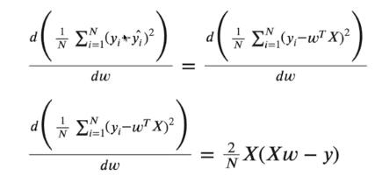
Linear Regression
Implement the algorithm
  Give X and y and not given the formula
  yhat =w0 + w1 * X
  eta =.1 # The learning rate and it is a hyperparameters
  w = np.random.randn(2,1) # w_new + w_old + eta*derivative
  n_interations = 1000 # Number of hyperparameters
  N = X_b.shape()[0] # Number of rows in the dataset
  X_b np.c_[np.ones((100,1)),X]
    Translates slice objects to concatenation along the second axis.
    creates a column of ones that will be calculus by the w0 value
  for iteration in range(n_iterations):
    gradients = 2/N * X_b.T.dot(X_b.dot(w)-y
    w = w - eta * gradients
Derivative provides the direction that you should go.
Don’t forget the gradient get multiplied by -1
Derivative of loss function

Slide 37
Linear Regression
Example
  X_b = [ [1,3], [1,4] , [1,7] ]
  w = [ 4, 2]
  # Predict for first/second/third
  yhat1, yhat2, yhat3 predictions
    yhat1 = 4 * 1 + 2 * 9
    yhat2 = 4 * 1 + 2 * 4
    yhat3 = 4 * 1 + 2 * 7
  Optimize by vector multiplication: w * X_b.T to multiply the two vectors

Slide 38
Linear Regression
y = 4 + 3*X
  If X increases by 1 unit then y increase by 3 units
  If X increases by 2 unit then y increase by 6 units
  Linear Relationship
Example of polynomial
  n = 200
  Xrp = 6 * np.random.randn(n,1) -3
  yrp = 2 + 1 * XRP + .4 * Xrp**2
    if I increased Xrp by 2 units
    yrp will increase 1 * 2 + .4*3^2 → polynomial feature
How can we incorporate the non linear relationship in our linear model
  There is a polynomial relationship between features and target – Still have a linear relationship, but now have a polynomial feature
  give Xrp, Yrp estimate w0 w1 w2 → find the coefficients for xrp and xrp^2

Slide 39
Linear Regression
Example
  from sklearn.linear_model import LinearRegression
  lr_l = LinearRegression()
  lr_nl = LinearRegression()
  lr_l.fit(Xrp,yrp)
  lr_nl.fit(Xrp_poly,yrp)
  lr_l.coef – got a single coefficient
  lr_nl.coef_ provided two coefficients
  [ lr_nl.intercept_, lr_nl.coef_ ]
The maximum we want to go is third power
  Most of the time taking the square is close enough
Using Scikit polynomial Transoformaiton

Slide 40
Linear Regression
Example using sklearn
  from sklearn.preprocessing import polynomialFeatures // Creates the polynomials of the numerical features
  poly = PolynomialFeaatures(degree=2, include_bias = False) // degress=2 create polynomial features using only squares
  Xrp.poly = poly.fit_transform(Xrp)
  Xrp_poly.shape // result (200,2) – feature, feature**2
Boston Data Set
  poly = PolynominalFeatures(degree=2, include_bias=False)
  X_train_poly = poly.fit_transform(X_trian_inputed)
  X_train.shape – 379 , 13 for Boston Housing
  X_trian_poly – 378 , 104 for Both Housing
    104 – Adding Square Terms
      X = has x1 x2 features
      poly.fit_transform(X2) –
      X2_[p;u = [x1 2 x1^2 x2^2 x1*x2 = 78 +13 features + 13 squares
      There are 12*13/2

Slide 41
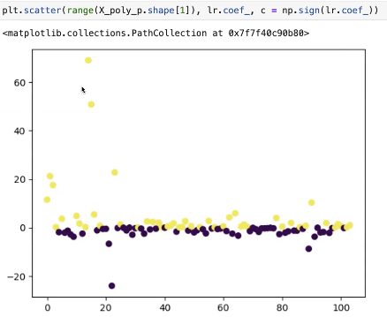
Linear Regression
After fitting we plotted the coefficients ( 104)
  Notice Once Coefficient has a real high value and one has a real low value
  Some of the columns are linearly correlated
  correlated
    same direction or different directions at the same
    When two or more variables are highly correlated whap happens
      inversely correlated – The first one will cancel the inpact of the other one
      When you see a real high variable and a real low variable then there is a
      good change they are highly correlated.
      called multicollinearity
    Ex. wage = w0 + w1*Age + w2 * Age
      Since they give the same exact information you drop one of them.
    Some cases one of the variables has more inpact on the model.
    The model is trying to fit the training set as good as possible
      If you has two extreme w values this might be a indication of the model overfitting,.
    What can be done – Ridge Regression

Slide 42
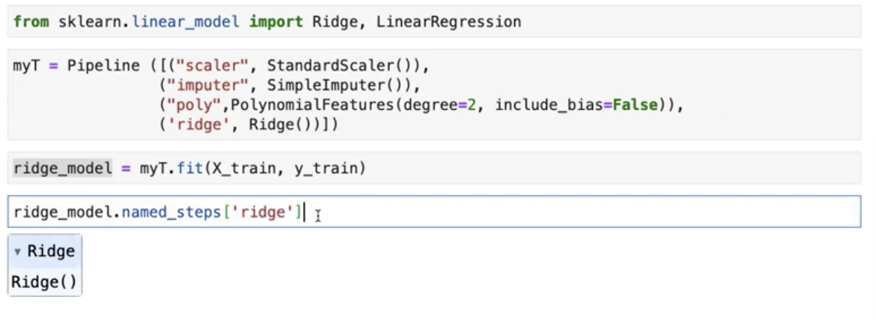
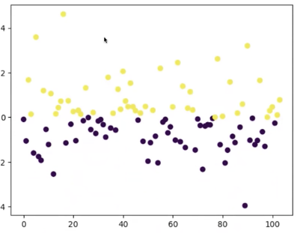
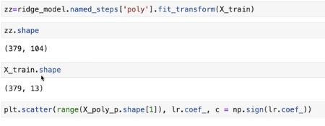
Linear Regression
Ridge Regression
  Problem with linear regression : there might be cases where the extremes fit good on the training, but not the testing dataset
  Solution : Penalize the extreme values since real high and real low values will hurt you on the test dataset
  Loss =
    Multiple the square of the weight by an alpha ( low – no penalty )
    alpha is considered a hyperparameter
    not be able to minimize the total lost function
  Lets ay you have x=.0001 to fit the model the corresponding w is 10 and in the
  test dataset x = 10, w=100
    The test dataset will have a lot of bad positions
Ridge Regression
  Graph with extreme
  values removed
  It took Ridgealpha by
  default, we can study
  it using girdsearch
  param_grid = {‘alpha’:
  np.logspace(-3,3,13))
  : giving alpha real small
  numbers and really high
  numbers
  mygrid.best_params_
  mygrid.best_estimator_

Slide 43
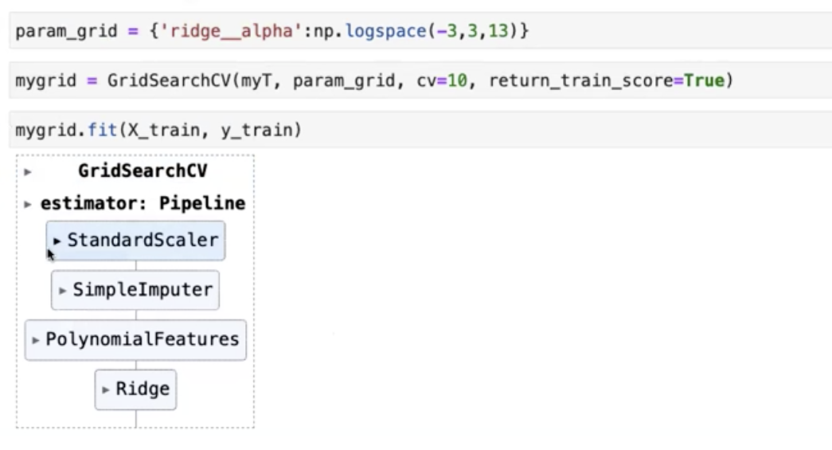
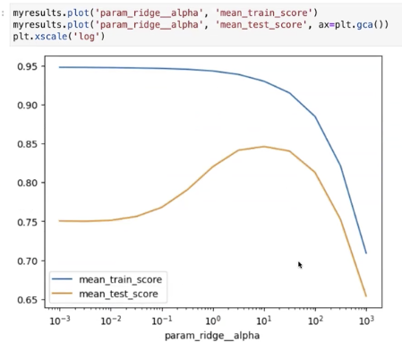
linear regression – last page
grid results – how the train and test scores are changing
See grid to the bottom right
  Find the model that best maximize the test score is around 10 to 100
  Num of coefficients did not a zero value to any of the coefficient
    did not eliminate any of the values

