Slide 1
Distrobox
https://www.youtube.com/watch?v=eM1p47tow4o&t=66s

Slide 2
What is Distrobox
Written Simple POSIX Shell
Wraps Podman or Docker
  Abstract most of the command length and complexity
  Seamless integration with host environment
Why Was it born
  Flatpak – Your favorite apps, unbound from the base Operating System
  Docker/Podman – your service unbound and isolated from the base operating system
  Distrobox – you enter userspace unbound from the base operating system
    userspace
      portion of memory containing unprivileged processes run by a user
      strictly separated from kernel space
Underlying technologies
  Battle tested container engines
  Container Manager
    Podman ( rootless / rootful )
    Docker Rootful

Slide 3
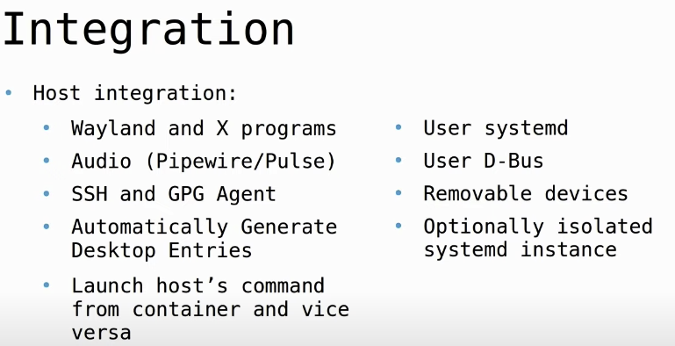
What is distorbox
  Faster and Lighter than VMs
  Can be used as a replacement CLI for everyday use
  Can act like a full system ( separate init, GUI )
Thi9s is not a secuirty tools
  You are not less and not much more secure than when on base OS
Rootless Distrobox using Podman
  When root in the container you are not root on the host
  You have a regular user
Rootful Distorbox
  You are root in the host and the container as the command to run them run as the command to run them runs as root

Slide 4
Usage
Commands
  create
  enter
  list
  rm
  stop
Utilities
  upgrade – will keep all containers up to date
    cycle through all boxes and run the package update commands
  ephemeral – create enter, destroy a temporary container
  generate-entry – create a desktop icon for your container

Slide 5
Use Case
Use Cases
  Immutable desktop
  Minimize base OS
    Less moving parts that can break
    User-land can be easily replaces
    Easier to make reproducible
  Some apps are specific to some distributions
  There is no Flatpak nor snap available
  Non packaged applications – You can access any package from any repot : AUR, Copr, OBS, PPA
  You don’t want to litter your system with lots of dependencies and libraries
  Sudoless setups
    Enterprise setups where you cannot be sudo on the machine, burt not ned software
  Mix and Match distor
    custom kernel for abandoned hardware stuck on ancient distribution
    Access to latest software on an LTS/Stable release distribution

Slide 6
Diversity
Hard dependency for container to work with distrobox are:
  Presence of POSIX compliant /bin/sh
  a supported package manager
    A package manager is needed to install base dependencies to ensure an user friendly experience even on minimal cloud images

Slide 7
Integration
App install and Export
  Export apps, binaries or services installed in a container back to the host
  execute transparently from the host
  distrobox export

