Slide 1
Oreilly – Java 9 to 21 How to code like a Pro
Henri Treblay

Slide 2
Trends
@Deprecated annotation improved
  @Deprected(since=”1.2”, forRemoval=true)
  {@link #suspend}
Technology falling out of favor has been moved to optional modules –
  For 9 and 10 use the –add-modules option with the full package name.
  For 11 and above use –module-path which contains the jar file
Reflection cannot make private fields accessible no more
Garbage Collection -- Good idea to look at Garbage Collectors and decide which one is best
Know your language went from
  Map<String, String> map = new Map<String, String>();
  var map = Map.of(“a”, “b”)
Copilot and these tools are useful, but they might not use the latest features.

Slide 3
Java 9
Internally Strings are stored as latin-1 or UTF16
  By default it is enabled and to disable +XX:-CompactStrings
  Have a flag internally telling them its compacted or UTF-16
Don’t Forget Jshell
of operator – Immutable, but still can change the internals
Java Modules – Easier to run programs and find classpath issue quicker.
  Before Java 9 – Load in jars with many different classes while needing only
  Now you have Java Modules – To make it easier to know the dependencies
  What are methodHandles -- method handles are a low-level mechanism for finding, adapting and invoking methods.
    access checks are made at creation time rather than at execution time
  AutoModule – not everything is aware they are module ( add the jar file to the app module path )
    java –module-path app/target:lib/target -m java89.app/app.App
    The module is a collection of packages designed for reuse, and Module JAR is a regular JAR with a module descriptor in its root folder. An Automatic Module is a JAR from the classpath that has been put in the module path. Their name is derived from the jar file name by default.
    Named Auto Module -- Can put information in the manifest entries such as automatic entires which will provide a real module name and not a generated one
      Use same syntax as above

Slide 4
Java 9
Can’t load two modules with the same name and cannot have the same package name in two different modules
Module
  Example Module-info – Opens lib and provides Hello with HelloStdout
    import lib.Hello
    import lib.HelloStdout
    module pro.trembly.java9.lib {
      export lib; exporting package name lib, everything else is hidden ( can hide stuff ) unless reflection is done
      } for security to reduce the attack vector.
  Example Module-info
    import lib.hello
    module pro.tremblay.java9.app {
      requires pro.trembly.java9.lib
  java –module-path app/target/classes – m pro.tremlby.java9.app/app
    Use the classes so that you don’t look at the jar to. Modules can only be defined once
For real modules and not automatic reflection cannot be done. -- can use --add-opens

Slide 5
Java 9
  Service Loader – Dynamic Loading of Interface of interface implementations
    Example
      ServiceLoader<Hello> serviceLoader(ServiceLoader(Hello.class); // Find all the implementations of the service
      serviceLoader.findFirst().ifPresent(Hello::helloWorld)
    In the module provided Hello with HelloStdout
    Can be used to load different FileIdentifiers, image formats, locales
      Good for plugin funcitonality

Slide 6
Java 10
made it easer to substitute JET Compile ( Hotspot)
  Graal VM could be plugged instead of HOTSPOT
    Just a JIT compile
Examples -- A restricted keyword has a specific meaning in the language, but only if you use that word in a specific way ( can still use it as a variable )
  var Leaves Java to infer a variable’s type.
  with Specifies a particular way of using a service.
  yield Marks the value of a case clause in a switch expression.
  var map – new ConcurrentHashMap<>() // Mean type is ConcurrentHashMap<Object, Object>
    Use it sparingly
Good use -- See his example for var
  var list = persons.entrySet().stream().map(entry → Object() { long id – entry.getKey(); String name = entry.getValue().getName(); }).collectors(toList());
  var allow you type things that were typeable
Epsilon Garbage Collector – Does not garbage collect and is useful for benchmark
  Extremely short lived jobs
  Last-drop latency improvements
  Last-drop throughput improvements
ZGC – Good for Big Heaps
With var you can ( @NotNull var t → t.plus(1));

Slide 7
Java 11
class HttpClient24 { -- Own Http Server
  @test
  public callMyWebsite() throws Exception {
    try (HttpClient client = HttpClient.newHttpClient()) {
    HttpRequest get = HttpRequest.newBuilder(URI.create(:https://glob.tremblay.pro”));
    CompletableFuture<HttpResponse<String>> response = client.sendAsync(get, HttpResponse.BodyHandlers(StandardCharSets.UTF_8));
    System.out.println(response.get().body());
    }
  }
Can do java java1.java // Java Compiles the class used for scripting deployments

Slide 8
Java 12
java microbenchmark
  @benchmark
  @benchmarkMode( Throughput, Average, SampleTime and SingleShotTime)
  @Fork ( value // how many time to be executed, warmups how many to run before dry-run is selected)
  @State(Scope.Benchmark) – Get rid of optimizations
  blackhole – used to run code that would be considered dead code
Better Switch ( imperative switch
  boolean weekDay = switch(data) {
    case Monday, Tuesday → weekDay = true
    case Saturday → weekDay = false
    default throw new IllegalStateException(“No data)

Slide 9
Java 13 Stop at 121
Have a class PreviewFeature ( interface) need specific flag to use preview –enable-preview
switch yield – can return out of an expression
  var day = switch(day) {
    case Monday
      yield true;
    Case Sunday
      yield false
Text Block – When printed out starts at the left side and can use escape characters
  “ \s” will prevent the IDE from trimming
  \ at the end of each line will make it one line
  String script = “””
    \t\tfunction hello() {
      print(“Hello World”);
    }
    hello(); // Put the tripple quotes here no newline.
    “””
try ( Context context = Context.create(“js”)) {context.eval(“js”, script); } System.out.println(script);

Slide 10
Java 15
Hidden Classes
  Dynamically generated and provide flexibility for low latency applications
  Generated at runtime and uses reflection to use them.
  used for lambda expressions

Slide 11
Java 17
Help NullPointerException – tell the class and method is causing the variable to be null
Pattern Matching – Could to put into equals
  if ( obj instanceof String s)
    int length = s.length();
Records – All variables are final, toString, equals, hashcode
  record Tuple = new Tuple(String name, int catAge);
  Can add and override methods, but no fields can be added
  replace anonymous with records
Tools
  jpackage
  jlink // Create a java program with only the modules needed
  jdeps

Slide 12
Java 17
Value-based classes ( Value Types ) -- Has no identities just add values
  primitive, immutable values to the Java language without the added overhead that traditional object-oriented classes bring.
  Properties
    Immutable
    Object Creation is done through factory
  Not suitable for synchronization
  Do not instantiate and compares values not references so no ==
  Example Double d = 25.0
  Could get rid of boxing.
Do Benchmarking to make sure that synchronization is modern in Java 17
Seal Classes – Use to show which class can inherit ( ex. AtomicInteger , Integer )
  Restrict how it can be extended --
  sealed interface Shape permits Circle, Polygon { … }
  record circle ( double radius ) implements shape {}

Slide 13
Java 17 -- LTS
Strongly encapsulate JDK internals – reflection is not possible if the mode does not have it open
SecurityManager – A class to restrict what you can do in a JVM
  Deprecated
  Security Manager -- It allows an application to determine, before performing a possibly unsafe or sensitive operation, what the operation is and whether it is being attempted in a security context that allows the operation to be performed
    Done at a time when we thought different wars would be permitted.
Context Specific Deserialization Filters – Accept or Rejects serialization based on runtime properties
  help prevent having a user create serialized objects that were binaries and could do stuff to the JVM
  Allows the setting of specific class types to deserialize
  Added since Security Manager is being deprecated

Slide 14
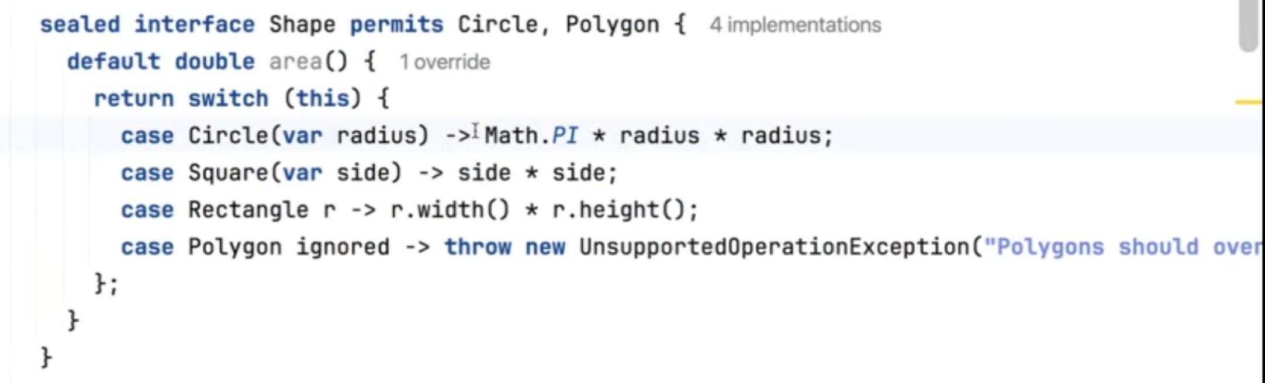
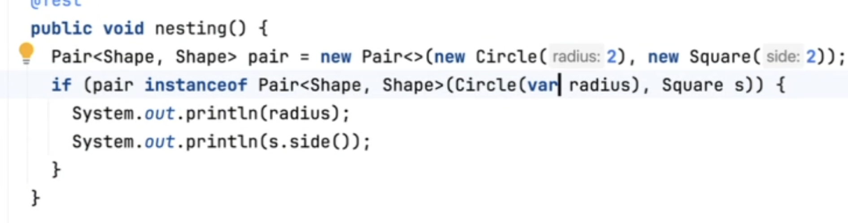
Java 17
Pattern Matching
  case null – No null Pointer exception
  default : Not null and Not Integer, Long, Double, String
  can do String s when s.isEmpty
  Matches in order
  Blends well with Seal Types since with Seal Type know what you are implementing
Another example of Pattern matching below
Record Pattern -- allow us to extract the values of a record into variables using pattern matching.

Slide 15
Java 18
UTF-8 By Default
Simple Web Server
Reflection reimplemented with Method Handles
  Method Handles
    A method handle is a typed, directly executable reference to an underlying method, constructor, field, or similar low-level operation, with optional transformations of arguments or return values
Vector API – Matrix Applications using Intel processor
Internet Address Resolution
  Convert an internet name to an IP Address. It a service provider so it can make use of these providers beside the default.
Simple Web Server – A toy web server that server statics file at context paths.
  private add = new InetSocketAddress(port:0);
  var server = SimpleFileServer.createFileServer(add,Path.of(“src/test/data”).toAbsolutePath(), simpleFileServer.OutputLevel.INFO);
  return server;
  server.stop
Markdown in Java Doc
  Can use <pre>@Code</pre>
  Added @snippet and can have {@snippet class=”pro.tremblay.alljava.solutions.CodeSnippets32” region=”example” } In the code have @start region=”example”
    need –snippet-path

Slide 16
Java Version 21
Virtual Threads
  Example
    public void test() throws Exception {
      for ( int I = 0; I < 100_000; i++) {
        System.out.println(“Launch Thread “ + I);
        Thread.startVirtualThread( () → { try { TimeUnit.MINUTES.sleep(1); } catch ( InterruptedException e) {e.printStackTrace(); } });
      }}
  Have a pool of virtual threads which are not thread
    The Runnable will assigned to the thread in the pool
  Advantages
    Cheap to create – They are just runanbles
    Threads are put aside until the IO is done – No waiting ( Every locks ( Reentrant Locks, sleep, IO will put out of the CPU until IO is done)
      Why you can create tons of them
  CPU Bound virtual threads are not a good case
Structured Concurrency – Way of doing parallel processing
Why did virtual threads come about
  Thread for every user transaction or session is often no feasible
  Context Switch is expensive for original threads
  Includes the native call stack along with the Java’s Call stack

Slide 17
Java Version 21
A continuation (or co-routine) is a sequence of instructions that can yield and be resumed by the caller at a later stage.
  Has an entry point and yield point ( where it was suspended ) -- All done in the language runtime
Threads can be started with Executors.VirtualThreadPerTaskExecutor

Slide 18
Java Version 21
  Example
    void test() throws Excpetion {
      try (var scope = new StrucuturedScope.ShutdownOnFailure()) {
        List<StructuredTaskScope.Subtask<Integer> ages = UserDao.NAMES.stream().
          map( firstName → scope.fork(() → dao.find(firstName).getAge())).toList();
      scope.join()
      scope.thorwIfFailed();
      ages.stream().map(StructuredTaskScope.Subtask::get).forEachOrdered(System.out::println); }
  Note scope.fork creates a bunch of subtasks and sets up the virtual threads
  less exception handling. ShutdownOnFailture will shutdown subtasks in case something goes worng
  ShutdownOnSuccess and result()
Scope Values
In Java 21 a lot became closable ex. Executors even have closable now.
Enhance the maintainability, reliability, and observability of multithreaded code by adopting a concurrent programming style that reduces the likelihood of thread leaks and cancellation delays, which are common risks associated with cancellation and shutdown

Slide 19
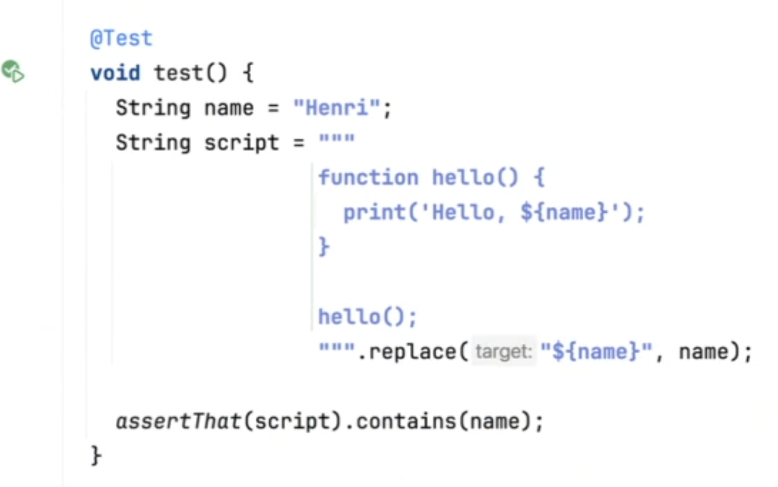
Java Version 21
Example
  ExecutorService executorService = Executors.newVirtualThreadPerTaskExecutioner();
  List<Future<String>> bodies = urls.stream.map( url → executorService.submit( () → { return retrieveBody(url); })).toList();
  boides.stream.map( future → { try { return future.get(); } catch( InterruptedException | ExecutedException e ) { throw new RuntimeException(e);
  retrieveBody(String url) throws IOException, InterruptedException {
    HttpRequest request = HttpRequest.newBuilder(URI.create(url)).
    Get().header(“Authorization”, authScoped.get()).build();
    return client.send(request,
    HttpResponse.BodyHandlers.ofString(StandardCharset.UTF_8)).body();
Scope.call( authScope, “password”, () → retrieveBody().toList() )
For the authScope and password passes it in like a local thread ( Scope Values)
Can still get race conditions and deadlocks
String Template – May not be around in the future ( May start with STR )
_ substitute with the current variable to show it is not being used
  won’t be flagged with unused warning
can just code using a void main()

Slide 20
Java 21
Sequence Collection – A new way to add an element to the beginning or ending of a List or Collection Data Stricture

