Slide 1
Conduktor – Apache Kafka Series
Kafka for Beginners v3 Edition

Slide 2
Kafka Introduction
Problems Kafka solves
  4 source systems and 6 target systems need to write 24 integrations
  Each integration comes with difficulties around technologies changing
    Protocol ( TCP, HTTP etc… ) -- How is the data transported
    Date Format – How the data is parsed (Binary, CSV, JSON )
    Data Schema and Evolution – How the data is shaped and may change
  Each source system will have an increase load from the connections
Solution – Kafka
  Decoupling of data and systems
  Source Sends ( Produces ) data into Apache Kafka using a data stream
  Destination can tap ( Consumes ) data into Apache Kafka
Why Apache Kafka
  Distributed, resilient architecture and fault tolerant
  Horizontal Scalability
    Can scale to 100s of brokers and millions of messages per second
  High performance ( latency of less than 10ms) – real time

Slide 3
Kafka Introduction
Use Cases
  Messaging System
  Activity Tracking
  Gather Metrics from may different locations
  Stream Processing
  De-coupling of system dependencies in microservices
  Integration with Spark, Flink, Storm, Hadoop
  Microservices publish/subscribe

Slide 4
Kafka Topics
A particular stream of data in a Kafka Cluster
  1 Cluster can container many topic
    Can have as many topics as you want
Identify a topic by its name and contains any message format ( binary , json, xml etc.. )
Data Stream – The sequence of messages is called a data stream
Use Kafka Producers to send data and Kafka Consumers to read data
  Cannot query topics

Slide 5
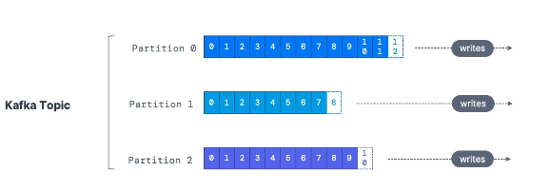
Partition and Offsets
Topics are split into partitions
  Each partition will contain messages which are ordered
  Message are written into the partition
  Each message within a partition gets an incremental id called offset
    Only have a meaning for a particular position
    Offsets are not reused even if a message is deleted
  Order is guaranteed only within a partition ( not across partitions )
Kafka topics are immutable: once data is written to a partition it cannot be changed
  Once data is written to a partition it cannot be changed -- immutability
Data is kept only for a limited time ( default is one week – configurable )
Data is assigned randomly to a partition unless a key is provide d
Can have as many partitions as you want

Slide 6
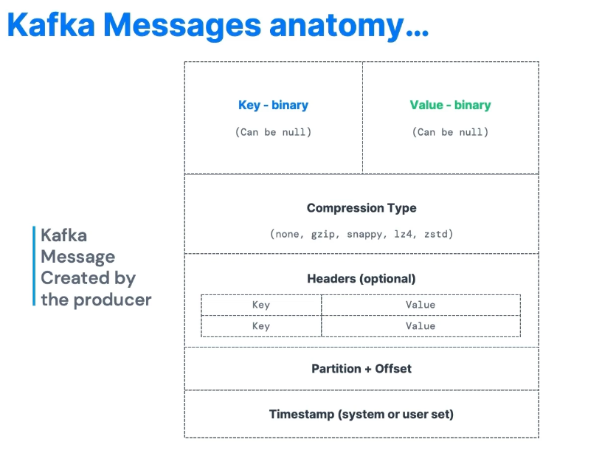
Producers
Producers write data to topic’s partitions and know in advance to which partition the data is written to and which Kafka broker has it.
In case of Kafka broker failures, Producers will automatically recover
Kafka scales since the load is balanced to many brokers thanks to the number of partitions
  Produces send data across all partitions based on a mechanism
  Each partition will get data from one or more producers
Message Scales
  Producers can choose to send a key with the message ( String, number, binary etc.. )
  Lets say we have a Producer that write data to one topic, but two producers
    Key = null Data is sent round robin ( partition 0 then 1 then 2 )
    Key != null All messages for that key will always go to the same partition ( hashing )
    A key is sent if you need message ordering for a specific filed ( ex truck_id)
      Ex. Mapping the routes of many trucks
Key Message Serializer
  Kafka only accepts bytes as an input from producers and sends bytes out as an output to consumers
  Construction of messages are not bytes and message serialization means transforming objects /data into bytes

Slide 7
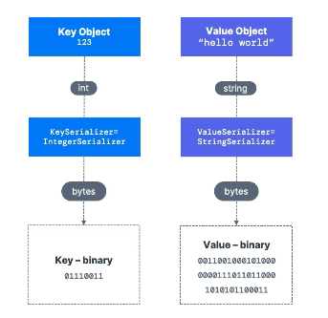
Producers
  Serializers are used on the key and value to send the data into the Apache Kafka
  Common Serializers
    String ( inc JSON)
    Int, Float
    Avro
    Prtotobuf
  Kafka Message Key Hashing
    A Kafka partitioner is code logic that takes a record and determines to which partition
    to send it to.
    Key Hashing is the process of determining the mapping of a key to a partition
      Default Algorithm is murmur2 algorithm
      Target partition = Math.abs(Utils.murmur2(keyBytes)) % ( numPartitions -1)

Slide 8
Consumer and Deserialization
Consumers read data from a top (identified name) – pull model
  Pull model – Consumers request data from the Kafka brokers and then get a response bacK
  Consumers automatically know which broker to read from
    In case of failures consumers know how to recover
  Data is read in order from low to high offset within each partitions
Consumer Deserializer
  Deserialize indicates how to transform bytes into object/data
  The serialization / deserialization type must not change during a topic lifecycle ( create a new topic instead )
    Reason : Serialization/Deserialization must know the type of data
  Serializer at the producer side / Deserializer as the consumer side

Slide 9
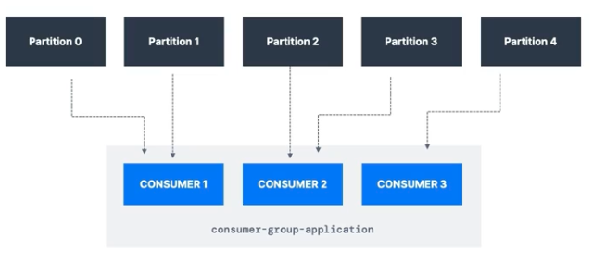
Consumer Groups
All the consumers in an application read data as a consumer groups
  Each consumer within the group reads from exclusive partitions
  A group read the Kafka topic as a whole
Consumer Groups – What if too many consumers
  If you have more consumers then some consumers will be inactive
  Later on add another consume. It will be inactive and a standby
Multiple Consumers on the same topic
  Could have one Consumer Group per service ( notifications, location service )
To create distinct consumers groups use the consumer property group.id
Consumer Offsets
  Kafka stores the offset at which a consumer has been reading
    The offsets committed are in Kafka topic named __consumer_offsets
    When a consumer in a group has processed data received from Kafka it should be periodically committing the offsets
      Kafka broker will write to __consumer_offsets, not the group itself
      Tells the Kafka broker how far we have been reading into the topic
        Useful – If the consumer dies it will be able to read back from where it left off thanks to the committed offset

Slide 10
Consumer Groups
Delivery Semantics for consumers
  By default Java Consumers will automatically commit offsets ( at least once )
  There are 3 delivery if you choose to commit manually
    At least once
      Offset are committed after the message is processed
      If the process goes wrong the message will be read again.
        Can result in duplicate processing of messages
        Processing should be idempotent
    At least once
      Offsets are committed as soon as message are received
      If the processing goes wrong message will be logs ( they will not be read again ) since we have committed offsets sooner than actually processing the message
    Exactly Once
      For Kafka => Kafka workflows: use the Transactional API ( easy with Kafka Streams API )
      For Kafka => External System workflows use an idempotent consumer

Slide 11
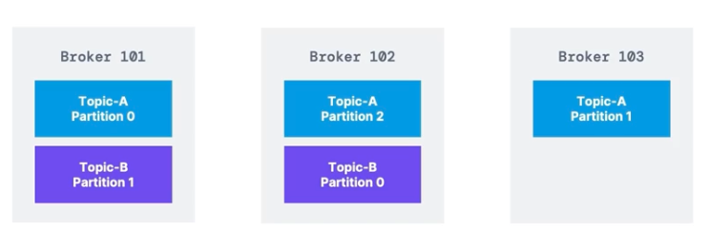
Brokers and Topics
A Kafka cluster is composed of multiple brokers (servers)
  They receive and send data
Each broker is identified with its ID (integer)
Each broker will contain only certain topic partitions
After connecting to any broker ( called a bootstrap broker ) you will be connected to the entire cluster
  Need to know how to connect to one broker and the clients can connect to the reset
A Kafka cluster can have 3 brokers, but some big clusters have over 100 brokers
Brokers
  Example Topic-A with 3 partitions and Topic B with 2 partitions
  Data is distributed
Brokers are the reason for horizontal scaling
Kafka Broker Discovery
  Every Kafka broker is a bootstrap server
  Only need to connect to one broker and the Kafka clients will know how to be connected to the entire cluster ( smart clients )
    The broker will return a list of all brokers to the client that made the connection

Slide 12
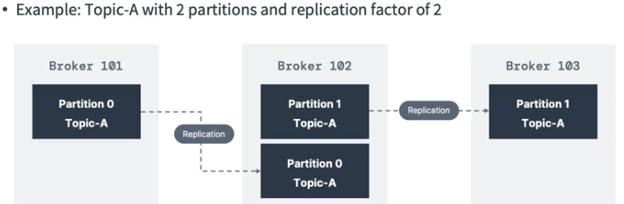
Topic Replication
Topic Replication Factory
  Should be value > 1 and between 2 and 3 for production
  If the broker is down another broker can serve the data
  Example Topic-A with 2 partitions and replication factor of 2
    Data is being replicated between brokers
    If we lose broker 102 then broker 101 and 103 can
    can server partition 0, topic A
Concept of a leader for a partition
  At any time only one broker can be a leader for a given partition
  Producers can only send data to the broker that is leader of the
  partition
    Other brokers will replace data
    If the data is replicated fast enough then each replica is an ISR ( in-sync replica )
  Default producer and consumer behavior with leaders
    Kafka producers can only write to the leader broker for the partition
    Kafka consumers by default will read from the leader broker for a partition
    The replicas are not read / write too.

Slide 13
Topic Replication
Kafka consumers replica fetching ( 2.4+)
  Since 2.4 it is possible to configure consumers to read from the closest replica

Slide 14
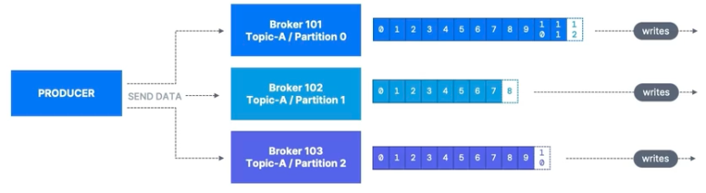
Product Acknowledgement and Topic Durability
Producers can choose to receive acknowledgement of data writes
  acks = 0 : Producer will not wait for acknowledgement ( possible data loss )
    If the broker goes down we will now know about it
  acks = 1 : Producer will wait for leader acknowledgment ( limited data loss )
  acks = all : Leader + all insync replicas acknowledgement ( no data loss )
Kafka Topic Durability
  For a topic replication factor of 3 topic data durability can withstand 2 broker loss
  General Rule : For replication factor of N, can permanently lose up to N-1 brokers and still recover your data

Slide 15
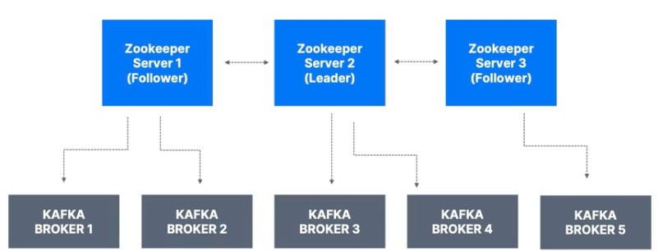
Zookeeper
Zookeeper – manages brokers ( keeps a list of them )
Zookeeper helps in performing leader election for partitions
Zookeeper sends notifications to Kafka in case of changes ( new topic, broker dies, broker comes up or delete topics )
Removal
  Up to version 2.8 Kafka could not work without Zookeeper
  Kafka 3.x can work without ZooKeeper ( KIP-500 ) - using Kafka Raft Instead
  Kafka 4.x will not have ZooKeeper
ZooKeeper by design
  operates with an odd number of servers ( 1, 3, 5, 7 ) ( ZooKeeper Servers )
  Has a leader ( writes) the rest of the servers are followers ( reads )
  Use to store consumer offsets
Zookeeper Cluster ( ensemble )
Should you use ZooKeeper –
  Yes until 4.0 for Brokers
  As the time of this course the Kafka Clients have been migrated to leverage the brokers as a connection endpoint
  Since Kafka 2..2 Kafka-topics.sh references Kafka brokers and not ZooKeepers for topic management and the Zookeeper CLI argument is deprecated
Reason ZooKeeper is going away is that Zookeeper is less secure than Kafka and ports should only be opened to allow traffic from Kafka brokers and not Kafka Clients

Slide 16
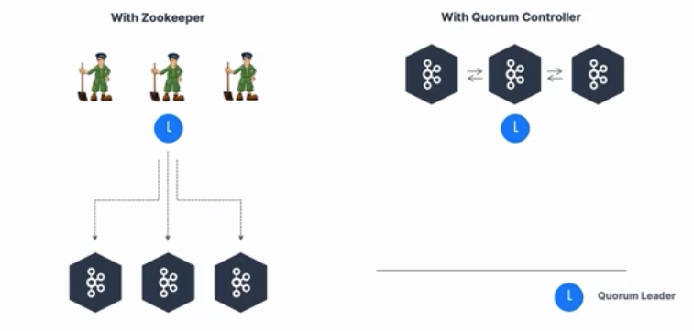
Kafka KRaft
ZooKeeper shows scaling issues when Kafka clusters have > 100,00 partitions
By removing Zookeeper
  Apache Kafka
    Scale to millions of partitions and becomes easier to maintain and set-up
    Improve stability and make it easier to monitory, support and administrator
    Single Security model for the whole system
    Single process to start with Kafka – Faster controller shutdown and recovery time
Kafka 3.x now implements the Raft Protocol (Kraft)
  Production ready since 3.3.1
  Kafka Raft Architecture
  Kraft provide improved Controlled Shutdown Time and Recovery Time after Uncontrolled Shutdown
  http://www.confluent.io/blog/kafka-without-zookeeper-a-sneak-peek/

Slide 17
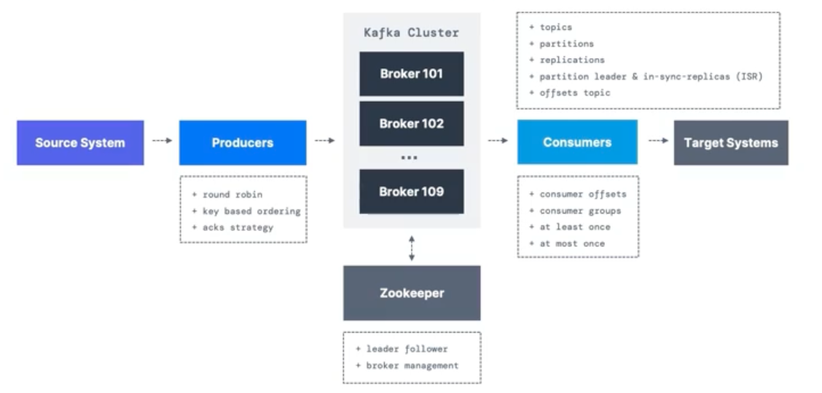
Review

Slide 18
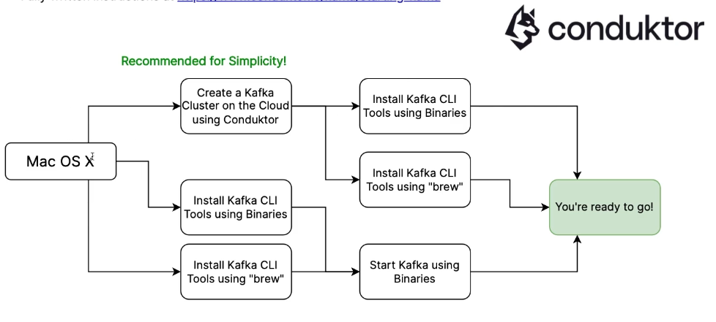
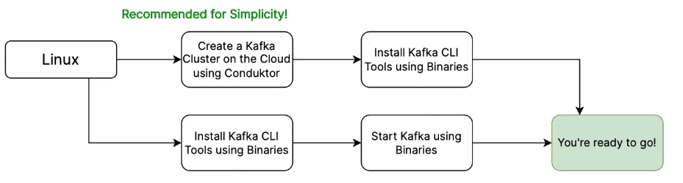
Starting Kafka
Macintosh
Linux

Slide 19
Start Kafka using conduktor
Free
  No credit card
  UI to speed up development
  Like a production cluster with multiple brokers
Steps
  Sign up at https://www.;conduktor.io/get-started
  Click the Try for Free Button
  At the end you will have Bootstrap URL, Username and Password and the list of default properties to connect to your Playground Center
  Types of Play Ground
    My PlayGround – Personal to you
    DataCumulus Playground – A place for you and the people you provide

Slide 20
One Kafka Broker –Download Kafka and Setup Path
Prerequisites
  Install JDK

Slide 21
Mac OS X: Start Kafka using Brew
Steps
  Install Brew
  Install Kafka using brew ( will install Java JDK for you)
  Start Zookeeper using the binaries
  Start Kafka using the binaries in another process
Brew install kaffka
  Brew services restart kafka
  Other command that will come with the kafka package such as kafka-topics
  Locations
    Binaries and scripts will be in /usr/local/bin
    Kafka configuration will be in /usr/local/etc/kafka
    Zookeeper configuration will be in /usr/local/etc/zookeeper
    Log.dirs config will be setup /usr/local/var/lib/kafka-logs
  Start Zookeeper -- /sur/local/bin/zookeeper-server-start /usr/local/etc/zookeeper/zoo.cfg
  Start Kafka -- /usr/local/bin/kafka-server-start /usr/local/etc/kafka/server.properties

Slide 22
Mac Osx – Start Kafka in Kraft
Kafka Kraft is production ready since Kafka 3.3.1
Steps
  Generate a cluster ID and format the storage using kafka-storage.sh
  Start Kafka using the binaries
    kafka-storage.sh random-uuid // Generate a Cluster id
    kafka-stoage.sh format -t <uuid> -c /kafka_2.13-3.1.0/config/kraft/server.properties where uuid is the output of the above command
    Kafka-server-start.sh ~/kafka_2.13–3.0.0/config/kraft/server.properties

Slide 23
Kafka Topics Command line
Using Conduktor
  Create a configuration file with the login properties – called playground config
  Anatomy of a command
    Kafka-topics.sh // Command
    --command-config playground.config // communication information necessary when you connect to a secure cluster
    --bootstrap-server cluster.playground.cdkt.i:9092 // location of kafka server
    Actions : --list, --describe, --create
Ex. kafka-topics.sh –comand-config playground.config –bootstrap-server cluster.playground.cdkt.io:9092 –create –topic first_topic
  On local host the command is the same, but –command-config is removed.
  --partitions → Can specify the number of partitions
  --replication-factor – Cannot specify the number of replications
    Replication for each topic cannot be higher than the number of brokers
    On Conduktor they have made a 3 no matter what the input is.
Ex kafka-topics –command-config playground.config –bootstrap-server cluster.playground.cdkt.io:9092 –list
  List all the topics

Slide 24
Kafka Topics Command line
Ex kafka-topics.sh –command-config playground.config –bootstrap-server cluster.playground.cdkt.io:9092 –topic –describe
  Shows the topic and the partitions
Ex. kafka-topics.sh –command-config playground.config –botstrap-server cluster.playground.cdkt.io:9092 –topic second_topic –delete
  Delete a specific topic

Slide 25
Kafka Console Producer Command Line Interface
Two Uses Case
  Key is null and the data distributed across all partitions
  Key is not null goes to a specific partition
Ex. kafka-console-producer.sh –proder.config player.config –bootstrap-server cluster.playground.cdkt.io:9092 –topic first_topic
  What will happen is that a > will be seen. Enter data and hit return and repeat until add data is entered. Then press control-C and you are out of the console-producer.sh
Ex. kafka-console-producer.sh –proder.config player.config –bootstrap-server cluster.playground.cdkt.io:9092 –topic first_topic acks-all
  Same behavior, but we introduce a key/value pair ( acks/acks-all)
Producing to a non existent topics – Get an error that the topic does not exist
  On the localhost if the command is tried three times then the topic will get created.
  On the localhost the automatic topic create is enabled.
Kafka-console-producer –proder.config playground.config –bootstrap-server cluster.playgorund.cdkt.io:9092 –topic first_topic –property parse.key=true –property key.separator=:
  When the > appears then enter hello : world where hello is the key and world is the value
  Send something without a colon an exception will be thrown.

Slide 26
Kafka Console Consumer Command Line Interface
Goals
  Read from tail of the topic
  Consume from the beginning of the topic
  Show both key and values in the consumer
Kafka-topics.sh –command-config playground.cofnig –bootstrap-server cluster.playground.cdkt.io:9092 –topic second_topic –create -–partitions=3
  Creates topic – second topic
Kafka-console-producer.sh –producer.config playground.config –bootstrap-server cluster.playground.cdkt.io:9092 –producer-property partitioner.class=org.apache.kafka.clients.producer.RoundrobinPartitioner –topic second_topic
  It is endless until Ctrl-C is hit.
  Can also have from –beginning
  Display the different partition number add ( to print timestamp, key, value )
    --formatter kafka.tools.DefaultMessageFormatter
    --property print.timestamp = true
    --property print.key = true
    --property print.value=true
    --property print.partition=true
Kafka-console-consumer.sh –cosumer.config playground.config –bootstrap-server cluster.playgorund.cdkt.io:9092 –topic first_topic
  // Show the number of messages that have been processed ( consumed )
Kafka – Get ordering per partition

Slide 27
Kafka Consumers in a Group
Goals
  Learn about –group parameter
  See how partitions read are divided amongst multiple Cli Consumers
Ex : Consuming from the third_topic and first_application
  Kafka-console-consumer.sh –consumer.config playground.config –bootstrap-server cluster.playground.cdkt.io:9092 –produce-property –topic third_topic –group my-first—application
    --group – tells kafka that a consumer group is being used
    When producing or consuming we can use the --group
--from-beginning is only helpful there has never been a consumer offset that has been committed as part of the group
Go over this one again and follow it

Slide 28
Consumer Group Management CLI
Use Cases
  List consumer groups
  Describe one consumer group
List Consumer Groups
  Kafka-consumer-groups.sh –command-config playground.config –bootstrap-server cluster.playgournd.cdkt.io:9092 –list
Describe Consumer Groups
  Kafka-consumer-groups.sh –command-config playground.config –bootstrap-server cluster.playgournd.cdkt.io:9092 –describe –group my-second-application
Lagged – Messages have been produced, but not yet consumed
When you start a console consumer you will see some groups such as console-consumer-87273 which is temporary.

Slide 29
Resetting Offsets
Conduktor Demo
Use Cases
  Resets Offsets
Ex. kafka-consumer-groups.sh –command-config playground.config –bootstrap-server cluster.playgorund.cdkt.io:9092 –group my-first-application –reset-offsets –to-earliest –topic first_topic –dry-run
  Can substitute –execute for –dry-run to execute the command
  -resets-offsets – read messages everywhere
  No consumers must be running when the –reset-offset is done
  Can also used –to-latest, --to-offset, --to-datetime, --to-current, --to-shift-by
Conduktor Demo
  They have an “access demo” with real data on line. Could be useful in studying the command line
  Made of different products besides console
    Testing
    Admin Add users and collaborate with others ( ex. Security )
    Monitoring Verify the metrics look good
    Data Masking
    Topic : Analyzer
    Topic : As a Service

Slide 30
Conduktor Demo

