Slide 1
Customize ZSH
https://www.youtube.com/watch?v=rgdR27KMxpo

Slide 2
History, ZSTYLE
History environment variables
  HISTFILE=~./.histifle // Where to save the history command
  HISTSIZE=110000 // Number of lines kept within the shell
  SAVEHIST=100000 // Number of lines of history to save to $HISTFILE
Zstyle
  Flexible way to modify default setting of ZSH Scripts ( modules, widgets, functions etc..)
  General expression : zstyle <pattern> <style> <values>
    Pattern acts as a namespace divided by colons and has a precise meaning
    Substring separated by : are called components
    :completion:<function>:<completer>:<command>:<argument>:<tag>
      :completion: is the namespace to avoid pattern collisions
    Don’t need to define every component of the pattern – replace them with a start
      The more specific component will win example :completion:*:*:cp:* has precedence over :completion:* it is more precise
Zstyle :compinstall filename ‘/home/rad/.zshrc

Slide 3
Autoload & COMPINT
Autoload
  Marks the name being a function
  Command line options
    -U suppress alias expansion
    -z – use the zsh type – need more information on this
compinit
  – create a .zcompdump file (A cache for completion)
  If compinit is not called then command line arguments can be found out using command line completion

Slide 4
File for Configuraiton
.zshenv
  Always Sourced
  Used for $PATH, $EDITOR, $PAGER,ZDOTDIR
.zshprofile
  For login shells -- A shell given to a user upon login into their user account
  Sourced before .zshrc
  Meant for KSH fans -- .zlogin and .zprofile are not meant to be used together.
.zshrc
  Set options for the interactive shell there
    Exampkes setopt and unsetopt commands, load modules, set history options, change prompt etc…
.zprofile
  For login shells
  Sourced after .zshrc if the shell is interactive
.zlogout
  Called when exiting the shell

Slide 5
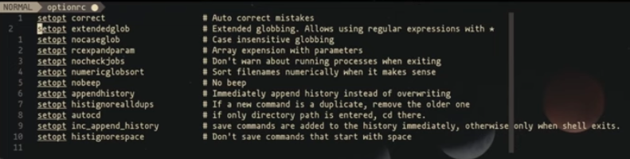
Setopt options
Set options zsh exposes
Examples

Slide 6
Plugins
Power Level 10K -- Creates a prompt
AutoSuggestions -- Suggestions based on history and completions
  When you see the gray text after the command and want to use that text press the right arrow key

