Slide 1
SQL
www,w3shcools.com
Section about SQL
  https://www.postgresqltutorial.com/what-is-postgresql/
  https://www.postgresql.org/docs/current/mvcc-intro.html

Slide 2
SQL
Select distinct values from a table
  Select distinct(city) from Persons;
Where
  Operators → =,<>,<,>,>=,<=, between, like, in
    Between → Is the value in a range
    Like--> does the value match regular expression
    In → Is the value in the list or the subquery
  AND, OR, NOT
Order by
  Sort by specified column
  Can have values ASC, DESC
    Example select * from customers order by Country DESC
Insert
  Insert into <table> ( column 1, column 2, column 3 …) values ( value 1, value 2, value 3...)
  Can use this command to insert only values into certain columns.
    Insert into Person ( LastName, FirstName) values ( 'Charles', 'Stockman')
  Execution Order of an SQL Statement
    Getting Data From Join
    Row Filter Where
    Grouping Grouping
    Group Filter Having
    Return Expressions Select
    Order and Paging Order by / limit and Offset

Slide 3
SQL
Written Order
  SELECT DISTINCT column, AGGREGATE(column)
  FROM table1
  JOIN table2
  ON table1.column = table2.column
  WHERE constraint_expression
  GROUP BY column
  HAVING constraint_expression
  ORDER BY column ASC/DESC
  LIMIT count;
Both select * and distinct are expensive operations
String Concatenation Example – Select first_name || ‘ ‘ || last_name from customer
If space in the column name then wrap in quotes

Slide 4
Select Example
Id | Name
1 | John Doe
2 | Jane Doe
3 | Alice Jones
4 | Bobby Louise
5 | Lisa Romero
Id | event | winner_id
1 | 100 meter | 2
2 | 500 meter | 3
3 | Cross country | 2
4 | triathalon | null
Result of Query : Select * from runners where id not in ( select winner_id from races)
Answer : Empty Set if the set being evaluated contains any values that
are null then the outer query will have return an empty set
Not in

Slide 5
Null Values
Null is a placeholder for unknown or inapplicable values
Is Null
  Select * from Persons where Address is null
Is Not Null
  Select * from Person where address is not null
Are cells where data does not exist, but is a property of data

Slide 6
Sql (2)
Update
  Update table set <column name> = value1, <column name> = value2
  Can set one value or two values
  Should always include the where statement
Delete
  Delete all rows → delete from Persons
Like
  Operators
    % → Accepts zero or more changes
    _ → substitute one character exactly
    [charlist] → Any single character in the list
    [^charlist] → Any single character not in in the list
  Example → select * from Persons where City like '%tav%'
  Example → select * from Customers where City Like ‘[bsp]%’;
  Example Select first_name, last_name from customer where first_name not like ‘Jen%’
  Ilike – Case Insensitive
    select first_name, last_name from customer where ilike ‘jen%’

Slide 7
SQL (3)
Top
  The TOP Clause is used to specify the number of records to return
  All tables support the top clause but it is different for all instances of Sql
    Sql Server → select TOP ( number | percent) columns_name(s) from table_name
    Mysql → select column name(s) from table_name limit number
    Oracle → select column_name(s) from table_name where rownum <= number
Limit
  The number that can be returned. I believe ansi command is fetch.
  select first_name, last_name from customers limit 2 offset 3
IN
  Select column_name(s) from table_name where column_name in ( value1, value2 …)
  Example select * from Persons where LastName IN ('Hansen', 'Petersen')
  Can use Not In
Between
  Select column_name(s) from table_name where column_name between value1 and value2
    Value(1|2) can be a string, date or number
    Not ansi sql standard behaves differently for each implementation
    Ex. Select * from payment where amount between 8 and 9;
    Ex. Select * from payment where amount not between 8 and 9

Slide 8
SQL(4)
Alias
  Can be a column or table name
    If the alias is a columns then when the data is display the column name should be the name of the alias
  Select column_name(s) as alias_name from table_name as alias_name
  Example : select po.OrderId as orderId, p.lastName, p.firstName
      from persons as P, Product_Orders as po
      where p.lastName='Hansen' and p.Firstname='Ola'

Slide 9
Sql(5)
Union Merges contents of two structurally compatible tables into a combined table and omit duplicate records
  Example
    Select column_name(s) from table_name1
    Union
    Select column_name(s) from table_name2
  Union all allows duplicates
  Limitation must have same number of columns. The first columns must have a matching table structure
Intersect
  Example : Select select_list from table_a intersect select select_list from table_b
Select into
  Select into statement selects data from one table and put into a different table
    Used mainly for backups
    Can use a where statement
  Example
    Select column_name(s) into new_table_name [ in external db] from old_table_name
    Select * into persons_backup in 'Backup.mdb' from persons
Exists
  Used to test for the existence of a any record in a subquery and true if it exist
  Select … from … where exists ( select column_name From table_name where condition)

Slide 10
SQL(6)
ALL
  Returns true if all of the subquery values ( rows ) meet the condition
  Example
    Select .. from .. where column_name operator ALL ( select column_name from table_name where condition)
    select * from teachers where age > ALL ( select age from students );
      In for the row of the teachers to be selected the age of the teacher must be greater than
Any
  Returns true if any of the subquery values meet the condition
  Examples
    Select … from … where column_name operator ANY ( select column_name from table_name where condition)
Case
  Example
    Select OrderId, Quantity,
    Case
      When quantity > 30 then “The quantity is greater than 30”
      When quantity = 30 then “The quantity is 30”
      Else “The quantity is under 30
    End as QuantityText
    From OrderDetails

Slide 11
Joins
Join
  Return rows where there is at least one match in both table
  Example : select column_name(s)
    from table_name1 inner join table_name2 on table_name1.column_name = table_name2.column_name
Left Join
  Return all rows from the left table and the rows in the right table where there is a match between the left and right table.
    The result is null for the right side if there is no match
  Example select columns_name(s)
    from table_1 left join table_name2 On table_name1.column_name = table_name2.column_name2
Right Join
  Return all rows from the right table and rows in the left table where there is a match
    The result is null for the left side if there is no match
  Example
    select columns_name(s)
      from table_1 right join table_name2 On table_name1.column_name = table_name2.column_name2
Full Join
  Return all rows where there is a match
    Select column_name(s)
      from table_name1 full join table_name2 on table_name1.column_name = table_name2.column_name
Full Outer Join
  all matching records from both tables whether the other table matches or not. So,
Self Join
  A table joined with itself can get hierarchical information ( example an employees immediate manager)

Slide 12

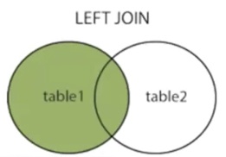
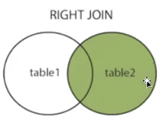
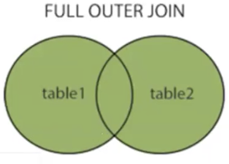
Joins
Basic Template
  select columns
    can use * , <attribute>, <table name>.attribute
  from table 1
  join table 2
  on table1.column1 = table2.column2
Common Domain
  Primary / Foreign Id usually, but if are not key and show up in the other table they are column domains
Type of domains
  Column Domain Foreign / Primary Key
  Integrity
    Domain Integrity The column must have the same datatype for all entries
    Entity Integrity Integrity of one table using the primary key
    Referential Integrity foreign key is from the same domain as the primary key
      Cannot enter a foreign key without the key being a primary key in another table
  inner join – Inner is an optional keyword
  When you do a join you can use any logical operator.
Common Domain Table 1 and Table 2
intersection is a combination – keys from table 1 and table 2

Slide 13
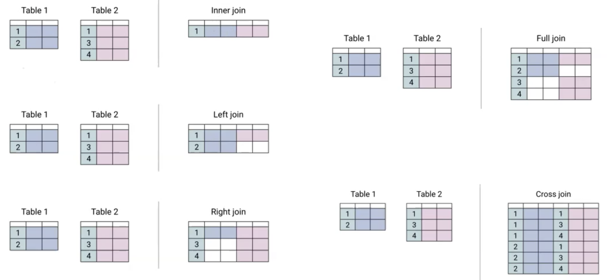
Joins
Example left join
  select column names(s)
  from table 1
  left join table2
  On table1.column = table2.column
Every foreign key should be a primary matching entry in the primary table
Example of a join
  select column_names(s)
  from table 1
  left join table2
  on table1.column = table2.column
  where table2.column is null
Example
  select column_names(s)
  from table1
  right join table2
  on table1.column = table2.column

Slide 14
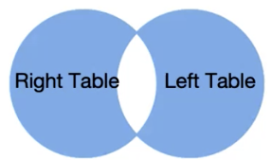
Join
Full Join Example
  Select column name
  from table 1
  full join table2
  on table1.column = table2.column 2
Example
  select column names
  from table 1
  full join table2
  on table1.column = table2.column
  where table1.column is null or table2.column is null
Equi Join - An equi-join is a join based on equality or matching column values.
  The difference is that the inner join can contain any relation equation , but the equi-join is about equality
Natural Join
  a JOIN operation that creates an implicit join clause for you based on the common columns in the two tables being joined
  Common columns are columns that have the same name in both tables.
  Can be an INNER join, a LEFT OUTER join, or a RIGHT OUTER join.

Slide 15
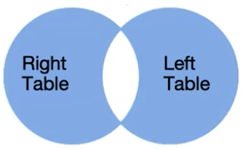
Join
Self Referential join-- Give the illusion of two tables by aliasing
  select column_name
  from table t1
  inner join table as t2
  on t1.column = t2.column
  where t1.column is null or t2.column is null
Example of a Self Referenced Join
  select f1.title, f2.title, f1.length
  from file as f1
  inner join file as f2
  on file.1.file_id <> f2.file_id and f1.length = f2.length
Table Aliasing – Used when having multiple joins
Cross Join is a permutation of the rows ( Cartesian Product )

Slide 16
Subqueries
Nested inside another query
Returns single value, row, column or table
called inner query
execute first
Any query written in join format can be written in subquery format
Example
  select *
  from (
    select date_trunc(‘day’, occurred_at) as day, channel, count(*) as events
    from web_events
    group by day, channel
    order by events desc) sub;
Can have a select from where <column> in <subquery> or where c1 = <subquery>
Example
  select * from orders where date_trunc(‘month’,occurred_at) = ( select date_trunc(‘month’,MIN(occurred_at)) as min from orders ) order by occurred
Exists
  ( select 1 from table where condition )
  In compares every single column, but when the condition is matched find the first match and short circuits

Slide 17
Administrative SQL
Create Database
  Example create database database_name
Drop db <name>
Backup
  Example
    Backup database <database name>
    To Disk = ‘filepath’
  Add with differential → Only changes are baked up
Create Table
  Example
    Create Table table_name {
      column_name1 datatype1,
      column_name2 datatype2
      …. }
    Create table new_table_name as select .. from … where ….
Dorp table
Alter table ( Not Ansi Compatible)
  Example alter table <table_name> drop column <column_name>

Slide 18
Admistrative SQL (2)
    Example
      Create Table Persons {
        P_Id int Not Null
        Name String varchar(255) }
Sql Constraints
  Limit the type of data that can go into the database
  Examples : Not Null, Unique, Primary Key ( Not Null, UNIQUE), Foreign Key (Is the key in a table), Check, Default, Index
  Check → Can be put on a table or column, checks a relational value
  Not Null – Enforces a column not to except a null statement
  Unique → Ensures that all values in a column are different
  Primary Key → Uniquely identifies each row in a table
  Foreign Key → Identifies a row/record in another table

Slide 19
Views
A Virtual Table
  Fields in the view are from one or more different tables
Example
  Create View <view_name> as <select statement>
    View name has the format title Current View List
      Example → Create view [ Current Product List]
  When view is create you would call it from SQL command based on the following example
    Select * from [Products Above Average Price]
  Create or update a view
    Create or replace <view_name> view name as <select statement>
  Delete a view
    Drop VIEW <view_name>
  Create Update Views
    The defining query must have exactly one entry in the FROM Clause which can be a table or another updatable view
    Does not contain group by , having, LIMIT, OFFSET , DISTINCT
    Does not contain a window function or set returning function or aggregate functioun
  Materialized View – Executes the query caches the result and refresh the results periodically
    Create Materialized View

Slide 20
Dates
As long as your data contains only the date portion your queries will work as expected
  When the time add it becomes more complicated
Data Functions
  MySql
    Now(), CURDATE(), CURTIME(), DATE(), EXTRACT(), DATE_ADD(), DATE_SUB(), DATEDIFF(), DATE_FORMAT()
  SQLSERVER
    GetDate(), DATEPART(), DATEADD(), DATEDIFF(), CONVERT()
Select * from orders where OrderDate = '2008-11-11'
  If the database contains only date then the query will work
  If the database contains the date and time it will not work
selectd sum(amount), date_trunc(‘day’, payment_date) as p_date from payment groupby p_date
  payment_date is a timestamp – ( date, time, timezone )
  date_trunc

Slide 21
Aggregate Functions
All aggregates functions ignore Null by default
  when sum is null it becomes 0 and is effectively ignored
  count – exclude null from count ( ignores them )
  avg – A null is 0 and will not part of the total count
    avg(field) could be different from sum(amount) / count(amount) – Verify this
    avg() excludes them totally
Avg
  Select Avg(column name) as OrderAverage from table_name
  Returns average values from a numeric column
  Select customer from orders where OrderPrice ( select AVG(OrderPrice) from Orders)
Count
  Null Values will not be counted unless it is setup in the where clause
Max, Min
The group-by statement
  Used in conjugation with the aggregate function to group the result set by one or more columns
  Select Customer, SUM(orderPrice) from orders
    It will select each customer and provide the sum of all the orders
  Select Customer , SUM(orderPrice) from order group by customer
  Can have a separated column list and have multiple columns for the group by
  How to find a duplicate record
    Duplicate records with one field
    Select name, count(email) from users group by email having count(email) > 1
  “select customer_id from payment group by customer_id” is the same as “select distinct customer_id from payment gooupby customer_id”

Slide 22
Aggregate Functions
select c1,c2, count(c3) from t1 group by c1
  Give an error
  Need to aggregate by c1,c2
  Whatever you don’t aggregate in your select statement use them in group by

Slide 23
Functions (2)
Having – Specify a condition to filter the aggregate groups.
  The where key could not be used with aggregate functions
  Example
    Select *
    From Persons
    Where <where clause>
    Group by street
    Having sum(*) > 5
  Ucase, lcase, len,
  Mid
    Mid( column, start , length) where length is optional
  Round
    Select ROUND(column_name, decimals) from table_name
  Now – Returns the current data and time
  round – round(column, number of decimal places)

Slide 24
Case
Always go with select clause
Once a condition is evaluated to True then the result is assigned and the case statement is exited.
Example
  Select title, length,
    Case
      when length <= 50 then ‘short’
      when length <= 120 then ‘medium’
      else ‘Long’
    end duration // Duration is a derived column
  from film

Slide 25
Case
Always go with select clause
Once a condition is evaluated to True then the result is assigned and the case statement is exited.
Example
  Select title, length,
    Case
      when length <= 50 then ‘short’
      when length <= 120 then ‘medium’
      else ‘Long’
    end duration // Duration is a derived column
  from film

Slide 26

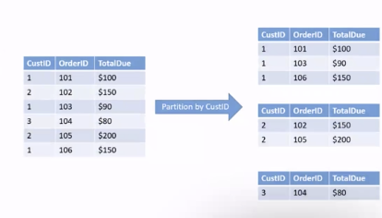
SQL Window Functions
Example: select key, sum(val) over partition by key from tbl
Creates a running total calculation a rolling operation
Window ordered subset of data
window_function(arg1,arg2…) over
  [Partition by partition expression ]
  [ORDER By sort_expression [jASC|DESC] [NULLS {FIRST|LAST}])
The partition by and order by are two optional parts
Partition By
  Divide Rows into multiple groups or partitions to which the window function is applied
  If skipped the window function will treat the whole result set as a signle partition
  Can specify more than one column for partition
Some window functions
  Avg, count, sum, min, max
  row_number, rank, dense_rank,
    that assigns a rank to each row within a partition of a result set.
    difference is how they handle ties
  lag – Compare with previous values has parameter to tell it what row in the partition by to compare it to,
  lead, first_value, last_value, Ntile(bucket)

Slide 27
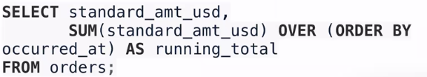
SQL Window Functions
Example
  select product_name, gorup_name, price,
    Row_Number() Over (
      partition by group_name
      order by price
  from products
  inner join product_groups using(gorup_id);
Key Word : join using <column name> – The column name is present in both tables.
As is a keyword

Slide 28
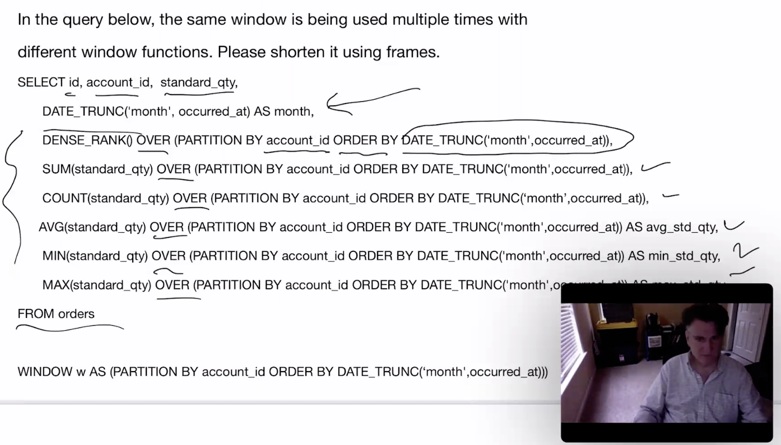
SQL Window Functions
Define a window to make the top query shorter
There is a lot of duplicated code.

Slide 29
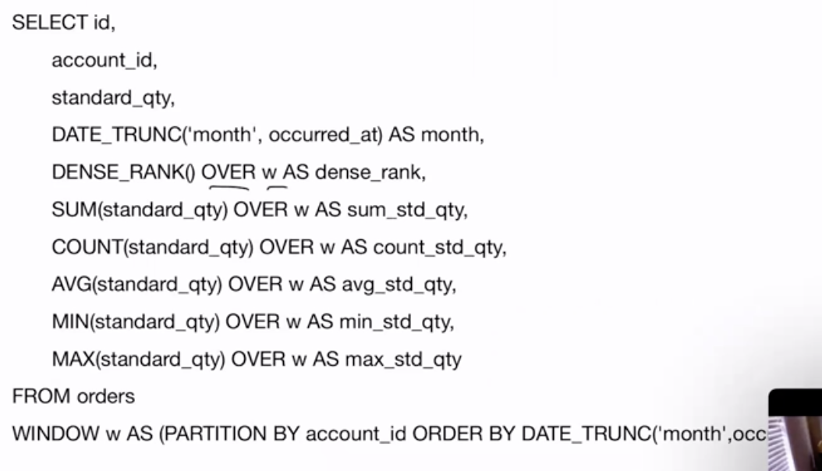
Window Function
Code that using Window to remove duplicate code

Slide 30
Injection
A technique where malicious users can inject sql commands into an sql statement via web page input
Example you have a web page with the following
  You have a text field for the Id. In the text field the user could enter 105 or 1 = 1.
  (The text from the id field is directly attach to the Select Statement ) and Select * from Users where UserId = 105 or 1 = 1
    Would print out all the data for the table
Ways to fix this
  Validate you input. For example an id should only be a number and have space or equals signs
  Due a sanity check on the backend. If a query is returning more than row log that information
  Use SQL Parameters

Slide 31
SQL Developer Turning Tips
Do an Explain Plan
  Displays the execution plans chosen by Oracle for select/update/insert/delete
  A statement’s execution plan is the sequence of operations Oracle performs to run the statement
Worried about what items are being access and how they are being accessed
  Example Both Order and Order Details have full Table Scans
    If lengthy can show up as a problematic SQL Statement
    Get Information about he tables
      See the number of rows and when they were last analyzed
        Select owner, table_name, num_rows, last_analyzed from dba_tables where owner || “.” || table_name
      Get the status
    begin
      dbms_stats.gather_table_stats( ownername=?’scortt’, “tabname=>’orders’)
      dbms_stats.gather_table_stats( ownername=?’scortt’, “tabname=>’orders_detals’)
    End
Once the statistics are updated the table works fine.
  On the order details column index the order data column since the query is dealing with time
  Create index scott.order_details_data_idx on scott.order_details
    With index not even accessing the tables anymore
Create indexes where you have joins
  Regenerate the explain plan when you change the query and/or database ( add indexes)

Slide 32
Debugging SQL
Get the results of the SQL Query String that it should be
Either by properties or configuration print out the SQL that is incorrect so that it can be cut or pasted into the SQL Editor
Review the code and start by executing the SQL Statements from the inside out.
  Can remove the where statement
Repeat the previous line
  Can mock up the inner code.
To validate run the sql query in all the database that it will be executed in.

