Slide 1
Command Line – Runit
https://www.linux-magazine.com/Issues/2020/234/Back-to-the-Future
https://www.youtube.com/watch?v=sftnVwj8DDg&t=3s

Slide 2
Introduction
The init process is the first process to run during bootup and the one that controls all other processes
Runit boots and shutdowns a system in 3 stages
Has two runlevels
  runs the services linked in /var/services
    default /var/services
    single which is used for rescue and recovery
  Other can be added
Navigation
  /var/service – contains all active services
  /etc/sv – contains all active services
  Each service is assigned a unique directory name which has a symbolic linke to /var/service
  Each directory has a single link called run which has a symbolic link to /var/service
  The run file is nothing more than a shell script running as a child of runsv utility

Slide 3
Introduction
Each service is started with a clean process
  Always has the same environment, resources, open file descriptors and controlling terminals
  runsv then runit can be configured to produce a reliable log.
  Running runit boots and shuts down quickly
  Runit stage 1 and 3 are governed by shell scripts making it easier to customize
Runit in action
  runit-inited The first process that the kernel starts is runit-inited
  init 0 shutdown the system
  init 6 reboots the system
  sv up /etc/sv/Service
  sv restart /etc/sv/Service
  sv status Service
  sv status /var/service/* – Returns the status of all service
  ln -s /etc /sv/SERVICE – Add new Services

Slide 4
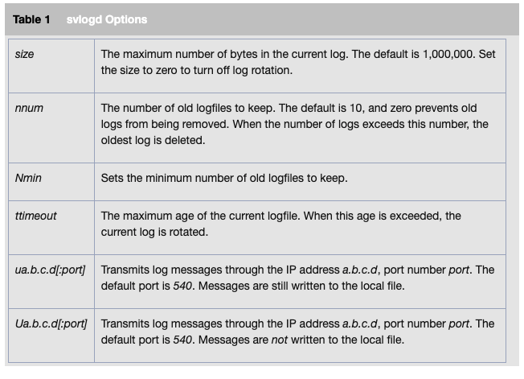
Introduction
  touch /etc/sv/SERVICE/down – prevent a service form starting automatically
    Rather than creating a file named down, the command signal runit to create a subdirectory
      a collection of binary files that define how the service runs
      If you no long want to prevent the service from starting automatically delete the supervise directory
  svlogd OPTIONS LOG-PATH
    Creates a log
  runsvdir /etc/sv/SERVICE LOG-PATH
    Up to 1000 entries can be monitored
    Every 5 seconds, runsvdir rescans if:
      A service is stopped then stops monitoring it
      restarted – A new process has been restarted
    All activity in the runit-related directories is recorded
    Runit does not need runsvdirt to function, but it is an administrative tool
  runsvchdir – Changes the log file for runsvdir

Slide 5
OpenRc
An init system that spawns executables and can manage them
The true init program ( PID 1 ) is whatever program is located at /bin/init
  OpenRc is designed to work with whatever is located there
  Any functional init binary is compatible with OpenRC because OpenRC can just be started by the initi program and will work independently
rc-status – Display information about process according the run level they were started in
rc-status -a – Show all services started in all run levels
rc-status boot – Will show only the processes started in the run level boot
rc-status --all Shows all the servers and their status
/etc/init.d contains executable scripts
  sudo /etc/init.d/ntpd stop
  sudo /etc/initd/ntpd start
  sudo /etc/initd/ntpd restart
  If the daemon crashes then you may have to pass the zap sudo /etc/init.d/ntpd zap

