Slide 1
Improving Deep Neural Networks
HyperParameters, Tuning, Regularization and

Slide 2
Test / Dev / Test Sets
Data Set
  Training Set Train algorithms
  Hold out Cross Validation ( Dev Set ) Which of many different models perform best on the Dev Set
  Test Set Evaluate best to model to get an unbiased estimate
Previous Era of Machine learning best practice was 70/30 or 60/20/20
  However, today we have big data ( a lot of data )
    The Dev and Test Set have become a smaller percentage of the total data amount
    For example a data set with 10^6 example, might only use 10^4 example for your dev set and for the Test Set then we might use 10^3
  Use the percentages ( 70/30 and 60/20/20 ) when the data set Is small then the historical percentages could be useful
Mismatched train/test distribution – Distributions of data may be different
  Example
    Training Set : Cat pictures from webpages
    Dev/Test Sets: Cat pictures from users using your apps.
  Make sure dev and test sets come from from the same distribution
    Use creative tactics to get a much bigger training set.
Might be ok to not have a Test Set if you do not need an unbiased estimate ( Review to Understand )
  Train the algorithm on the training set
  Use the Dev set to study different model architectures and evaluate

Slide 3
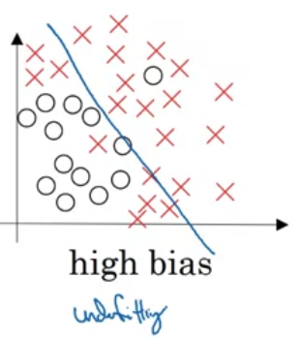
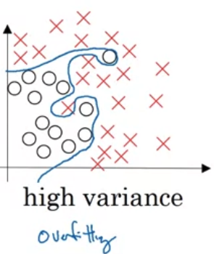
Bias / Variance
High Bias
  A straight line through the data
  Not a very good fit
  under fitting
High Variance
  Fit the data perfectly – cannot generalize
  overfitting
In between ( just right )
Examples
  To understand bias and variance look at the Train Set Error and Dev Set Error
  Predicated on the assumption -- People can do this task nearly easily ( 0% error )
    Optimal Error called Bayesian Optimal Error
    When no classifier can do very well ( ex. blurry images ) then Bayes Optimal Error is higher
Looking at the Training Set Error to see how well the Test Data is Fitting – Tells you if you have bias problem
How much higher when you go from the dev set to the training set that should provide a sense of how bad the variance problem is
Assumptions for the previous two lines: Bayes error is low and training and dev sets are drawn from the same distribution ( Review Again)

Slide 4
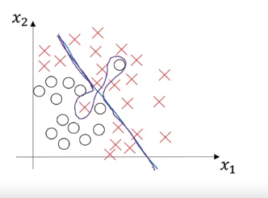
Bias / Variance
Example
  Train Set Error : 1% and Dev Set Error 11%
    Doing very well on the training set and relatively poorly on the testing set
    OverFit ( High Variance )
  Training Set Error 15% and Dev Set Error 16%
    Not doing well on the training set.
    underfitting ( High Bias )
    Doing very well on generalization so low variance
  Training Set Error 15% and Dev Set Error 30%
    High Bias and High Variance
  Training Set Error .5% and 1% error
    Low Bias and Low Variance
What does high variance and high bias look list
  Mostly linear with overfitting in certain areas ( too much flexibility in the middle )

Slide 5
Basic Recipe for Machine Learning
Train an initial model
Does the algorithm have high bias
  If yes then
    Train a bigger deep learning network
    Add more nodes layers
    ( Maybe try a different architecture – could or could not work )
  If you have a big enough network you should be able to fit the training data well so long as the human can do the task the network can do it
Does the algorithm have variance problem
  Are you able to generalize from a training set performance to a good dev set performance
  If you have high variance then
    Get more Data ( training )
    Regularization
    ( Maybe a different architecture – could or could not work )
Bias – Variance Tradeoff – In previous it was usually an inverse relationship --
  Train a Bigger Network reduces bias without hurting variance
  Getting more data could reduce variance and not hurt variance
  Reason why deep learning is very useful for supervised learning

Slide 6
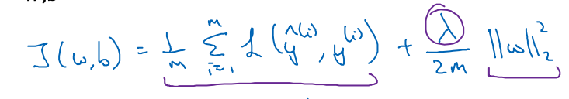
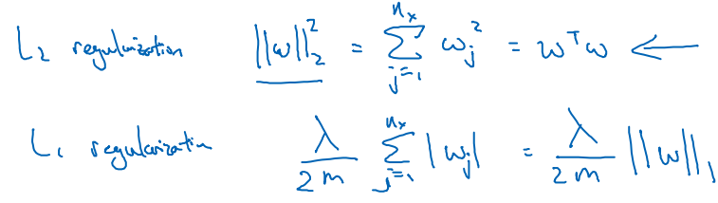
Regularization
lambda ( called regularization parameter)
Neural Network is overfitting your data have a high variance problem
  Try Regularization – prevents overfitting
  Try more training data that is quite reliable
For logistic Regression
Note for the loss function – w is a matrix and b is a number
L1 and L2 Regularization
  L2 is the most common type of Regularization
    Used much more often
  L1 – W will be sparse ( Vector a lot of zeros in it )
    Easier to compress model
    Not used that much since it only helps a little bit in model compression
Why do you regularize w and not b
  Can do this , but w is usually a high dimensional parameter vector, but
  b is a single parameter
    b is usually a small amount of the parameters compared to w
In the first function ( cost function ) The first ( starting with 1/m ) combined doing well in your training set vs setting the 2 normal of your parameters to be small ( Review )

Slide 7
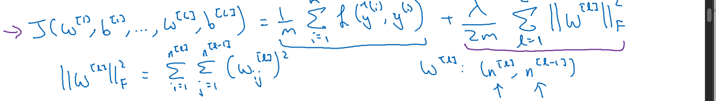
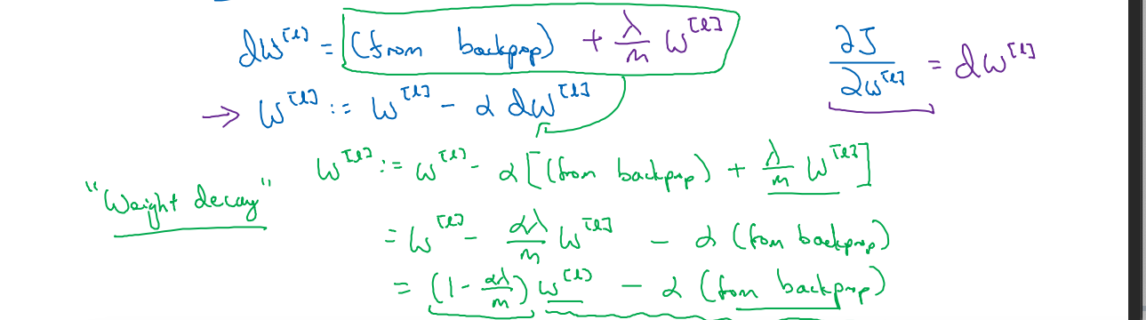
Regularization
Neural Network
Called the Frobenius Norm
How do you implement Gradient Descent
  L2 regularization is also called weight decay

Slide 8
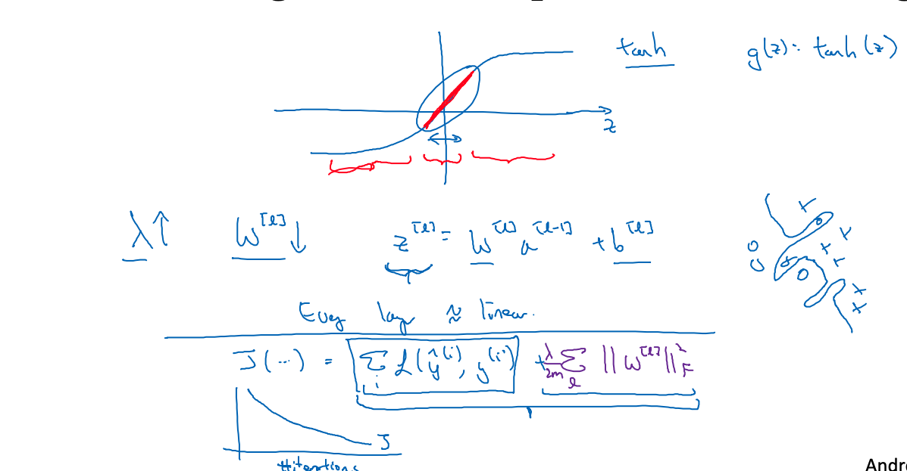
Why Regularization reduces overfitting
Regularization penalizes the weight matrices for begin too large
  Intuition – Make regularization parameter large then the weight will be close to 0
    Zero out the impact of the hidden units. (Review)
    Goes from overfitting to underfitting ( variance to bias )
    All the neurons are still but act like a smaller network which is less prone to overfitting
second try on showing reduction of overfitting
  Using a tanh function for activation
  If the small amount of the left and right side from (0,0) point is used ( see red line )
    using the linear part of the tanh function
    If z is allowed to wander the activation become less linear.
    Intuition
      If lambda is large then your weights will be small
        then z will be small then g(z) will be roughly linear
        Will not fit those complicated decision boundaries so can’t overfit
Implementation Tip
  Debug Gradient Descent : Plot Cost Function vs # iterations

Slide 9
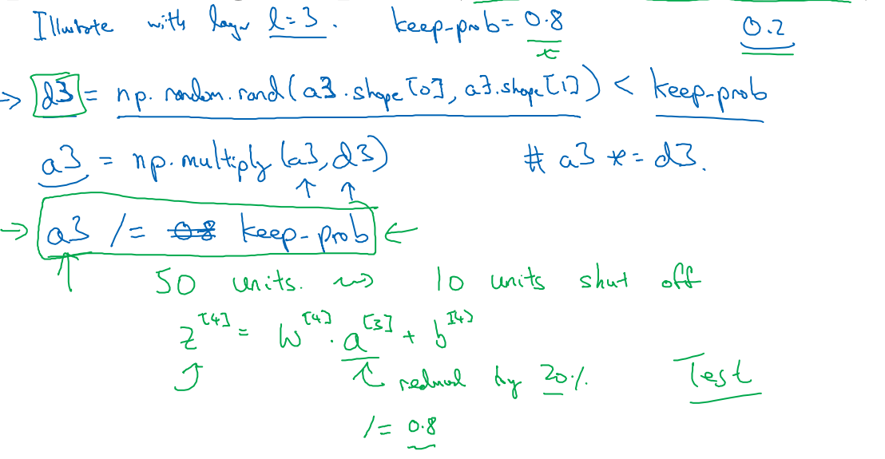
Dropout Regularization
Prerequisite : Have a neural network that is overfitting
  Steps
    For each Layer have a probability that each neuron will not be used
    For the neurons that are not used remove them
    Have different runs where you calculate the nodes being used by probability
      For each set run the training data again.
      create a smaller network which are being trained
        less chance of overfitting
Inverted DropOut
  keep_prob – probability a hidden node will be kept.
  d3 will be a matrix where 80% of cell being 1
  a3 will be activation and an element wise multiplication
    The nodes are zeroed out
  THEN A3 /= keep_prob
    Use to not change the expected value of Z
    At test time this is easier since you have less of a scaling problem

Slide 10
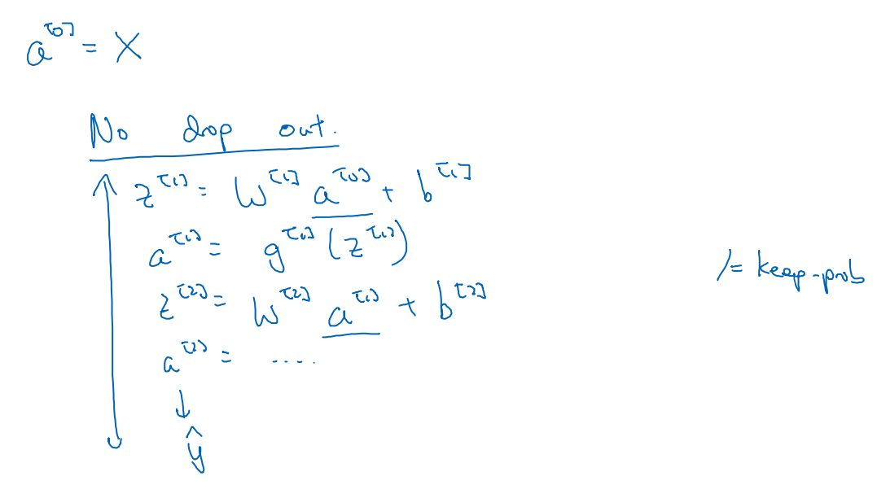
Dropout Regularization
Making predictions at test time
  Don’t use drop out at test time
    Don’t need /= keep-prob

Slide 11
Understanding Dropout
Why does drop out work
  Intuition – Can’t rely on any one feature so you have to spread out weights.
    Using a smaller network should have a regularizing effect
  Lets look at a neuron with n inputs and 1 output
    Eliminate some of the units then any one feature could go away at a time
    Neural Network would be reluctant to put all its weight on one feature
    By spreading out the weights it will shrink the square nor of the weights
      Shrinks the weights help prevent overfitting just like L2
      An adaptive form of L2 regularization
When implementing dropout vary keep probability by layer
  The large the weights matrix the keep probability should be lower ( More layers more chance of overfitting )
  1.0 – Keep the layer the same
Can apply drop out to the input layer
Can have some layers where you apply drop out and some where you don’t
Best use was computer vision since the input size was so big and you never have enough data ( input a lot of pixels )
Downside of Drop Output is the cost function J is well defined. -- Harder that is going downhill on every iteration

Slide 12
Other Regularization Techniques
Data Augmentation
  To increase the number of image you have testing you flip one, crop, random zoom
    Redundant so it is not a good as getting independent examples
    Don’t add as much information
    Doing these techniques you are telling the algorithm that if a image is the correct image it still correct when flipping
Early Stopping
  As you run gradient descent plot cost vs iterations
  Plot for dev set error and training error
  Usually the dev error will go down for a while and then increase
  Early Stopping – Stops then the Dev Error Starts going up again
    Works – With less iterations your parameter w will be close to 0 ( assumption – w is initialized to small random values )
  Downside
    Optimize for J ( cost function ) -- Gradient Descent, momentum, adom
      care about making w and b smallest as possible
    Not Overfit – Regularization, Getting more data
    Ortheganalization – Concentrate on task at time

Slide 13
Other Regularization Techniques
        Coupling Optimization and cost function with not overfitting
          Using one tool that mixes the two
L2 Regularization – Train the neural network as long as possible and the search space of hyperparameters easier to decompose and easier to search
  Downside : Try a lot of parameters of lambda more time expensive or computationally
  Advantage of early stopping run the gradient process just once ( for small, medium, large without needing to try a lot of values
Early stopping does

Slide 14
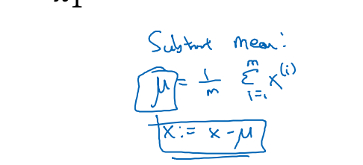
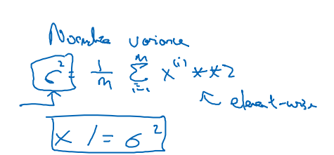
Normalizing Inputs
Normalizing inputs speeds up training
  subtract mean
  normalize variance
  Use the same equations to normalize the test set
Why normalize inputs
  If you features are on different scales
    Ex. feature 1 ranges from 1 to 1000 and feature 2 ranges from 0 to 1
    normalization make items more symmetric
      Non Symmetric means learning rate should be smaller
      More spherical than can take much larger steps
When the feature are different ranges it hurts the optimization
  Ex feature 1 is 0 to 1000, feature 2 is 0 to 1 and feature 3 is -1 to 1 then feature would hurt the algorithm

Slide 15
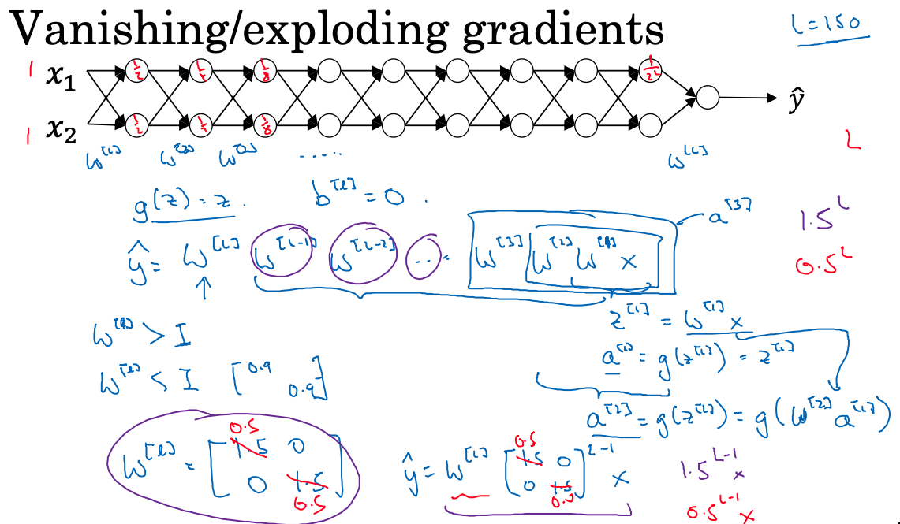
Vanishing Exploding Gradients
Sometime your derivatives can be very very big or very very small.
  Solution : Good use of random weight initialization to
  reduce the problem
    Partial Solution
  If you have a deep network ( such as on the right ) the value
  of y will explode since we are dealing with y = 1.5^L-1 * x
  Intuition
    If the weights are a little bit bigger then the Identity Matrix
    then with a deep network the activation will explode
    If the weights are a little bit lower than the identity Matrix
    then with a deep network the activation will get really
    small
  Makes training difficult
    small then gradient descent will take tiny steps

Slide 16
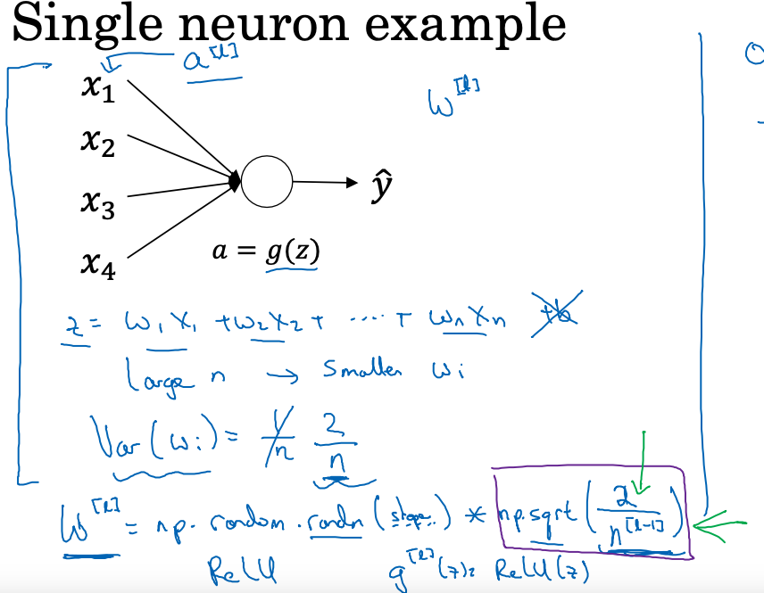
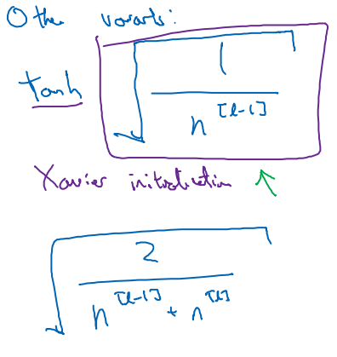
Weight Initialization for Deep Network
In order for z not to be too big or too small
  larger n the smaller the weights should be
  Set the variance of w to be 2/n
    set W^[l] to the equation at the bottom of the page
    If the input features of activations are roughly mean 0
    and standard deviation of 1 this would cause z to take
    on a similar scale
      helps to reduce the problem
  This solution assumes a RELU
Other Variants
All these equations give you
a starting point
  hyperparameter
  Don’t tune this one first

Slide 17
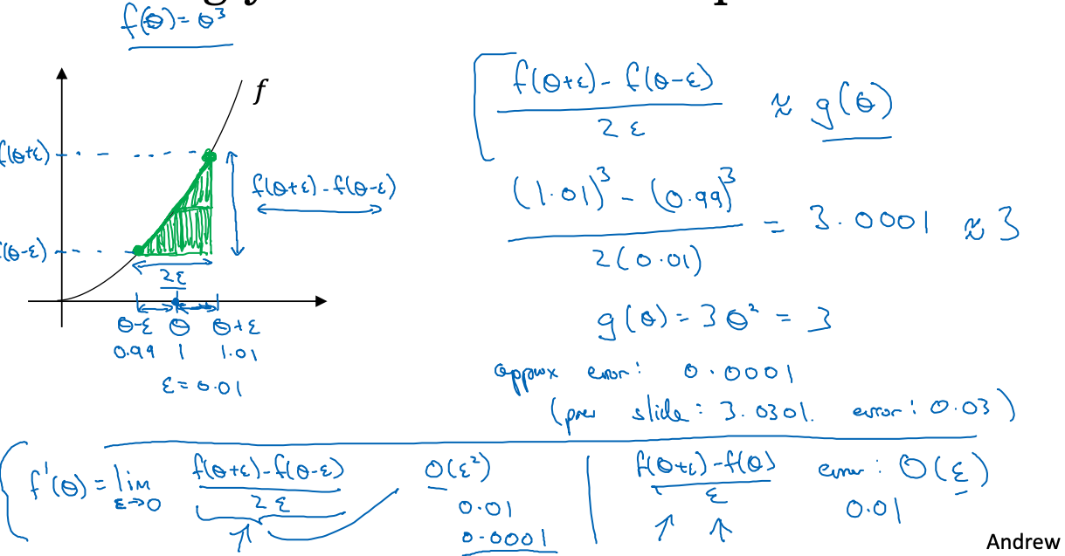
Numerical Approximation of Gradients
Gradient checking makes sure the back propagation is correct.
Actually taking bigger rectangle between 0 – episilon and 0 + epsisolon
(Get a screenshot )
Run twice as slow, but much more accurate
By taking the two side different can numerically verify if the function g is
the correct implementation of the function

Slide 18
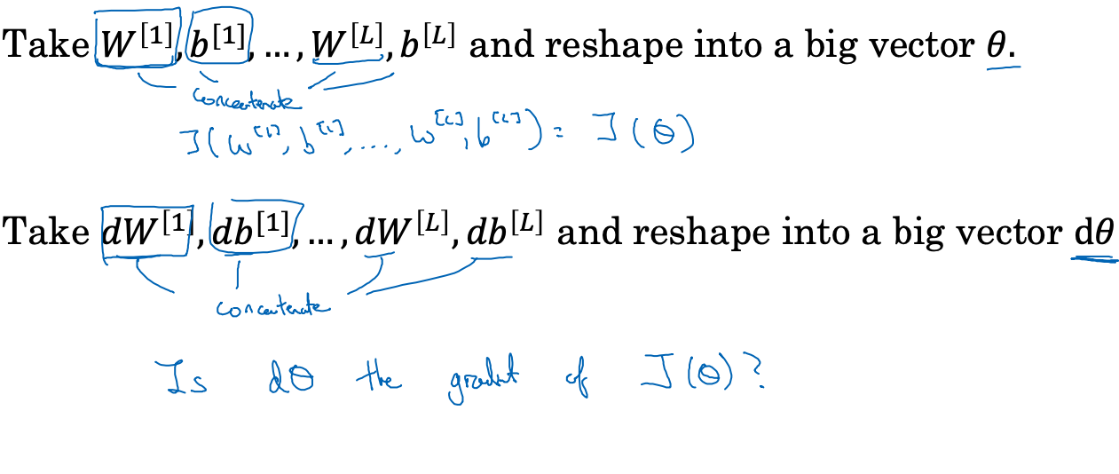

Gradient Checking
Technique -------------------------------------------------------

Slide 19
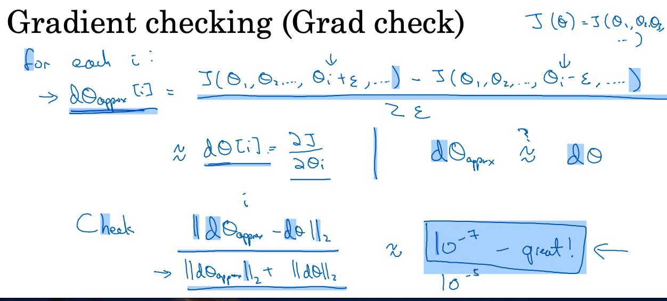
Gradient Checking
Algorithm
  derivative of first equation
    Doing a two sided difference
    nudging epsilon with +,-
    diving the derivative of epsilon with ( 2 * Epsilon )
    Compute for every value of I and end up with two vectors
      Theta Approx and Theta
      Make sure they are approximate
        Check by computing the Euclidian distance ----------------------
        the L2 Norm
    Use epsilon – 10^-7 and if equal or smaller
      If 10^-5 start assuming there might be a bug
      10^-3 start worrying there is a bug

Slide 20
How to Implement Gradient Checking
Gradient checking should not be used in training only debugging.
If the algorithm fails grad check look at components to try to identify bug.
  Look at the actual value of the derivatives for both approx and actual and see which of ( actual and approximate are way off )
Remember regularization
  Include the regularization term in the derivative
Does not work with dropout since in every iteration different neurons are being computed
  no easy compute cost function
  check with keep probability =1.0 then turn on dropout and hope that the implementation is correct
Run at random initialization; perhaps after some training
  Could be that w and b are accurate when close to 0
  Use Random Initialization and train the network for a while so they wander away from and do gradcheck again.

