Slide 1
Kafka Notes
https://www.youtube.com/watch?v=DU8o-OTeoCc

Slide 2
Kafka Deep Dive w/ a Ex-Meta Staff Engineer
https://www.youtube.com/watch?v=DU8o-OTeoCc

Slide 3
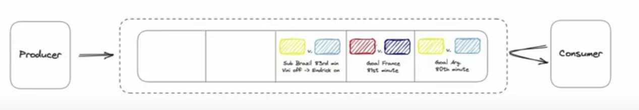
Kafka
Can be used as a message queue or stream processing unit
Overview – We have a producer and consumer
  What happens when they expand then the sever0
  is struggling how
  can we scale

Slide 4
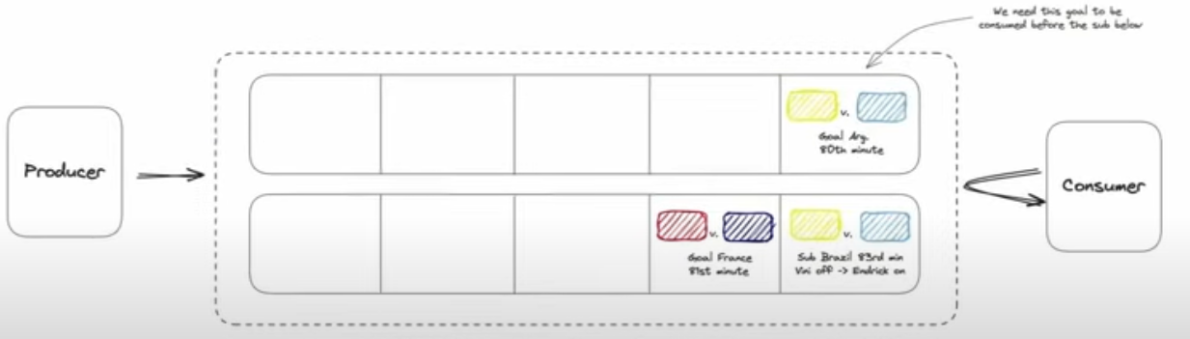
Overview Example
Problem #1: Too many events on the queue and the server hosting queue running out of space – Scale Horizontally
Problem : As the producer produces an event and we are going to randomly distribute those events across the server then the events would
be out of order.
  The consumer would be reading of the queues

Slide 5
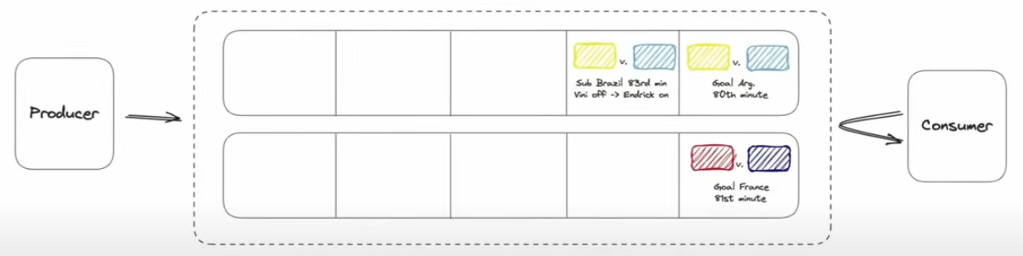
Overview
Problem #3: Now events are not processed in the correct order. -- Partition by game
  Each queue is a different
  game.
  Guarantee the vents of a specific game are in the correct order
Important idea
  For Kafka in order to scale messages send and received
  through Kafka require an user distribution strategy
    How do we distribute or partition different events

Slide 6
Overview
Problem #3: We scales so many events ( queues ) and our producers are creating so many events our consumers can no longer keep up. Solution add more consumers
Problem: Consumer 1 and Consumer 2 could read the same goal
and our consumer ends up with two events
Solution: Consumer Groups – Each event is guaranteed to
only be processed by one consumer in each group

Slide 7
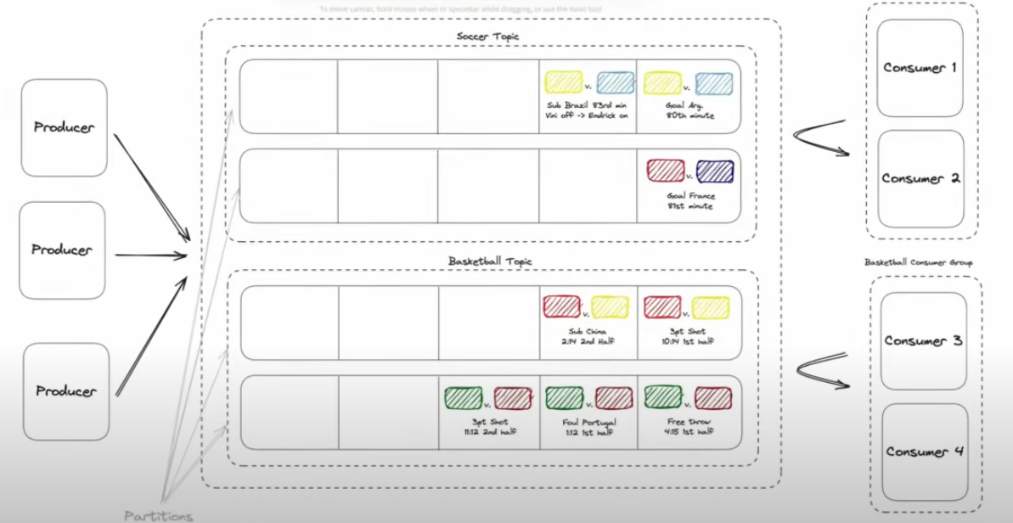
Overview
What happens if we want to expand – Example start with producing data for soccer event and want to add basketball events, but two different application so get the data ( 1 application for soccer and one for basketball: Topics
Each event will be associated to a topic and consumers will
subscribe to a topic.
  Can have two topics: soccer and basketball
The set of problems in this Overview gets you to a Kafka Cluser

Slide 8
Overview
Terms
  Broker – Set of severs
  Servers – Contains the queues
  Queues ( Partitions ) -- Ordered, Immutable sequence of messages
  Topics – Logical groups of partitions
    exist in code
    organizing data
  Partition – Physical grouping of partitions
    exist on disk
    scale data
  Producers – Write records from topics
  Consumers -- Read records from topics
  Consumer Group – A group of consumers where each request is consumed by one consumer.
Each broker can have multiple partitions

Slide 9
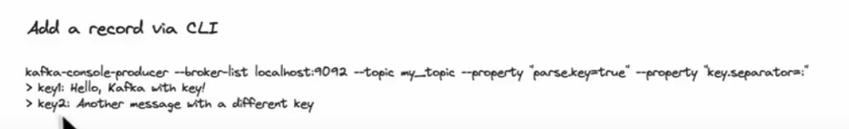
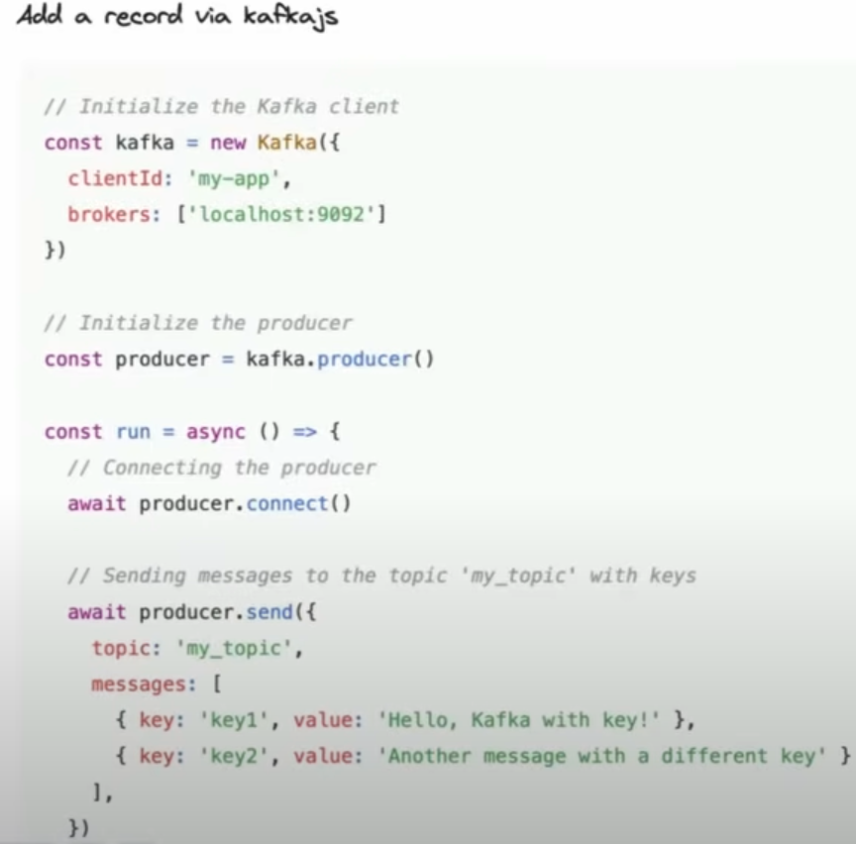
Overview
Lifecycle of a message
  Producer will create and public a message
  A message consist of Headers, Key, Value, Timestamp
    timestamp – Determines ordering default machine time
  Producer creates a message
    A producer produces a message-
      See two Example – Command Line and JS

Slide 10
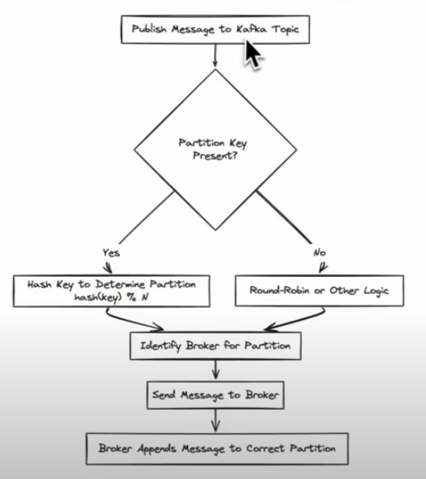
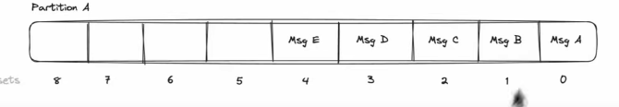
Overview
The message is send to a partition
  Round Robin logic works for simple problems not scaling
  hash key % N – Equation to determine the Partition
The message is appended to the Append message Log
file
  Note the corresponding offset ( 0,1,2..)

Slide 11
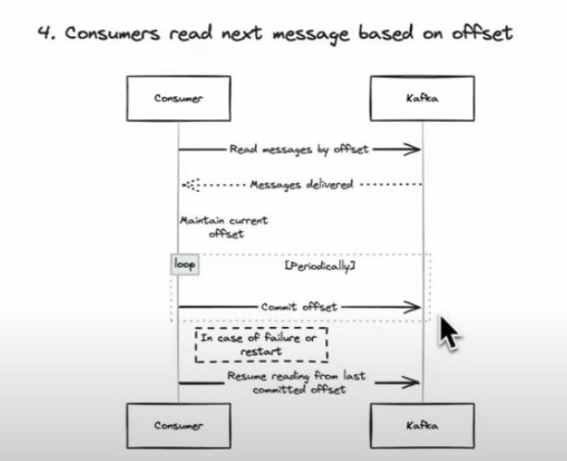
Overview
Consumers consume a message by specifying the
last message’s offset
What happens if a consumer goes down and it forgets its offset
  Consumer periodically commits its offsets to Kafka
  Kafka now nows what offsets have been read by the consumer group
  and can provide the last message if the offset is forgotten

Slide 12
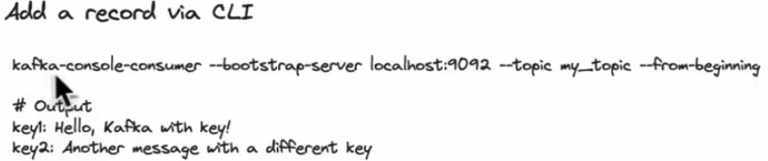
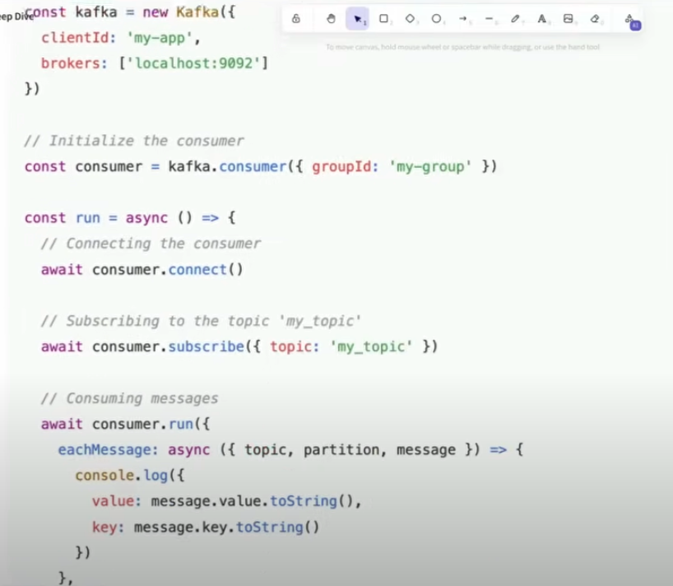
Overview
Reading from kafka

Slide 13
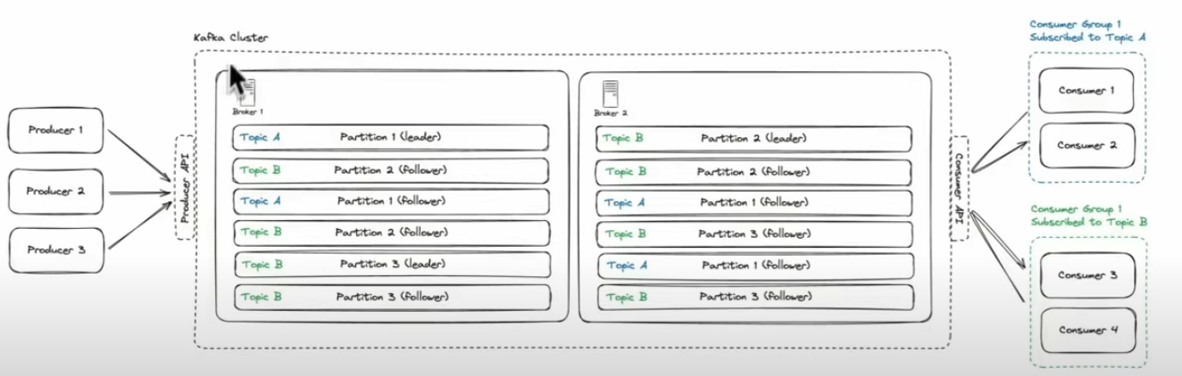
Overview
In order to achieve durability and availability we have a replication mechanism
  Each partition is designated a leader replica which handles the read/write request to the partition
  The Cluster controller decides who the leader will ensure the leader replica is effect distributed across the cluster to balance the load
  The followers don’t handle direct client request, but passively replicate the data from the leader and are ready to take over if the leader goes down
A picture to put it together

Slide 14
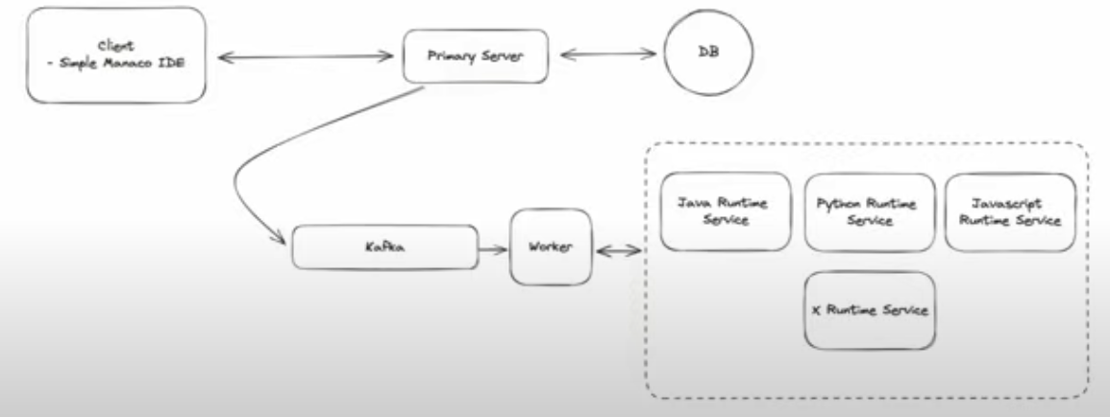
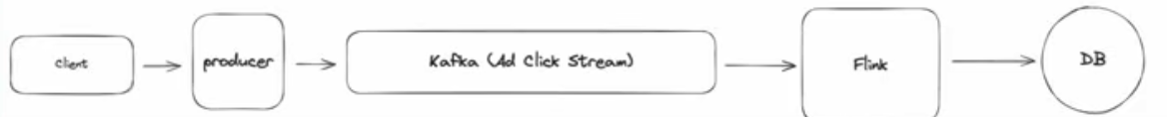
When to Use
When to use Kafka in an interview
  Anytime you need a message queue
    Processing can be done Asynchronously
  Need In order processing ( Used as a queue )
  Decouple the producer and consumer
    See image on right
    want to scale independently
  Any time you need to stream
    See image on the right
    Need to process realtime data ( ad click
    aggregator)
    flink is the consumer

Slide 15
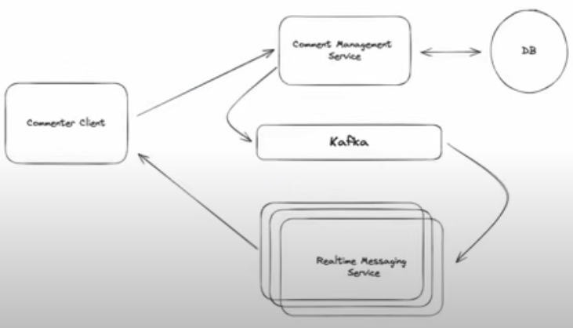
When to use
Stream of messages to be processed by multiple consumers simultaneously
  Example an user comments on a live stream and it updated on everyone’s else screen
  called pubsub

Slide 16
Deep Dives
Scalability
  Constraints: Aim for < 1MB per message to ensure optimal performance
    Don’t overwhelm network or memory
    Example have a message with a video blob is bad ( overwhelm resources )
      instead have a key videoId with an S3URL instead of the video blob
  One broker can store a terabyte of data and handle 10000 messages per second
    Good Baseline
    Do the math and ask do your system exceed this. If not then perhaps you don’t need scaling.
  However, if you need to scale
    More Brokers
      More resources need ( disk, memory), but process more message
    Create a good partition key
      Bad key : Your data show up on one partition overwhelming traffic
      Good key evenly distribute over partition space
  Scaling is made easy by Managed Cloud services – Example AWS
    only thing you need is to pick your own partition key

Slide 17
Deep Dives – 33:20
  hot partition
    Definition : Everything is going to a single partition
    Ways to handle a hot partition
      Remove the key from the messages
        By doing so, randomly distribute your keys across partitions
      Compound key – AdIin or AdId:UserId
        Change to a compound key ex. Adlin Key to compound key Adid:UserId
        Could change it to random number for each partition ex Adin:1, Adin:2 etc…
        Take a hot partition and spread it out.
        Need logic in the producer that understand which partitions are hot and does this concatenation on keys in those partitions
        No ordering for these keys anymore
      Back pressure slow down producer
        Our producer can understand our topic is overwhelm and slow down the rate of productino

