Slide 2
Network Address Translation (NAT)
Designed to overcome IPv4 shortages
IPv4 addresses are either publicly routable or they fall within the private address space of IPv4
Public Routable Address are assigned by a central agency and regional agencies and assign them to ISPs and then get assigned to users
  Each IPv4 Address must be unique
  Private addresses such as those in the 10.0.0 range can be used in multiple places, but cannot be routed over the internet
    To give internet access to private devices use NAT
Types of NAT – All translate private ip address to Public IP Address
  Static NAT – 1 private to 1 fix public address ( IGW )
    used where IPs need to be consistent
  Dynamic NAT – 1 private to !st available public
    Have a pool of public addresses
  Port Address Translation (PAT) – Many private to 1 public (NATGW)
    ex. Home internet router – Many devices to one public ip address

Slide 3
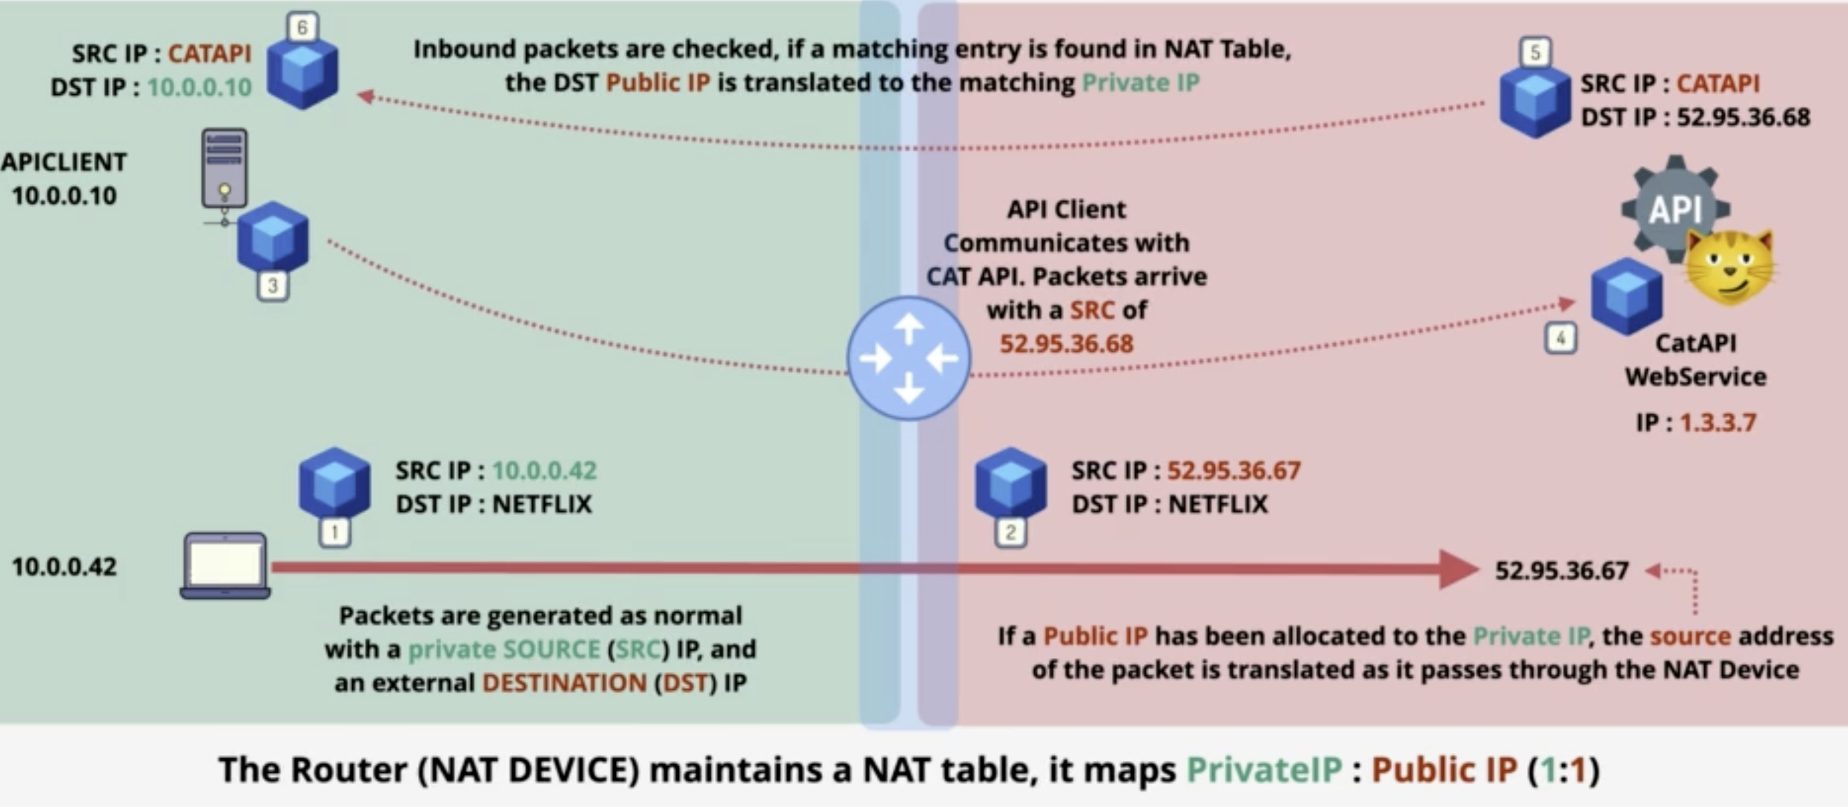
Network Address Translation (NAT)
Public Network on right and Private Network on left
Symbol with 4 arrows pointing in is a NAT Gateway
There is an entry in the NAT Table for the laptop on
the bottom left
  SRCIP 10.0.0.42 – Private
  Dest IP:Netflix (52.95.36.67) – Static
AWS – Process performed by the internet gateway
For the server, the CAT API responds with the CAT API
as the source and the dest is the original source ip addr

Slide 4
IP Address and Subneting
The number of IPv4 address which is 4,294,967,296 which is less than one address per person
Part of the address space is private and can used an reused freely
Address Spaces
  Class A
    Start at 0.0.0.0 and end at 127.255.255.255
    Contains 128 Networks which has 16,777,216 IPs Each
    These were reserved for huge networks such as big businesses
      Ex. Apple, Military
      Many of these organization have given up these ranges
    0. anything is reserved.
    The first octet denotes the network and the remaining for host and subnetting
  Class B
    Start at 128.0.0.0 and Ends at 191.255.255.255
    Contains 16 Networks with 65,36
    Typically used for large businesses, but these ranges have been given up.
    The first two octets are the network and the last two octets can be used for devices and subnetting

Slide 5
IP Address and Subnetting
  Class C
    starts at 192.0.0.0 and ends at 223.255.255.255
    2,097,152 Networks with 256 IPS Each
    The first three octects deno the network and the remaining are for host and subnetting
    Used for smaller businesses and allocated for authroies
  Class D is used for multicast
  Class E is reserved
Three Ranges that can only be used internally – Are not routable across the IPv4 internet
  First Private range
    10.0.90.0 to 10.255.255.255 ( 1 x Class A Network )
    provides a total of 16,777,216 IPv4 addresses
    Used in cloud environments and chopped into smaller subnetworks
  Second private range
    172.16.0.0 - 172.31.255.255 ( 16 x Class B Networks )
    172.16, 172.17, 172.18, 172.19

Slide 6
IP Address and Subnetting
  Third Private Range
    192.168.0.0 to 192.168.255.255 ( 256 x Class C networks )
    192.168.0, 192.168.1, 192.168.2 …. 192.168.255
    Used within home and small office networks
    Use them for the devices and the router provides NAT Translation Devices
  With these ranges avoid using the same one multiple times.
    If two private networks are connect that use the same addressing there will be trouble configuring
Ipv6 – 340,282,366,920,938,463,463,374,607,431,770,000,000 IP Addresses

Slide 7
IP Address and Subnetting
  Third Type

