Slide 1
Cloud Warmup Night

Slide 2
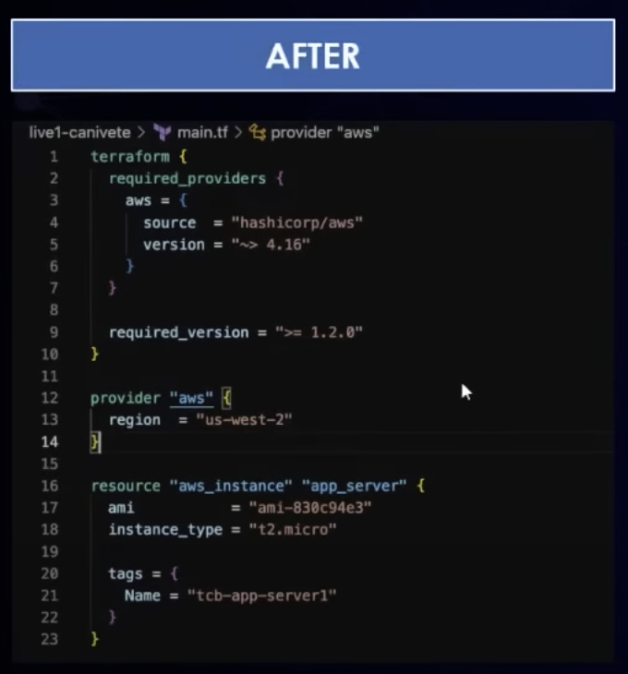
Toolkit of the MultiCloud & DevOps Professional
Terraform – Infrastructure provisioning
  cloud Agnostic
Iaas – Provision infrastructure in multi cloud environment fully
automated at scale
Ansible – Environment Configuration
  A playbook is a set of tasks executed by Ansible in parallel across multiple
  servers ( that are defined in hosts )
  ansible-playbook -i hosts install-apachye.yam
    -i The host you want to configure
  For each host open an ssh session at the same time so the work is done in
  parallel
Docker
  A container runtime to deploy containers in the cloud without running servers
  Don’t need to manage virtual machines ( ??? )
Kubernetes
  Container Orchestration
  Create a cluster of where each pod has the same application
    A pod can hold one or more containers
  Scalable –

Slide 3
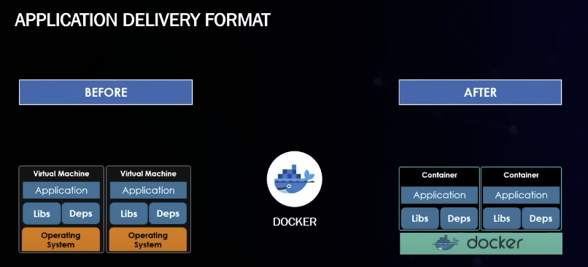
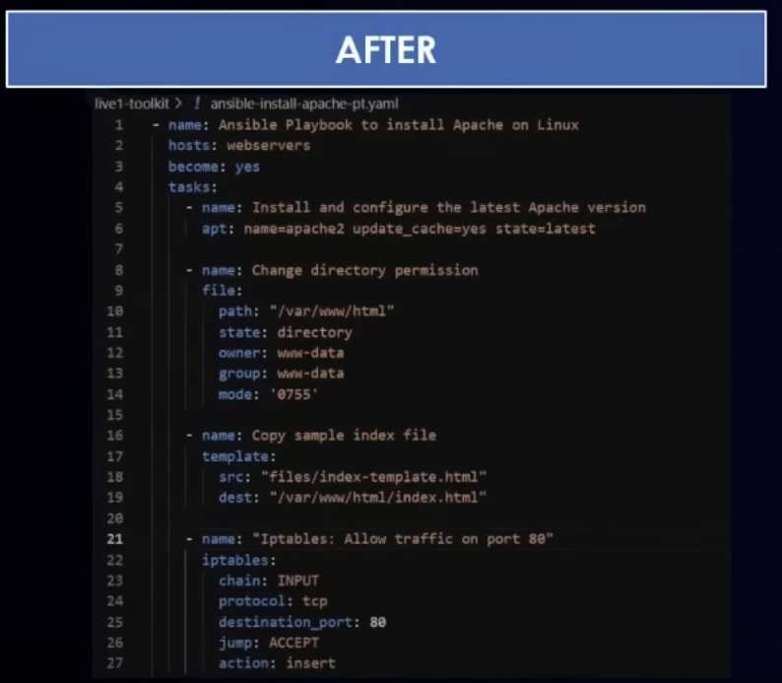
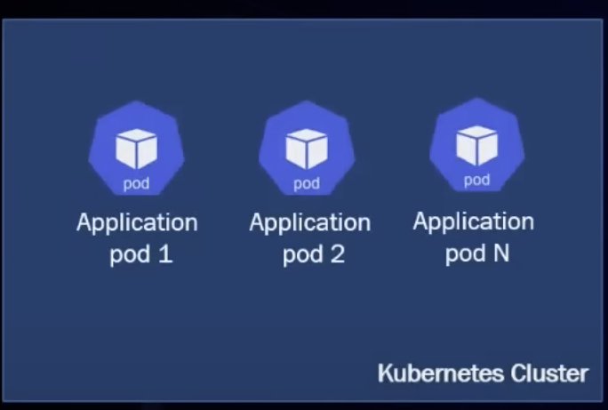
Toolkit of the MultiCloud & DevOps Professional
ansible

Slide 4
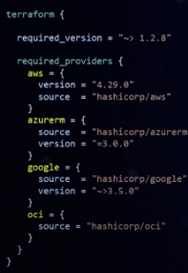
Hands on with Terraform and AWS
What is Terraform
  An infrastructure as code (IaC) tool that lets you build/change/version
  both cloud and on-premises resources
  Cloud Agnostic
  declarative language (HCL)
  Agentless or Masterless
Use Cases
  Resource Provisioning on Cloud Providers
    plugins connected to providers
    MultiCloud Deployments
  Resource provisiioning on vmware environments
Combine with multiple tools together
  Ansible / Kubernetes

Slide 5
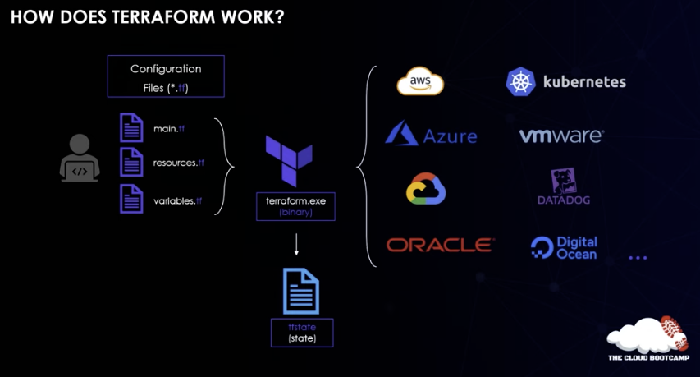
Hands on with Terraform and AWS
How does Terraform work
  main.tf, resources.tf, variable.tf
  State file only provision what is not
  there and configured correctly

Slide 6
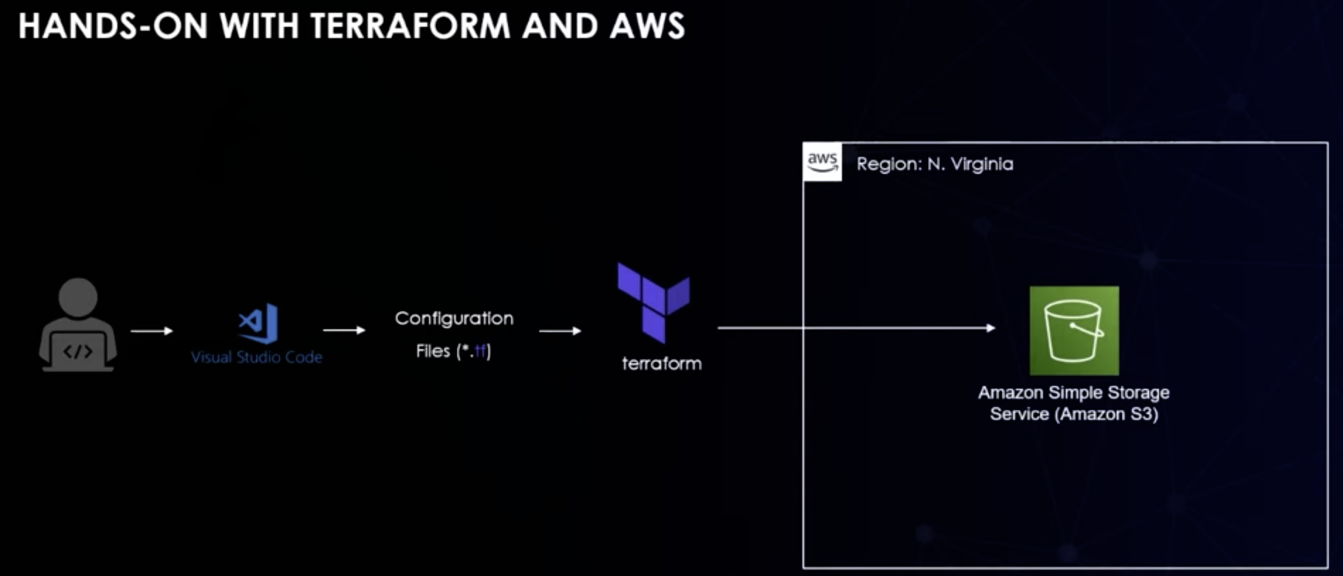
Hands on with Terraform and AWS
https://registry.terraform.io/

Slide 7
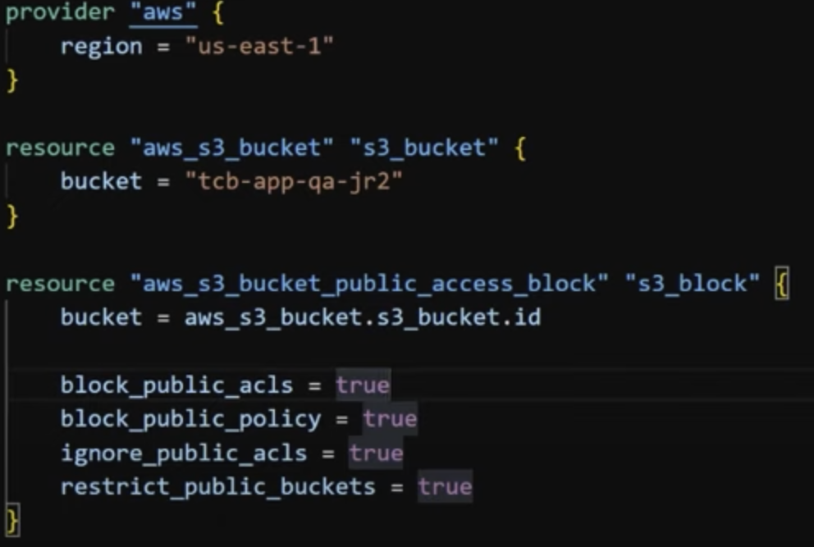
Hands on with Terraform and AWS
resource <type> <name>
Execution
  Install Terraform on your machine
    https://developer.hashicorp.com/terraform/tutorials/
    aws-get-started/install-cli
  Can Use CloudShell from AWS
    Select the amazon/linux instructions from Terraform
    upload the Terraform file ( extension tf)
    terraform init // Download the AWS Files needed by AWS
    terraform plan // Dry run what is Terraform going to do
    terraform apply // Provisioning
Next Request – Can you remove access
  terraform now looks at the state file and understands what
  resources and configuration needs to be completed
    The S3 bucket will not be created again
terraform destroy // Remove the infrastructure create by terraform

Slide 8
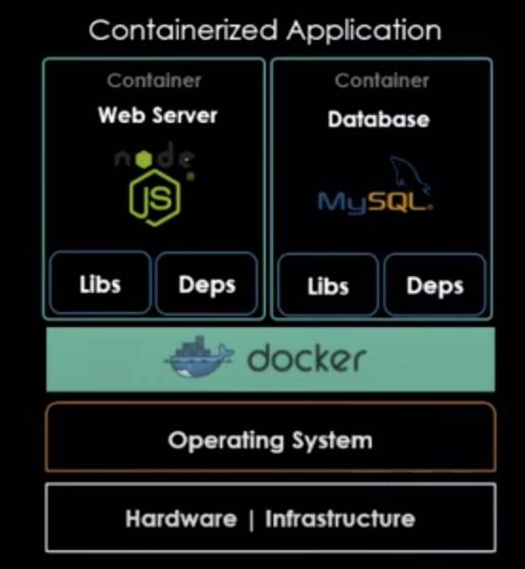
Docker on Cloud
What is Docker
  An open source platform for building, deploying and managing containerized applications
App Modernization – microservices architecture
Advantages
  Portable
  Extremely Light
  Works on all machines instead of “It works on my machine”
  isolated and independent architecture
Use Cases
  Modernization from traditional to Microservices applications
    If a container fails only part of the application will be unavailable
    New dpeloys without affecting other components/services
Deployment Pattern – Docker Images are build using definition files
Similar Environments
  Docker Runs anywhere, anytime
  You just need Docker installed

Slide 9
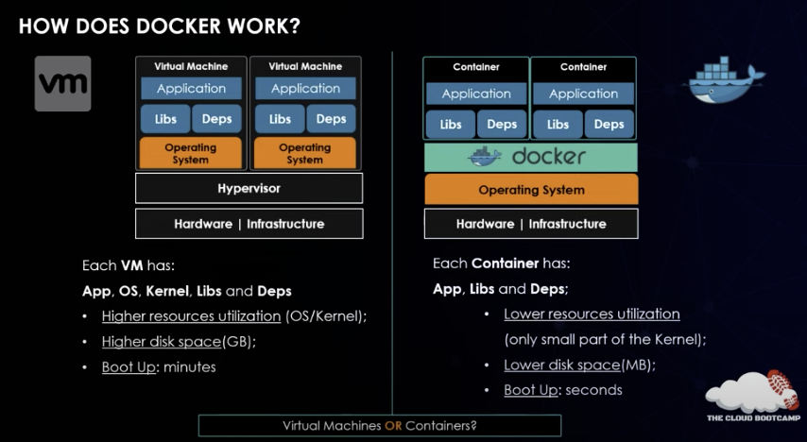
Docker on Cloud
How does docker work
  Operating sytem is not part of the container, but outside.
  Container runtime – Allocates new containers
  Container engine – Bridge and communication with the
  operating system
  The container only has the libraries and dependencies
Virtual machines are really only be used for applications that cannot
be modernized

Slide 10
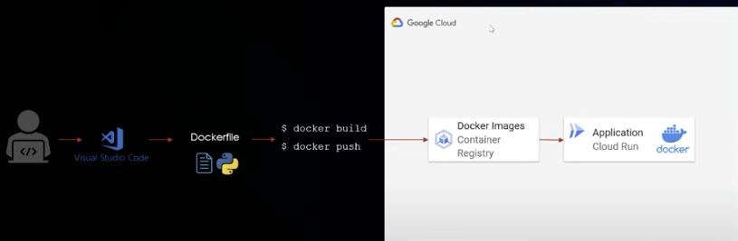
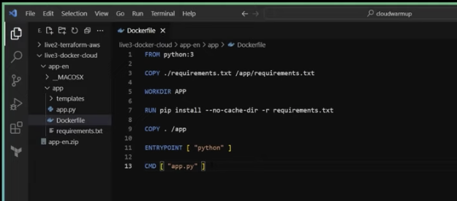
Docker on Cloud
Hands on with Docker on cloud
  Cloud Run – A servless service to deploy docker
  containers without managing infrastructure
dockerhub
  commands in a docker file
    From
    Copy
    Workdir – The working directory
    RUN – executes commands
    EntryPoint – Commands to start application
    CMD – argument to the entry point
commands
  docker build -t app:1.0 .
    app:1.0 is the tag
    . is the directory that docker is build in

Slide 11
Docker on Cloud
  docker container run --name app -p 5000:5000 app:1.0
    -name – name of the container
    -p – port forwarding
  docker container ls // Show all containers running
  docker container ls --all // Show all containers running and stopped
  docker tag app:1.0 us.gcr.io./dootted-rookery--321921/app ( see 46:40 )
  docker image ls – will show both the old and new tag
  docker push dootted-rookery--321921/app // The second tag

Slide 12
Hands-on with Kubernetes on Cloud
What is Kubernetes
  A popular container orchestration system organized by projects
  Deployment based on simple yaml
  Open source and supported by public cloud providers
Use Cases
  Container Orchestration in Microservices Architectures
    K8S manages containers and optimizes processes
  Environments that require High Availability / Scalability
    K*S allows you to scale applications quickly
  Fit to any type of cloud ( Public, Private, Hybrid, MultiCloud )
How does Kubernetes works
  Nodes – A place to run containers
  Cluster – Set of nodes
    If a node fails an application should survive

Slide 13
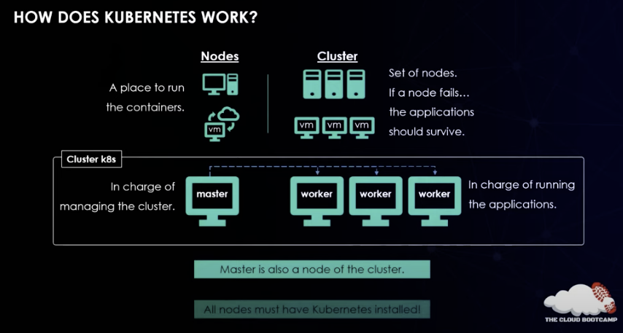
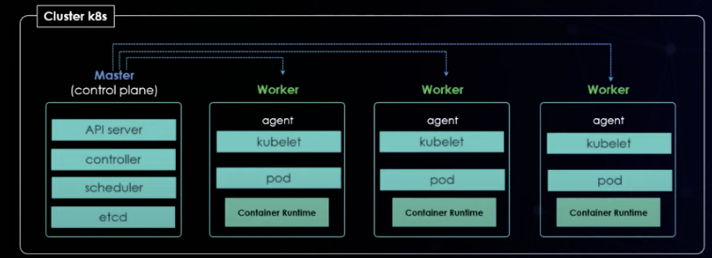
Hands-on with Kubernetes on Cloud
  Architecture
    Master Node ( Control Plane )
      API Server
        Exposes the Kubernetes API
        to the developer
      Controller
        Noticing and responding when
        nodes go down
      Scheduler
        looks for newly created
        pods with no assigned node
        and selects a node to run on
      etcd
        Highly Scalable Key Value
        Store to store cluster data
    Worker Nodes-- Container responsible for
    running nodes
      Container RunTime -- Responsible for
      running containers
      Kublet – Agents run on each node and
      make sure containers are running in a pod
      ‘pod - A group of one or more containers
      with storage/network resource and a spec

Slide 14
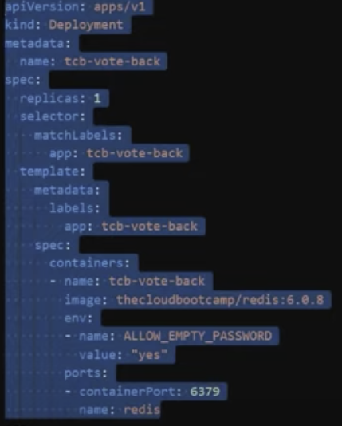
Hands-on with Kubernetes on Cloud
Usually have two different pods: one for the backend and one for the frontend
  The frontend and backend could be inside the same pod which could make it a
  monolith.
Analysis of Kubernetes YAML Config file
  Deployment Block – Configuration for pods in the Kubernetes Cluster
    Specification – How Kubernetes should run the container
    `env: – specifics the environment variables
    ports

Slide 15
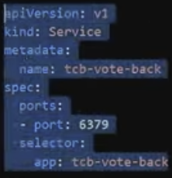
Hands-on with Kubernetes on Cloud
Service Block – Responsible for exposing port for the front end and backend to communicate
Another deployment Block which focuses on the front end – No Image
Service block which focuses on the front end – No Image
For Google Cloud Sheell
  gcloud config set project <project id>
  gcloud services enable clouddbuild.googleapis.com--projet <product id>
  gcloud builds submit --tag gcr.io/dotted-rookery-321921/tcb-vote-front
    Builds the docker images and puts them in the container registry
  Next Step is kubectl apply – create the cluster
    update the config image and add the id to the spec → image
  Next Step – See Second Picture to generate the kubeconfig entry
kube commands
  kubectl get nodes – kuebctl is communicating with API to get the number of nodes
  kubectl apply -f tab-vot-plus-redis-v2.yaml – Deploy the backend
  automatic – pay only if you have pods running –

Slide 16
Hands-on with Kubernetes on Cloud
Kubernetes increases the number of pods when there is load on the system.
kubectl get pods
kubctl get deployment tcb-vote-front
kubectl autoscale deplymnent tcb-vote-front --cpu-percent=50 --min =1 --max=10 When cpu usage reach 50% scale out by adding pods
kubectl get hpa ( horizontal part of scalar) – Show the minpods, maxpods, replicas
Rum a ;load generator bottom picture
Scales in automatically, but take more time to scale in to verify that the extra resources are not needed

Slide 17
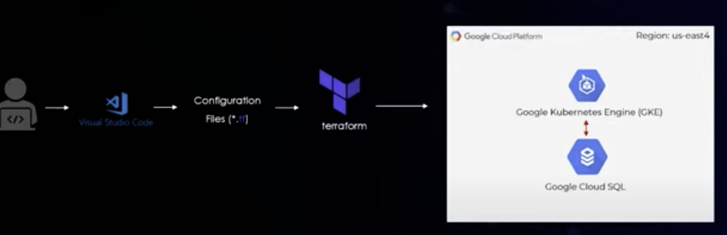
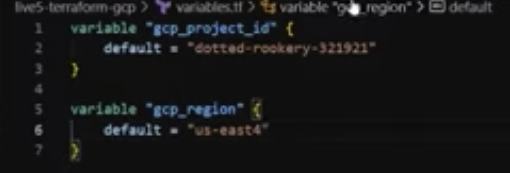
Terraform on Google Cloud
Architecture for today --------------------------------→
  We will provision one Kubernetes Cluster and
  Goggle Cloud SQL – a service to provision databases
  on SQL
Need tow files
  variables.tf
  main.tf
  get the product ID from Google

Slide 18
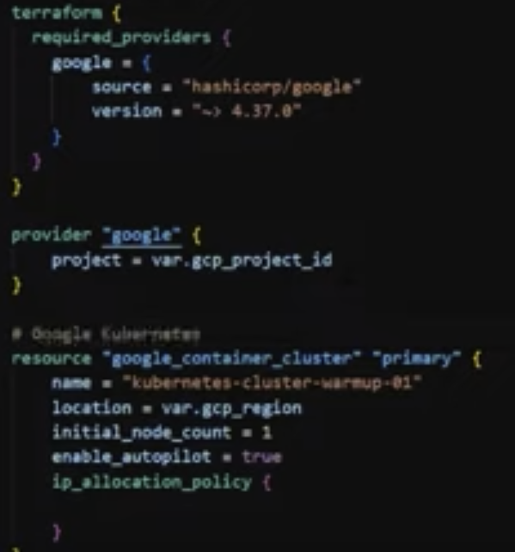
Terraform on Google Cloud
To access a variable from variable.fm use var.<variable name>
resource <type of resource> <name>
Part 1 of the cluster code -----------------------------------------------------------

Slide 19
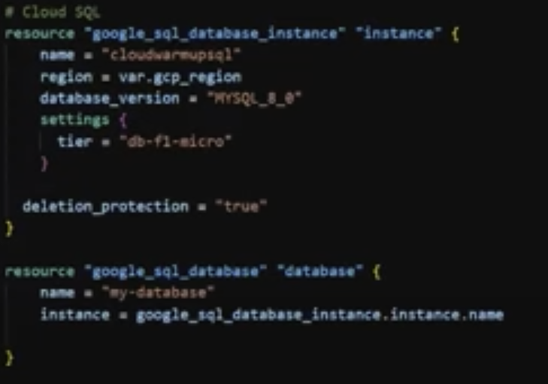
Terraform on Google Cloud
Second part of the main.tf document -============================
-

Slide 20
Terraform on Google Cloud
Architecture for today --------------------------------→
  We will provision one Kubernetes Cluster and
  Goggle Cloud SQL – a service to provision databases
  on SQL
Need tow files
  variables.tf
  main.tf
  get the product ID from Google

Slide 21
Terraform on Google Cloud
To access a variable from var.fm ue var.<variable name>
resource <type of resource> <name>

