Slide 1
Data Structure and Algorithm Analysis
Guo Yuhang (郭宇航)
guoyuhang@bit.edu.cn

Slide 2
class information
classes
week 4(2020-September-29)-17
Tuesday 6,7 13:20-14:55 良乡理教楼208
Friday 1,2 8:00-9:35 良乡理教楼208
hours
lecture: 40
lab: 16
instructor: Guo Yuhang

Slide 3
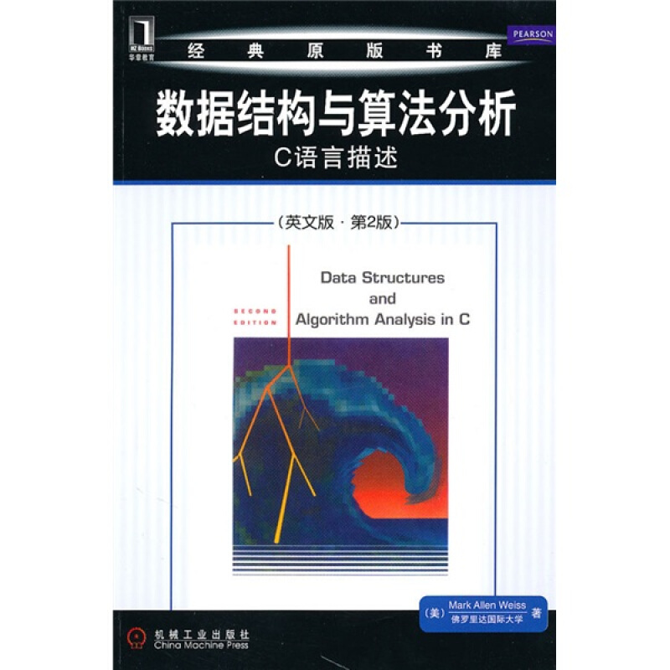
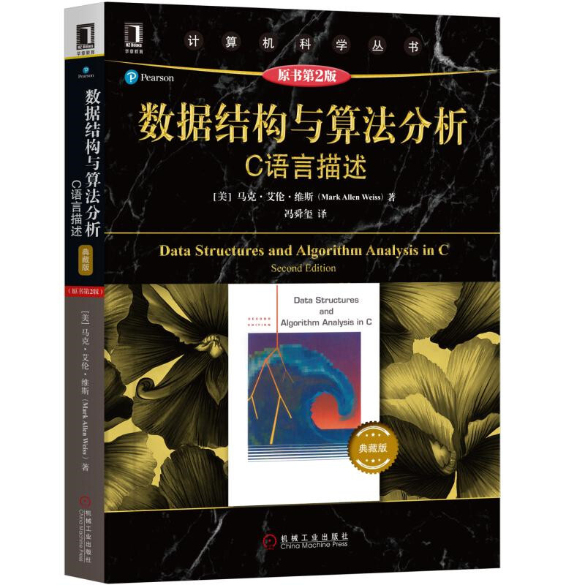
text book
Data Structures and Algorithm Analysis in C (DSAAC)
by Mark Allen Weiss

Slide 4
reference
text book
数据结构（C语言版）
严蔚敏，吴伟民 编
MOOC
中国大学MOOC：www.icourse163.org
浙江大学：陈越、何钦铭
学堂在线：tsinghua.xuntangx.com
清华大学：邓俊辉
lab
online.bit.edu.cn
乐学 2020-2021 第一学期 数据结构(2020双语班)

Slide 5
grading
exercises, homework and attendance (10%)
experiments (20%)
consultation allowed but no copying
late submission not accepted
exam (70%)
Notes:
我们有查重的工具

Slide 6
lets begin

