Slide 1
Sasha Goldshtein blog.sashag.net CTO, Sela Group @goldshtn
Production Monitoring and Diagnostics of .NET Applications

Slide 2
Semantic logging
ETW instrumentation and tracing
Automatic performance monitoring and trace analysis
Dump files
CLRMD
Automatic extraction and analysis of dump files

Slide 3
Introduction to ETW

Slide 4
Performance Monitoring Spectrum
Performance metrics and simulations
Development-time profiling
Performance/load tests
Production-time performance investigations
Continuous low-overhead monitoring
Today’s focus

Slide 5
Problems with Traditional Profilers
Invasiveness
Often requires restart or code injection
Overhead
2x slowdowns are not unheard of
Trace size
Often not applicable for continuous monitoring for hours/days on end
Licensing costs
Production mode or remote profiling mode not always available

Slide 6
Event Tracing for Windows
High-performance facility for emitting 100K+ log events per second with rich payloads and stack trace support
Used widely across Windows, .NET, drivers, services, third party components

Slide 7
ETW Participants
A provider generates ETW events
A controller starts and stops ETW collection
A consumer logs, analyzes, or processes ETW events
Providers
Controllers
buffers
events
Event tracing sessions
Log files
real-time
events
logged events
Providers
Providers
Providers
Providers
Providers
Consumers

Slide 8
Sample ETW Scenarios
Profile an app in sampling mode
Perform wait-time analysis
Log disk accesses including stacks
Log GC and JIT events
Log memory allocation statistics (.NET/C++)
Custom application event log

Slide 9
Semantic Logging

Slide 10
Semantic Logging
Unstructured logs are a thing of the past
Require additional parsing, discipline, and tools to get through
Semantic logging associates structure with each log message
Unstructured | Structured
[572 09:04:10.112/@prod1] WARN Connection to cluster head node head1 lost, attempting reconnect in 2 seconds from prod2; this may be a temporary failure | TYPE = CONN_HEAD_LOST ID = 572 TIME = 09:04:10.112 SERVER = prod1 HEAD_NODE = head1 RECONNECT_IN = 00:00:02 RECONNECT_FROM = prod2

Slide 11
ETW Events Have Structure
Each ETW event has a well-defined payload
Tools can use the payload format to easily consume and analyze large volumes of logging information
<Event MSec="5905.4352" PID="476" PName="explorer" TID="2352" EventName="EdgeUi_Invoke_Mouse_HitSingleEdge"
TimeStamp="12/01/14 21:56:06.880587" ID="3205"
Level="Informational" CPU="7" EventIndex="27983"
ProviderName="Microsoft-Windows-Immersive-Shell" ...>
<PrettyPrint>
<Event ... EdgeUiComponent="3"/>
</PrettyPrint>
...
</Event>

Slide 12
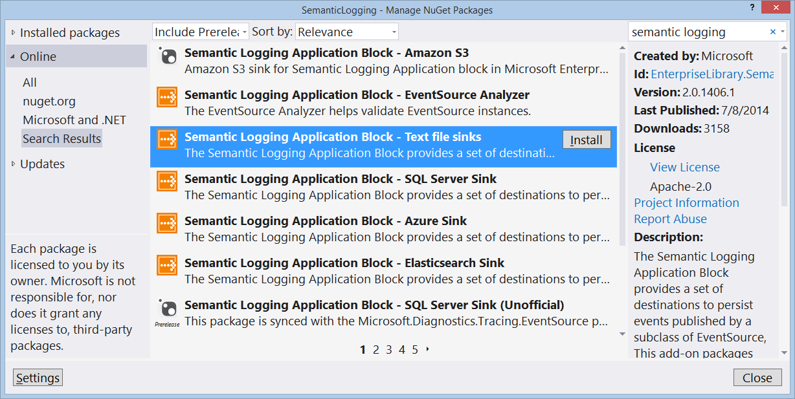
Semantic Logging Application Block
A p&p project that logs events from an ETW provider to a database, text file, Azure storage, ElasticSearch, etc.

Slide 13
EventSource
The EventSource class greatly simplifies ETW providers in .NET applications
class PerformanceEventsSource : EventSource
{
public void StartOperation(string op) { WriteEvent(1, op); }
[Event(2, Message = "Completed {0} with result {1}")]
public void StopOperation(string op, string result)
{
WriteEvent(2, op, result);
}
}

Slide 14
Configuring SLAB
ConsoleLog.CreateListener().EnableEvents( OperationsEventSource.Log, EventLevel.LogAlways);
RollingFlatFileLog.CreateListener(
"informational.log", 1000, "yyyy-MM-dd",
RollFileExistsBehavior.Increment, RollInterval.Hour)
.EnableEvents(OperationsEventSource.Log, EventLevel.Informational);
var listener = new ObservableEventListener();
listener.EnableEvents(OperationsEventSource.Log, EventLevel.LogAlways);
listener.LogToElasticsearch(Environment.MachineName, "http://localhost:9200", "slab", "logs", bufferingCount: 1);

Slide 15
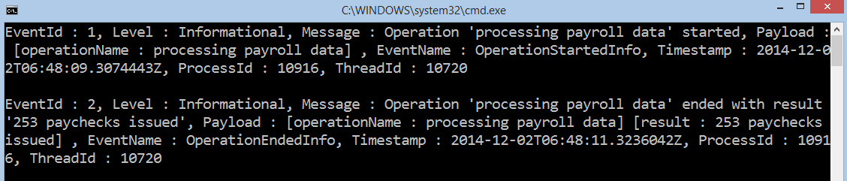
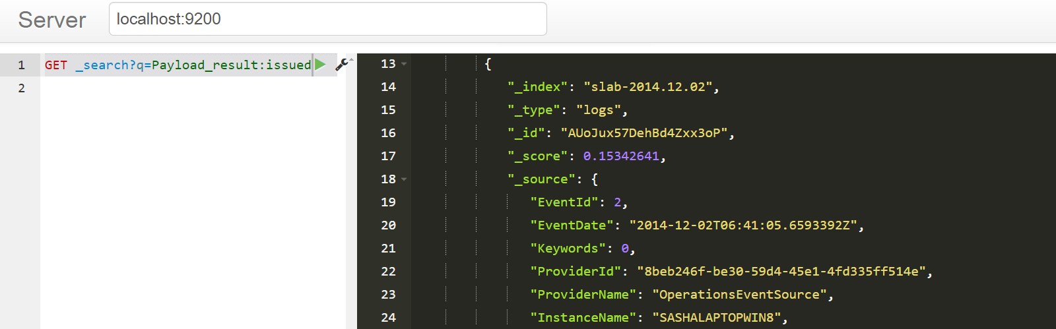
Structured Payload Examples

Slide 16
Lab 1: Your First Structured Log

Slide 17
Trace Capturing and Analysis

Slide 18
ETW Tools
xperf.exe: Command-line tool for ETW capturing and processing
wpr.exe: Command-line and GUI for end users
wpa.exe: Visual trace analysis tool
PerfView.exe: Visual tool for capturing and recording ETW events from managed providers and the CLR
logman.exe, tracerpt.exe: Built-in Windows tools for trace recording and formatting

Slide 19
Production Use
All ETW tools are suitable for production use
Some things to watch out for:
Choose event providers carefully to minimize the performance impact on the system
Capture to a circular log file to avoid running out of disk space
Set triggers to stop collection (and keep all preceding events) when a critical event occurs

Slide 20
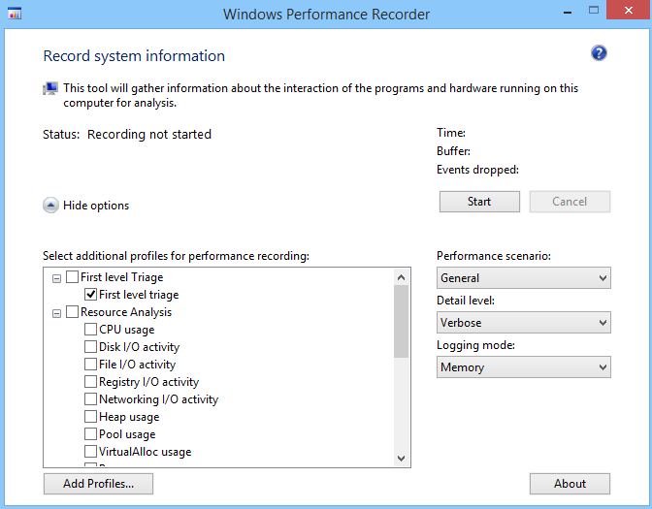
Capturing a Trace
Xperf
xperf -on DiagEasy
...
xperf -d diag.etl
WPR

Slide 21
Xperf Providers and Flags
Xperf makes it easy to capture a trace from the kernel provider using a set of flags and groups
Examples:
Group | Flags
Base | PROC_THREAD, LOADER, DISK_IO, HARD_FAULTS, PROFILE, MEMINFO, MEMINFO_WS
FileIO | PROC_THREAD, LOADER, DISK_IO, HARD_FAULTS, FILE_IO, FILE_IO_INIT
SysProf | PROC_THREAD, LOADER, PROFILE
File create, delete, read, write, etc. operations
Process/thread creation/deletion
1ms sampling event for profiling

Slide 22
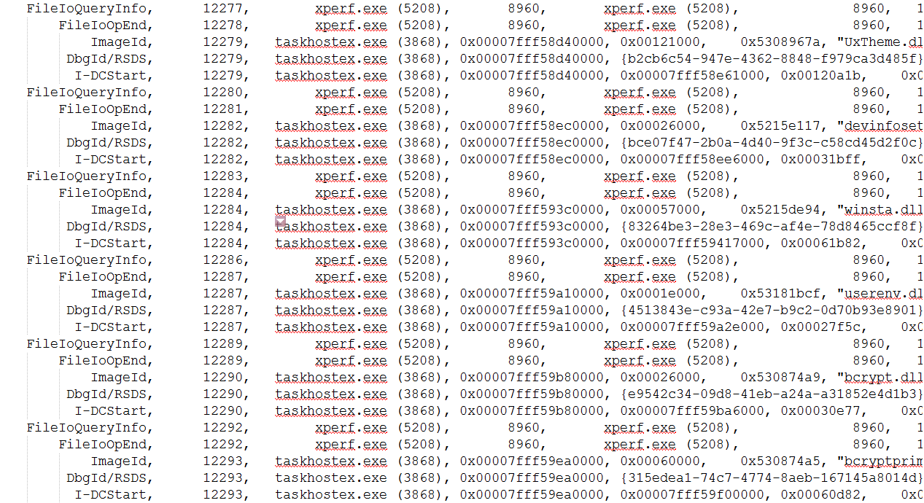
What’s In A Trace?
A trace is a huge list of events
Events have multiple columns (payload)
Useless without additional processing

Slide 23
Trace Processing with Xperf
I/O summary report per file
xperf -i fileio.etl -o fileio.csv -a diskio -summary
Interactive profiling report (for a specific process)
xperf -i cpu.etl -o cpu.html -symbols -a stacks -process app.exe -butterfly

Slide 24
Managed Stacks
To display managed stack traces correctly, additional CLR data is required
WPR & PerfView take care of this automatically
If using Xperf, see:
http://msdn.microsoft.com/en-us/library/windows/desktop/hh448186.aspx

Slide 25
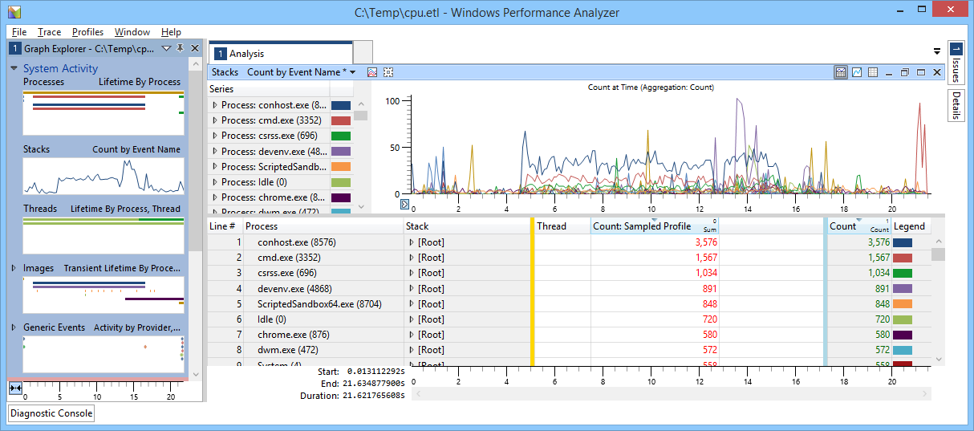
Trace Analysis with WPA
Graph display
List of graphs
Ungrouped columns
Grouped columns
Grouping bar

Slide 26
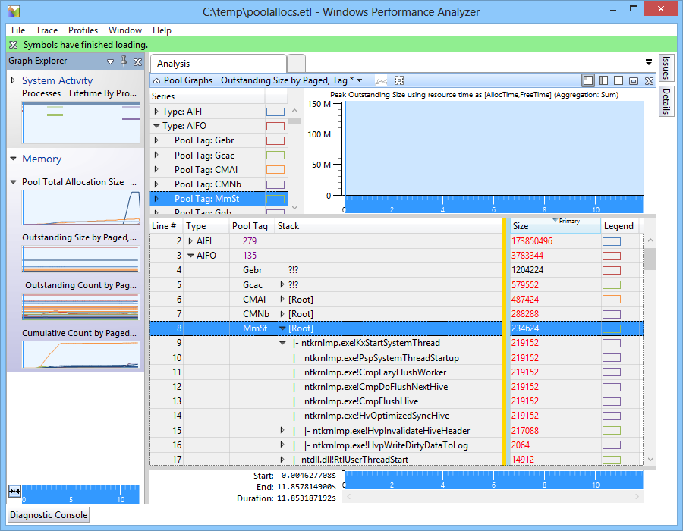
Stack Summaries
Learn how to read stack summaries
Group by Stack column
Expand “hot path”, like in profiler
Stack resolution requires symbols (slow)

Slide 27
Lab 2: Collecting File I/O Information

Slide 28
PerfView
ETW collection and analysis tool tailored for .NET applications (but not only)
Can be used as a sampling profiler
Can be used as an allocation profiler
Can be used for heap snapshot analysis

Slide 29
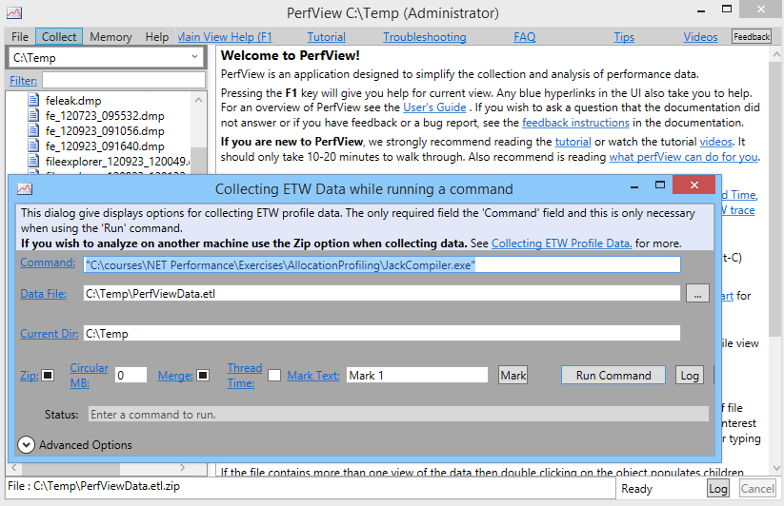
Collecting Data with PerfView
CLI
PerfView run app.exe
GUI
Option | Meaning
/MaxCollectSec:N | Stop collection after N seconds
/StartOnPerfCounter /StopOnPerfCounter | Start/stop collection based on performance counter
/Providers=… /OnlyProviders=… | Restrict to specific set of providers
/CircularMB:N | Circular logging N megabytes of newest events

Slide 30
Continuous Monitoring with PerfView
PerfView can be configured to record into a circular buffer in memory and stop on an interesting event
/Circular:512 /InMemoryCircularBuffer
Stop conditions (partial list):
/StopOnGCOverMSec:N
/StopOnRequestOverMSec:N
/StopOnPerfCounter:WHAT>N
/StopOnEtwEvent:PROVIDER/EVENT

Slide 31
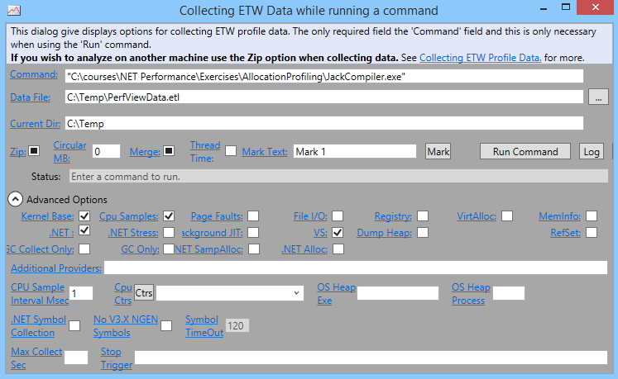
PerfView Collection Options
Profiling wall-clock time
File/registry accesses
CPU sampling profiling
Allocation profiling

Slide 32
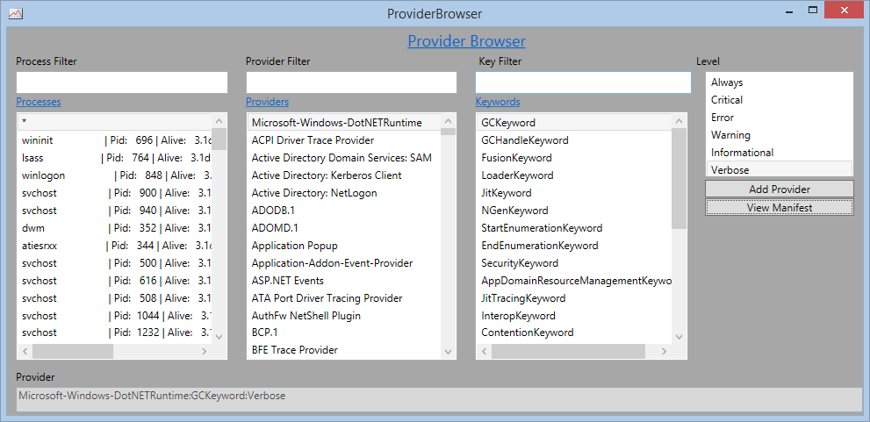
Browsing Installed Providers

Slide 33
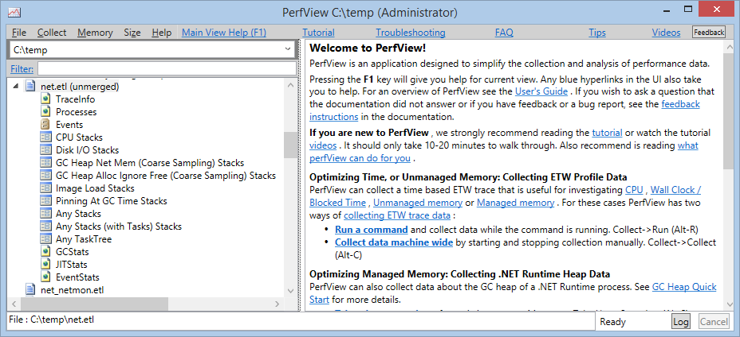
PerfView Reports
PerfView has built-in support for CPU utilization, GC and JIT information, disk and file I/O, and a bunch of additional reports

Slide 34
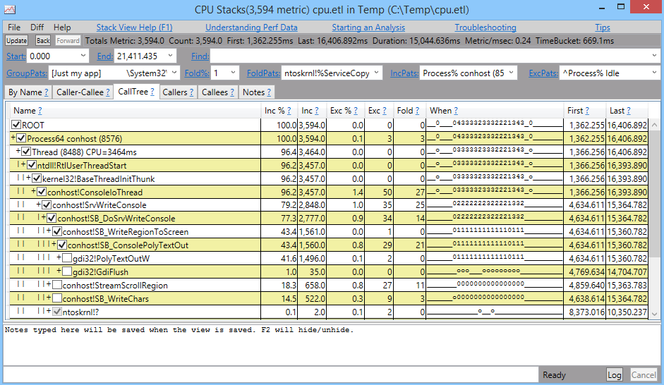
CPU Stacks
Grouping options
Filtering options
Call stack tree
In-trace activity highlighter

Slide 35
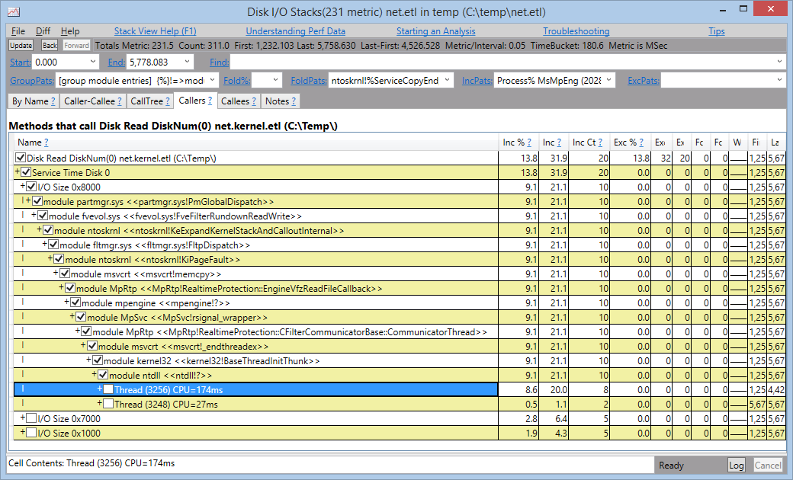
Disk I/O Stacks

Slide 36
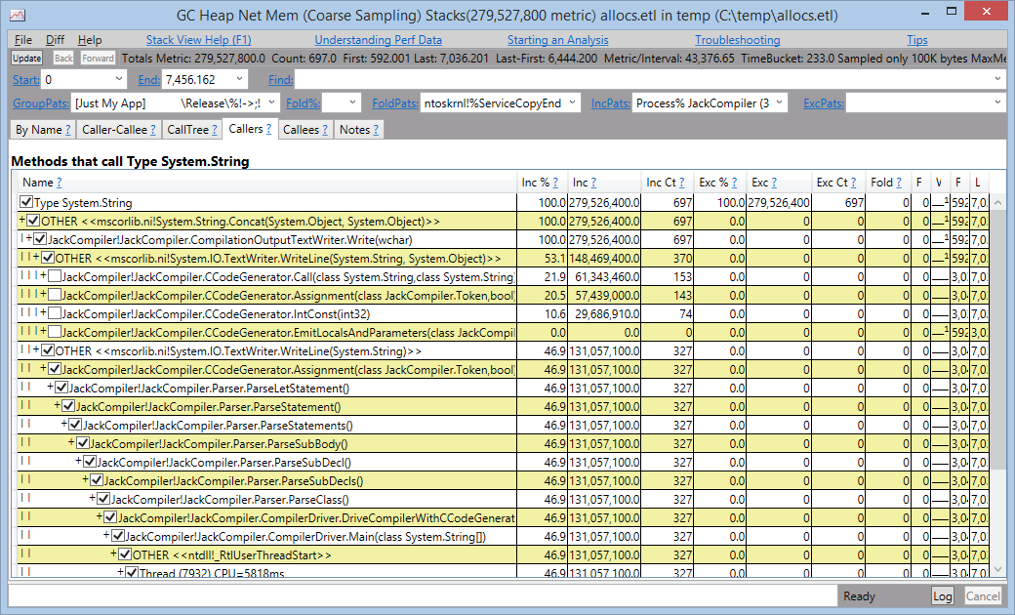
.NET Allocation Stacks

Slide 37
Lab 3: Diagnosing Slow Performance

Slide 38
Lab 4: Diagnosing Excessive Allocs

Slide 39
Memory Analysis with PerfView

Slide 40
.NET Memory Leak Analysis Process
Ascertain that a memory leak is present
Capture memory snapshots of target process usually done by capturing dump files or using a profiler that can capture snapshots
Compare snapshots to understand which objects are being added and not removed
Determine why these objects aren’t being garbage collected i.e., which reference paths are keeping the objects alive

Slide 41
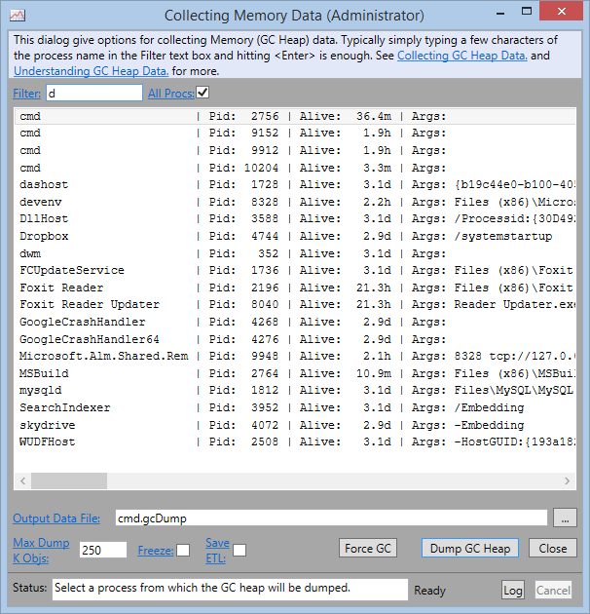
Memory Leak Analysis with PerfView
PerfView can generate heap snapshots (smaller than a dump), analyze, and compare them
Can also import dumps directly

Slide 42
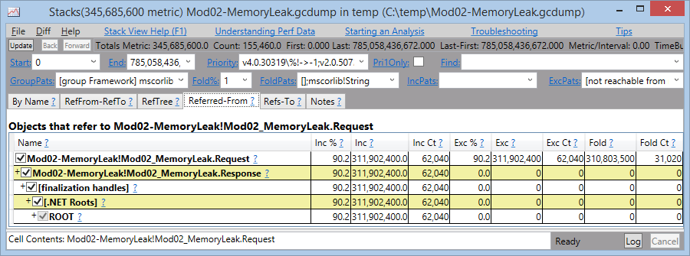
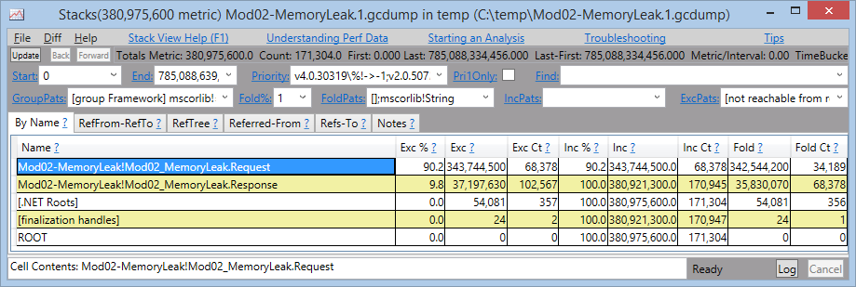
Comparing Snapshots
Baseline with referencing paths
Diff between snapshots

Slide 43
Lab 5: Memory Leak Analysis

Slide 44
Programmatic ETW Analysis

Slide 45
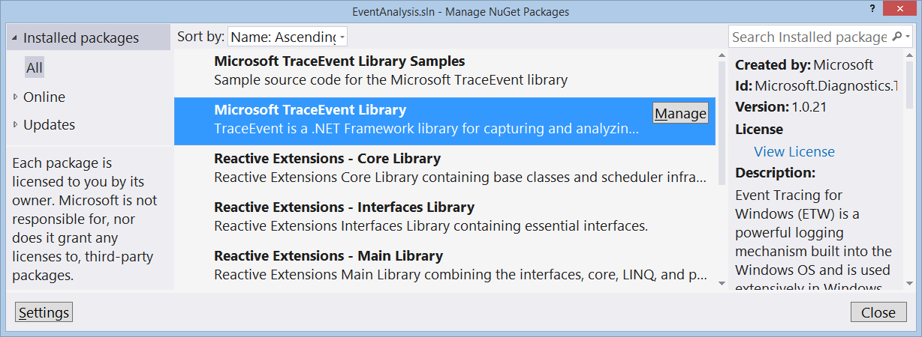
Automatic ETW Analysis
The TraceEvent NuGet package provides an ETW analysis API
Understands kernel and CLR events
Supports call stacks (incl. managed)
Can start ETW sessions and/or process log files

Slide 46
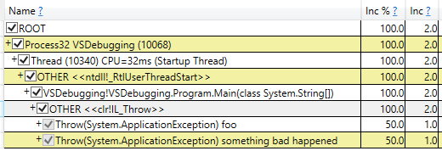
Example Analysis Scenarios
Monitor the system for CLR exceptions w/ stacks
ExceptionTraceData
Get a profiling trace and look for regressions
TraceLog
SampledProfileTraceData
TraceCallStack

Slide 47
Trace Analysis Example
var traceLog = TraceLog.OpenOrConvert("trace.etl");
var process = traceLog.Processes.LastProcessWithName(...);
var symbolReader = new SymbolReader(Console.Out, symPath);
foreach (var exc in process.EventsInProcess.ByEventType<ExceptionTraceData>())
{
Console.WriteLine(exc.ExceptionType);
Console.WriteLine(exc.ExceptionMessage);
var stack = exc.CallStack();
while (stack != null)
{
Console.WriteLine(stack.CodeAddress.Method.FullMethodName);
stack = stack.Caller;
}
}

Slide 48
Trace Session Example
var session = new TraceEventSession("ObserveGCs");
session.EnableProvider(ClrTraceEventParser.ProviderGuid, TraceEventLevel.Verbose, (ulong)ClrTraceEventParser.Keywords.GC);
// Allocation tick every 100KB
var alloc = session.Source.Clr.Observe<GCAllocationTickTraceData>();
alloc.Subscribe(ad => Console.WriteLine(ad.AllocationAmount));
var gc = session.Source.Clr.Observe<GCHeapStatsTraceData>();
gc.Subscribe(cd => Console.WriteLine(cd.GenerationSize2));
session.Source.Process();

Slide 49
Client1 Performance Monitoring Workflow
Web server
Web server
Analysis system
IIS, web application
Trace file collector
Symbol cache
ETW collection agent
Trace cache
Stack report files
Alerting
On-disk buffer

Slide 50
Client2 Boot Performance Analyzer
End-user system
Reporting dashboard
End-user system
End-user system
Boot collection agent
Post-boot trace analyzer
AutoLogger .etl

Slide 51
Lab 6: Live Trace Analysis

Slide 52
Production Debugging

Slide 53
Production Debugging
Requirements
Obtain actionable information about crashes and errors
Obtain accurate performance information
Limitations
Can’t install Visual Studio
Can’t suspend production servers
Can’t run intrusive tools

Slide 54
In the DevOps Process…
Automatic build (CI)
Automatic deployment (CD)
Automatic monitoring
Automatic error triage and analysis
Automatic remediation

Slide 55
Dump Files

Slide 56
Dump Files
A user dump is a snapshot of a running process
A kernel dump is a snapshot of the entire system
Dump files are useful for post-mortem diagnostics and for production debugging
Anytime you can’t attach and start live debugging, a dump might help

Slide 57
Limitations of Dump Files
A dump file is a static snapshot
You can’t debug a dump, just analyze it
Sometimes a repro is required (or more than one repro)
Sometimes several dumps must be compared

Slide 58
Taxonomy of Dumps
Crash dumps are dumps generated when an application crashes
Hang dumps are dumps generated on-demand at a specific moment
These are just names; the contents of the dump files are the same!

Slide 59
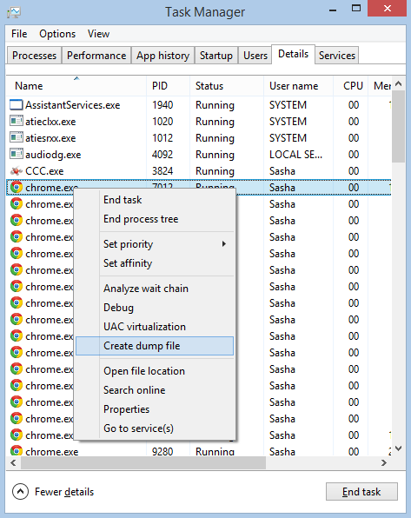
Generating a Hang Dump
Task Manager, right-click and choose “Create Dump File”
Creates a dump in %LOCALAPPDATA%\Temp

Slide 60
Procdump
Sysinternals utility for creating dumps
Examples:
Procdump -ma app.exe app.dmp
Procdump -ma -h app.exe hang.dmp
Procdump -ma -e app.exe crash.dmp
Procdump -ma -c 90 app.exe cpu.dmp
Procdump -m 1000 -n 5 -s 600 -ma app.exe

Slide 61
Windows Error Reporting
WER can create dumps automatically
HKLM\Software\Microsoft\Windows\Windows Error Reporting\LocalDumps
Can be application-specific, not system-wide

Slide 62
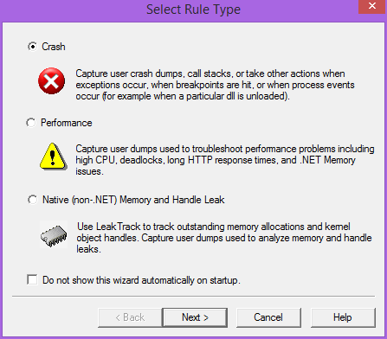
DebugDiag
Microsoft tool for monitoring and dump generation
Very suitable for ASP.NET
Dump analysis component included

Slide 63
Debugging Symbols
Debugging symbols link runtime memory addresses to function names, source file names and line numbers
PDB files
Required for proper debugging and dump analysis

Slide 64
Symbols for Microsoft Binaries
Microsoft has a public symbol server with PDB files for Microsoft binaries
Configure _NT_SYMBOL_PATH environment variable
setx _NT_SYMBOL_PATH srv*C:\symbols*http://msdl.microsoft.com/download/symbols

Slide 65
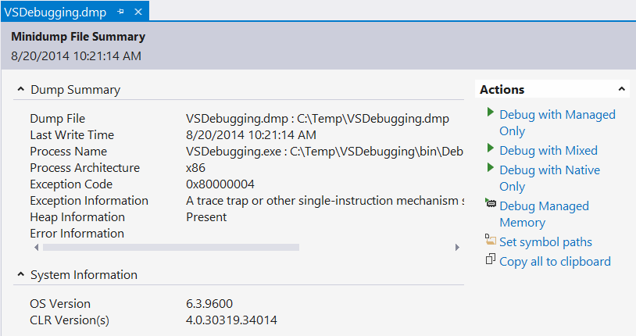
Opening Dump Files
Visual Studio can open dump files
For .NET, CLR 4.0+ and VS2010+ required

Slide 66
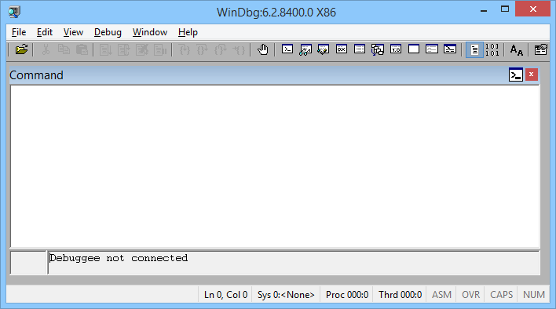
Opening Dump Files
WinDbg is a free lightweight debugger
No intrinsic .NET support, but has SOS extension
!analyze -v (CLR 4.0+)
.loadby sos clr
!printexception
!clrstack

Slide 67
Lab 7: Automatic Dump Generation

Slide 68
Automatic Dump Analysis

Slide 69
Basic Automation
Run WinDbg automatically on a bunch of files and log its output:
@echo off
for %%f in (.\*.dmp) do (
echo Launching analysis of file %%f...
start "Analyzing %%f" "C:\Program Files (x86)\Windows Kits\10\Debuggers\x86\cdb.exe" -z %%f -c ".logopen %%f.log; !analyze -v; .logclose; qd"
)

Slide 70
Basic Automation
Parse the results for interesting tokens:
for %%f in (.\*.dmp.log) do (
echo In file %%f:
findstr "EXCEPTION_MESSAGE MANAGED_OBJECT_NAME" %%f
)

Slide 71
ClrMD
Text-based analysis of debugger command output is very fragile and limited
ClrMD is a .NET library for analyzing dump files and running processes
A managed API for interacting with the .NET debugging runtime (“SOS API”)
Open-source on GitHub https://github.com/Microsoft/clrmd
Also used by PerfView, msos, NetExt and some other open-source projects

Slide 72
ClrMD Basic Classes
DataTarget
ClrRuntime
ClrRuntime
ClrHeap
ClrThread
ClrType
ClrType
ClrThread

Slide 73
mscordacwks.dll
Managed dump analysis requires mscordacwks.dll matching the CLR version
It can be automatically downloaded from the Microsoft symbol server in most cases

Slide 74
Connecting to a Target
Attach to a process or open a dump:
DataTarget target = DataTarget.LoadCrashDump(@"dump.dmp");
target.AppendSymbolPath(
"srv*C:\symbols*http://msdl.microsoft.com/download/symbols");
var runtime = target.ClrVersions[0].CreateRuntime();

Slide 75
Basic Exception Triage
foreach (var thread in runtime.Threads)
{
var e = thread.CurrentException;
if (e != null)
{
Console.WriteLine("Thread {0}", thread.ManagedThreadId);
Console.WriteLine("\t{0} - {1}", e.Type.Name, e.Message);
foreach (var frame in e.StackTrace)
Console.WriteLine("\t" + frame.DisplayString);
}
}

Slide 76
Inspecting the Heap
Enumerate all heap objects and statistics
Find specific objects
Inspect GC information (roots, finalization queues, etc.)
ClrHeap
EnumerateObjects
GetObjectType
EnumerateRoots
ClrType
GetSize
EnumerateRefsOfObject
GetFieldValue

Slide 77
Wait Information
Threads have a list of blocking objects, which have owner threads
Wait analysis and deadlock detection is made possible
ClrThread
BlockingObjects
BlockingObject
Reason
Object
HasSingleOwner
Owner/Owners
Waiters

Slide 78
Client3 Dump Analysis Portal
Production server
Analysis web server
Production server
Analysis agent proxies
Production server
Application
Server and dump management
Analysis agent stub
> connect prod1-west-us
> listdumps --days 3
dump1.dmp
dump2.dmp
> opendump dump1.dmp
> printexception
WER .dmp files

Slide 79
Client4 Automatic Dump Analysis and Ticket Assignment
Production server
Analysis system
Redmine work item tracker
Production server
Dump analysis and triage agent
Production server
Application
FTP server
One-way link
Zipped dumps
WER .dmp files

Slide 80
Lab 8: Stack Dumper

Slide 81
Lab 9: Object Inspector

Slide 82
Sasha Goldshtein blog.sashag.net CTO, Sela Group @goldshtn
Thank You!

