Slide 1

Which products should we shoot?
A prediction of images’ types and products’ color
Charles Zufferey

Slide 2
Agenda
1
Background
Why have I done this?
2
Technical Information
Which models & applications did I use?
3
Demonstration
Can I show you how it works?
4
Possible use cases and enhancements
But what is the point?

Slide 3
Background
2018
2020
2016
Started working with imagery
Final Project
Got frustrated because of errors and lack of automation
On Imagery questions related to my last role
Started a new job
In a new company
2017
2019
Started a new job
Started Spiced
In the same company

Slide 4
Why this frustration?
Lack of automation
  A lot of data but only tools for storage (sql)
  Humans needed for filtering / tagging
Errors in image tagging
  Resulting in inconsistency on the website
  And therefore making it difficult to identify products in need of reshooting
Difficulty of predicting which products to shoot first
  Somewhat successful products
  Non-perfect / wrong imagery

Slide 5
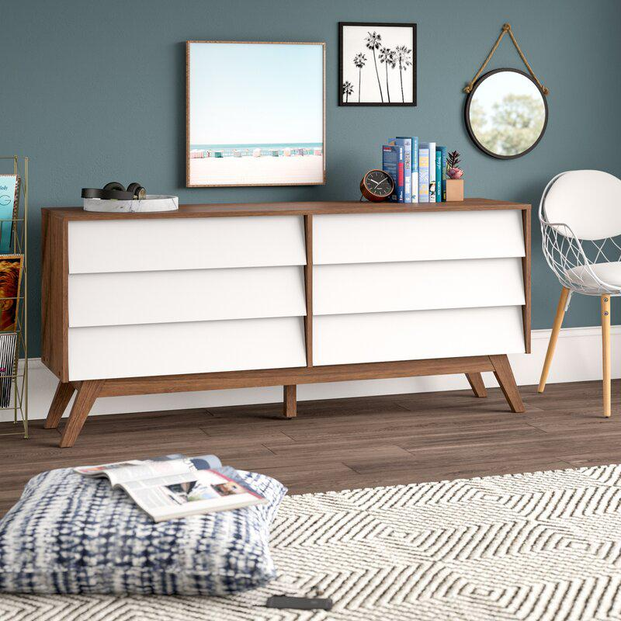
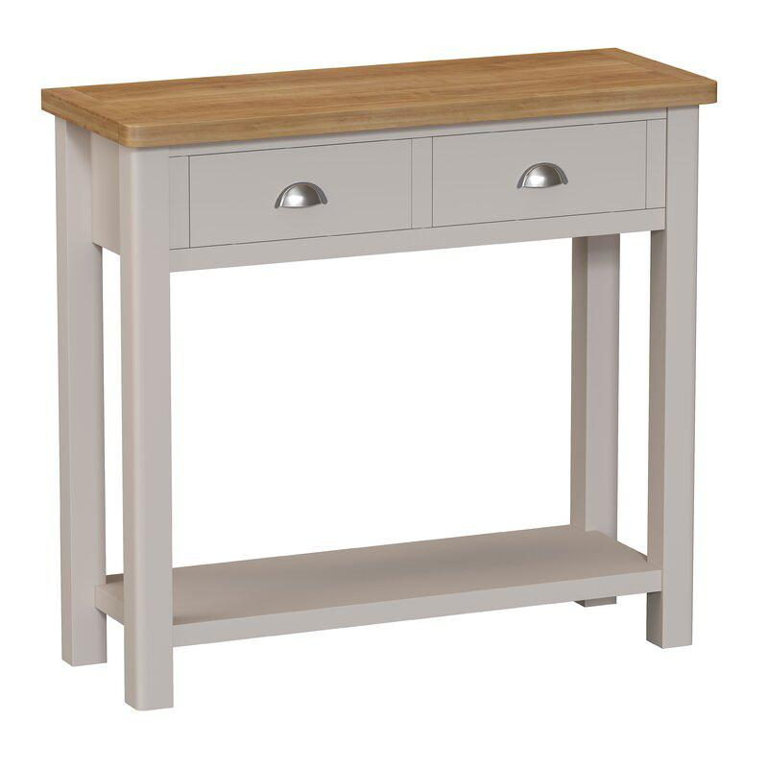
Types of imagery
Silhouette vs Environmental

Slide 6
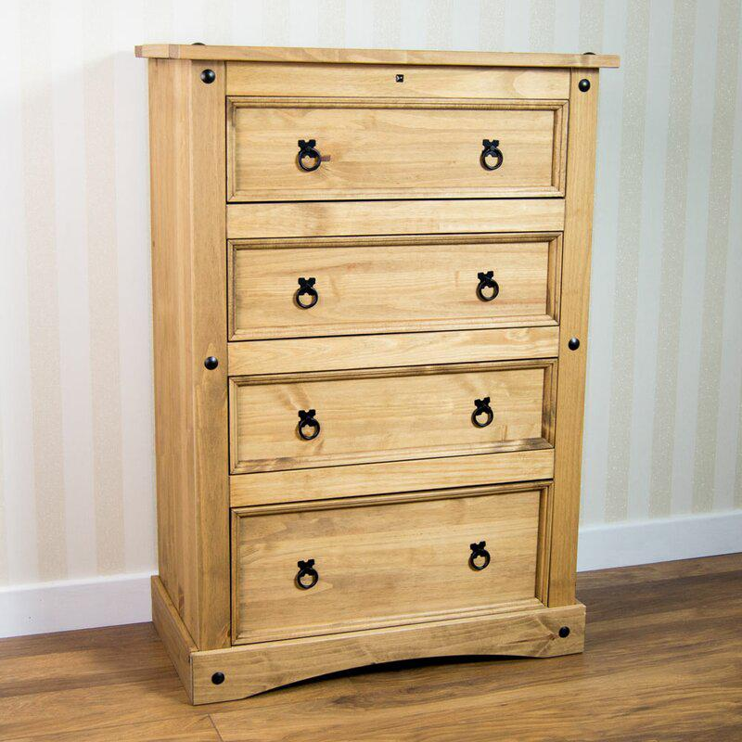
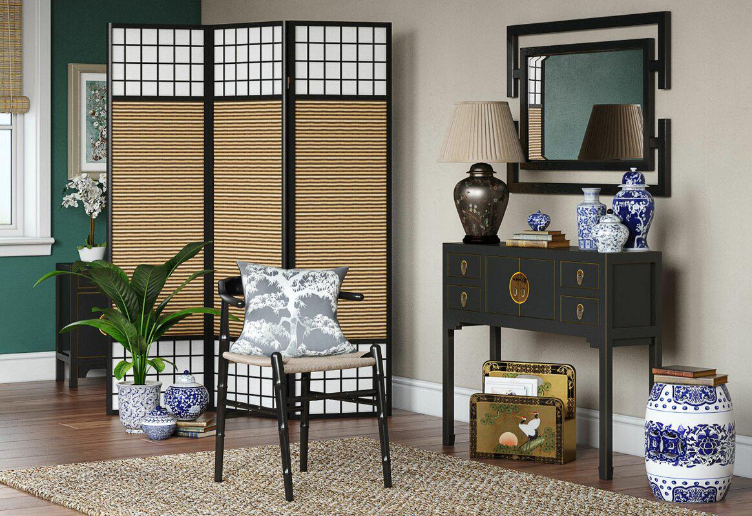
Types of imagery
Primary vs Secondary

Slide 7
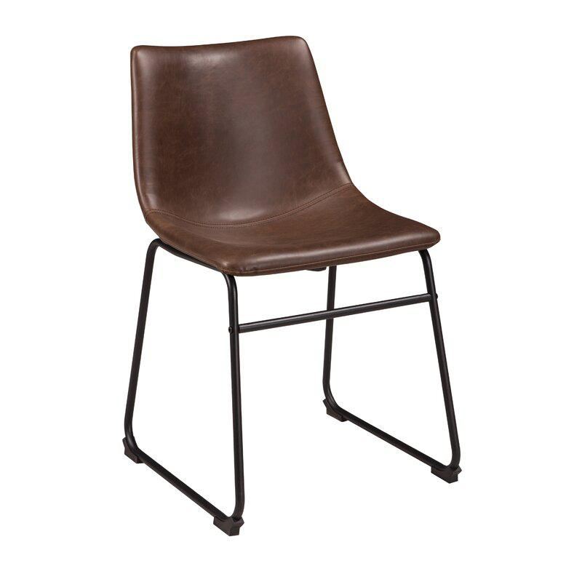
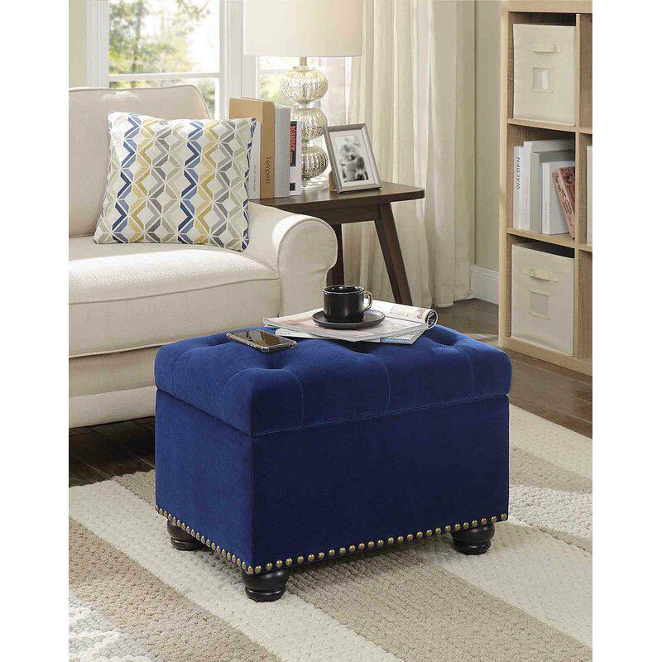
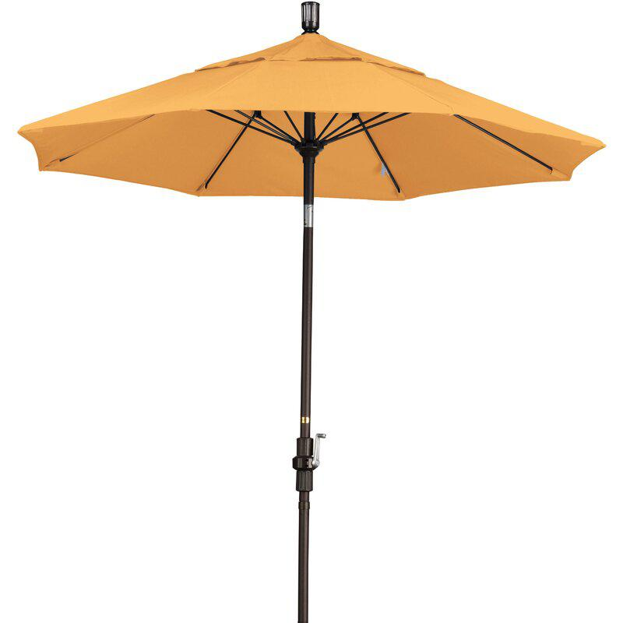
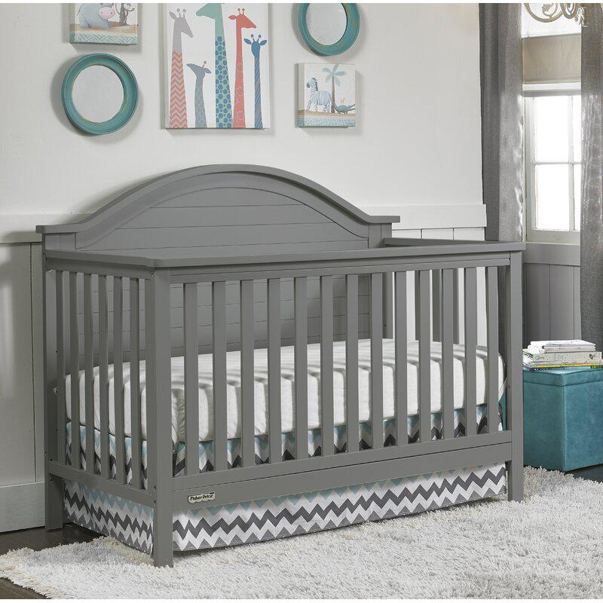
Color of product
(I only focused on: brown, blue, yellow, gray,
Red, white and black)

Slide 8
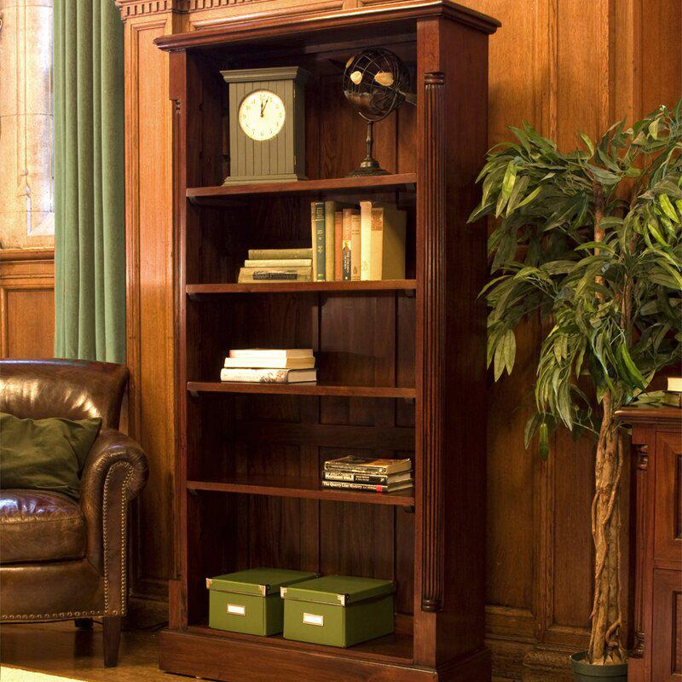
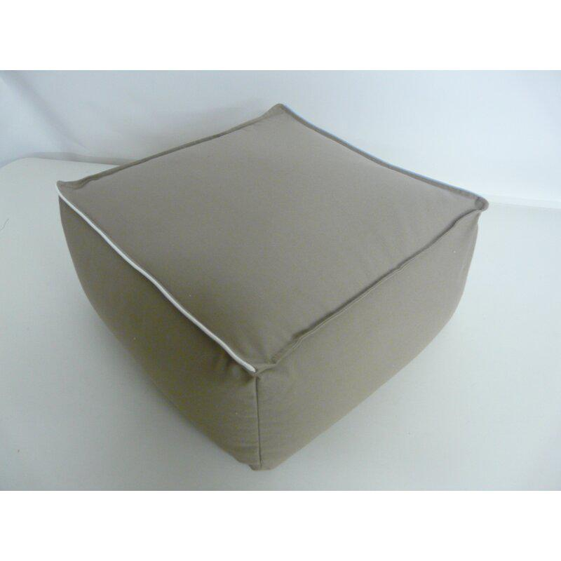
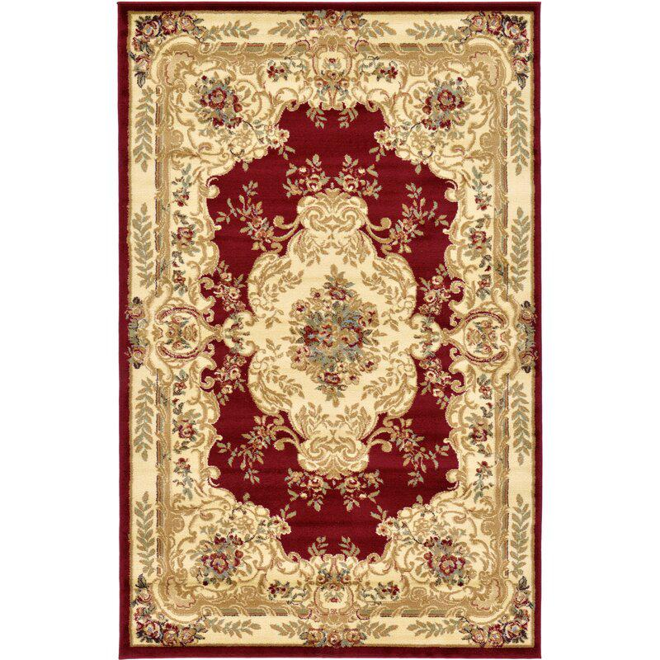
Is that primary
or secondary?
Possible errors
& confusions
Is that silhouette
Or environmental?
What is the main
color of that?

Slide 9
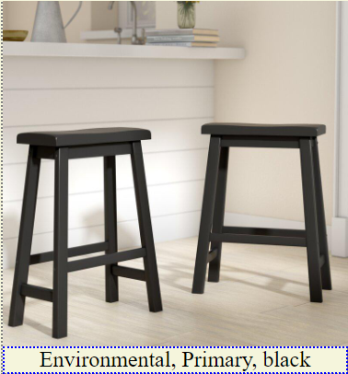
ConvNet
Convolutional Neural Network
The idea is therefore to try to predict the type of the image and the color of the product depicted on the image.
For this, I have used three different models (one for primary vs secondary, one for silhouette vs environmental and one for the color of the product).
I also used:
- a flask to create a little user interface
- Scrapy to extract images from the website.

Slide 10
ConvNet Architecture
Conv2D #1
(150x150x3)
MaxPooling #1
Conv2D #2
(150x150x64)
MaxPooling #2
Conv2D #3
(150x150x128)
MaxPooling #3
Conv2D #4
(150x150x128)
MaxPooling #4
Dense Layer
(sigmoid / softmax)
Dense Layer (relu)
Regularization
(dropout, flatten)

Slide 11
Training the model
Silhouette vs Environmental
Around 1500 images were used, including 200 for validation and 150 for test
Test Accuracy: >95%
Primary vs Secondary
Way easier to find primary images. Around 1500 images too, but more primary.
Test Accuracy: ~90%.
Model
Colors
Around 250 images per color, including 50 for validation and 50 for test
Test Accuracy: ~50%
Conv2D

Slide 12
Steps of the program
Give recommendation
What products are in need of a new image?
Run images through model
Predict type and color
Scrape website
Download all images from first result page
Step 4
Identify images to scrape
Ask for user’s input
Step 3
Step 2
Step 1

Slide 13
Demonstration

Slide 14
Observations
- Scraping for training is painful due to website protection (headless chrome)
- Model is quite good at identifying silhouette vs environmental
- It suffers from the lack of consensus regarding primary & secondary, but seems robust
- More difficulty with colors, mainly due to the low number of images used for training. Still promising though.

