Slide 1
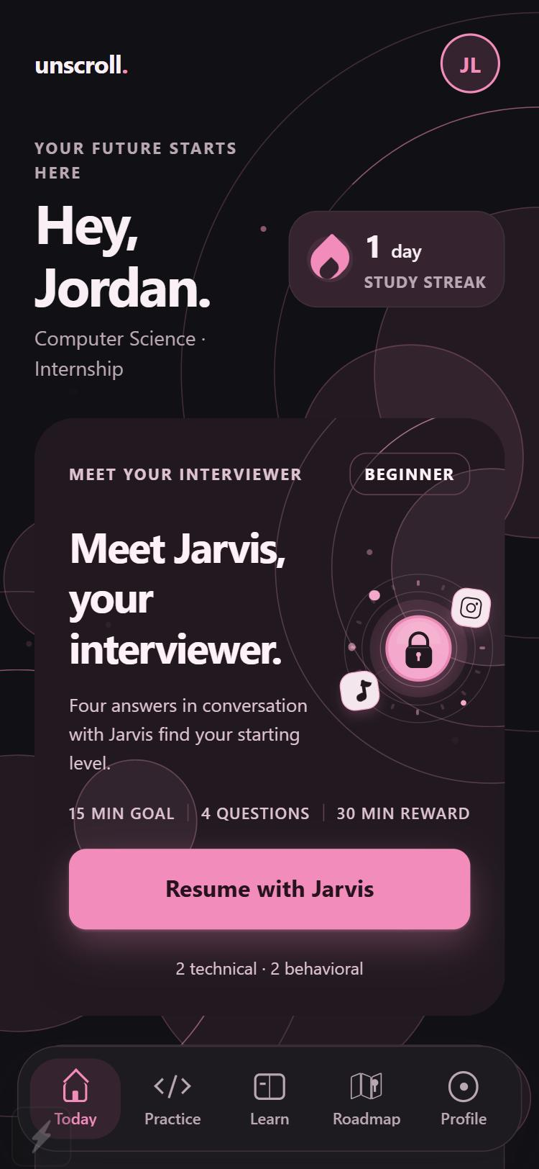
WHITMAN HACKATHON · PRODUCT PITCH
unscroll.
Less scrolling. More becoming.
Pass a short interview with Jarvis, your AI interviewer. Earn your break.
Watch the 40 second film
Notes:
Open with the line, then the one-sentence promise. Unscroll is an iPhone app a student team built at the Whitman Hackathon. Pause on the phone screen: this is the real app, running today.

Slide 2
WHY · THE PROBLEM
The scroll always wins
Interview practice is important and easy to put off. The feed is one tap away, and it pays out right now.
Scrolling
Reward: now
Interview practice
The tension we designed for. Our observation as students, not a statistic.
Reward: months away
unscroll.
02
Notes:
Start with the problem, in the audience's own experience. Interview practice matters and is easy to put off, because its reward is months away. The feed is one tap away and rewards you now. So the scroll wins. We are describing the tension we designed for, not quoting a study.

Slide 3
WHAT · UNSCROLL
Make practice earn the break
Unscroll swaps the next scroll for a short interview. Pass, and the apps you chose open for a timed break.
The next scroll
becomes
One interview rep
A design bet to test with students, not a result we have measured.
then a break you earned
unscroll.
03
Notes:
What Unscroll is, in one sentence: it makes practice earn the break. A short practice session feels more rewarding when it unlocks something the student already wants. Say plainly that this is a design hypothesis we want to test with students, not a measured result.

Slide 4
HOW · IT WORKS
Three steps, repeated daily
1
2
3
Pick your distractions
Pass an interview with Jarvis
Earn your break
Choose the apps that pull you in, plus your major, goals and target companies.
A short daily set of technical and behavioral questions. Answer by voice or by typing.
Pass to open a 15, 30 or 60 minute break. A missed answer returns as a different question.
unscroll.
04
Notes:
Three steps. One: the student picks the apps that distract them. Two: a short daily interview with Jarvis, technical and behavioral, typed or spoken. Three: passing opens a 15, 30 or 60 minute break. A failed answer cannot be skipped: you read the feedback, then get a different question.

Slide 5
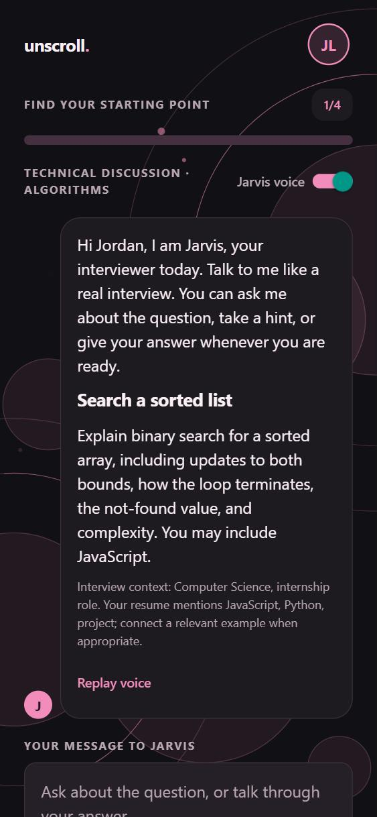
HOW · THE INTERVIEWER
Meet Jarvis,
your AI interviewer
He asks, then listens
Answer out loud or type it. He reads each question to you.
Clarifying questions are free
Ask what he means before you answer. It is never graded.
Hints cost evaluation points
Ten points each, three per question. Pass or fail uses the raw grade.
Feedback on what you said
Behavioral answers get STAR feedback, line by line.
05
Notes:
This is the standout feature. Jarvis is a conversation, not a form. He reads the question aloud. Asking him to clarify is free. A hint costs ten evaluation points, at most three per question, and pass or fail still uses the raw grade. Behavioral answers get STAR feedback: situation, task, action, result.

Slide 6
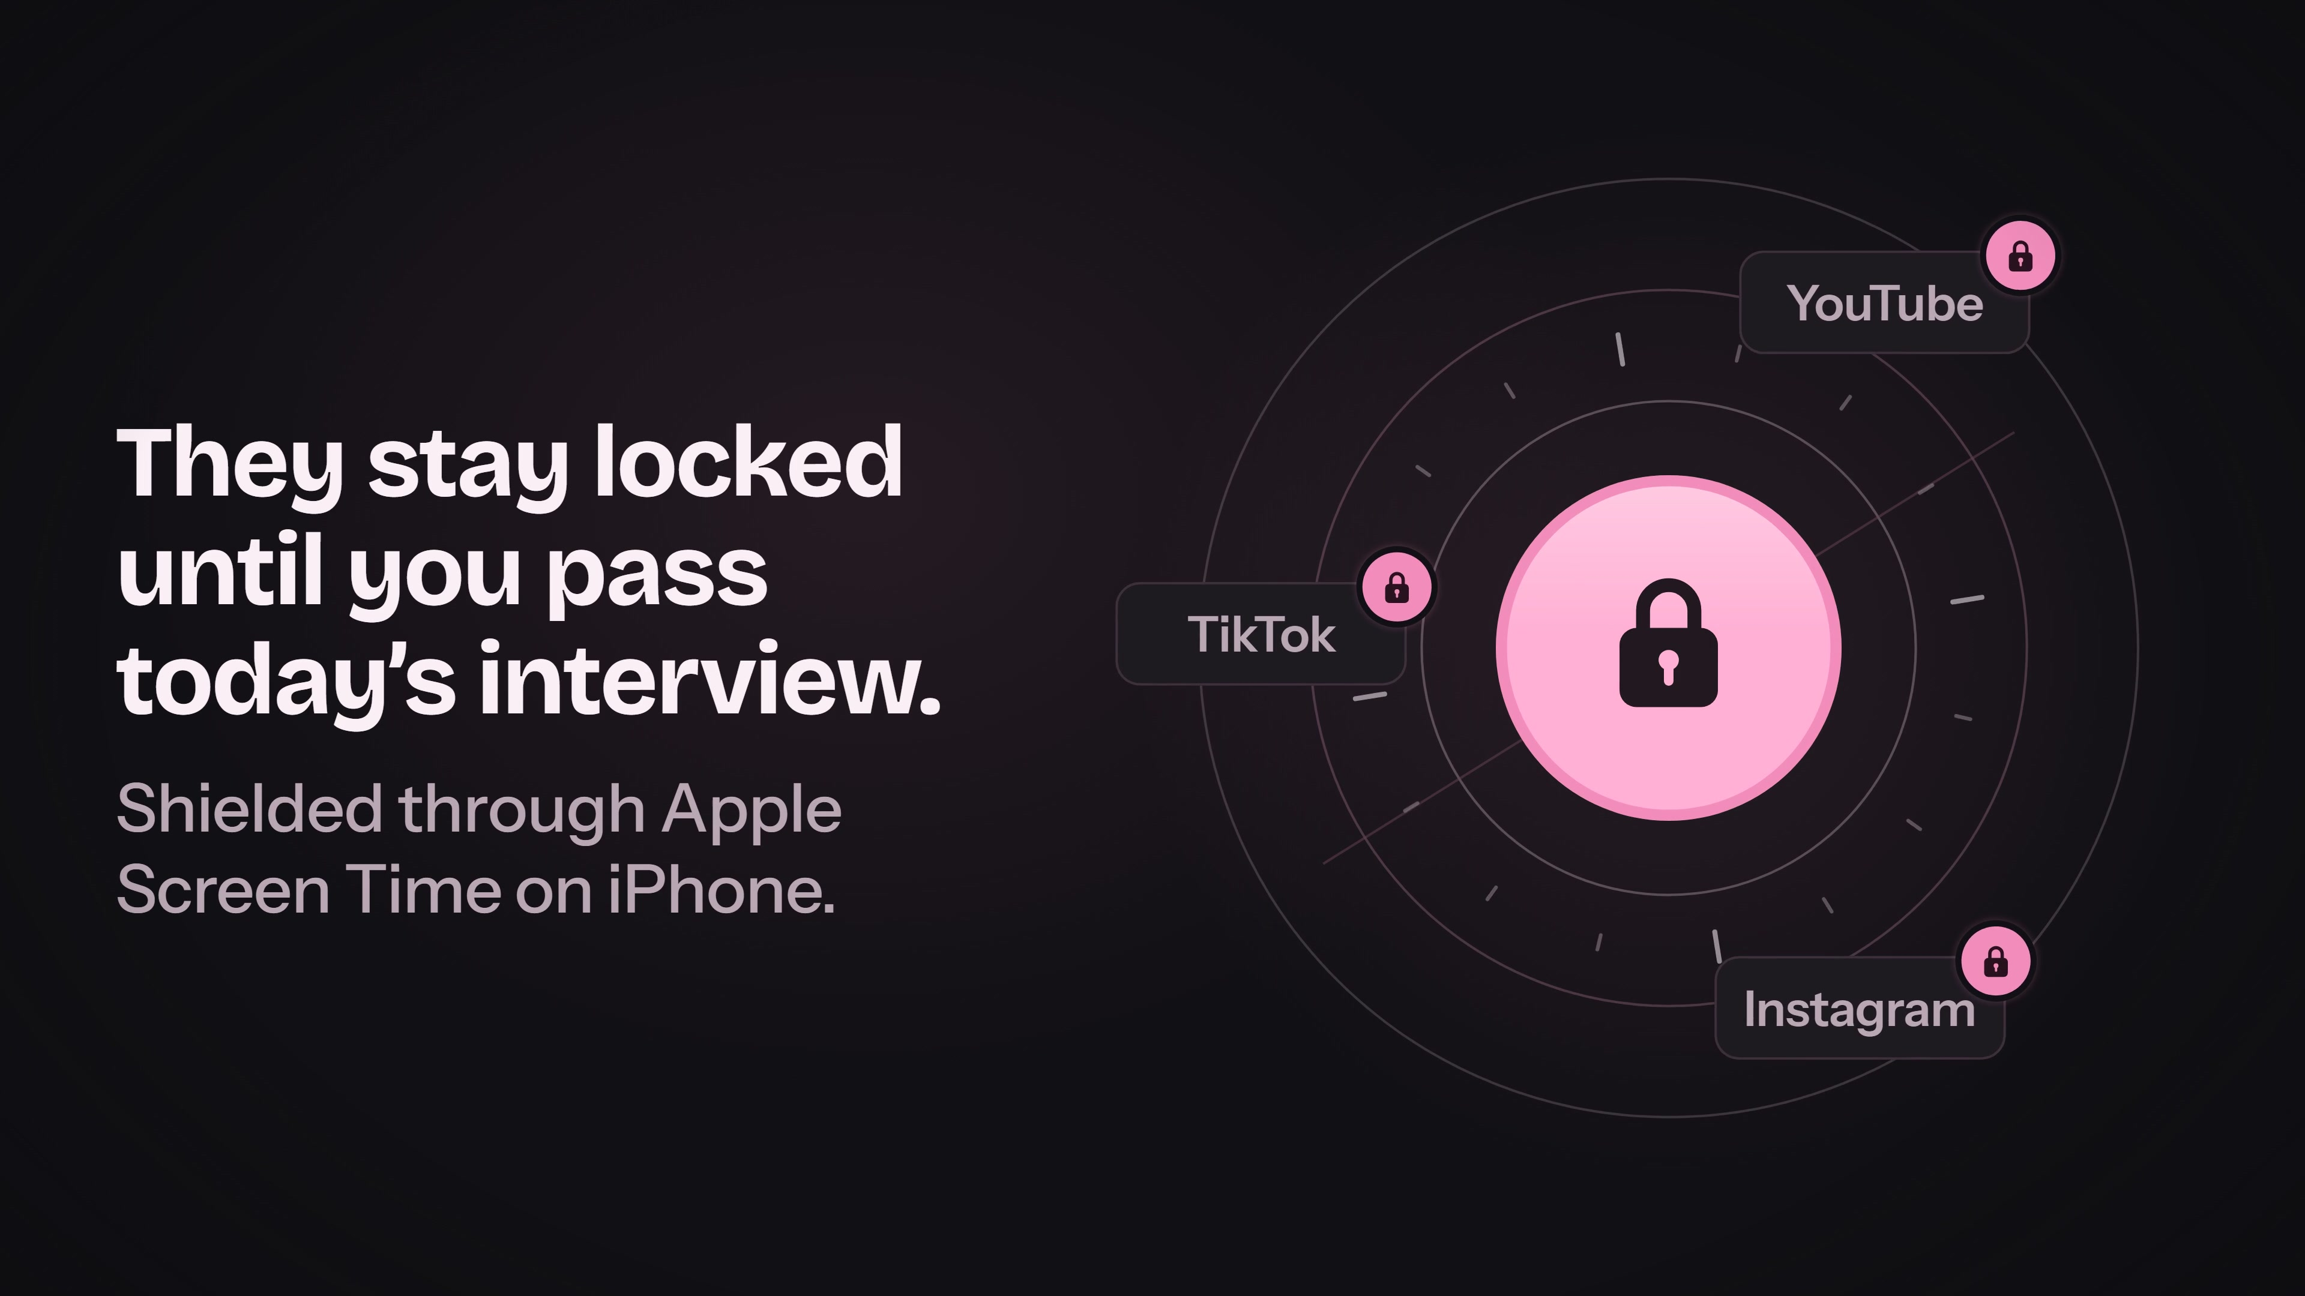
THE FILM
Why, what and how in forty seconds
WHY
It always starts with one more scroll.
WHAT
Your apps stay locked until you pass today's interview.
HOW
Play on YouTube
Pick your apps, pass with Jarvis, earn your break.
youtu.be/fKccxDHB6GI · drawn, scored and narrated in code
unscroll.
06
Notes:
Play the film here. It is forty seconds, drawn, scored and narrated entirely in code. Click the picture or the button: it opens on YouTube. The three lines beside it are what the film says: why (the scroll wins), what (practice earns the break), how (pick apps, pass with Jarvis, earn the break). If the room has no sound, the captions carry it.

Slide 7
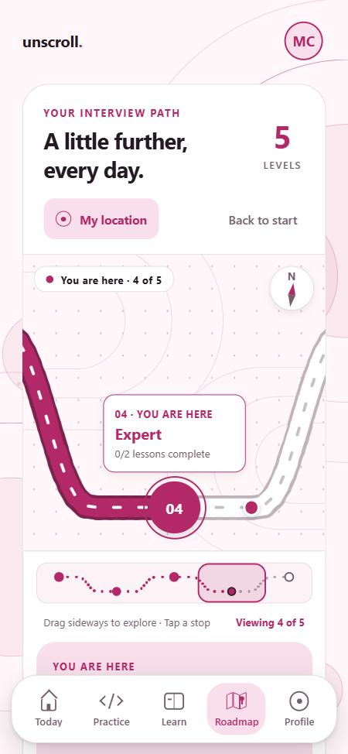
HOW · THE EVALUATION
Know where you stand
Three skill standings from your graded answers, and a road map of five levels you can drag.
ILLUSTRATION
Communication
Technical discussion
Coding
unscroll.
07
Notes:
The evaluation tells a student where they stand in three skills: communication, talking through technical problems, and coding. Standings come only from graded answers, and a skill with no answers shows as not measured yet. The road map is five levels, Beginner to Master, and you drag it sideways.

Slide 8
HOW · UNDER THE HOOD
AI and voice, all on free tiers
JOB
PROVIDER
MODEL
MEASURED
Interviewer and grading
NVIDIA
nemotron-3-super-120b
1.6 to 2.6 s
Your voice to text
Groq
whisper-large-v3-turbo
about 0.5 s
Jarvis voice
Groq
orpheus-v1-english
0.5 to 1.0 s
No key at all
On device
Rubric feedback, phone voice
Still works
Expo · React Native · TypeScript · Node 24 · SQLite. Keys stay on the server, never in the app or the repository.
unscroll.
08
Notes:
Everything here runs on free tiers. NVIDIA grades and drives Jarvis in about two seconds. Groq turns speech into text and gives Jarvis his voice. With no key at all the app still works on rubric feedback and the phone voice. Keys live only on the server, never in the app or the repository.

Slide 9
HONEST STATUS
What is proven, and what is next
Proven today
Still to prove
Runs on an iPhone through Expo Go
App shielding needs the signed native build
163 automated tests pass, CI green
Code answers are reviewed, not executed
Live AI grading and voice on free tiers
Free tiers are rate limited
unscroll.
09
Notes:
Be straight about the line between proven and not yet proven. Proven today: it runs on an iPhone through Expo Go, 163 automated tests pass with CI green, and live AI grading and voice work on free tiers. Still to prove: real app shielding needs the signed native iPhone build, which is untested on a device; code answers are reviewed, not executed; and the free tiers are rate limited.

Slide 10
LIVE DEMO
One complete rep
A better reason to put the phone down.
1
Create an account on the iPhone
2
Jarvis asks. Ask him one free clarifying question
3
Take one hint, then answer by voice or typing
unscroll.
4
Read the feedback and the STAR lines
Less scrolling. More becoming.
Film: youtu.be/fKccxDHB6GI
5
See the recap, the standings and the earned break
Code: github.com/Charlesganu2004/Whitman-Hackathon
unscroll.
10
Notes:
Run the demo in this order on the iPhone, about three minutes. Describe the earned break as practice mode in Expo Go; do not present app shielding as working. Close on the line, then leave the links on screen for questions.

