Slide 1
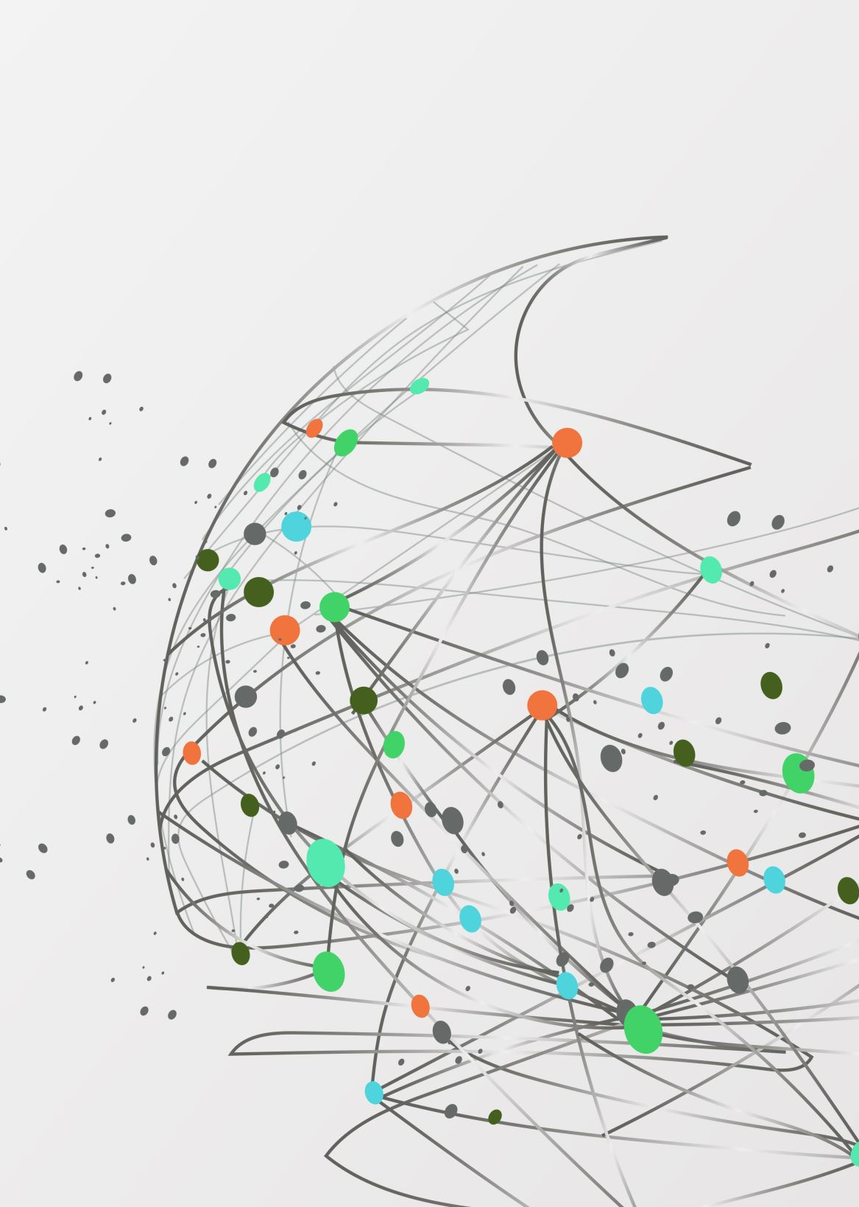
QNA MAKER
Web application that provides a Covid-19 Chatbot using Azure QnA Maker

Slide 2
Azure
The Azure cloud platform is more than 200 products and cloud services designed to help you bring new solutions to life—to solve today’s challenges and create the future. Build, run, and manage applications across multiple clouds, on-premises, and at the edge, with the tools and frameworks of your choice.

Slide 3
Azure QnA maker
QnA Maker is commonly used to build conversational client applications, which include social media applications, chat bots, and speech-enabled desktop applications

Slide 4
Application of QnA Maker
QnA Maker can be used when you have static information in your knowledge base of answers. This knowledge base is custom to your needs, which you've built with documents such as PDFs and URLs.
It can also be used when you want to provide the same answer to a request, question, or command, when you want to filter static information based on meta-information or also when you want to manage a bot conversation that includes static information.

Slide 5
What is a knowledge base?
QnA Maker imports your content into a knowledge base of question-and-answer pairs. The import process extracts information about the relationship between the parts of your structured and semi-structured content to imply relationships between the question-and-answer pairs. You can edit these question-and-answer pairs or add new pairs.

Slide 6
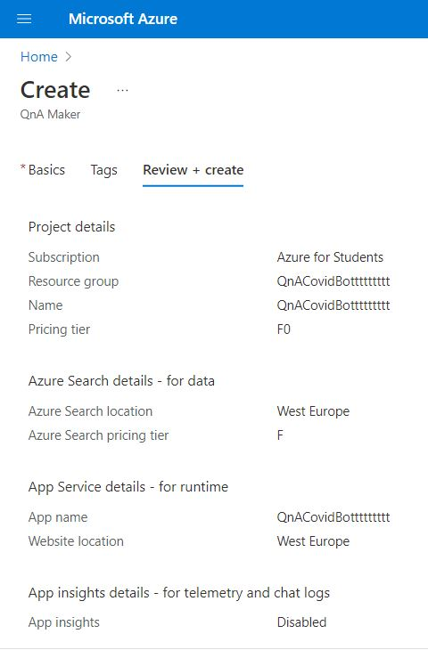
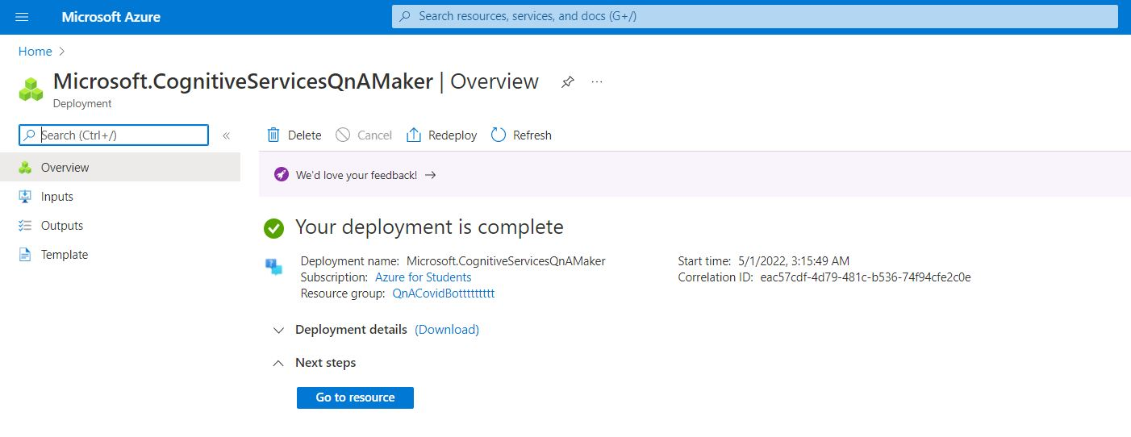
Building a Web application that provides a Covid-19 Chatbot using Azure QnA Maker
Step 1: Create QnA maker Service:

Slide 7
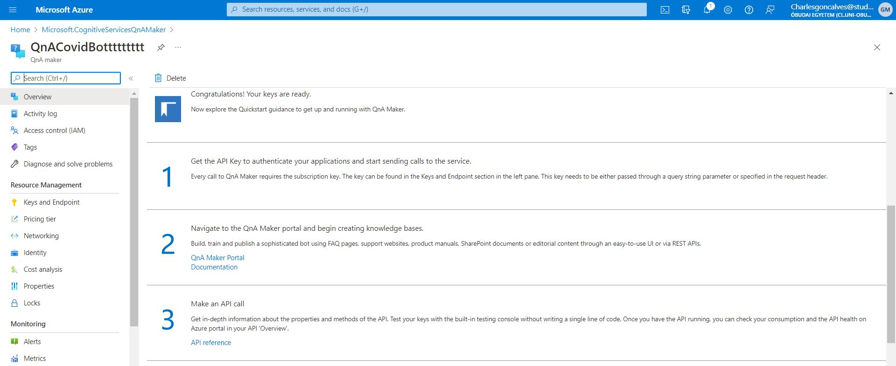
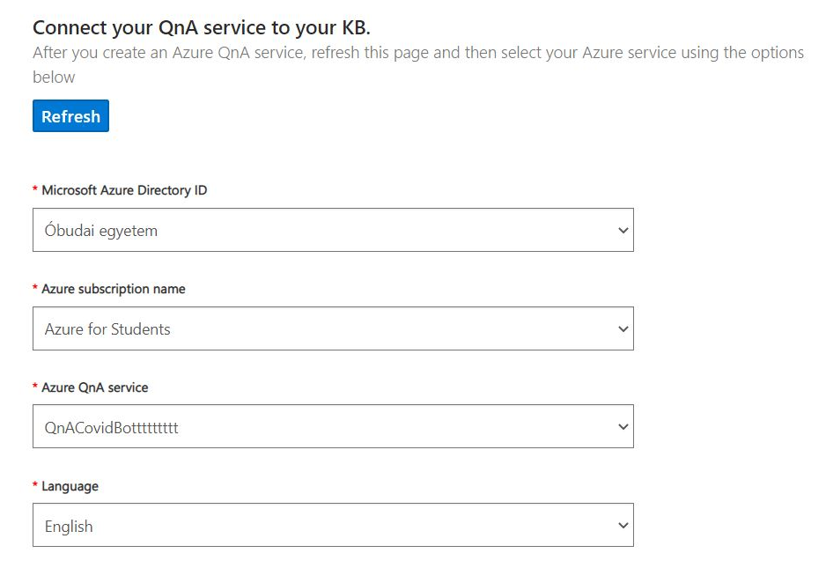
Step 2: Connect the QnA maker Service to a Knowledge Base (KB):

Slide 8
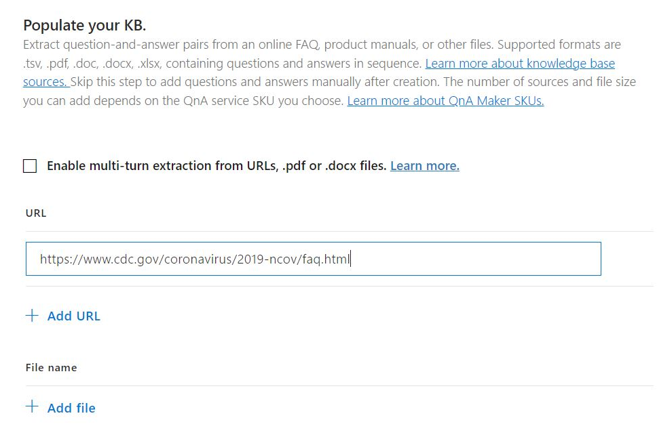
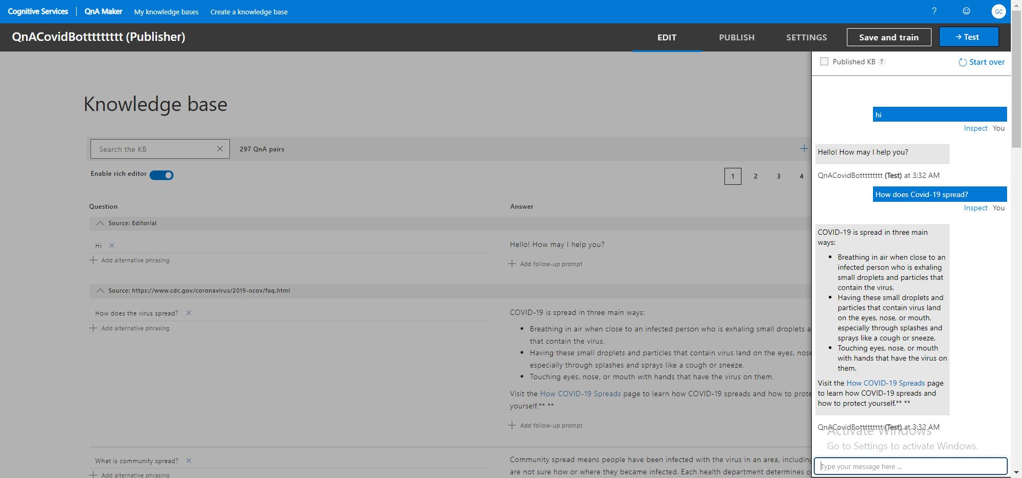
Step 3: Populate, add questions and answers (if needed), and test the Knowledge Base (KB):

Slide 9
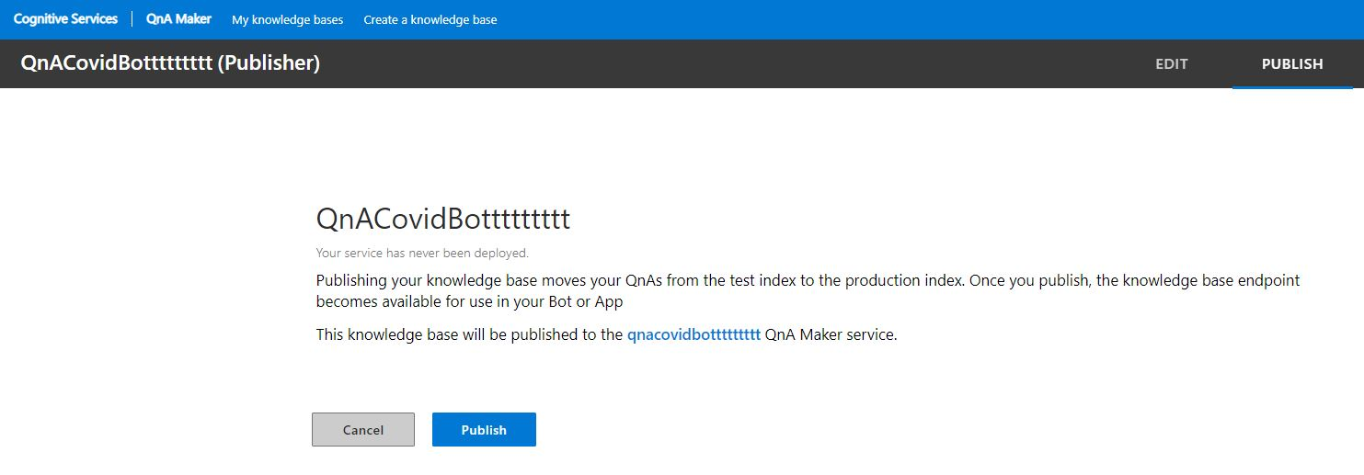
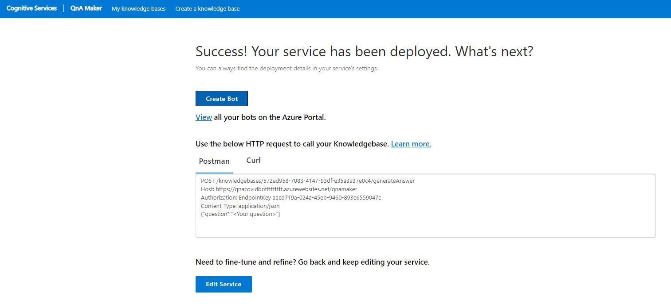
Step 4: Publish the Knowledge Base (KB):

Slide 10
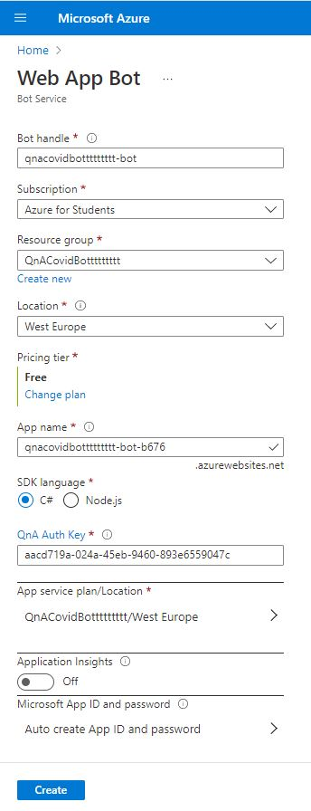
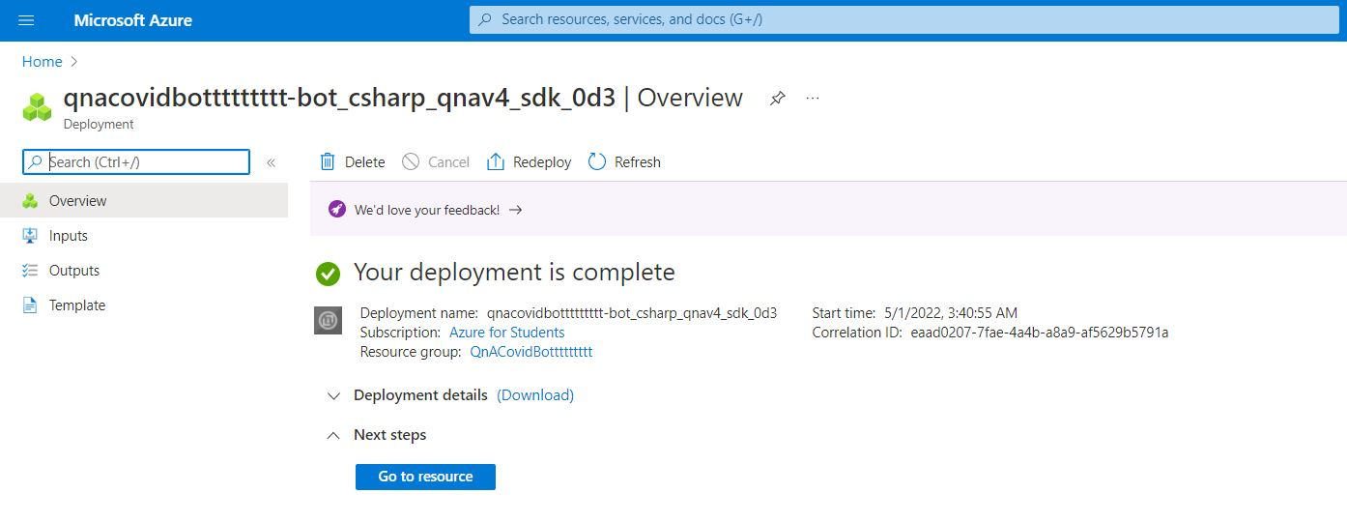
Step 5: Create a UI for the bot where the QnA service populated with the KB will be applied to.

Slide 11
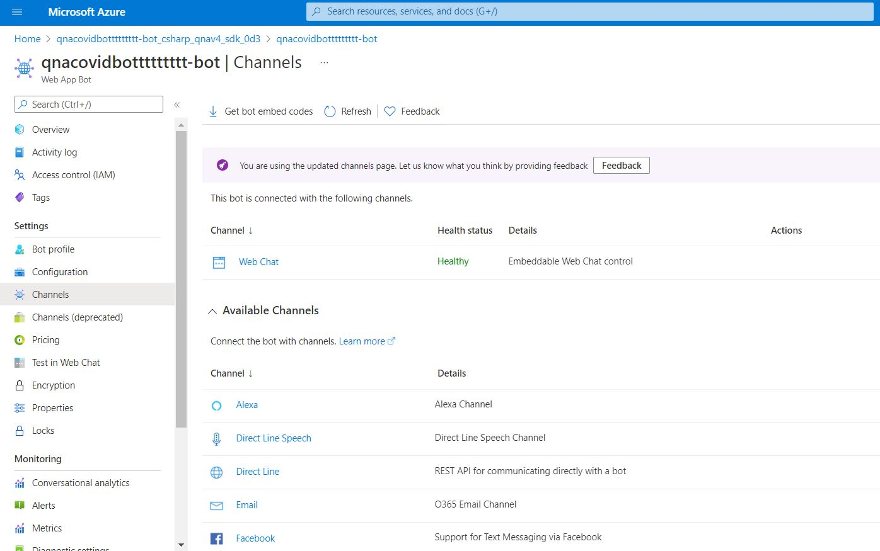
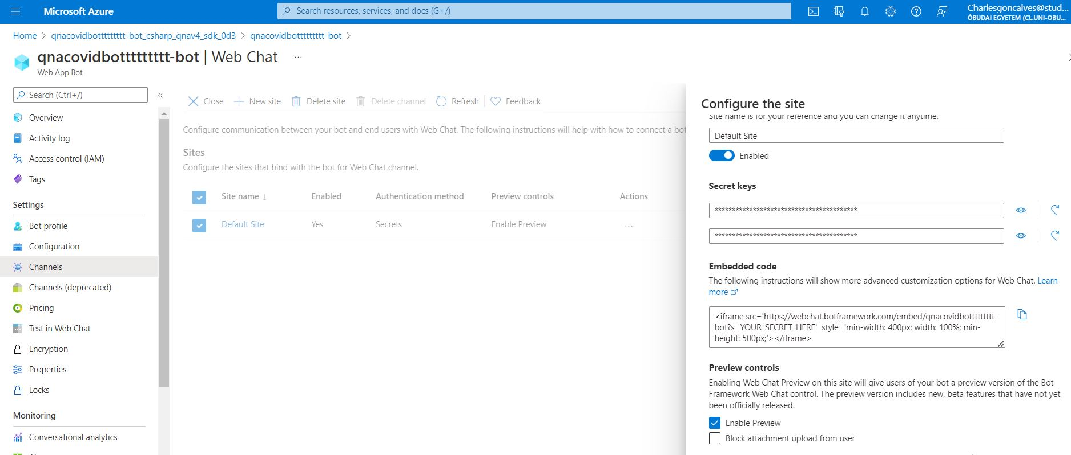
Step 5: Create a UI for the bot where the QnA service populated with the KB will be applied to.

Slide 12
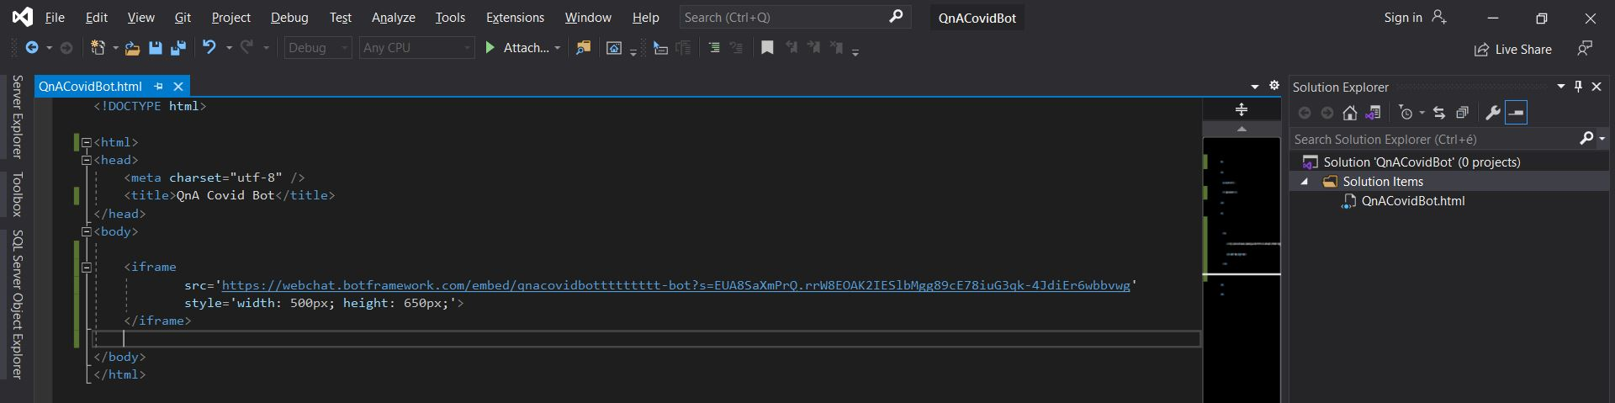
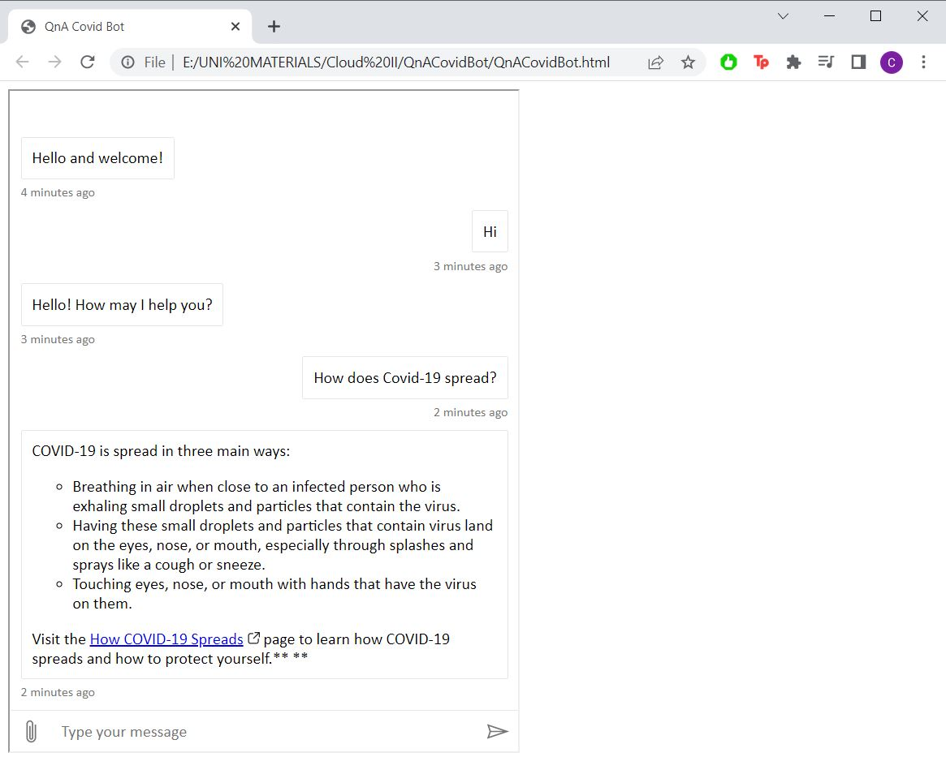
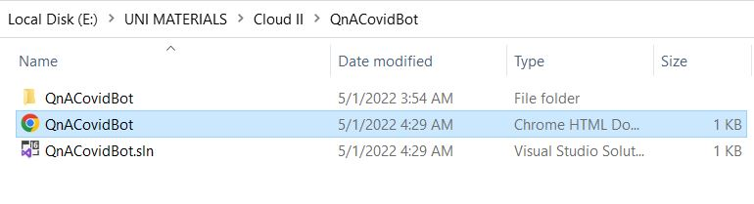
Step 6: Use the embedded code and the secret keys of the created Web chat bot in order to use it in the desired application.

Slide 13
Thank you for your attention! ☺

