Slide 1
React Redux

Slide 2
So let’s say you have an “AllArtists” component, and you want it to render a list of musical artists from a database (assuming routes are already written!)
What are the steps you should take?

Slide 3
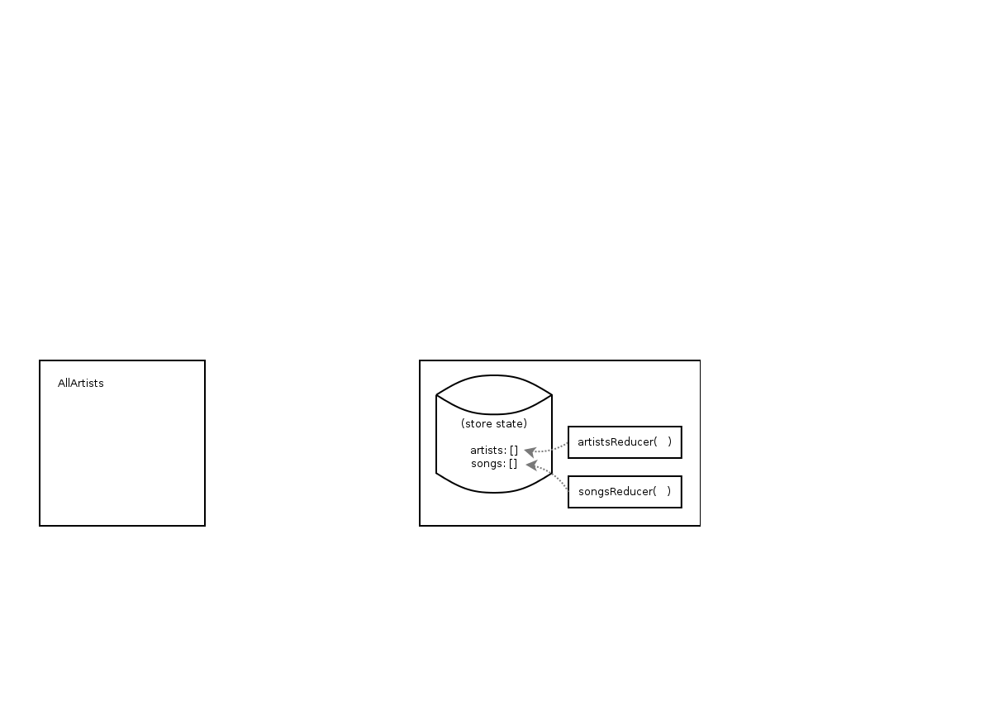
Write your AllArtists
component
Make an (artists) reducer with an empty
array as initial state

Slide 4
The artists reducer can change the
artists array depending on the action object

Slide 5
Note that there is a songs reducer here too,
for changing the songs part of the state
(ignore this for now, we’ll come back to this!)

Slide 6
Now what?

Slide 7
Now what?
We need something to go to the backend and get the relevant information from the database.
We need something to take that information from the database, and pass it to the reducer to change the artists part of the state

Slide 8
Now what?
We need something to go to the backend and get the relevant information from the database. (axios request!)
We need something to take that information from the database, and pass it to the reducer to change the artists part of the state (dispatch action object!)

Slide 9
Now what?
We need something to go to the backend and get the relevant information from the database. (axios request!)
We need something to take that information from the database, and pass it to the reducer to change the artists part of the state (dispatch action object!)*
* Note we’ll also need an action creator for converting that information from the database into the action object so the reducer will know what to do with it!

Slide 10
Now what?
We need something to go to the backend and get the relevant information from the database. (axios request!)
We need something to take that information and make it into something that a reducer can “understand” (action creator to make action object)
We need to pass that data to the reducer to change the artists part of the state (dispatch action object!)

Slide 11
Now what?
axios request
action creator
Dispatch
Let’s wrap all these steps up into one function (a thunk!), that, when dispatched, will kick off the chain of events that eventually updates our store the way that we want!

Slide 12
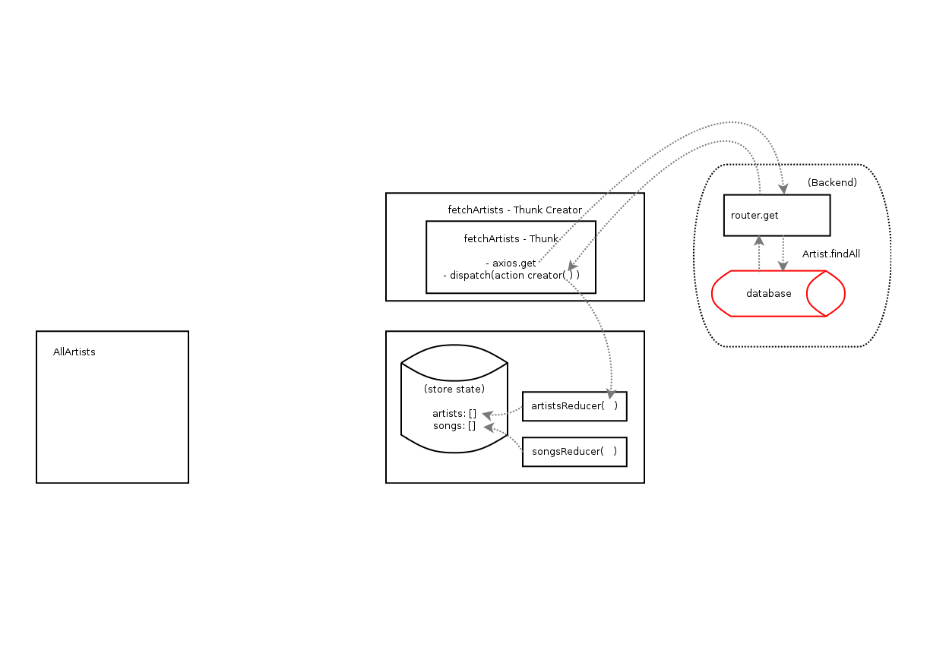
This fetchArtists thunk right here will be responsible for making all of this happen (whenever it gets dispatched)

Slide 13
Now that we have something in charge of kicking off a change in the store…

Slide 14
… how do we “hook it up” to the AllArtists component?

Slide 15
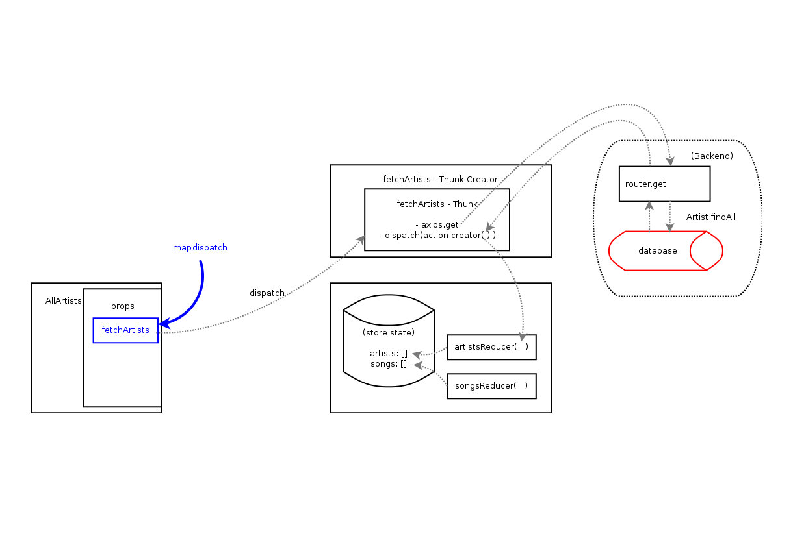
Mapdispatch to props!
This will “attach” a function (that dispatches the thunk we wrote earlier) to the props of the AllArtists component

Slide 16
Now, whenever we invoke this.props.fetchArtists (or props.fetchArtists if dumb component), it starts the chain of events that will ultimately change your store state!

Slide 17
But notice there are no grey arrows pointing from the store state back to the AllArtists component!

Slide 18
Dispatching fetchArtists will do all this crazy stuff and eventually change the store… but then what? We want the changes in the store to actually do something...

Slide 19
Specifically, we want those changes to affect the AllArtists component… to give it access to the new data in the store (the updated artists array), and re-render it with the new data

Slide 20
So what should we do?

Slide 21
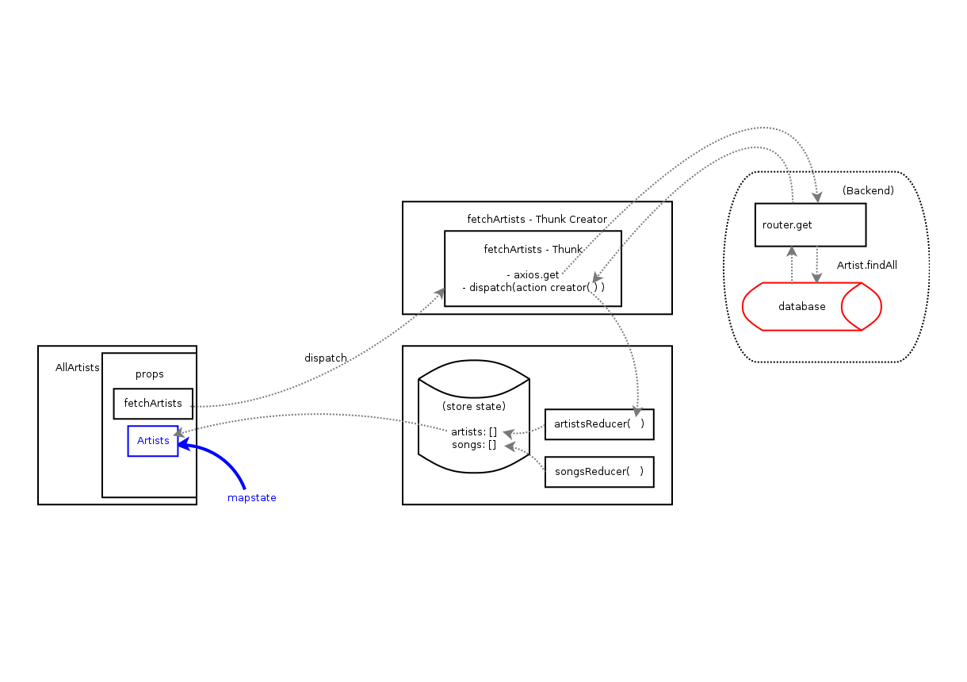
Mapstate to props!

Slide 22
Mapstate to props!
Now the artists part of the store state is “linked” to the component!

Slide 23
Mapstate to props!
Now the artists part of the store state is “linked” to the component! Any changes to that part of the store will re-render AllArtists, and give it access to the new state of that array!

Slide 24
Mapstate to props!
What about the songs reducer? How will changes to the songs part of the store state affect AllArtists?

Slide 25
Mapstate to props!
It won’t! Because we only mapped Artists, changes to the songs part of the store will NOT re-render this component!

Slide 26
Now everything is pretty much in place…

Slide 27
We have a thunk for getting data from the backend and changing the store
We have a way to dispatch that thunk by linking it to the props of AllArtists
We’ve linked the relevant part of the store to AllArtists so that changes in that part of the store will in turn change AllArtists appropriately

Slide 28
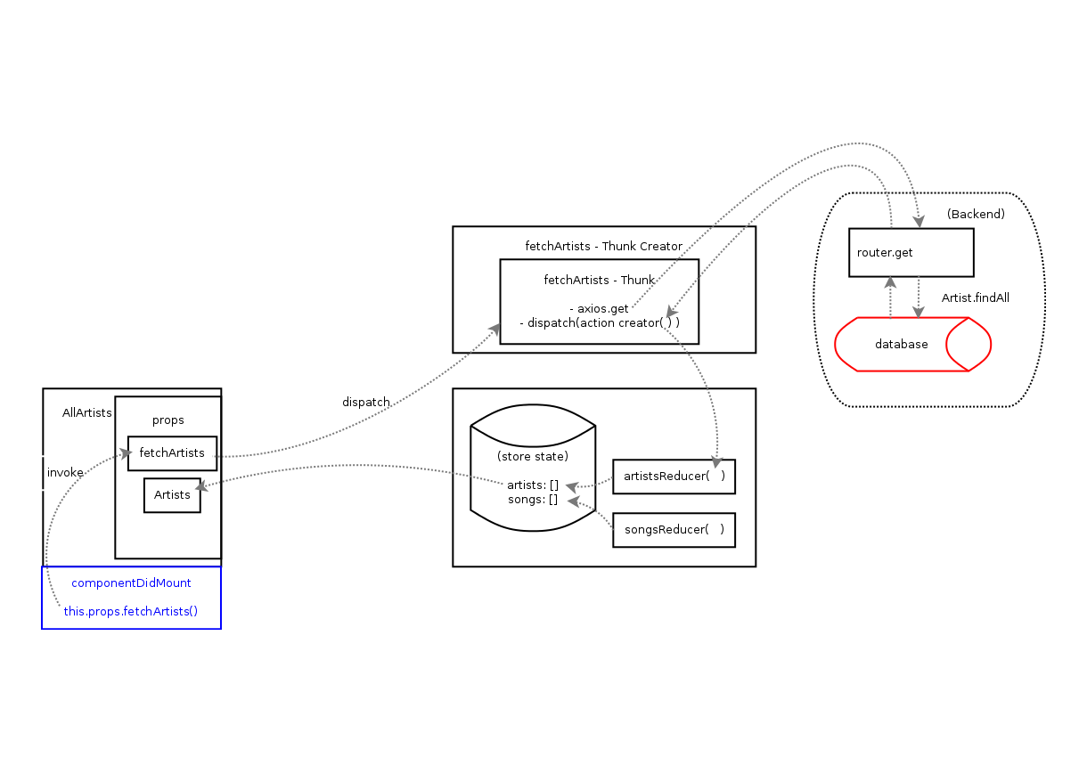
All we need now is to decide where we want to actually invoke the fetchArtists dispatching function that we mapped to props.
Since we’ll likely need the list of artists as soon as we are on this component, let’s just put in the componentDidMount

Slide 29
Now… whenever a user visits the part of your site where they “see” AllArtists (i.e., the component mounts) ... this cool chain of events will happen:

Slide 30
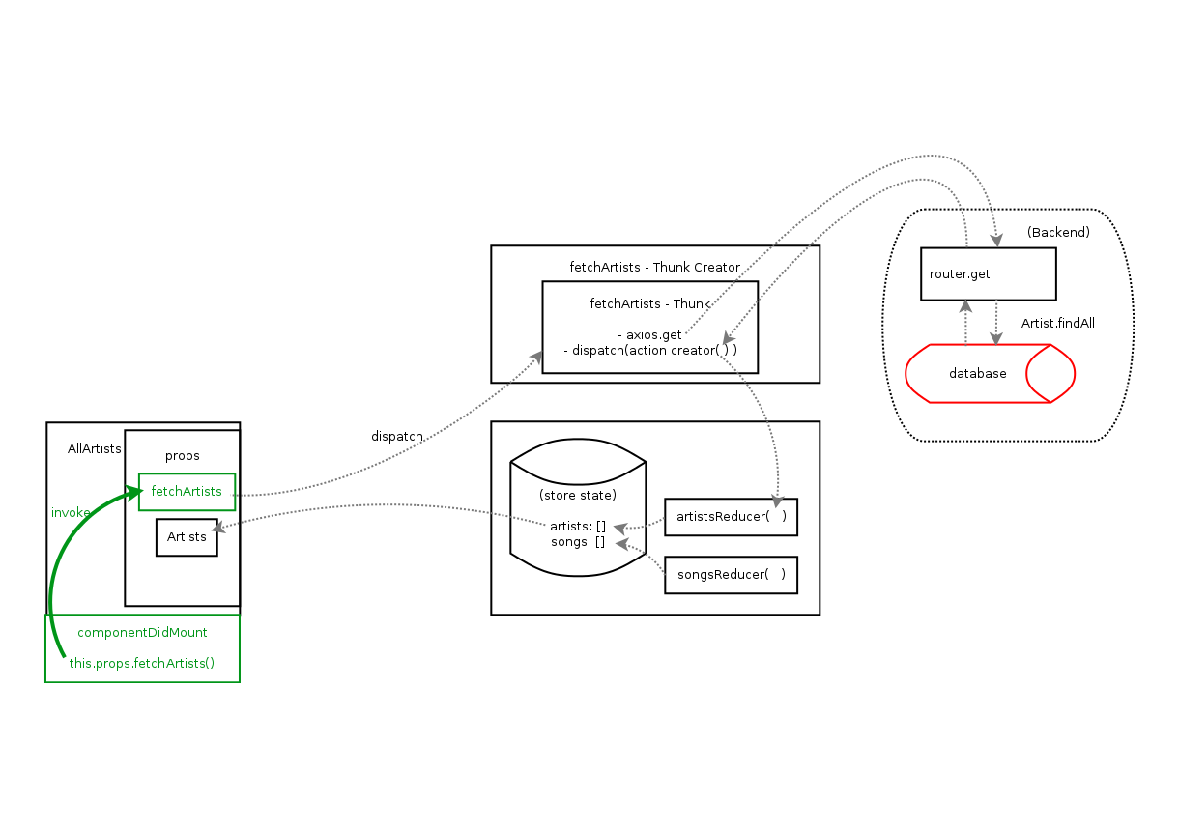
fetchArtists function that we mapped to props is invoked

Slide 31
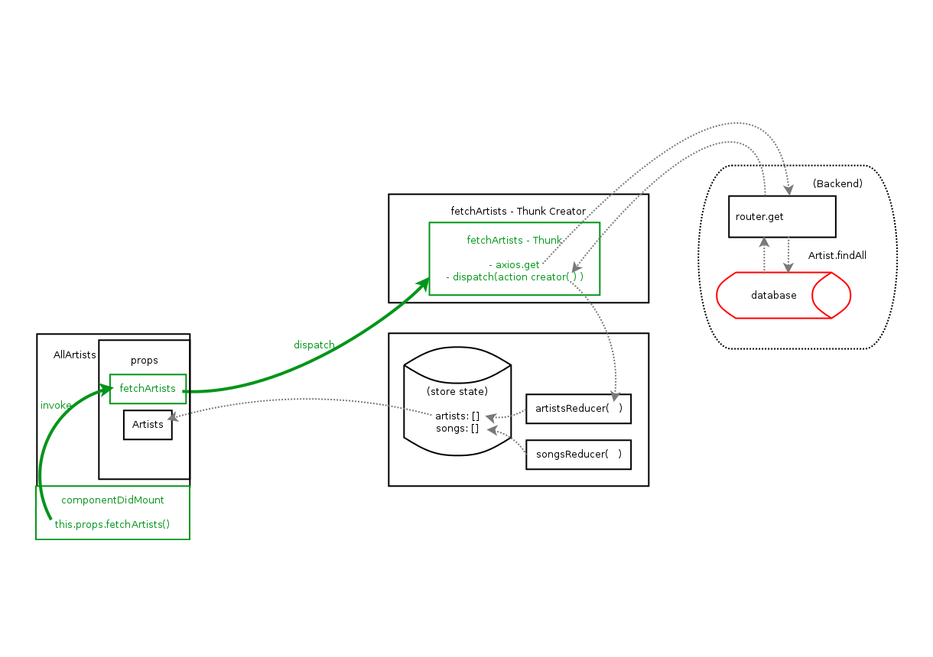
This dispatches the thunk we wrote earlier

Slide 32
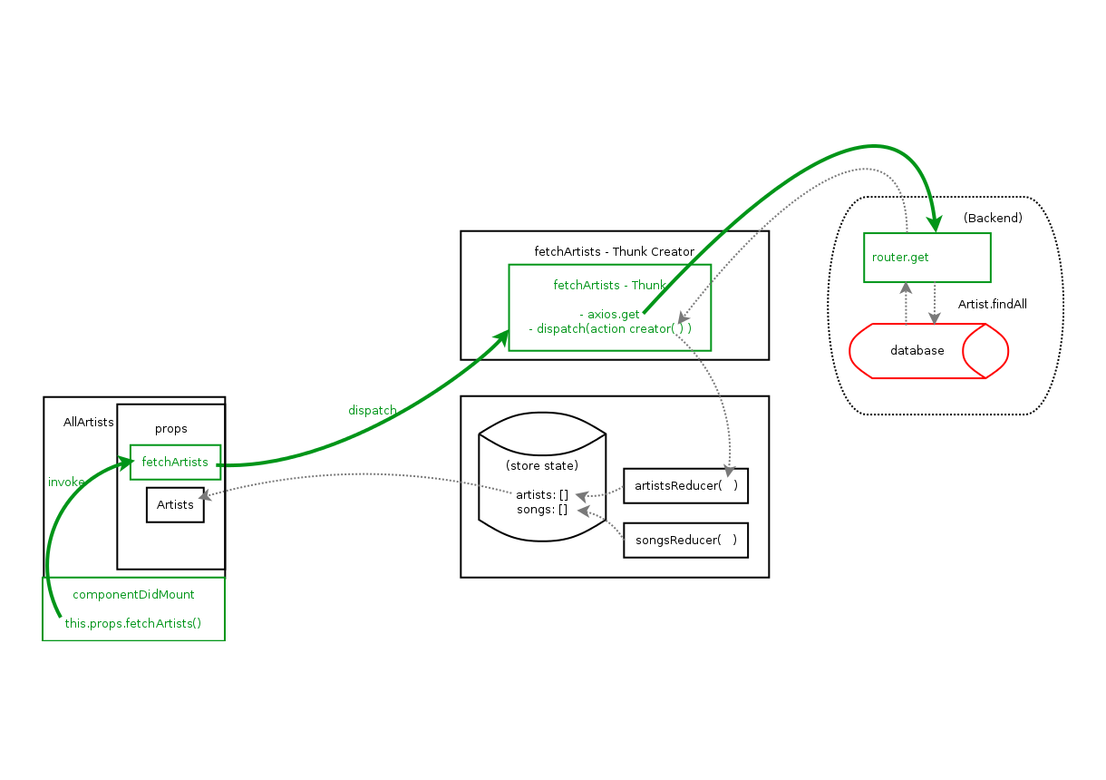
The thunk makes an axios request to the backend

Slide 33
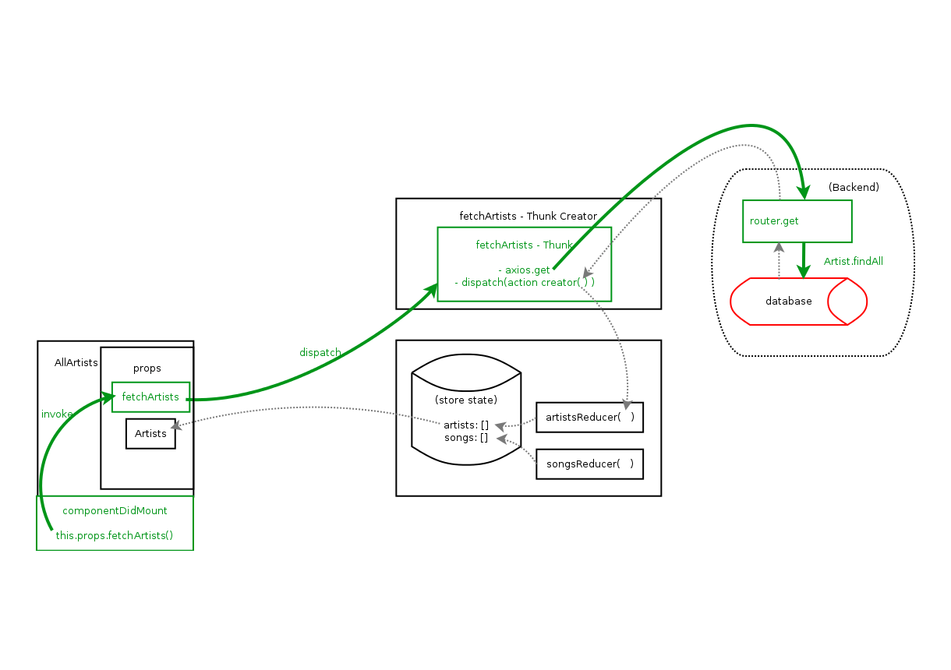
.. And hits a route which makes a query to the database (something like Artist.findAll )

Slide 34
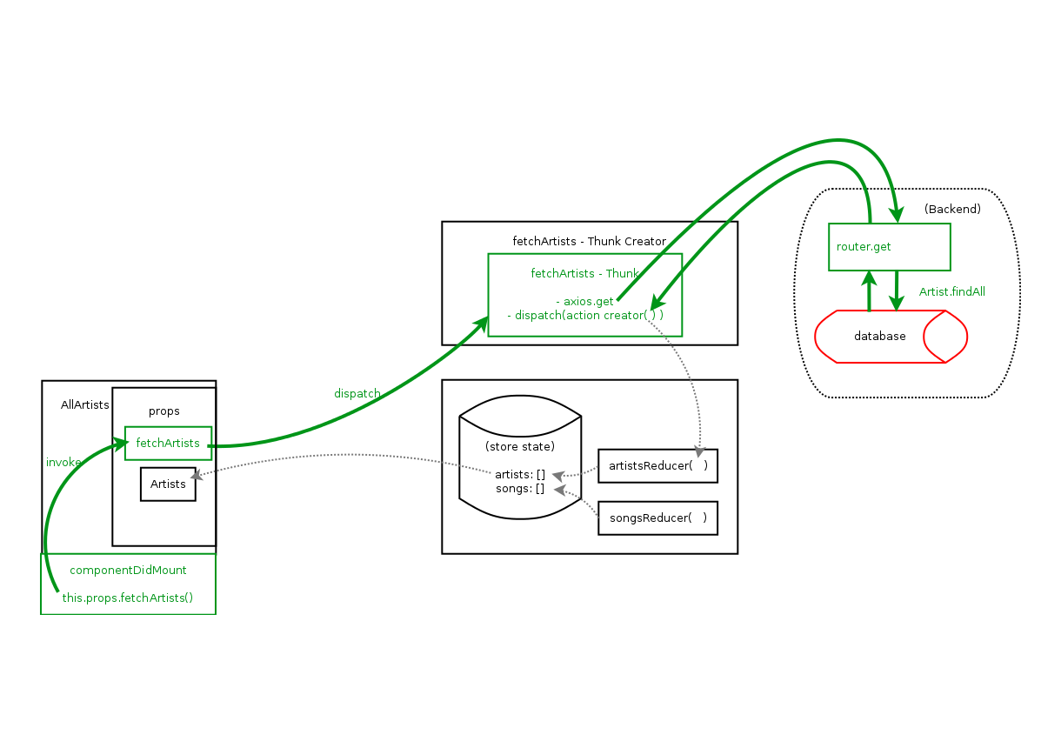
The result from the database is sent back (res.json) and passed as an argument to the action creator

Slide 35
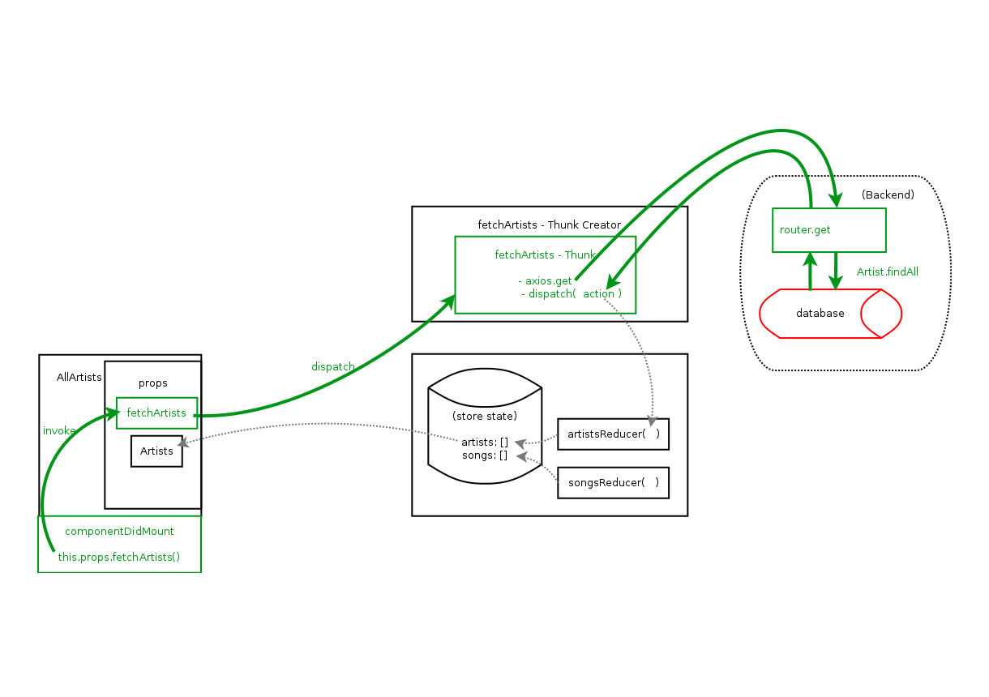
Action creator creates the action object

Slide 36
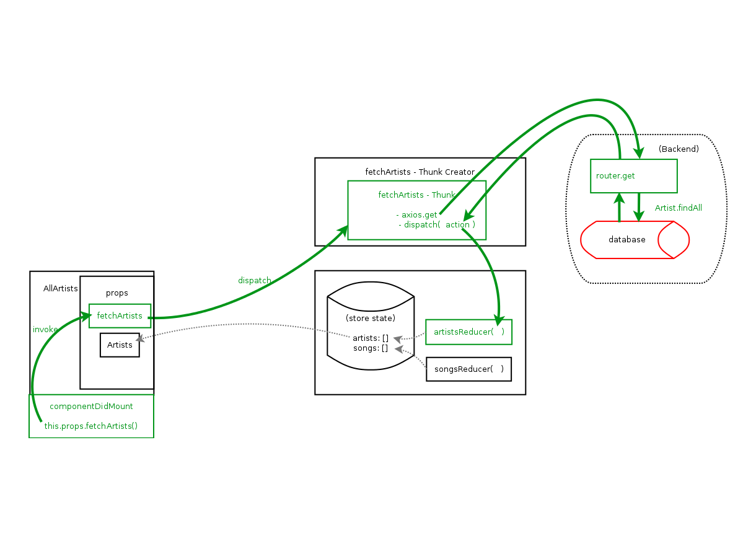
This object is dispatched, passing the action to the artistsReducer*
*technically, it gets passed to songsReducer (and all other reducers) too, but if you wrote your reducers and cases correctly, only the artistsReducer will return a new state

Slide 37
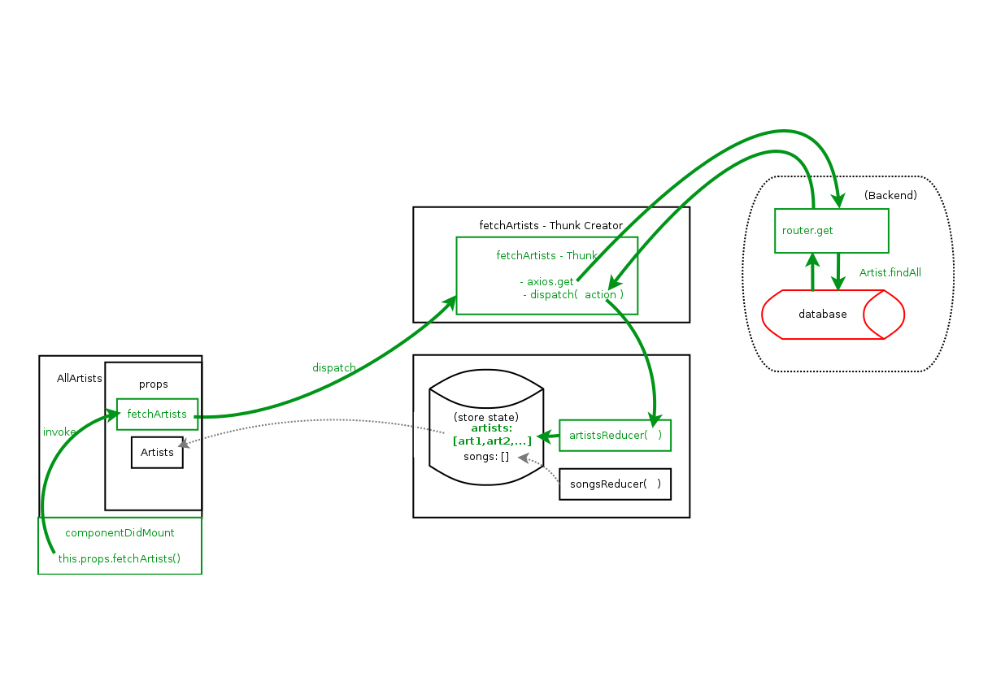
artistsReducer returns a new state, and updates the artists array of the store

Slide 38
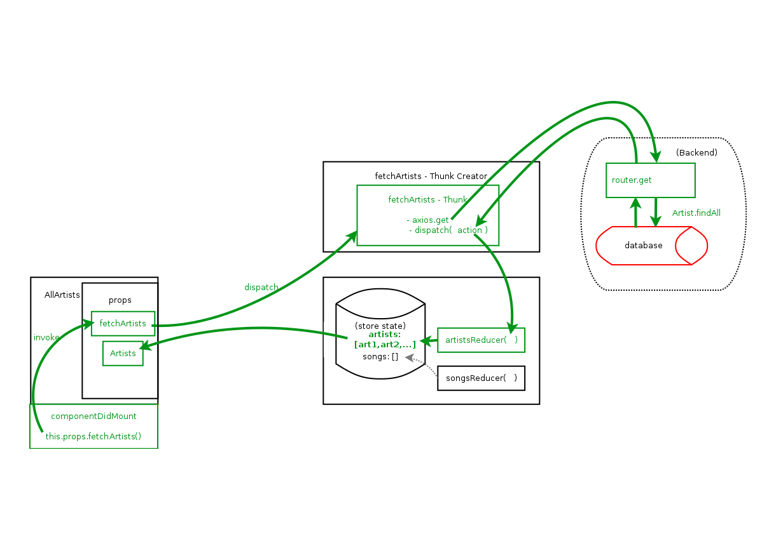
That change in the artists part of the store state re-renders AllArtists because we mapped that part of the state to props!

