Slide 1
CA1 Data Exploration &
Preparation
By Charles Franklin Jahn, 2020315

Slide 2
Here are my contributions to this CA.

Slide 3
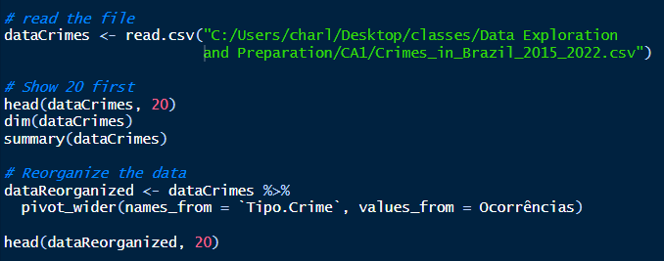
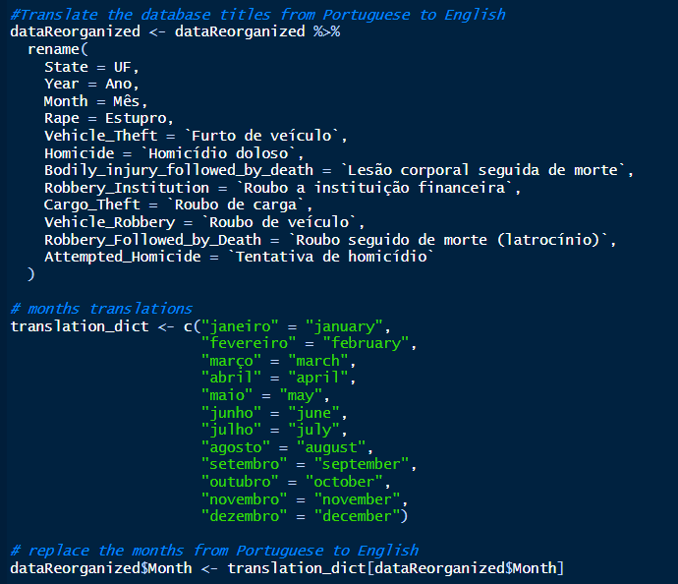
Starting
In the first week, together with Thiago, I presented the dataset that we could use. I have also created the repository on GitHub and shared the document on Google Docs for the project report.

Slide 4
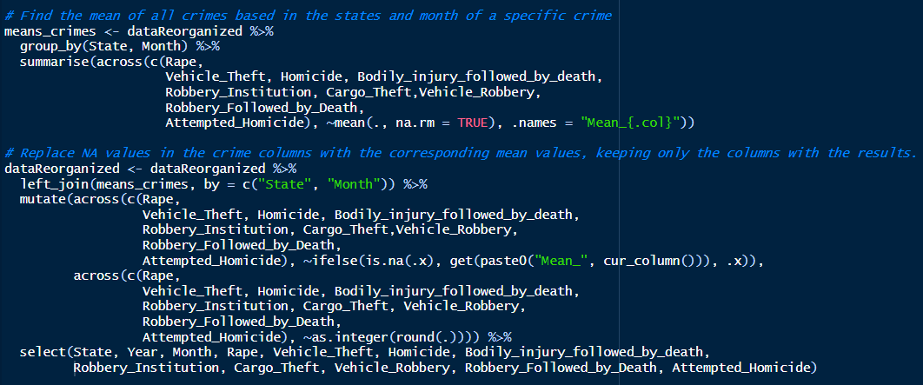
2. After a few weeks, I started working on the CA little by little. I was responsible for restructuring the table, translating important information and also calculating the mean, median, minimum, maximum and standard deviation.

Slide 5
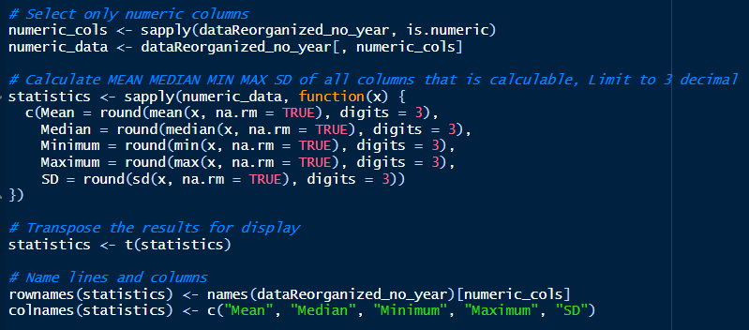
Ending
In the last week of the project I started creating the report and the last details in the code, such as indicating the Total_Crimes column and representing some graphs.

Slide 6
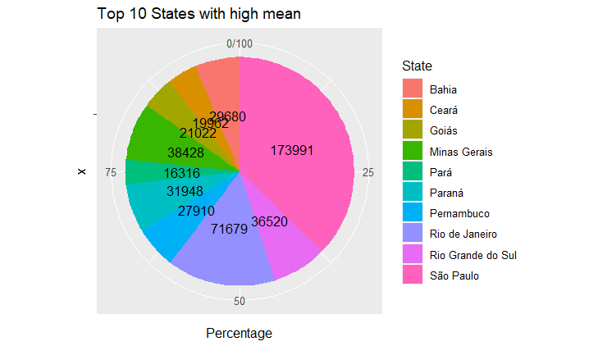
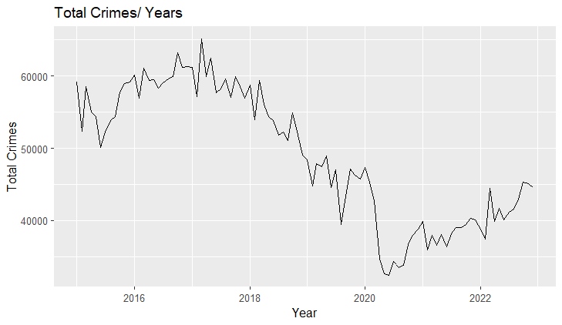
The bottom graph, I did a relation of total crimes vs year. I use line plot because it is a simple relation.
The graph on top, we can see top 10 highest mean of total crimes by each state.

Slide 7
Conclusion
Although data analysis is not my main expertise, immersing myself in the R language was a challenging journey. By exploring statistical parameters, exploratory data analysis, and even techniques like Principal Component Analysis (PCA), I realized how impactful understanding the data in detail and using it can be. This experience allowed for a more comprehensive understanding of the patterns and trends present in the data sets.

