Slide 1
HW03:HillFinding

Slide 2
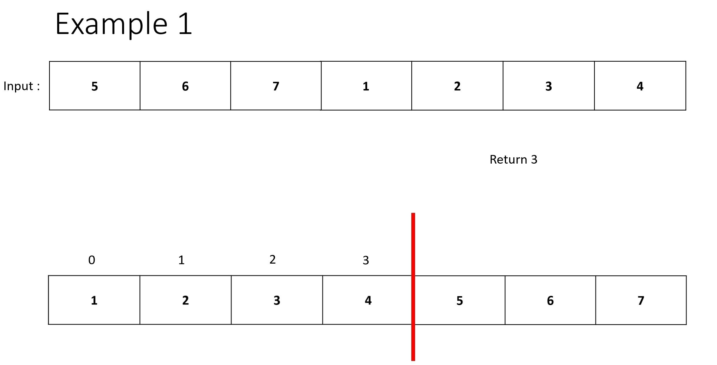
Assignment Requirement:
Input: An array.
In this mission we find the peak of the array, then find out which cutting position of the array which could produce a sorted array .
Final return: Cutting position of the array
Example1
Return 3

Slide 3
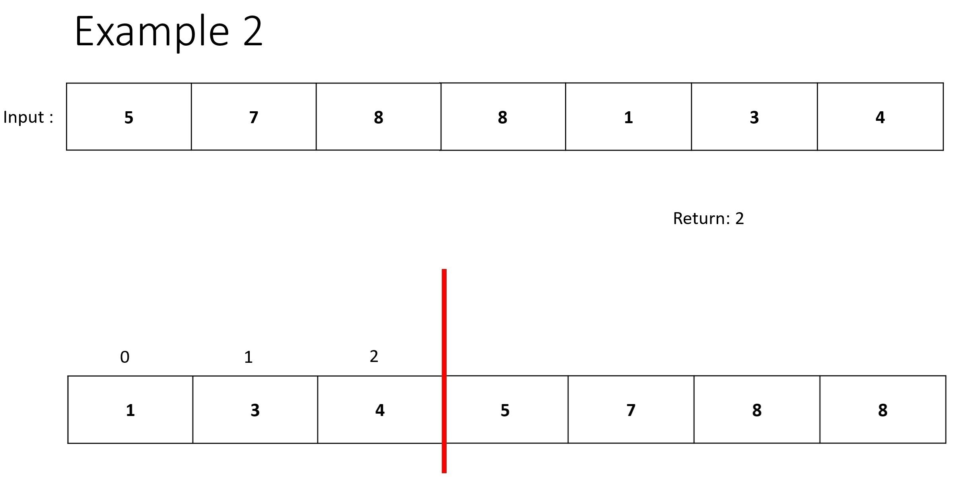
Assignment Requirement:
Example2
Return 2

Slide 4
Assignment Requirement:
TestCase(input) will not include arrays like:
[ 8, 8 , 8 , 8 , 8 , 8 ] (all same)
[ 1 , 2 , 3 , 4 , 5 , 6 , 7 ] (whole ascending) .

