Slide 1
File Management System From Scratch
CS305 Final Project
Group Members: 肖淇文 何昊东 胡宇晗

Slide 2
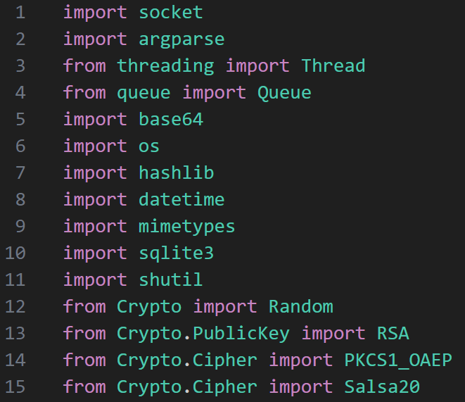
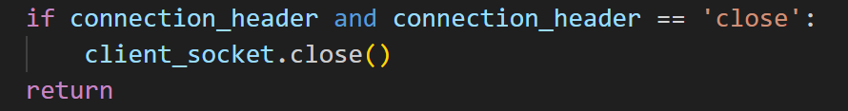
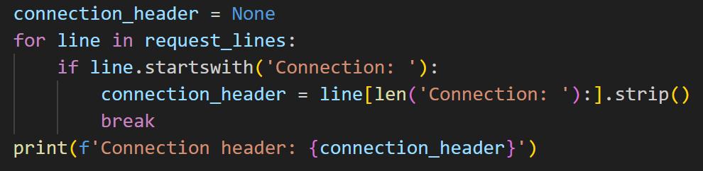
Part I. HTTP Server
All packages used
Persistent Connection

Slide 3
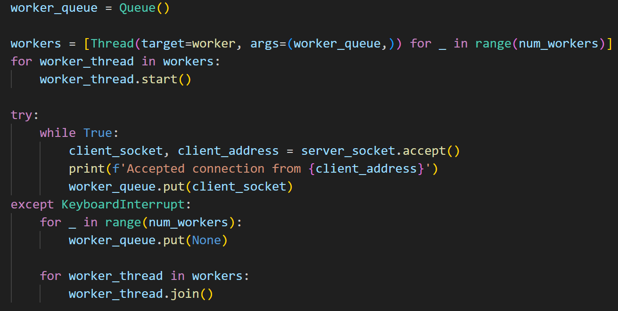
Part I. HTTP Server
Multiple clients and connections

Slide 4
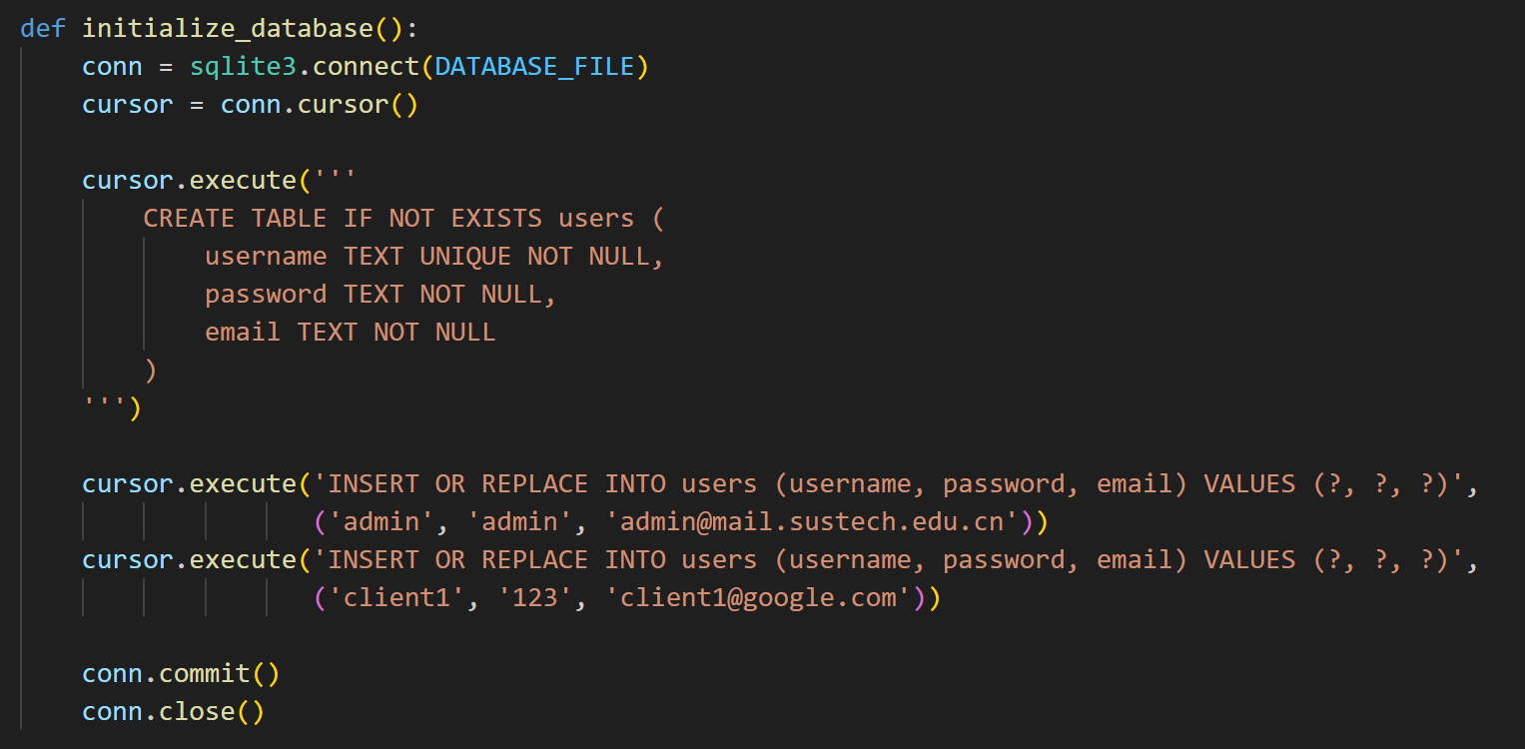
Part I. HTTP Server
Registration and Authorization: http://localhost:8080/register

Slide 5
Part II. View and Download
Presented on the browser.
Corner cases:
1. Non-existent file: http://localhost:8080/114514.txt
2. Overstepping (under account client1): http://localhost:8080/admin/dfs.cpp

Slide 6
Part III. Upload and Delete
Presented on the browser.
Corner cases:
1. Overstepping (under account admin): upload to/delete /client1/...

Slide 7
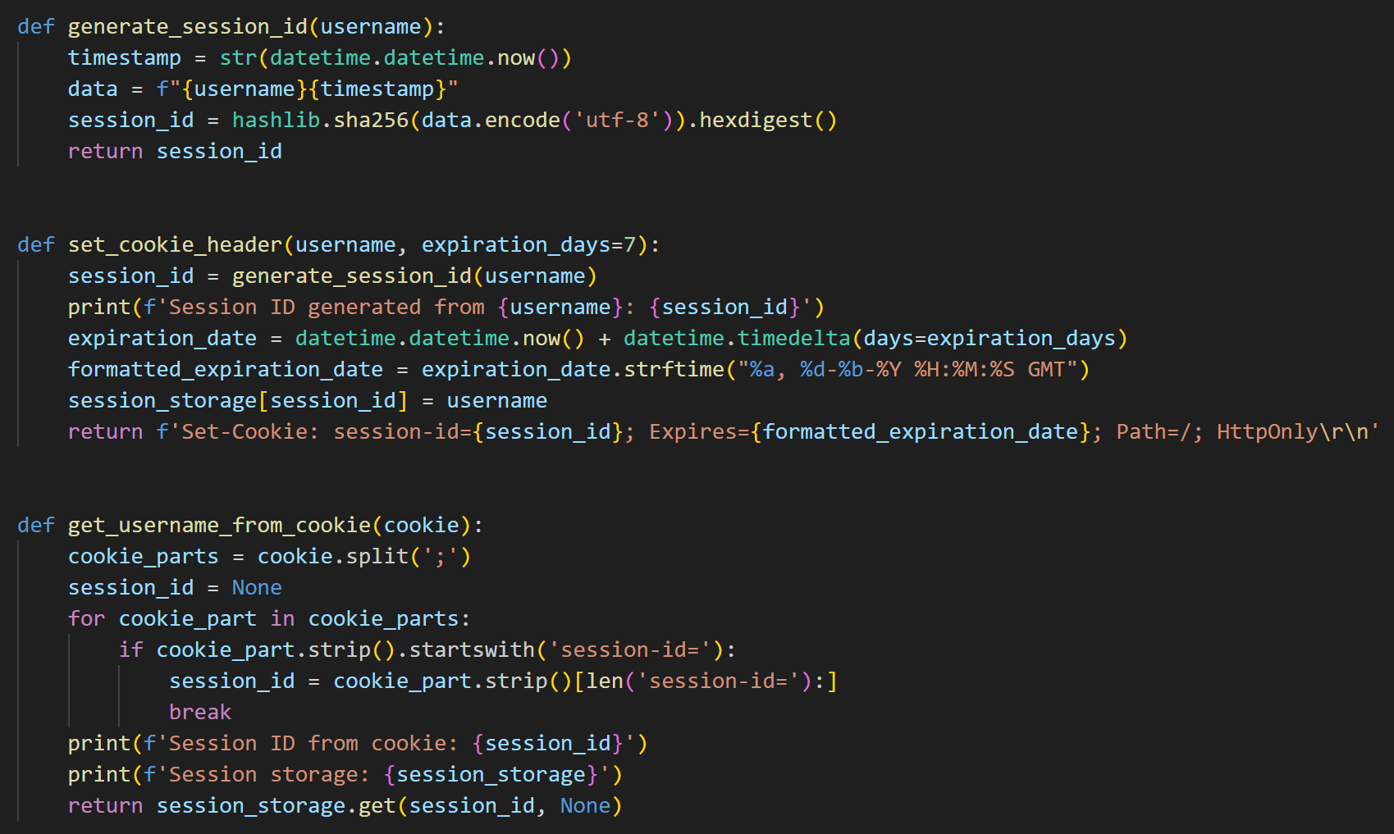
Part IV. Cookie and Session

Slide 8
Part V. Chunked Transfer
Shown in command line.

Slide 9
Part VI. Range Transmission
Shown in command line.

Slide 10
Part VII. Encryption

