Slide 1


程序设计范式
2 – 基于过程的编程
赵钦佩（博士，副教授）
Email: qinpeizhao@tongji.edu.cn
http://sse.tongji.edu.cn/zhaoqinpei

Slide 2

2–基于过程的编程
2.1 如何撰写函数？
2.2 我们能相信别人吗？
2.3 能否在效率上得到提高？
2.4 是否可以传入不同类型或不同数量的参数给一个函数呢？
2.5 是否可以有一个函数支持不同的数据类型？
2.6 怎么用非标准库内的头文件？

Slide 3

2.1 How to write a function?
int functionA(int iX, int iY);
int functionA(int iX, int iY) {}
functionA(3,5);
The first is a declaration, the second is a definition (with null statements), the third is an invoking (function call)
Declaration of a variable or function can appear many times, while definition only once
iX & iY - parameters, 3 & 5 - arguments

Slide 4
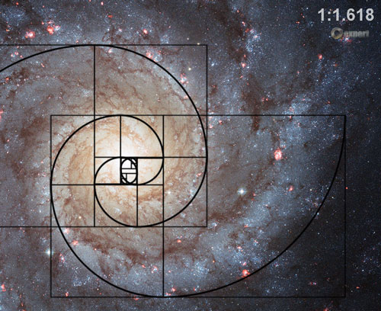
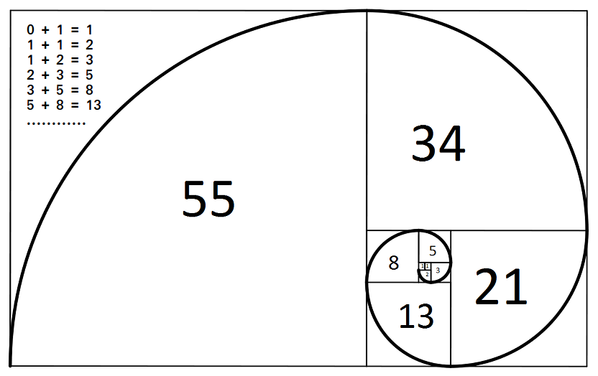
2.1 A simple starting point
Fibonacci number sequence: 1, 1, 2, 3, 5, 8, 13, 21, …
We build a function to get a certain element of the sequence
int fibon_elem(int iPos)
{
int n2 = 1, n1 = 1;
int iElem = 1;
for (int iX = 3; iX <= iPos; iX++)
{
iElem = n2 + n1;
n2 = n1;
n1 = iElem;
}
return iElem;
}

Slide 5
2.2 Can we trust others?
Can we calculate a Fibonacci number at position 2000?
What’s the maximum number we can reach on Fibonacci sequence? (code)
Users may not be trustworthy, assumption is dangerous.
Be doubtful!

Slide 6
2.2 Could we always trust others? – A better version
bool fibon_elem(int iPos, int &iElem)
{
int n2 = 1, n1 = 1;
if (iPos <= 0 || iPos >= 1024)
{
iElem = 0; return false;
}
iElem = 1;
for (int iX = 3; iX <= iPos; iX++)
{
iElem = n2 + n1;
n2 = n1;
n1 = iElem;
}
return true;
}
Users may not be trustworthy, assumption is dangerous
Be doubtful

Slide 7
2.3 Can we improve the code?
Calculating elements in every calling is not so efficient
We need only calculate them once, then pick the corresponding one
bool fibon_elem(int iPos, int &iElem)
{
int n2 = 1, n1 = 1; ……
iElem = 1;
for (int iX = 3; iX <= iPos; iX++){
iElem = n2 + n1;
n2 = n1;
n1 = iElem;}
return true;
}
iPos = 5, 8, 10, ….
1, 1, 2, 3, 5
1, 1, 2, 3, 5, 8, 13, 21
1, 1, 2, 3, 5, 8, 13, 21, 34, 55

Slide 8
2.3 How about this?
vector<int>* fibon_seq(int iLength)
{
if (iLength <= 0 || iLength >= 1024)
{
cerr << “Length ” << iLength
<< “not supported, reset to 8”
<< endl;
iLength = 8;
}
vector<int> Elems( iLength );
for (int iX = 0; iX < iLength; iX++)
{
if (iX == 0 || iX == 1)
Elems[iX] = 1;
else
Elems[iX] = Elems[iX-1] + Elems[iX-2];
}
return &Elems;
}
← Problem

Slide 9
2.3 Extent
Elems has only “Local Extent”
Its memory was allocated on the program stack
Discarded after the function completed
Can’t be seen from outside of the function
Pointer to a ‘died’ object is dangerous
Result of dereferencing a ‘died’ object is not defined
Declared it outside of the function will have “File Extent”
Its scope is from the declaration point to the end of the file
Its memory was allocated before entering the main function, and never discarded until the program ends
Internal(Built-in) type was initialized as 0 automatically

Slide 10
2.3 Extent (cont.)
Also we could leverage the “Dynamic Extent”
Use the new and delete operators in any functions
Its memory was allocated from the free store
Manually memory management by the programmer
Example
int* funcA() void funcB(int* p)
{ {
int* p = new int[1024]; cout << p[ 1 ] << endl;
return p; delete [] p;
} }

Slide 11
2.3 Mem Management of Extent objects
For those objects having local and file extent – Automatic Memory Management
The system allocate and de-allocate the memory automatically
For those objects having dynamic extent – Dynamic Memory Management
Adaptive and convenient
System will never free them automatically while the program running
Explicit delete is necessary, or there will be “Memory Leak”

Slide 12

2.3 Memory Areas in C++
5 areas store variables and objects
Const data area
For those literal const data, only internal types
Global or static data area
Once the program starts, the memory allocated for global or static objects, but may not be initialized at once (eg. static objects in function)
Support user-defined data types
Stack
For local objects
Objects destroyed at the end of their scope
Free store
For the objects constructed and destroyed using new & delete and their family
Heap
For the objects constructed and destroyed using malloc & free and their family

Slide 13
2.3 ‘new’s & ‘delete’s
It’s recommended using new & delete
For user-defined data types, it will not only allocate and de-allocate memory, but also invoke their ctors and dtors
Never mix-use the new & delete and malloc & free, for they allocate spaces in different memory areas
new and array new, delete and array delete
string* stringPtr1 = new string; //one ctor called
string* stringPtr2 = new string[100]; //100 ctors called
…
delete stringPtr1; //delete a single object
delete [] stringPtr2; //delete an object array, 100 dtors called

Slide 14
2.3 ‘new’s & ‘delete’s (cont.)
Use the same form in corresponding uses of new & delete
Mis-match will lead undefined behavior
Never to make typedef to arrays
typedef string AddressLines[4];
string* pal = new AddressLines;
…
delete pal; //Undefined result, at least memory leak
delete [] pal; //OK, but seems strange

Slide 15
2.3 Inside story of ‘new’
new operator VS operator new(operator new[])
new operator, also called new expression, is a language-defined behavior that can not be re-defined or overloaded
string*ps = new string(“Hello”);
2 steps of the new operator behavior
Allocate enough memory for the object (using operator new)
Invoke its constructor to initialize
operator new allocate certain size of raw memory, and return the pointer
void* operator new(size_t size);
Programmer can define his own allocation behavior, that is, operator new could be overloaded
The first parameter must be a size_t

Slide 16
2.3 Inside story of ‘new’ (cont.)
Pseudo code from the compiler for a new operator
string*ps = new string(“Hello”);
void* memory = operator new(sizeof(string));
call string::string(“Hello”) on *memory;
string *ps = static_cast<string*>(memory);

Slide 17
2.3 Inside story of ‘new’ (cont.)
Some advanced topics about ‘new’
Placement new – to construct objects at specified position
char s[1000];
void* buffer = static_cast<void*>(s);
new (buffer) string(“Hi”);
Exceptions thrown when failed in allocating enough memory
new-handler – error handling function that invoked before throwing exceptions
Similar story in delete operator and operator delete

Slide 18
2.3 A corrected version – Local Static Objects
Elems declared as local objects in the function, which doesn’t exist after the function returns
Although declare it in the file scope will work, it is not a good idea
A risk, functions are harder to understand (logic about not only the functions but also the global variables needs to understand)
A bad design, breaking the independency between the functions and increasing the coupling
We could work it out by using local static objects

Slide 19
2.3 A corrected version – Local Static Objects (cont.)
const vector<int>* fibon_seq(int iLength)
{
static vector<int> Elems;
if (iLength <= 0 || iLength > 1024)
{
cerr << “Length ” << iLength
<< “not supported” << endl;
return 0;
}
//existing elements won’t be calculated
for (int iX = Elem.size(); iX < iLength; iX++)
{
if (iX == 0 || iX == 1)
Elems.push_back(1);
else
Elems.push_back(Elems[iX-1] + Elems[iX-2]);
}
return &Elems;
}

Slide 20
2.3 A corrected version – Local Static Objects (cont.)
Here Elems is defined as a local static object
Its memory is not on the program stack, and won’t be destroyed and reconstructed in every calls
It is now safe to return the object address

Slide 21
2.3 Another corrected version
vector<int> fibon_seq(int iLength)
{
…
return Elems;
}
Using the passing by value to copy the vector object
Maybe not so efficient, but that will work
Thousands of way to make it work, pick the most appropriate one

Slide 22
2.3 Improve from efficiency – inline
bool is_size_ok(int iLength)
{
if (iLength <= 0 || iLength > 1024)
{
cerr << “Length ” << iLength
<< “not supported” << endl;
return false;
}
return true;
}
We could split the fibon_seq() into small functions
Extract the length validation part to an independent function

Slide 23
2.3 Inline Functions
Well organized, but may bring overhead
For performance, declare it as inline
inline bool is_size_ok(int iLength) { …… };
‘inline’ is not compulsive, its only a suggestion to the compiler
If the compiler decides to accept, it will expand a copy of code at the calling point, thus enhance the performance
It is recommended that inline functions and their definition be placed in head files, for effectiveness and better visibility
Never abuse, only for small, simple and frequently called functions

Slide 24
2.4 What is function overloading?
int add(int x, int y) {
return x + y;
} //integer version
double add(double x, double y){
return x + y;
} //double versioin
int add(int x, int y, int z){
return x + y + z;
} //different number of parameters
The compiler is able to determine which version of add() to call based on the arguments used in the function call.
We can define as many overloaded add() functions as we want, so long as each add() function has unique parameters.

Slide 25
2.4 Function Overloading
We could use the same function name for functions with different parameter number and type
void display(char);
void display(char*);
void display(string &, ostream& = cout);
void display(vector<int>&, ostream&);
When calling, the compiler compare the arguments type with each parameter list, and choose the most appropriate one
That’s why the parameter list should be unique among overloading functions

Slide 26
2.4 Function Overloading (cont.)
Why return value type is not enough for function overloading?
void display(int);
bool display(int); //?
int display(int); //?
Because the compiler could not resolve the conflict when we call it like this
display(iX);

Slide 27
2.4 Default Parameter Values
An output function supporting multiple output streams
void display(const vector<int> &vec, ostream &os = cout)
{
for (int iX= 0; iX < vec.size(); iX++)
{
os << vec[iX] << endl;
}
}
Calling
display(vec); //normal, output to standard output
ofsteam OutFile(“out.txt”);
display(vec, OutFile); //output to file

Slide 28
2.4 Default Parameter Values (cont.)
Another example: switch on/off debugging information
void vec_incre(const vector<int> &vec, ostream *ofile = 0)
{
for (int iX= 0; iX < vec.size(); iX++)
{
vec[iX]++;
if (ofile)
(*ofile) << endl;
}
}
Q: Could we use
ofstream &ofile = 0 ?
Calling
vec_incre(Vec); //not debug
ofsteam OutFile(“out.txt”);
vec_incre(Vec, &OutFile); //debug to file
Notes:
Answer: reference 不同于指针，不能为0

Slide 29
2.4 Default Parameter Values (cont.)
Rules
If certain parameter specifies default value, all the parameters on its right side should have default values
void funcA(int iX = 0, int iY, ostream os = cout) //invalid
void funcA(int iY, int iX = 0, ostream os = cout) //valid
void funcA(int iX = 0, int iY = 0, ostream os = cout) //valid
Default parameters can be specified only once (at declaration or definition)
It is suggested specify them at function declaration in head files, for better visibility

Slide 30
2.5 A function for different data types
C++ function templates
C++ function templates are those functions which can handle different data types without separate code for each of them.
The syntax of the function template is:
Type
Specifies type of parameters to the function
Specifies return type of the function
Declares variables within the function
template<class Type>
function definition;
where Type is called a formal parameter of the template

Slide 31
2.5 Function template
Suppose we need 3 more display() functions
void display(const vector<long>& vec, ostream & os = cout);
void display(const vector<double>& vec, ostream & os = cout);
void display(const vector<string>& vec, ostream & os = cout);
Could we use only one implementation?
Use function templates to peel off the data type, and make bindings while execution

Slide 32
2.5 Template Functions (cont.)
template <typename ElemType>
void display(const vector<ElemType> &vec, ostream &os = cout)
{
for (int iX= 0; iX < vec.size(); iX++)
{
ElemType t = vec[iX]
os << t << endl;
}
}
Calling
vector<int> iVec;
display(iVec);
ElemType will be bound to int automatically, and an entity of vector<int> generated

Slide 33
2.5 Template Functions (cont.)
Template could be bound to any internal or user-defined data types
In essence, it asks the compiler to delay the resolution of type, and provide it until execution

Slide 34
2.5 When Parameter Defaulting, When Overloading & When Template
Use Parameter Defaulting when:
Function has only one implementations or algorithm
Parameter has appropriate default value
Use Overloading when:
Function has multiple implementations or algorithms
Implementations rely on input of the function
Use Function Template when:
Function has only one implementations or algorithm
Needs to handle variant data types

Slide 35
2.6 How to include a file?
Why you need to #include files?
Why you would want to have multiple .cpp files for a program?
Speeds up compile time
Keeps your code more organized
Separates interface from implementation
Compile / wait 8 minutes / "oh crap, forgot a semicolon" / compile / wait 8 minutes / debug / compile / wait 8 minutes / etc
// in myclass.h
class MyClass {
public:
void foo();
int bar;
};
// in myclass.cpp #include "myclass.h" void MyClass::foo() { }
//in main.cpp #include "myclass.h" //defines MyClass
int main() {
MyClass a; // no longer produces an error, because MyClass is defined
return 0;
}

Slide 36
2.6 #include files
include files repeatedly?
// x.h
class X { };
// myclass.h
class MyClass {
void DoSomething() { }
};
// a.h
#include "x.h"
class A { X x; };
// b.h
#include "x.h"
class B { X x; };
// main.cpp
#include "myclass.h” // define MyClass
// Compiler error - MyClass already defined
#include "myclass.h"
// main.cpp
#include "a.h" // also includes "x.h"
#include "b.h" // includes x.h again! ERROR

Slide 37
2.6 #include files
do nothing if: A makes no references at all to B
do nothing if: The only reference to B is in a friend declaration
forward declare B if: A contains a B pointer or reference: B* myb;
forward declare B if: one or more functions has a object/pointer/reference as a parameter, or as a return type: B MyFunction(B myb);
#include "b.h" if: B is a parent class of A
#include "b.h" if: A contains a B object: B myb;

