Slide 1

面向对象程序设计
8 – 并发、多线程
赵钦佩（博士，副教授）
Email: qinpeizhao@tongji.edu.cn
http://sse.tongji.edu.cn/zhaoqinpei

Slide 2

8–并发、多线程
8.1 什么是摩尔定律？
8.2 为什么要并发？
8.3 并发如何写，有什么问题？
8.4 如何解决冲突问题？
8.5 如何同步线程？

Slide 3

8.1 Moore’s Law?
Moore‘s law is the observation that the number of transistors in a dense integrated circuit doubles approximately every two years. The observation is named after Gordon E. Moore, the co-founder of Intel and Fairchild Semiconductor 1965
Advancements in digital electronics are strongly linked to Moore's law: quality-adjusted microprocessor prices, memory capacity, sensors and even the number and size of pixels in digital cameras.

Slide 4

8.1 Moore’s Law?

Slide 5
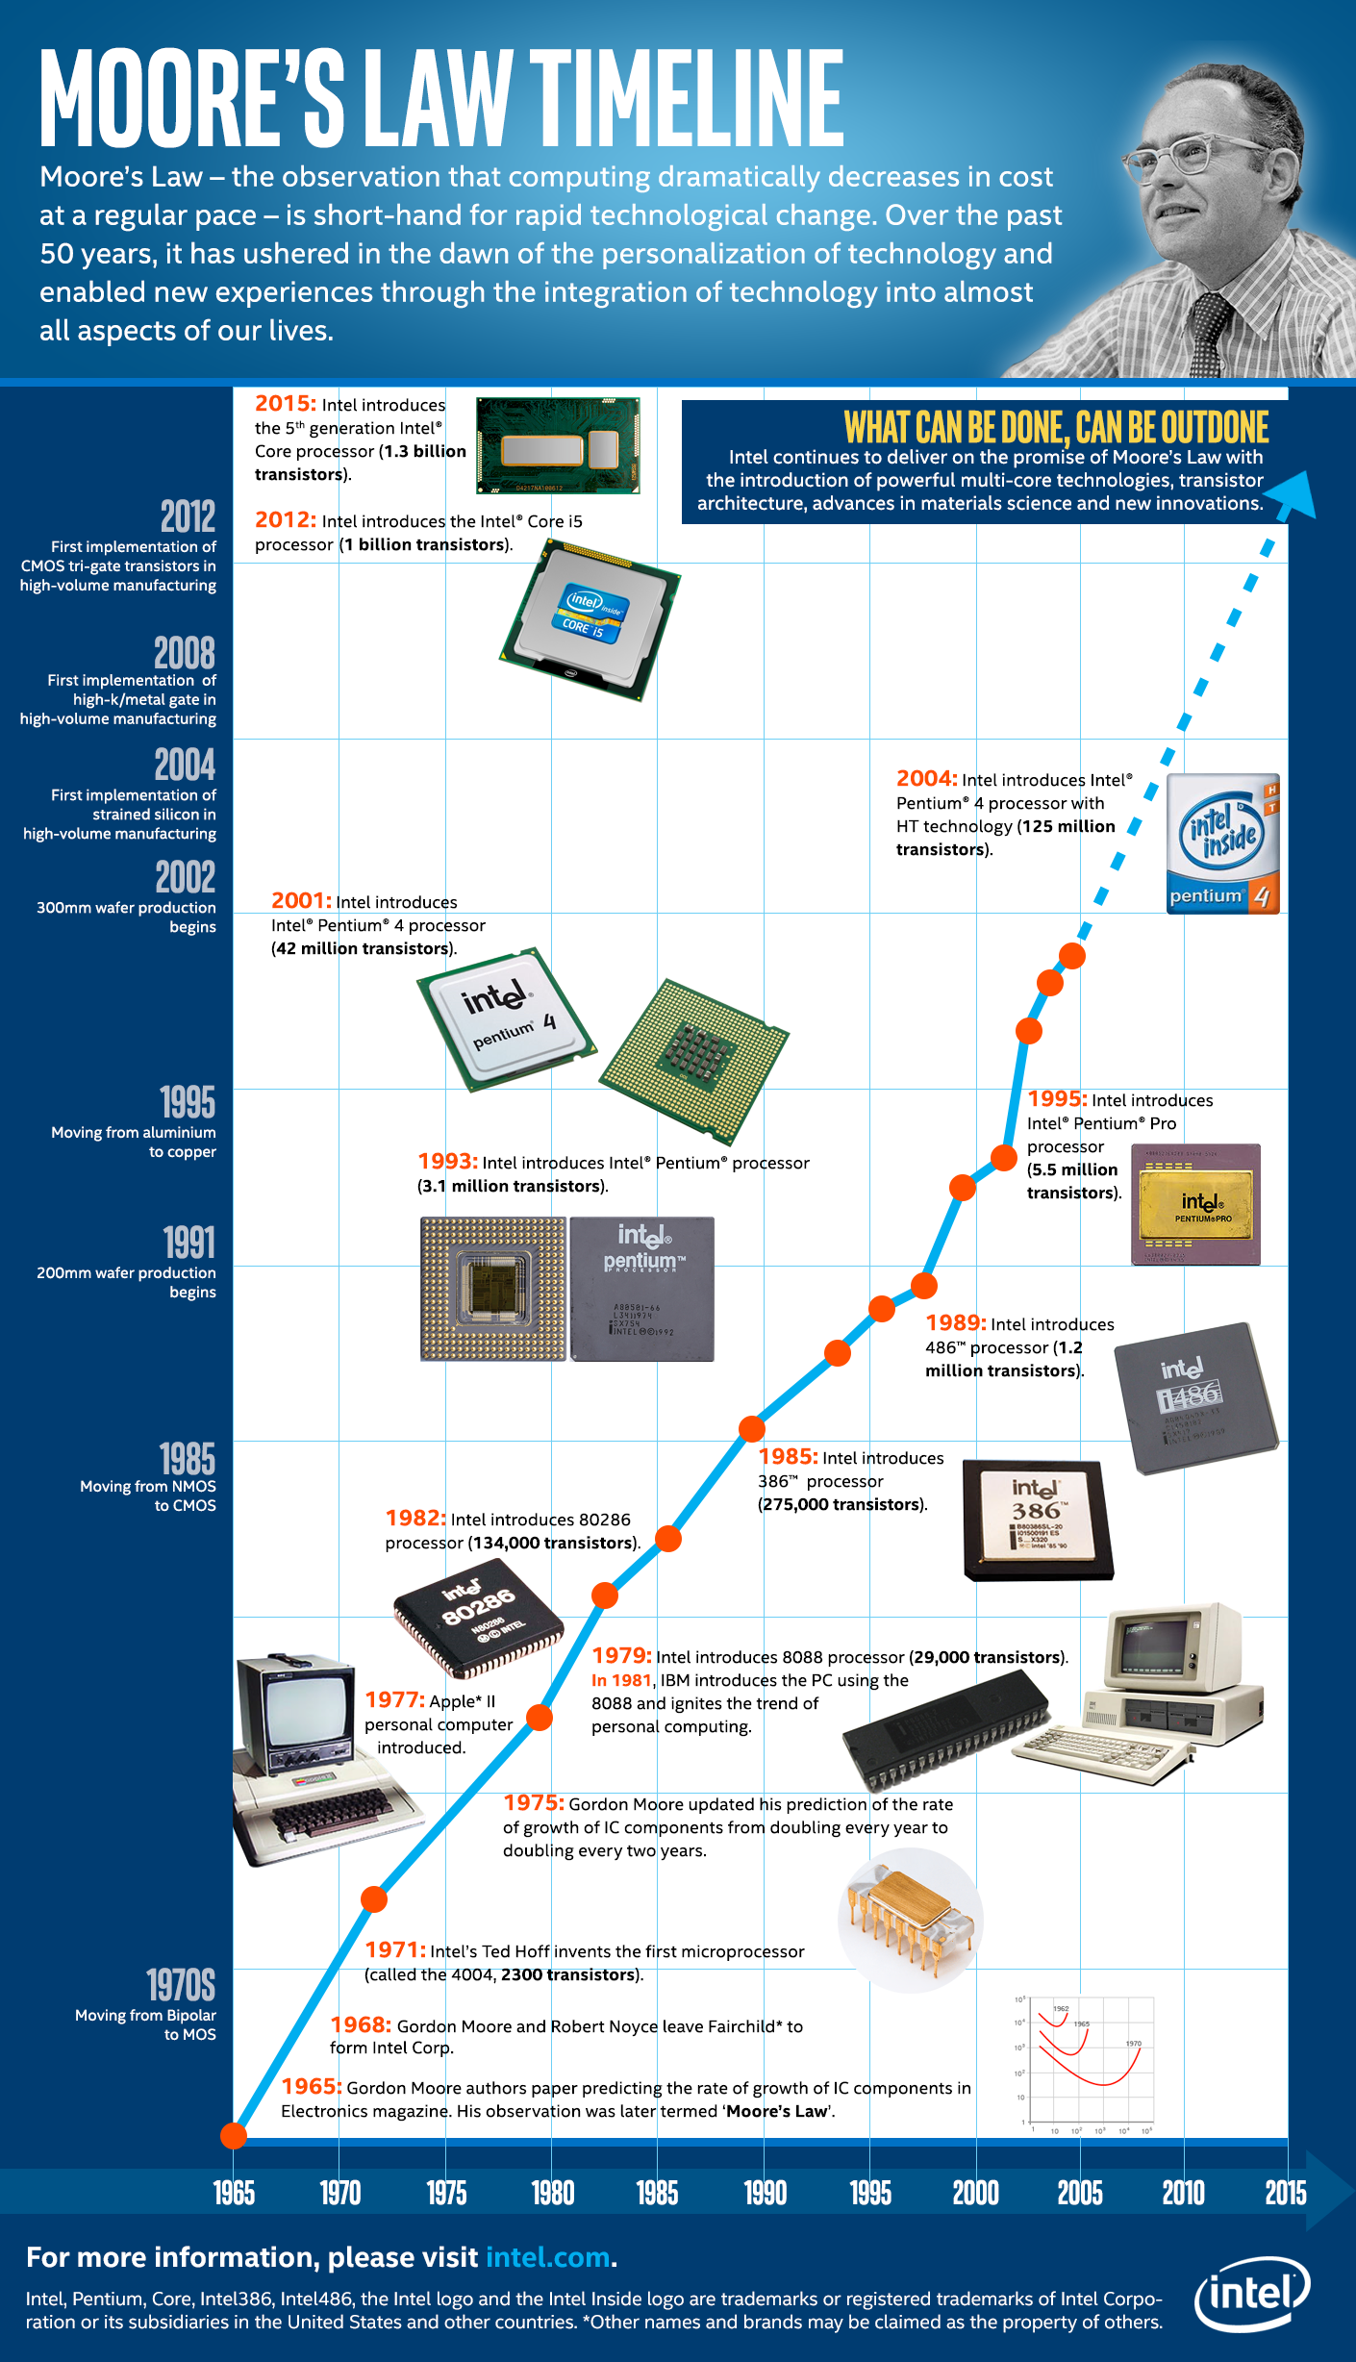
8.1 Moore’s Law?

Slide 6
8.2 How to make the program faster?
Processor speed has slowed and we can use transistors from Moore’s law for parallelism to increase speed.
Concurrent programming is necessary to utilize parallel hardware.
Sometimes it is natural to describe a problem with multi-threads just like divide a problem into several steps.

Slide 7
8.2 Why Concurrency?
Original C++ Standard was published in 1998 only support single thread programming.
The new C++ Standard (referred to as C++11 or C++0x) was published in 2011. It will acknowledge the existence of multithreaded programs. Memory models for concurrency is also introduced.

Slide 8
8.2 Why Concurrency?
Dividing a problem into multiple executing threads is an important programming technique.
Multiple executing threads may be the best way to describe a problem.
With multiple executing threads, we can write highly efficient program by taking advantage of any parallelism available in computer system.

Slide 9
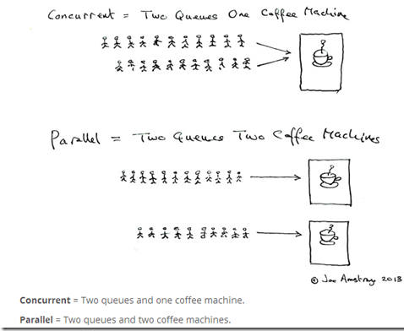
8.2 Concurrency v.s. Parallel

Slide 10
8.3 What constitute Concurrency?
Thread creation - be able to create another thread of control.
Thread synchronization – be able to establish timing relationships among threads.
One thread waits until another thread has reached a certain point in its code.
One threads is ready to transmit information while the other is ready to receive the message, simultaneously.
Thread communication – be able to correctly transmit data among threads.

Slide 11
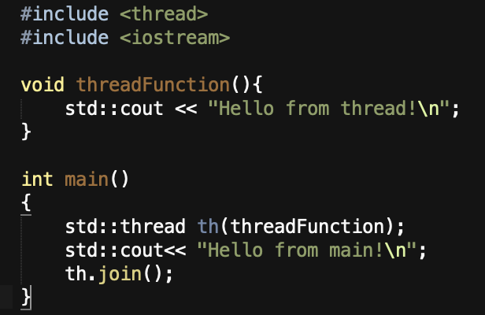
8.3 How to create threads?
C++11 introduced a new thread library including utilities for starting and managing threads.
Creating an instance of std::thread will automatically start a new thread.
The join function here is to force the current thread to wait for the thread th to finish. Otherwise the main function may exit without the thread th finished.
Two thread will be created. The main thread will launch a new thread when it encounter the code std::thread th() to executive the function threadFunction();

Slide 12
8.3 What’s the problem existing?
Data are usually shared between threads. There is a problem when multiple threads attempting to operate on the same object simultaneously.
If the operation is atomic(not divisible) which means no other thread can modify any partial results during the operation on the object, then it is safe. Otherwise, we are in a race condition.
Critical Selection is a piece of code that accesses a shared resource (data structure or device) that must not be concurrently accessed by more than one thread of execution.
Preventing simultaneous execution of critical section by multiple thread is called mutual exclusion.
The join function here is to force the current thread to wait for the thread th to finish. Otherwise the main function may exit without the thread th finished.

Slide 13
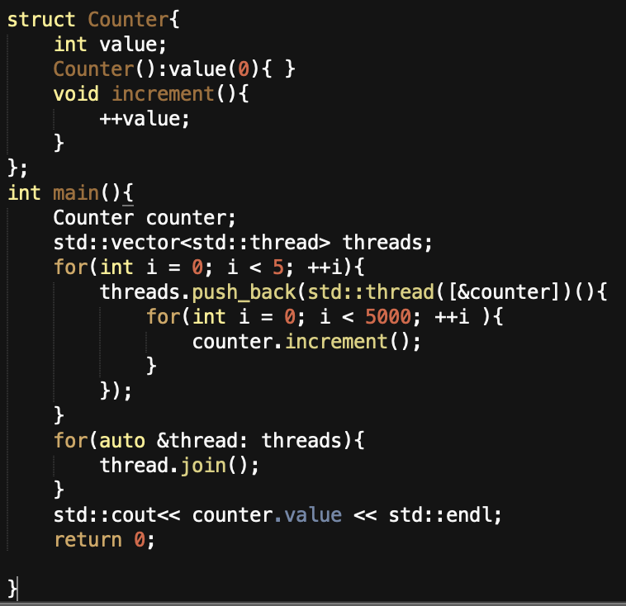
8.3 Example
Shared objects between threads will lead synchronization issues.
5 threads created try to increase the counter 5000 times. This program has a synchronization problem. Here are some result obtained on my computer:
24138
20326
23345
25000
17715
It is not the same every time.

Slide 14
8.3 Protect shared data
The problem is that the increment is not an atomic operation
Atomic operation: during which a processor can simultaneously read a location and write it in the same bus operation. Atomic implies indivisibility and irreducibility, so an atomic operation must be performed entirely or not performed at all.
The increment in the example is made of three operations:
Read the current value of value
Add one to the current value
Write that new value to value
So when you launch more than one thread, they might interleave with each other and make the result impossible to predict.

Slide 15
8.4 What’s the solution?
Solutions
Semaphores — Mutex is a binary semaphore.
Atomic references
Monitors — guarantee on thread can be active within monitor at a time. C++ does not support monitor but Java does.
Condition variables.
Compare-and-swap — It compares the contents of a memory location to a given value and, only if they are the same, modifies the contents of that memory location to a given new value
Etc.

Slide 16
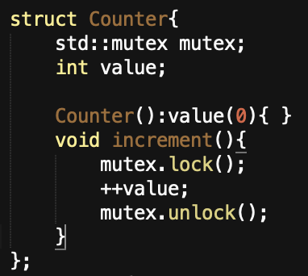
8.4 Protect shared data with Mutexes
Mutexes (name after mutual exclusion) enable us to mark the code that access the data structure as mutually exclusive so that if any thread was running one of them, any other tread that tried to access the data had to wait until the first thread was finished
In C++, you create a mutex by constructing an instance of std::mutex, lock it with a call to the member function lock() and unlock it with a call to the function unlock().
Lock(): enable a thread to obtain the lock to block other thread.
Unlock(): release the lock to unblock waiting threads.

Slide 17
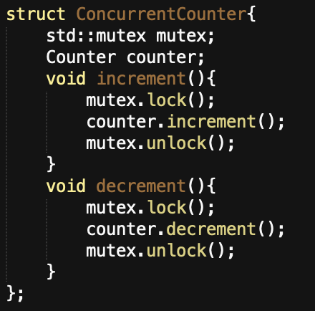
8.4 RAII IDIOM
It is not wise to call the member functions directly because you have to remember to Unlock() on every code path out of a function including those due to exceptions.
The template std::lock_guard implements that Resource Acquisition Is Initialization (RAII) idiom for a mutex
mutex.lock() is called when the instance of std::lock_guard is constructed and mutex.unlock() is called when the instance guard is decontructed.
Because of mutexes, only one thread can do counter.increment() each time ensuring the correctness of our result.
Notes:
Resource acquisition is initialization (RAII) is a programming idiom used in several object-oriented languages to describe a particular language behavior. In RAII, holding a resource is a class invariant, and is tied to object lifetime: resource allocation (or acquisition) is done during object creation (specifically initialization), by the constructor, while resource deallocation (release) is done during object destruction (specifically finalization), by the destructor.

Slide 18
8.4 Advanced locking with mutexes
Recursive Locking .
std::recursive_mutex
Recursive locking enables the same thread to lock the same mutex twice and won’t deadlock.
Timed Locking
std::timed_mutex, std::recursive_timed_mutex
Timed locking enables a thread to do something else when waiting for a thread to finish.
Call once
Std::call_once(std::once_flag falg, function);
It is possible we only want a function to be called only one time no matter how many thread is launched. Each std::call_once is matched to a std:::once_flag variable.

Slide 19
8.4 Atomic types
C++11 concurrency library introduces atomic types as a template class: std::atomic. You can use any type you want with the template and the operation on that variable will be atomic and so thread-safe.
std::atomic<Type> object.
Different locking technique is applied according to the data type and size.
lock-free technique: integral types like int, long, float. It is much faster than mutexes technique.
Mutexes technique: for big type(such as 2MB storage). There is no performance advantage for atomic type over mutexes.

Slide 20
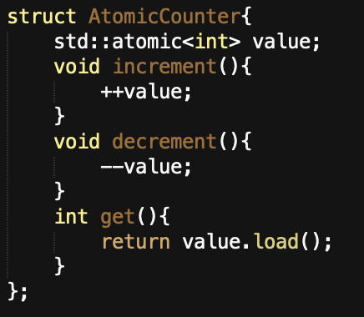
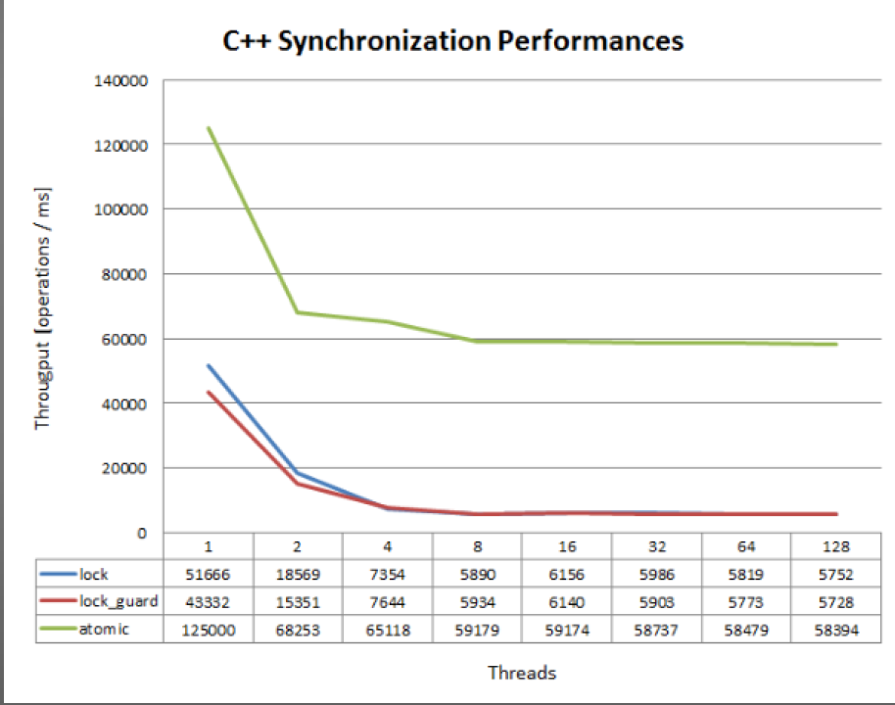
8.4 A comparison
Speed comparison between atomic type and mutexes
The same example with atomic template

Slide 21
8.5 How to synchronize between threads?
Except for protecting shared data, we also need to synchronization action on separate threads.
In C++ Standard Library, conditional variables and futures are provided to handle synchronization problems.

Slide 22
8.5 Conditional variable
The condition_variable class is a synchronization primitive that can be used to block a thread, or multiple threads at the same time, until:
a notification is received from another thread
a timeout expires
Any thread that intends to wait on std::condition_variable has to acquire a std::unique_lock first. The wait operations atomically release the mutex and suspend the execution of the thread. When the condition variable is notified, the thread is awakened, and the mutex is reacquired.

Slide 23
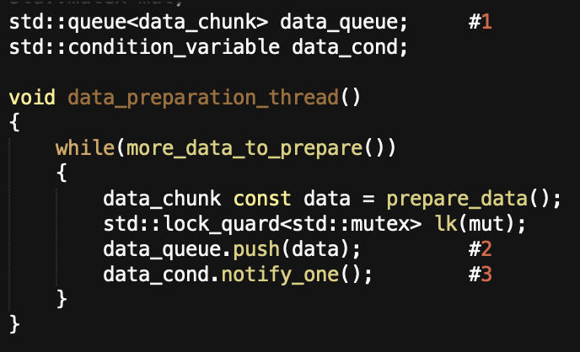
8.5 Example
queue is used to pass data between two threads
When data is ready, the thread locks the mutex and push the data into the queue(#2) and then call notify_one() member function in std::condition_variable instance to notify the waiting thread(#3)

Slide 24
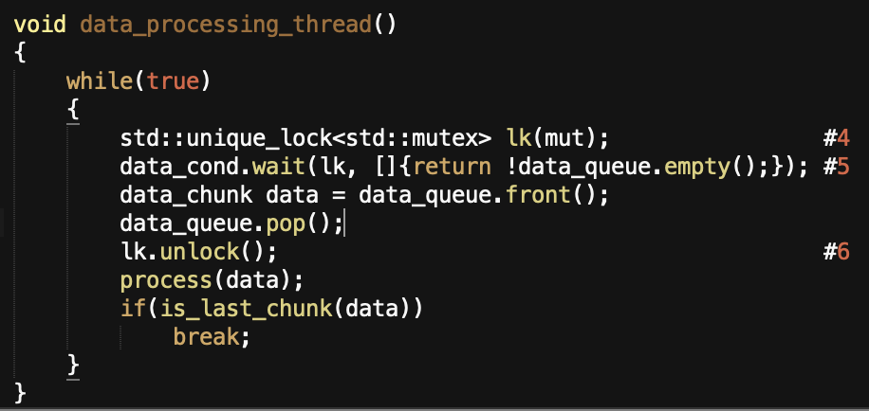
8.5 Example
On the other hand, the processing thread first lock the mutex with std::unique_lock. The thread calls wait() in the condition variable and checking the condition in the lambda function.
When the condition variable is notified by a call to notify_one() from the data preparation thread, the thread wakes and check the condition and lock the mutex if the condition is true and then process the next command.

Slide 25
8.5 More about Unique_Lock
The condition variables require std::unique_lock rather than the std::lock_quard — the waiting thread must unlock the mutex while it is waiting , the lock it again afterwards and the std::lock_guard does not provide such flexibility.
The flexibility to unlock a std::unique_lock is not just used for the call to wait() , it is also used once we've got the data to process, but before processing it (#6): processing data can potentially be a time-consuming operation, and it is a bad idea to hold a lock on a mutex for longer than necessary.

Slide 26
8.5 One-Off event with Futures
If a thread needs to wait for a specific one-off event, then it obtains a future representing this event. The thread can poll the future to see if the event has occurred while performing some other task.
Two sorts of futures templates in C++ Standard Library.
std::unique_furture<> — the instance is the only one that refers to its associated event.
std::shared_future<> — multiple instances of it may refer to the same event. All the instance become ready at the same time, and they may all access any data associated with the event.

Slide 27
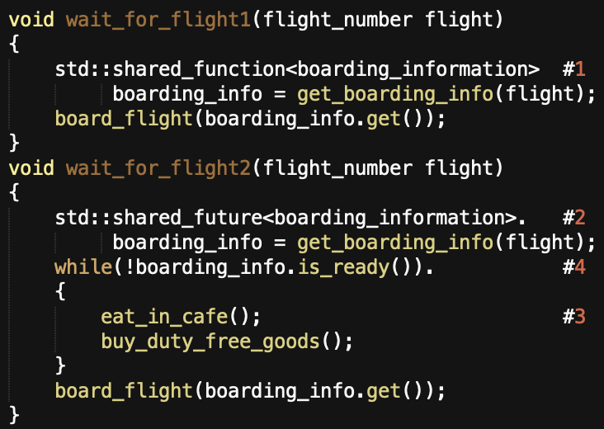
8.5 One-Off event with Futures
The first thread, running wait_for_flight1() obtains a std::shared_future<bording_infomation> with the bording information(#1), and call get(), which waits for the future to become ready.
The second thread, running wait_for_flight2() , after obtaining the future(#2), does something else while periodically checking to see if the flight is ready to board by calling is_ready() on the future(#4).

