Slide 1


Python
Quick Review & Improvement
Qinpei Zhao（PhD., Associate Professor）
Email: qinpeizhao@tongji.edu.cn
http://sse.tongji.edu.cn/zhaoqinpei

Slide 2

Content
1.1 Python Syntax
1.2 Python Modules
1.3 Installation of Python IDE
1.4 Practice: Data Analysis and Visualization

Slide 3
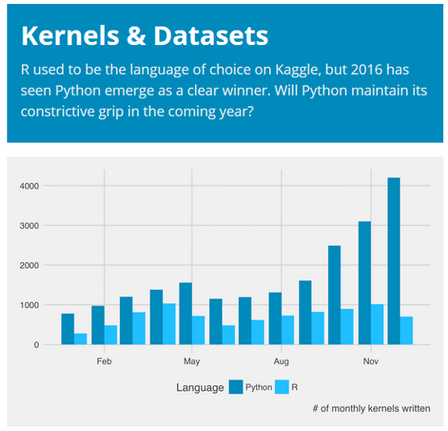
Introduction to Python
Python is becoming increasingly central tool for data science.
Python works on different platforms (Windows, Mac, Linux, Raspberry Pi, etc).
Python has a simple syntax similar to the English language.
The most recent major version of Python is Python 3. However, Python 2, although not being updated, is still quite popular.
Python’s strength is in its variability and huge community.

Slide 4
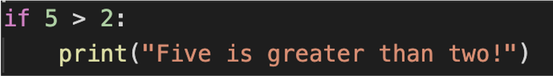
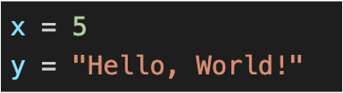
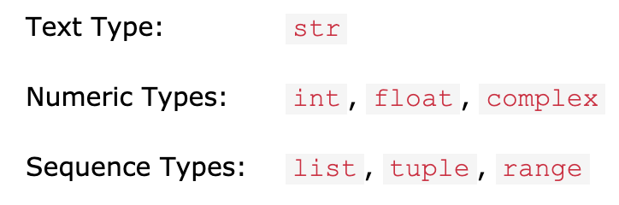
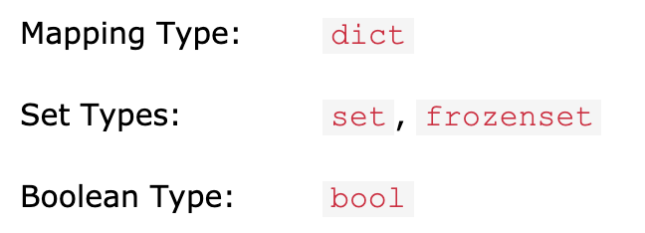
2.1 Python Syntax
Variables
Python uses whitespace to delimit program blocks. First you hate it, later you love it.
Python variables are created when you assign a value to it. The datatype is set after assigning the value.
Python has the following data types built-in by default, in these categories:

Slide 5
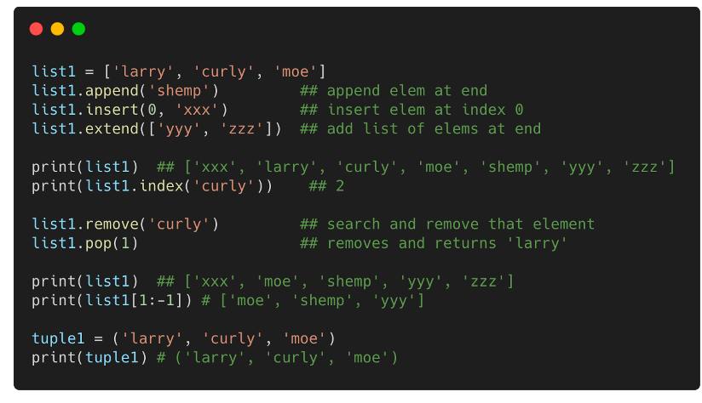
2.1 Python Syntax
Collections – List / Tuple
Lists are used to store multiple items in a single variable.
Lists are created using square brackets.
Lists are changeable, meaning that we can change, add, and remove items in a list after it has been created.
A tuple is a collection which is ordered and unchangeable.
Tuples are written with round brackets.

Slide 6
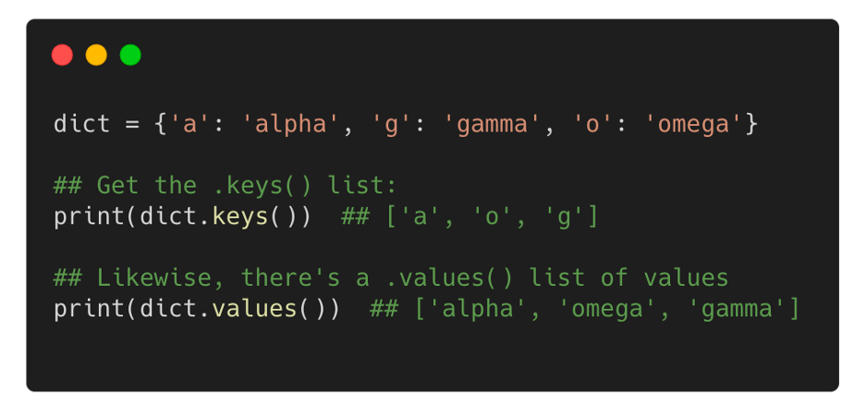
2.1 Python Syntax
Collections -- Dict
Python's efficient key/value hash table structure is called a "dict". The contents of a dict can be written as a series of key:value pairs within braces { }.
Looking up or setting a value in a dict uses square brackets, e.g. dict['foo’].
Looking up a value which is not in the dict throws a KeyError -- use "in" to check if the key is in the dict, or use " dict.get(key) " which returns the value or None if the key is not present

Slide 7
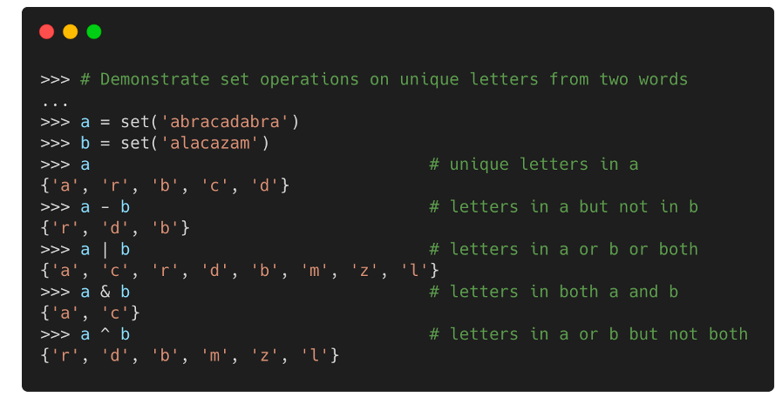
2.1 Python Syntax
Collections -- Set
Sets are used to store multiple items in a single variable.
A set is a collection which is both unordered and unindexed. Set items can appear in a different order every time you use them, and cannot be referred to by index or key.
Sets are unchangeable, meaning that we cannot change the items after the set has been created.
Sets are written with curly brackets.

Slide 8
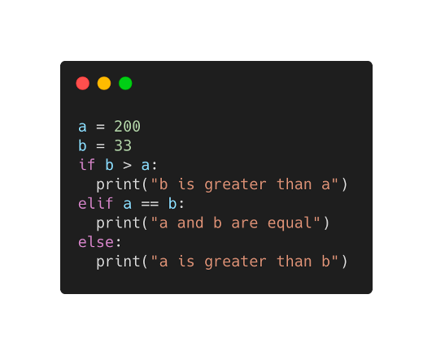
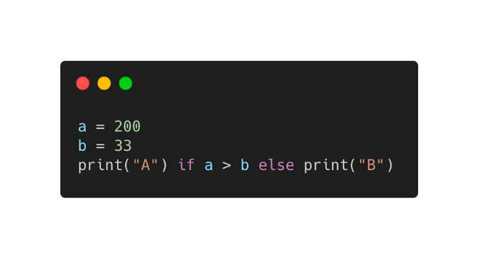
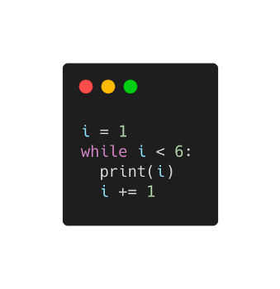
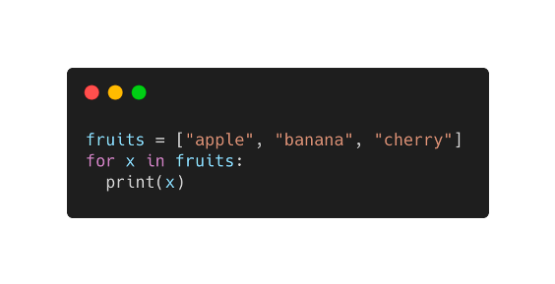
2.1 Python Syntax
Control flow
If…elif…else
Shorthand for If…else
While Loops
For Loops

Slide 9
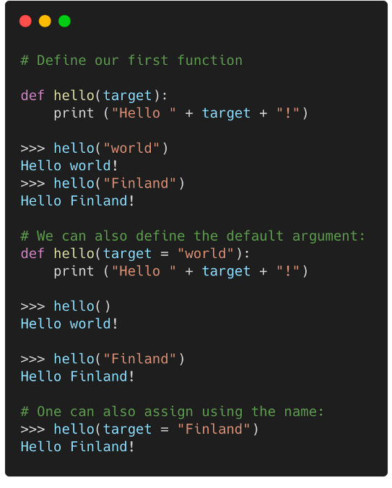
2.1 Python Syntax
Functions
Functions are defined using the def keyword.
Function definition can appear anywhere in the code.
Functions can be imported to other files using import.
Function arguments can be positional or named (see code).
Named arguments improve readability and are handy for setting the last argument in a long list.

Slide 10
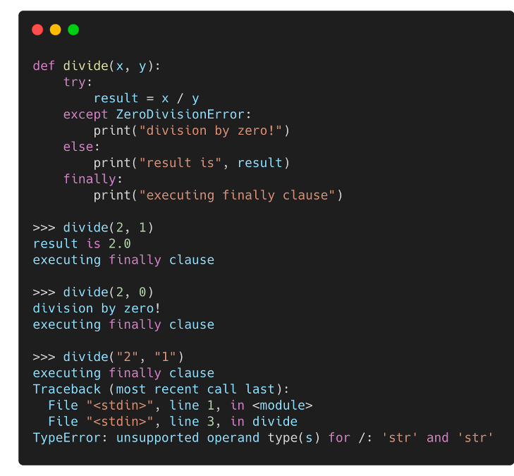
2.1 Python Syntax
Exceptions
When an error occurs, or exception as we call it, Python will normally stop and generate an error message. These exceptions can be handled using the ”try…except…finally” statement.
The try block lets you test a block of code for errors.
The except block lets you handle the error.
The finally block lets you execute code, regardless of the result of the try- and except blocks.

Slide 11
2.1 Python Syntax
File Handling
The key function for working with files in Python is the open() function. The open() function takes two parameters; filename, and mode and returns a file object “f”. There are four different methods (modes) for opening a file:
"r" - Read - Default value. Opens a file for reading, error if the file does not exist
"a" - Append - Opens a file for appending, creates the file if it does not exist
"w" - Write - Opens a file for writing, creates the file if it does not exist
"x" - Create - Creates the specified file, returns an error if the file exists
It is good practice to use the ”with” keyword when dealing with file objects. If you’re not using the ”with” keyword, then you should call ”f.close()” to close the file and immediately free up any system resources used by it, otherwise, the result may not be completely written to the disk, even if the program exits successfully.

Slide 12
2.1 Python Syntax
File Handling
Read a file object “f”:
f.read(size), which reads some quantity of data and returns it as a string (in text mode) or bytes object (in binary mode).
f.readline() reads a single line from the file
If you want to read all the lines of a file in a list you can also use list(f) or f.readlines().
Write a file object “f”:
f.write(string) writes the contents of string to the file, returning the number of characters written.
f.tell() returns an integer giving the file object’s current position in the file.
To change the file object’s position, use f.seek().

Slide 13
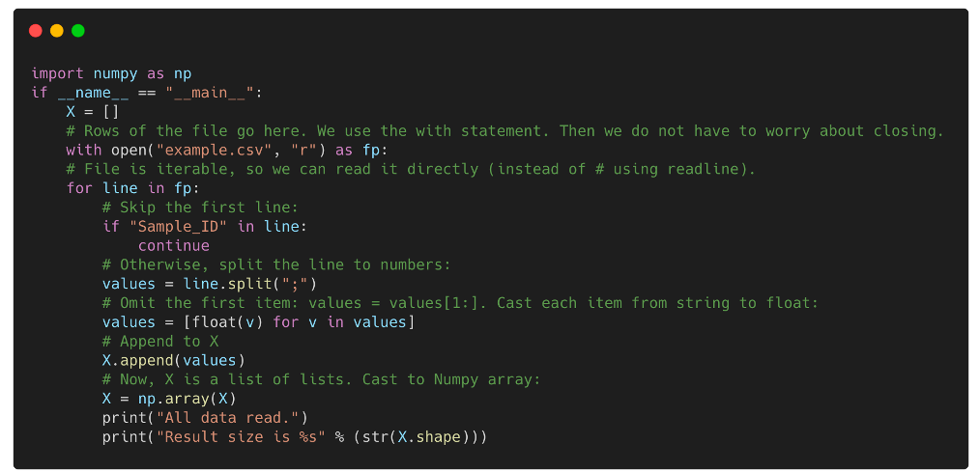
2.1 Python Syntax
File Handling
An example of reading a csv data file:
Suppose we need to read a csv file (text file with Comma Separated Values) into Python. The file consists of 216 rows (samples) with 4000 measurements each. We will write file reading code from scratch.

Slide 14
2–Content
2.1 Python Syntax
2.2 Python Modules
2.3 Installation of Python IDE
2.4 Practice: Data Analysis and Visualization

Slide 15
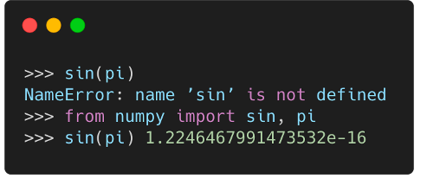
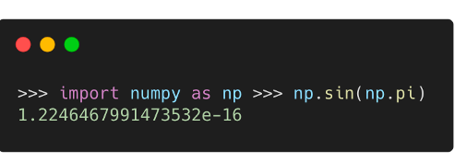
2.2 Python Modules
A module is a file containing Python definitions and statements. A module can define functions, classes, and variables. A module can also include runnable code. Grouping related code into a module makes the code easier to understand and use. It also makes the code logically organized.
Each module needs to be imported before use.
Three common alternatives:
Import the full module: import numpy
Import selected functions from the module:
from numpy import array, sin, cos
Import all functions from the module:
from numpy import *

Slide 16
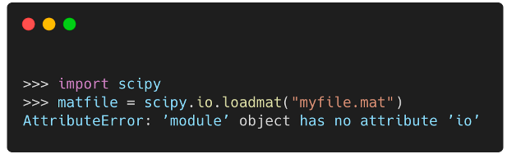
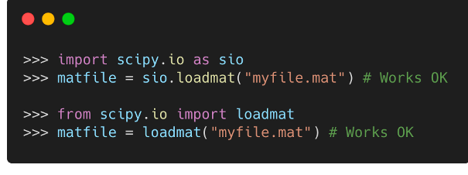
2.2 Python Modules
Notations
A few things to note:
All methods support shortcuts; e.g.,
import numpy as np.
Sometimes import <module> fails, if the module is in fact a collection of modules. For example,
import scipy. Instead, use import scipy.signal
Importing all functions from the module is not recommended, because different modules may contain functions with the same name.

Slide 17
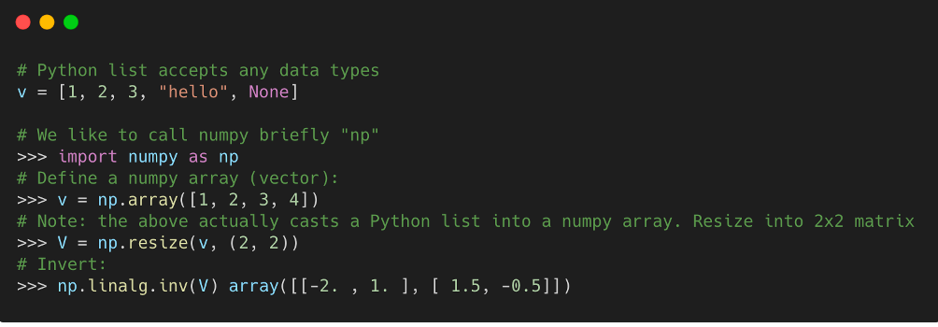
2.2 Python Modules
Numpy
Practically all scientific computing in Python is based on numpy and scipy modules.
NumPy provides a numerical array as an alternative to Python list.
The list type is very generic and accepts any mixture of data types.
Although practical for generic manipulation, it is becomes inefficient in computing.
Instead, the NumPy array is more limited and more focused on numerical computing.

Slide 18
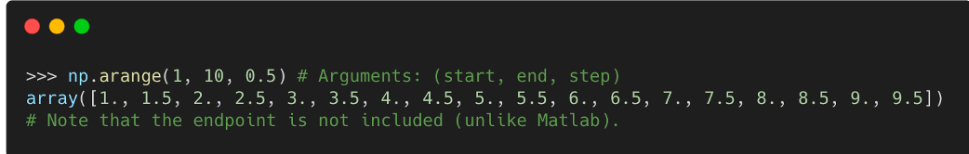
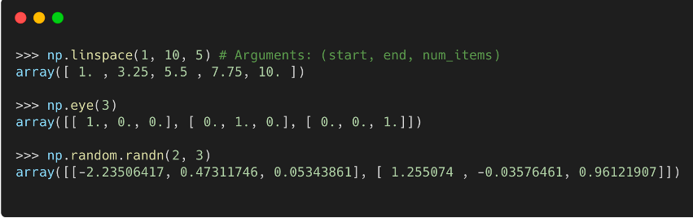
2.2 Python Modules
Numpy - more on vectors
NumPy np.arange creates a range array .
Some of the vector/matrix functions

Slide 19
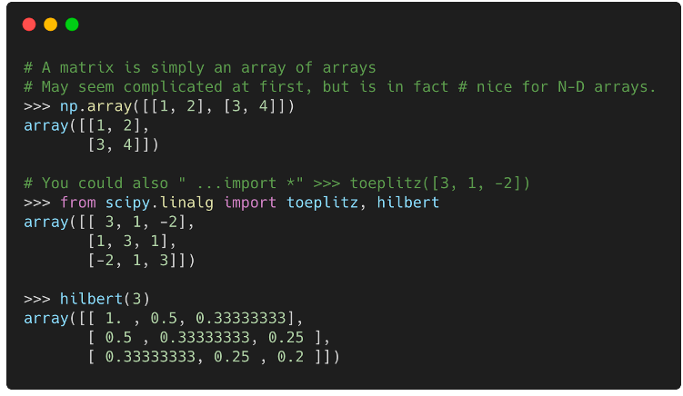
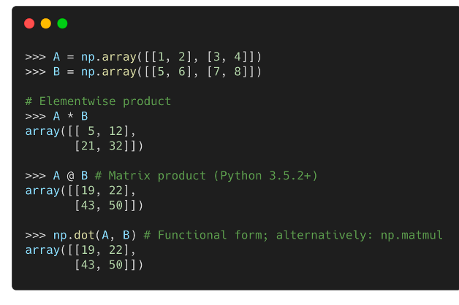
2.2 Python Modules
Numpy - Matrix
A matrix is defined similarly; either by specifying the values manually, or using special functions.
Matrix multiplication use ’@’ operator or function np.matmul.

Slide 20
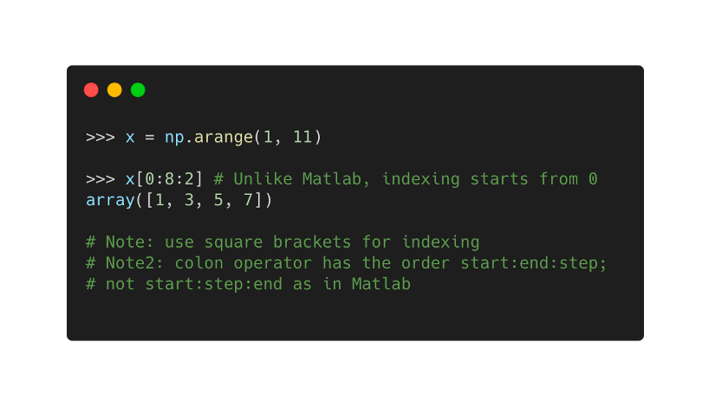
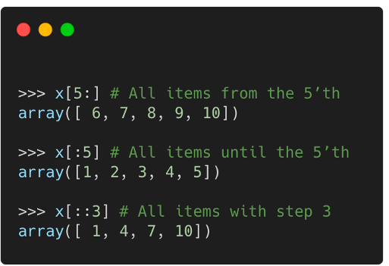
2.2 Python Modules
Numpy - Indexing
Indexing of vectors uses the colon notation. We extract selected items from the vector 1...10 on the right.
The start and end points can be omitted:

Slide 21
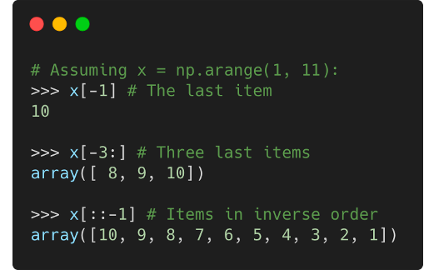
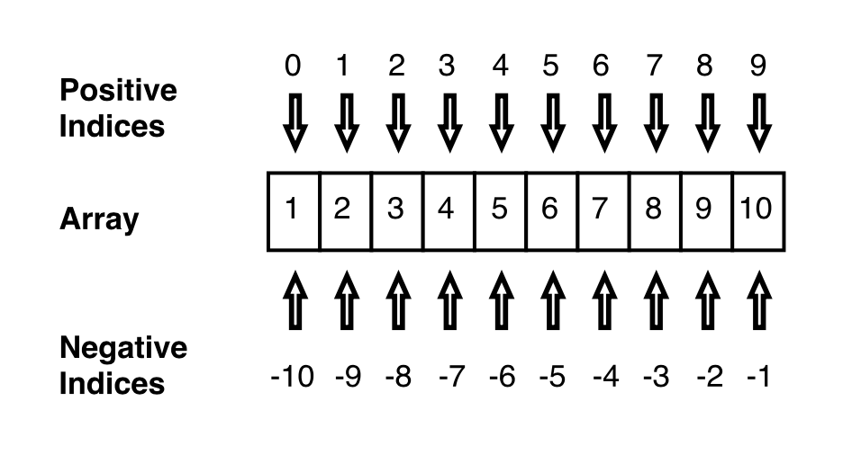
2.2 Python Modules
Numpy - Indexing
Negative indices are counted from the end (-1 = the last, -2 = second-to-last, etc.):

Slide 22
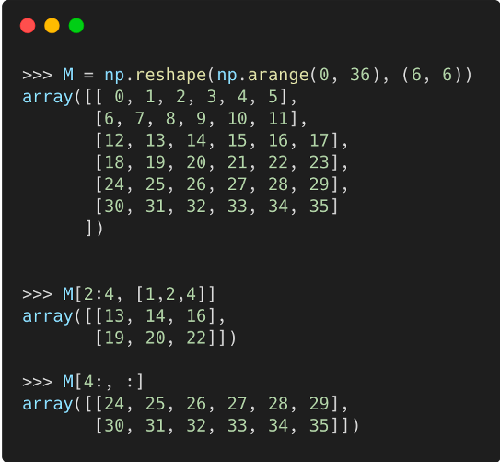
2.2 Python Modules
Numpy - Indexing
Also N-dimensional arrays (e.g., matrices) can be indexed similarly. This operation is called slicing, and the result is a slice of the matrix.
In the example on the right, we extract items on the rows 2:4 = [2,3] and columns 1,2,4 (shown in red).
Note: the first index is the row; not "x-coordinate".
To specify only column or row indices, use ":" alone.
Now we wish to extract two bottom rows.
M[4:, :] reads "give me all rows after the 4th and all columns".
In this case, alternative forms would be, e.g., M[-2:, :] and M[[4,5], :].

Slide 23
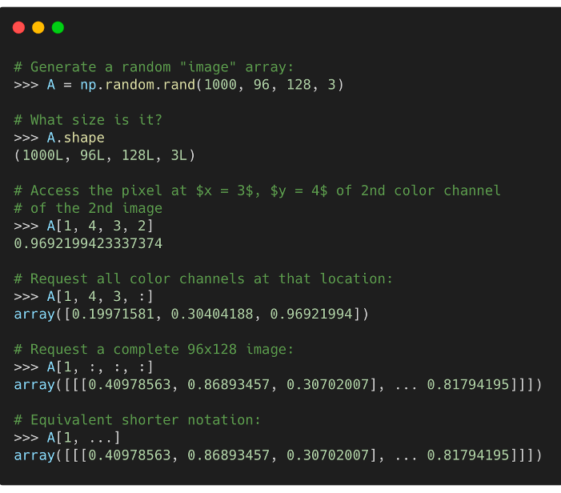
2.2 Python Modules
Numpy – N-Dimensional Array
Higher-dimensional arrays are frequently encountered in machine learning.
For example, a set of 1000 color images of size w × h = 128 × 96 is represented as a 1000 × 96 × 128 × 3 array.
Here, dimensions are: image index, y-coordinate, x-coordinate, color channel.

Slide 24
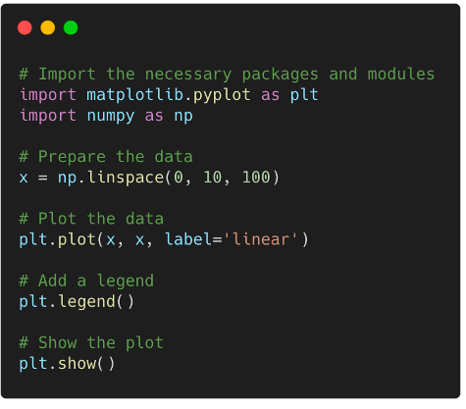
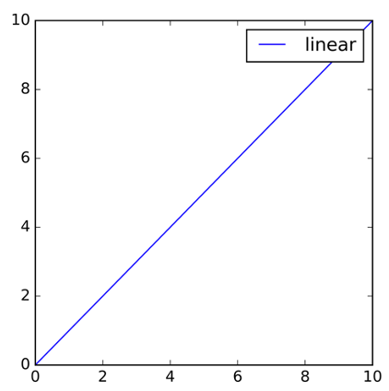
2.2 Python Modules
Matplotlib – basis
Matplotlib is a low level graph plotting library in python that serves as a visualization utility.
Matplotlib don’t need much to get started: you need to make the necessary imports, prepare some data, and you can start plotting with the help of the plot() function! When you’re ready, don’t forget to show your plot using the show() function.

Slide 25
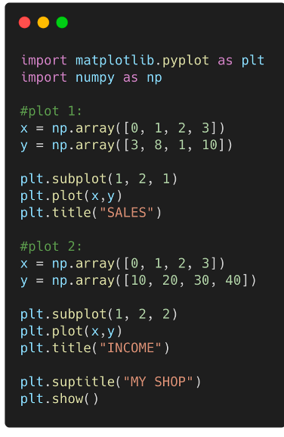
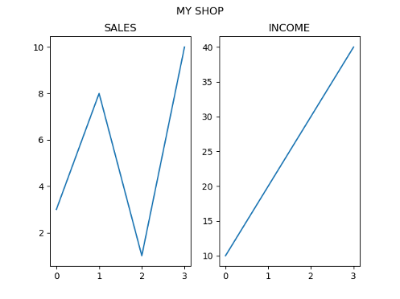
2.2 Python Modules
Matplotlib – Subplots
With the subplots() function you can draw multiple plots in one figure.
The subplots() function takes three arguments that describes the layout of the figure. The layout is organized in rows and columns, which are represented by the first and second argument. The third argument represents the index of the current plot.

Slide 26
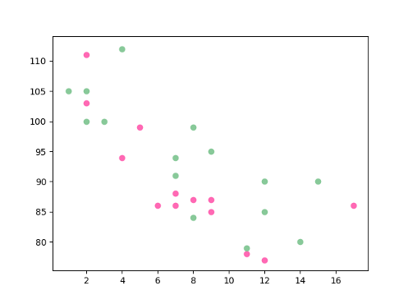
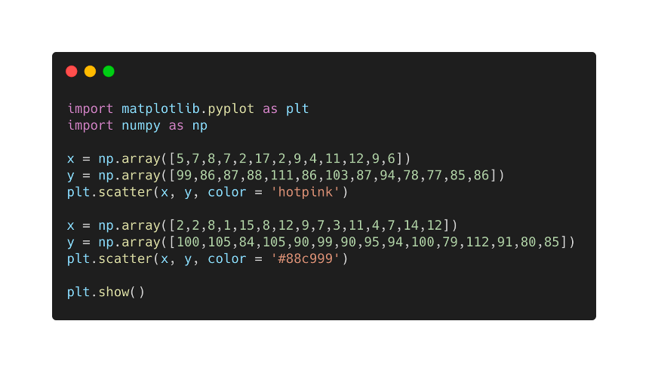
2.2 Python Modules
Matplotlib – Scatter
With Pyplot, you can use the scatter() function to draw a scatter plot.
The scatter() function plots one dot for each observation. It needs two arrays of the same length, one for the values of the x-axis, and one for values on the y-axis.

Slide 27
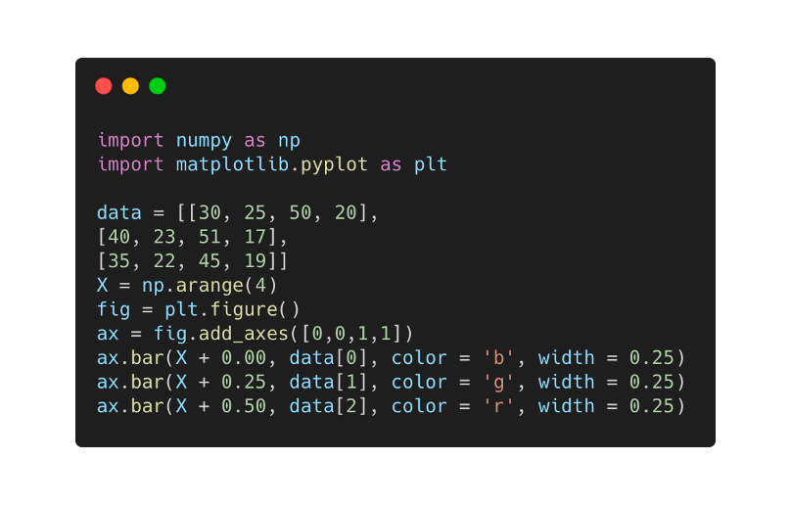
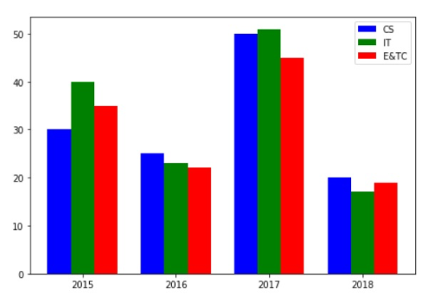
2.2 Python Modules
Matplotlib – Scatter
With Pyplot, you can use the scatter() function to draw a scatter plot.
The scatter() function plots one dot for each observation. It needs two arrays of the same length, one for the values of the x-axis, and one for values on the y-axis.

Slide 28
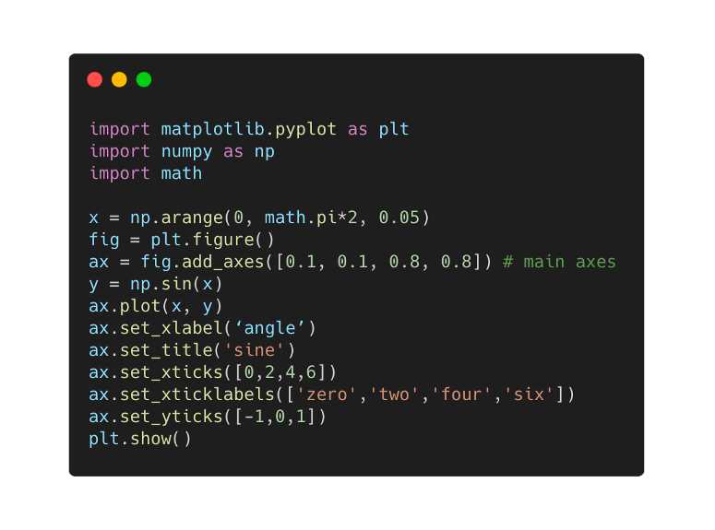
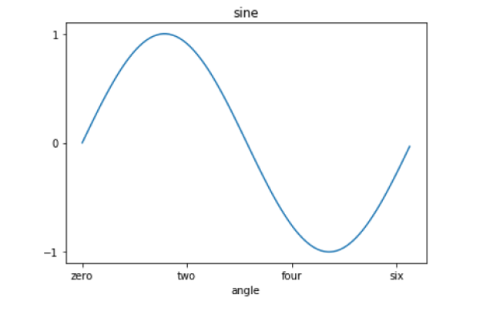
2.2 Python Modules
Matplotlib – Setting ticks
Ticks are the markers denoting data points on axes.
The xticks() and yticks() function takes a list object as argument. The elements in the list denote the positions on corresponding action where ticks will be displayed.

Slide 29
2–Content
2.1 Python Syntax
2.2 Python Modules
2.3 Installation of Python IDE
2.4 Practice: Data Analysis and Visualization

Slide 30
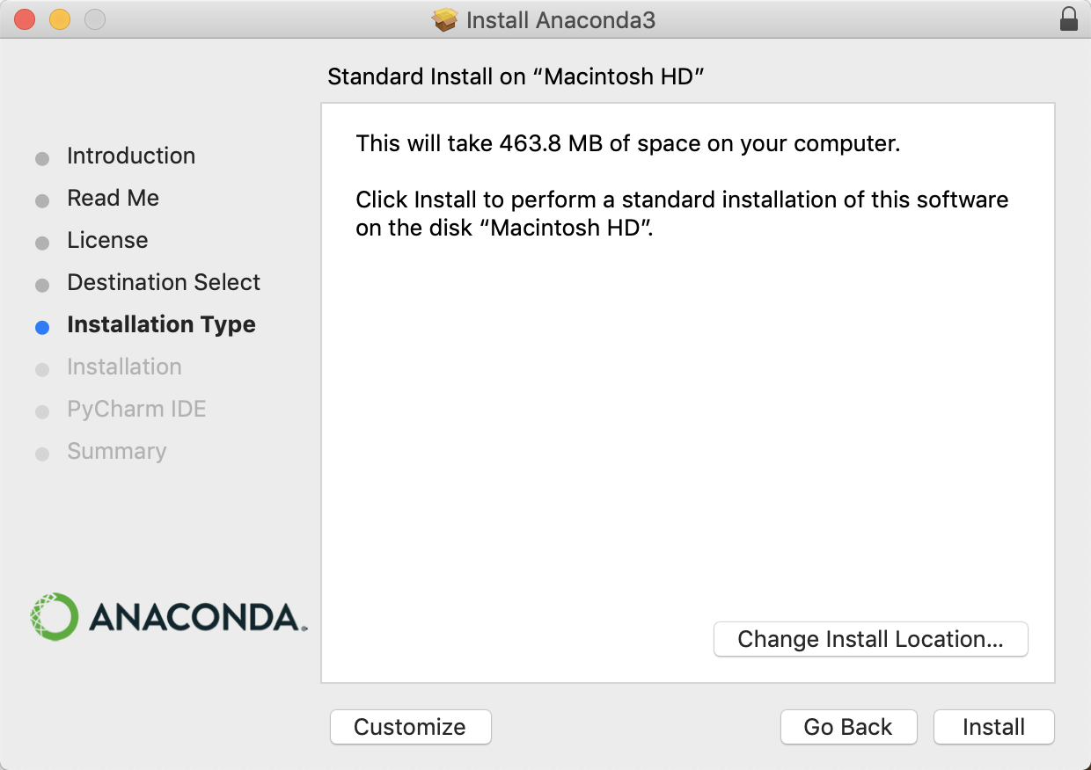
2.3 Installation of Python IDE
Anaconda Individual Edition is a free, easy-to-install package manager, environment manager, and Python distribution with a collection of 1,500+ open source packages. Anaconda is platform-agnostic, so you can use it whether you are on Windows, macOS, or Linux.
Good editors: Spyder, VSCode, PyCharm. Spyder and VSCode come with Anaconda, PyCharm you install on your own.
STEP1 – Install Anaconda
Windows: https://www.anaconda.com/download/#windows
Mac: https://www.anaconda.com/downloads#macos

Slide 31
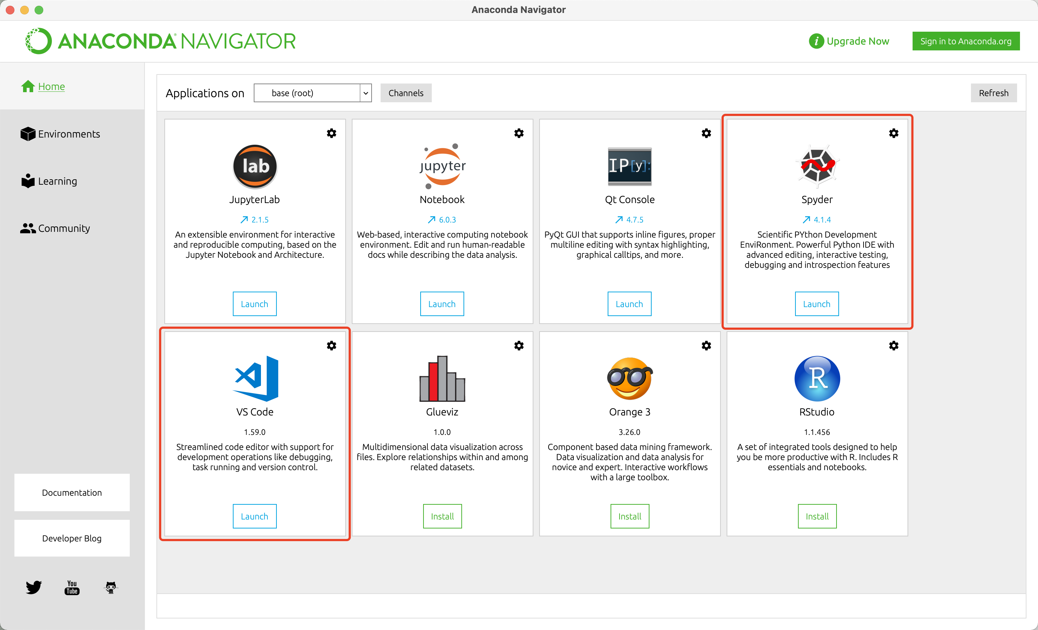
2.3 Installation of Python IDE
Good editors: Spyder, VSCode, PyCharm. Spyder and VSCode come with Anaconda, PyCharm you install on your own.
Anaconda manages VSCode and and Spyder into entrances.

Slide 32
2.3 Installation of Python IDE
Jupyter Notebook
There is also an entrance for Jupyter Notebook in Anaconda.
The Jupyter Notebook App is a server-client application that allows editing and running notebook document via a web browser.
Notebook documents are both human-readable documents containing the analysis description and the results (figures, tables, etc..) as well as executable documents which can be run to perform data analysis.
The Jupyter Notebook App can be executed on a local desktop requiring no internet access or can be installed on a remote server and accessed through the internet.
A notebook kernel is a “computational engine” that executes the code contained in a Notebook document. The ipython kernel, referenced in this guide, executes python code.

Slide 33
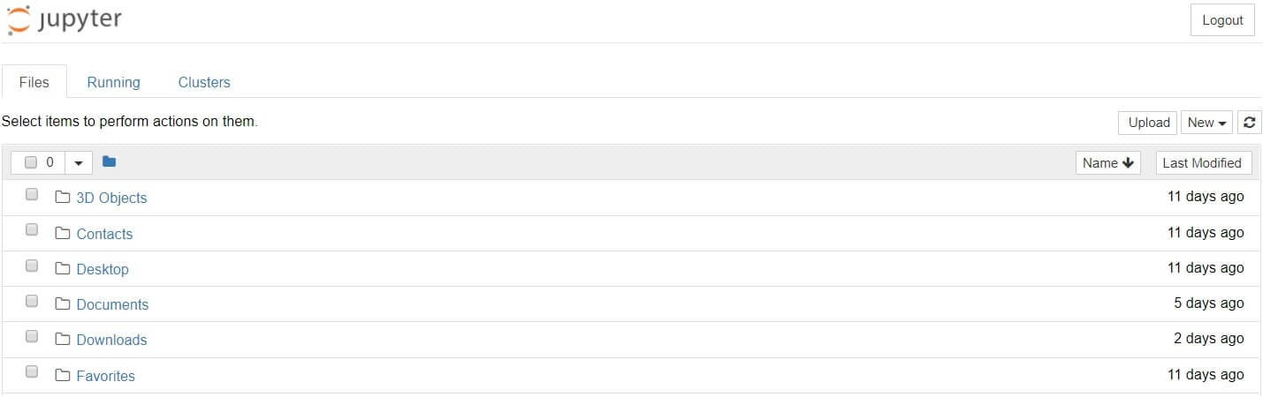
2.3 Installation of Python IDE
Running Jupyter
You can run Jupyter via the shortcut Anaconda adds to your start menu, which will open a new tab in your default web browser that should look something like the following screenshot.
It is also possible to start the dashboard on any system via terminal by entering the command jupyter notebook.

Slide 34
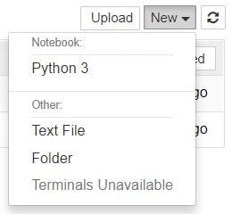
2.3 Installation of Python IDE
Running Jupyter
With Jupyter Notebook open in your browser, you may have noticed that the URL for the dashboard is something like https://localhost:8888/tree. Localhost is not a website, but indicates that the content is being served from your local machine: your own computer.
Browse to the folder in which you would like to create your first notebook, click the “New” drop-down button in the top-right and select “Python 3”.

Slide 35
2.3 Installation of Python IDE
Running Jupyter
With Jupyter Notebook open in your browser, you may have noticed that the URL for the dashboard is something like https://localhost:8888/tree. Localhost is not a website, but indicates that the content is being served from your local machine: your own computer.
Browse to the folder in which you would like to create your first notebook, click the “New” drop-down button in the top-right and select “Python 3”.
If you switch back to the dashboard, you will see the new file Untitled.ipynb.

Slide 36
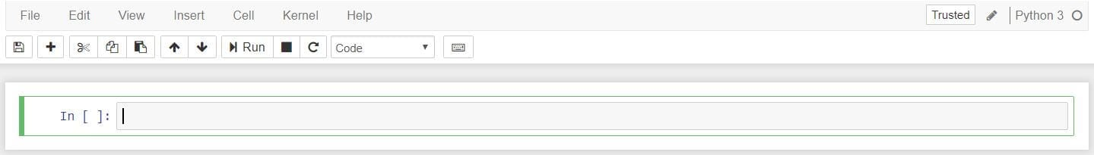
2.3 Installation of Python IDE
Notebook Interface
There are two fairly prominent terms that you should notice: cells and kernels are key both to understanding Jupyter and to what makes it more than just a word processor.
A kernel is a “computational engine” that executes the code contained in a notebook document.
A cell is a container for text to be displayed in the notebook or code to be executed by the notebook’s kernel.
A code cell contains code to be executed in the kernel.
A Markdown cell contains text formatted using Markdown.

Slide 37
2–Content
2.1 Python Syntax
2.2 Python Modules
2.3 Installation of Python IDE
2.4 Practice: Data Analysis and Visualization

Slide 38
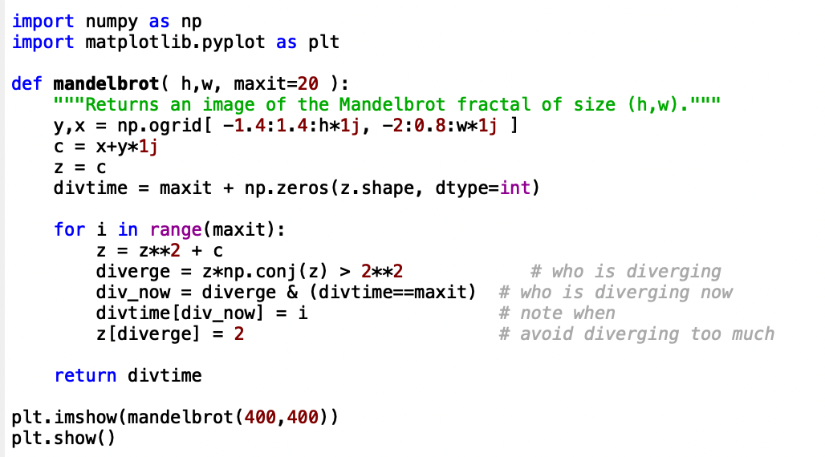
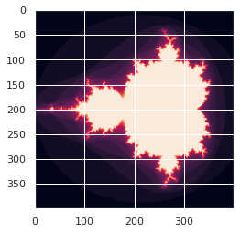
2.4 Practice: Data Analysis and Visualization

