Slide 1
GPT-2 + BERT Reddit bot
By Charlie Bell
Machine Learning Engineer

Slide 2





Project overview
Aim: To automatically generate realistic replies to Reddit comments.
Stack:

Slide 3
Approach
GPT-2 Generator -> BERT Discriminator -> BERT Predictor:
1. GPT-2 Generator: Fine-tune on comment-reply pairs to generate candidate replies when given a comment.
2. BERT Discriminator: Discriminate against candidate replies and filter out the obvious fakes leaving only the most realistic.
3. BERT Predictor: Predict how many upvotes each realistic reply will get and return the one with the most upvotes predicted.

Slide 4
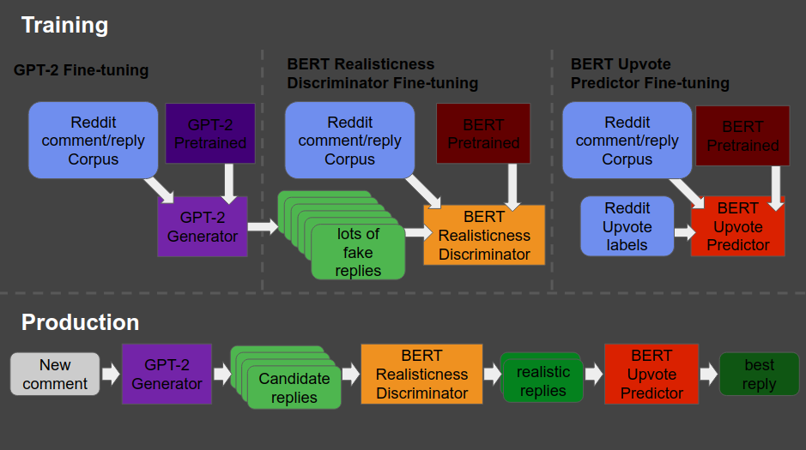
Approach

Slide 5
Data
Reddit post-reply pairs with upvotes from subreddits.
Data was extracted with Google BigQuery.
Time period was all comments and replies from 2018 and 2019.
Subreddits used: 'writing', 'scifi', 'sciencefiction', 'MachineLearning', 'philosophy', 'cogsci', 'neuro', 'Futurology'.

Slide 6
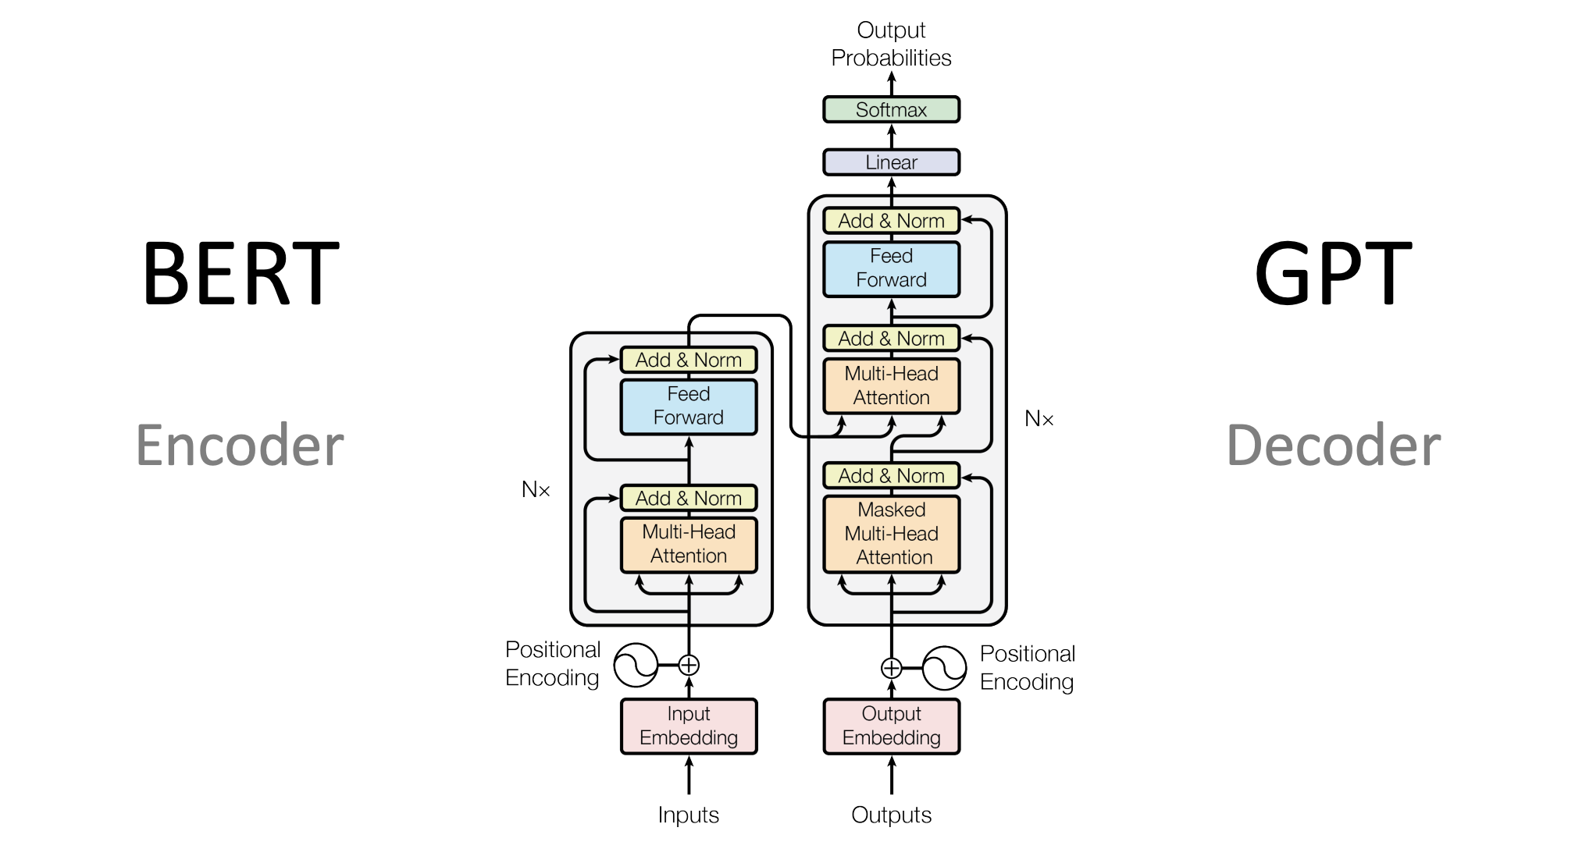
Models

Slide 7
Training
Models trained on GPU (Nvidia GeForce 1650 4GB)
GPT-2 Generator | BERT Discriminator | BERT Predictor
Input: comment + separator + reply Head: Sequential Sequence length: 1024 Batch size: 2 Train time: 12 hours | Input: reply, label Head: Classification Sequence length: 512 Batch size: 4 Train time: 3.5 hours | Input: reply, value Head: Regression Sequence length: 512 Batch size: 4 Train time: 3.5 hours

Slide 8
Examples:
To Reddit!!!

