Slide 1
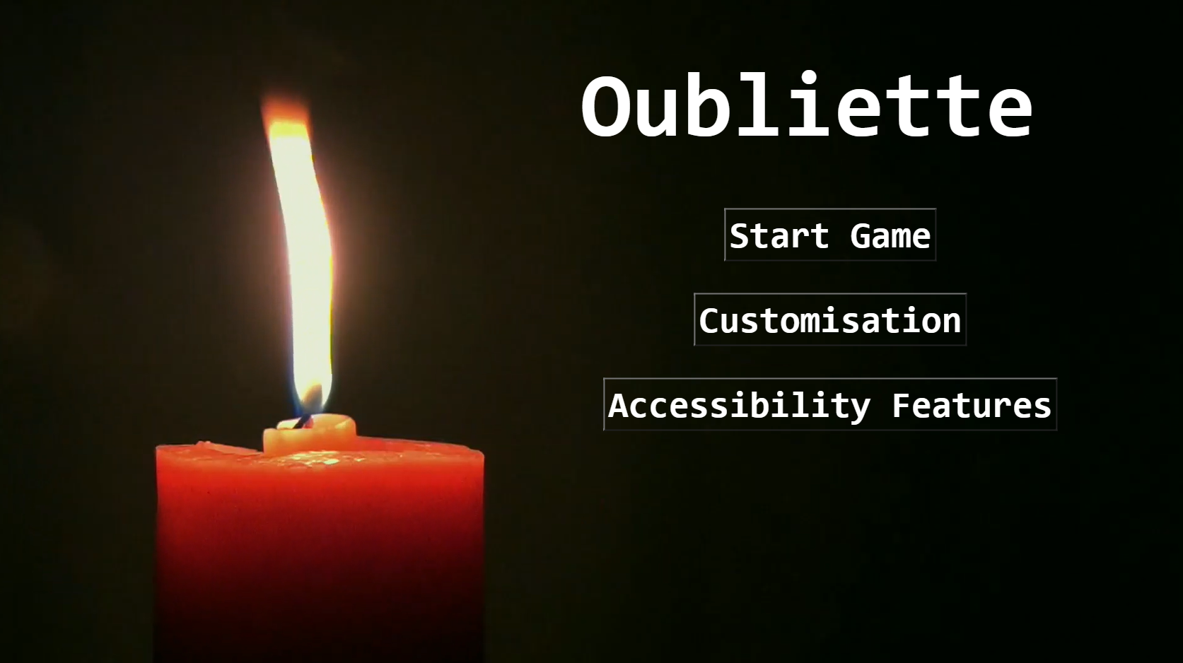
CSC1030 Group Project
By Charlie McClements (40324036), James McAlea (40325506), Ruari Craig(40264694), Charlie Ogilby (40330373)

Slide 2
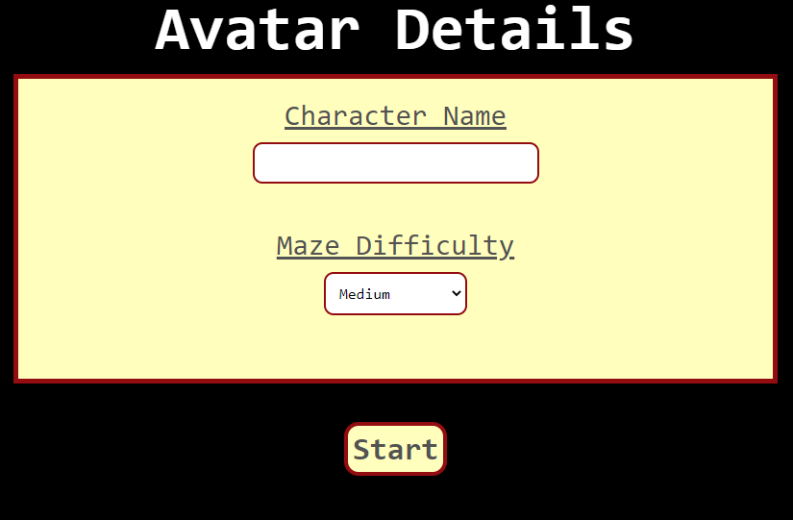
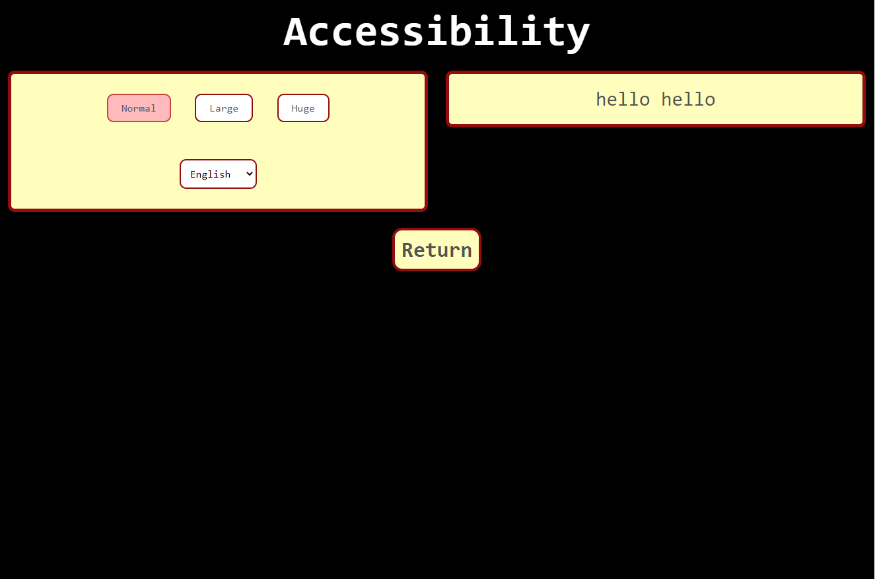
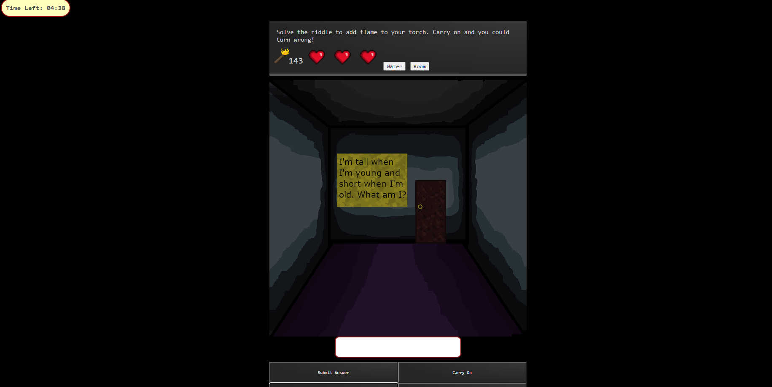
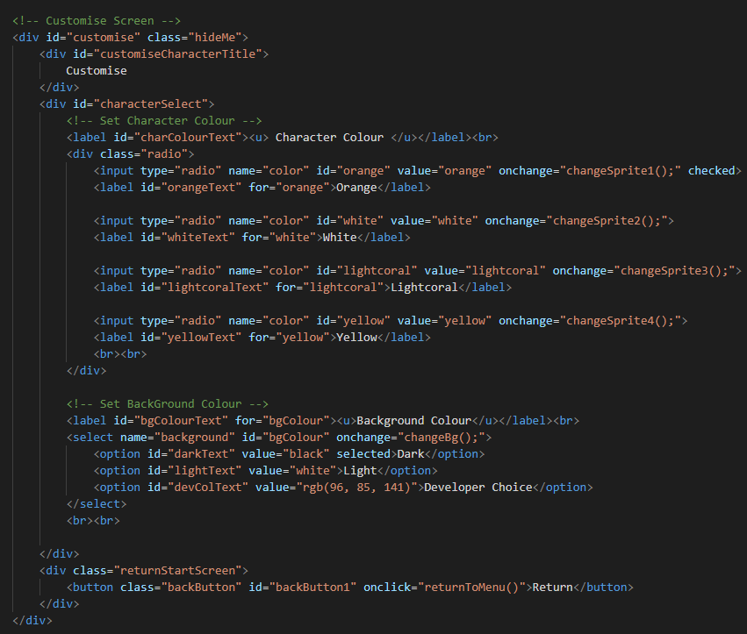
Collection of Data using HTML form
When the user is greeted with this screen, it asks them to input a name a difficulty setting which affects the in-game experience.
In the accessibility setting, form data is collected using a radio button for the text size, and a drop-down option for the language choice.
In a riddle-based challenge, the user is asked to input their answer to be able to pass.

Slide 3
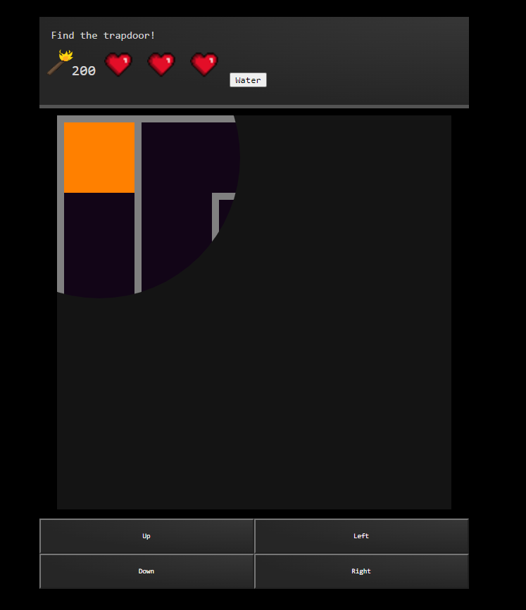
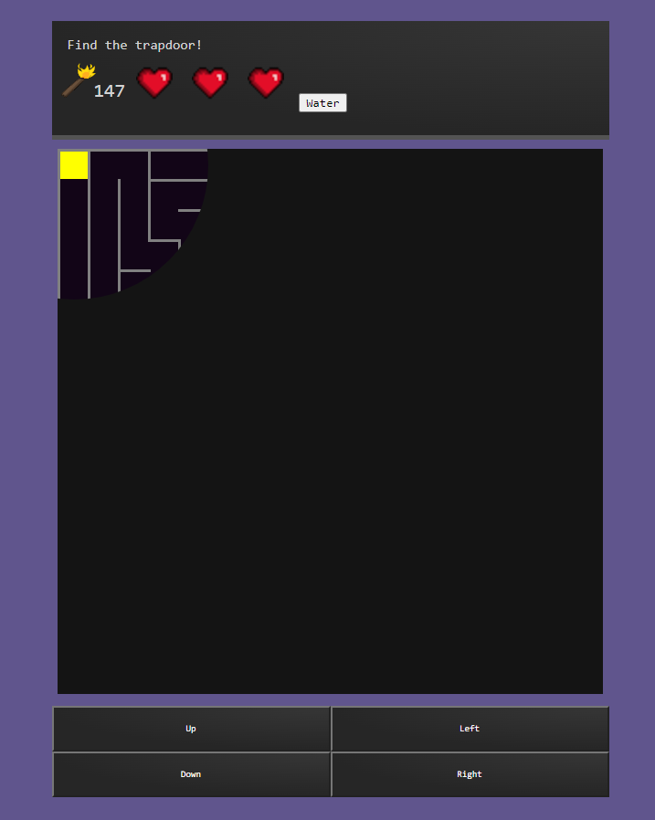
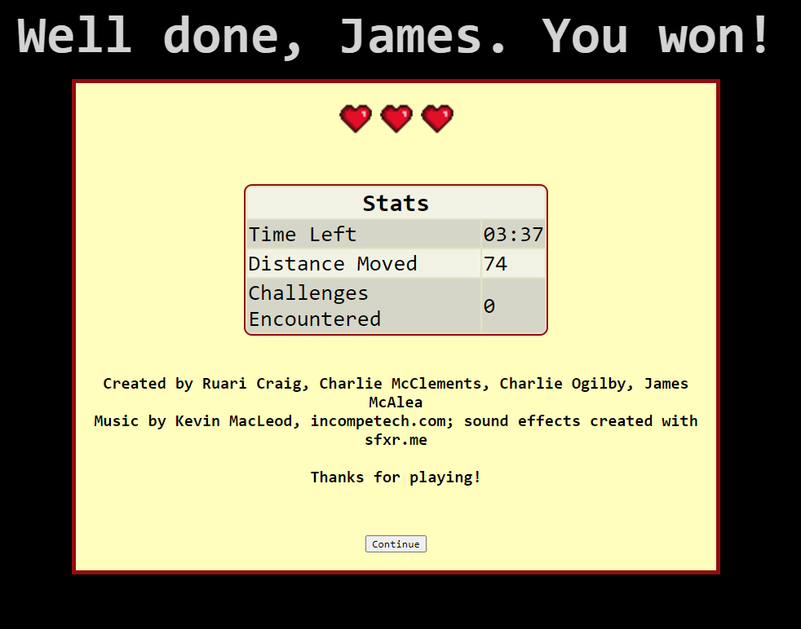

How HTML form data has been used to personalise game
On the two images on the right, you can see how the form data alters the user’s character and can also change the background colour of the game from black to a light purple. On the furthest image on the right, you can also see how the maze difficulty setting affects the size of the maze (compared to the corresponding left-hand image beside it).
On the two images on the left, you can see how the form data alters the text of the game. The user can input their name and their name will show up in the story box text and end screen text.

Slide 4

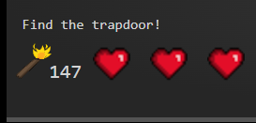
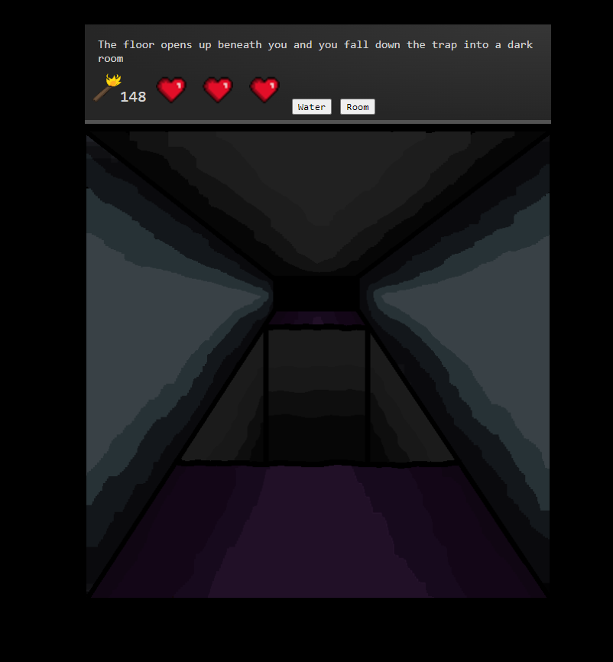
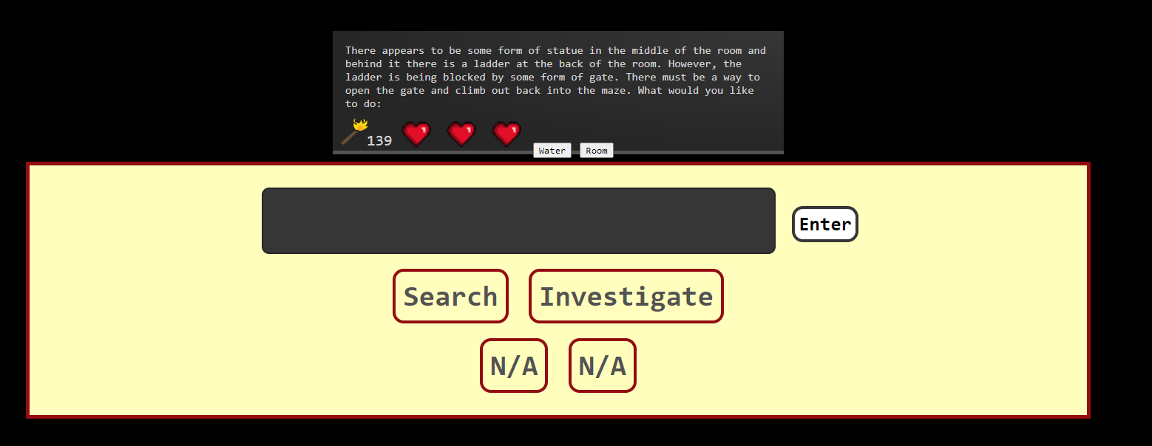
JS Timed Event
When the user hits begin, a 5-minute timer will begin to count down. If the timer hits 0, the game will end, with a corresponding game over message.
On medium and hard difficulty, the strength of the torch will periodically decrease so that the user’s visibility is decreased over time.
When the user enters the trapped room challenge, they are shown an image of what their character would see in the actual maze before they are shown the next screen where they can pick what they want to do next.

Slide 5
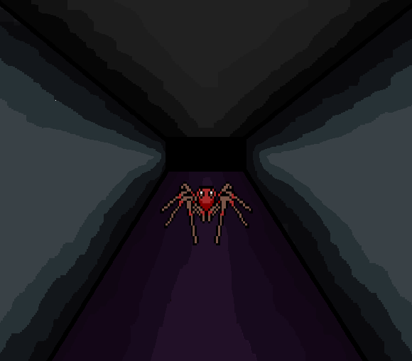
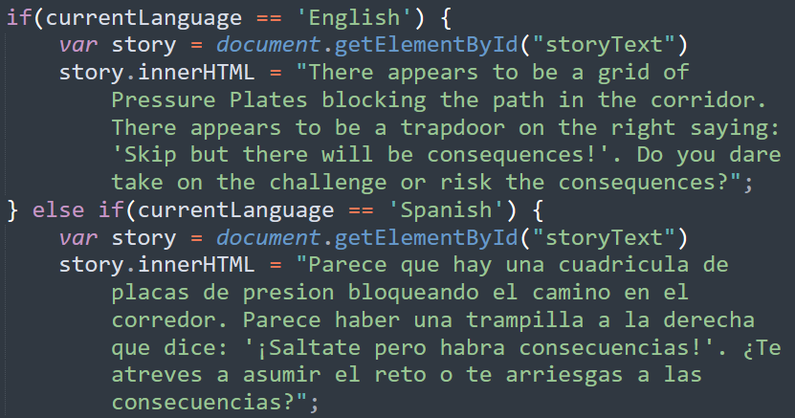
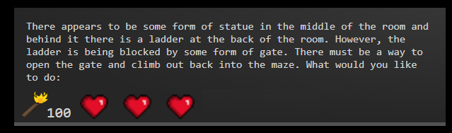
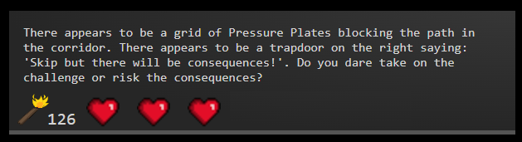
Text adventure elements
An ever-present story box describing the player's adventure, as well as the text-driven option buttons, keep the game true to its roots as a text-based game.
The story box is changed when appropriate within the game's code using innerHTML. Likewise, button values are changed to be suitable for each challenge.
Additionally, a range of images has been used to compliment the text. There are also a couple of light animations, a video, and some sound effects.

Slide 6
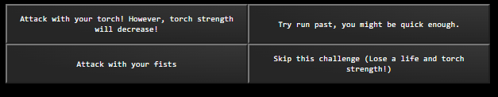
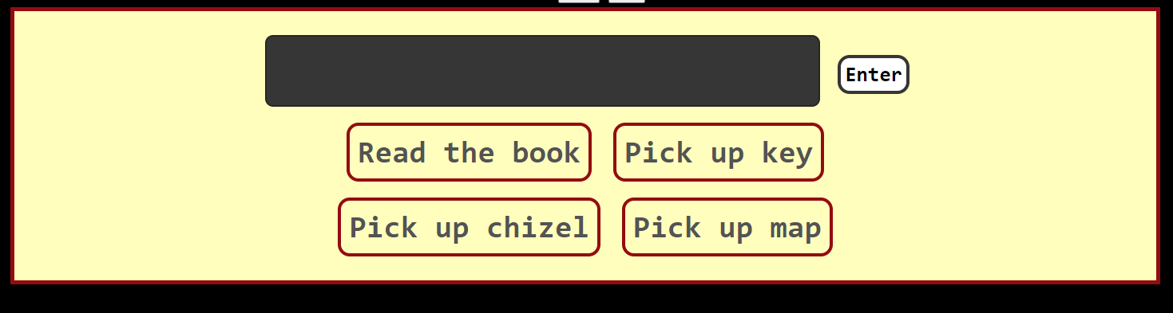
Text adventure elements (2)
In some of the challenges the user will be presented with a range of different options they can choose from. However, the user will have to pick the correct option otherwise they will take penalties.

Slide 7
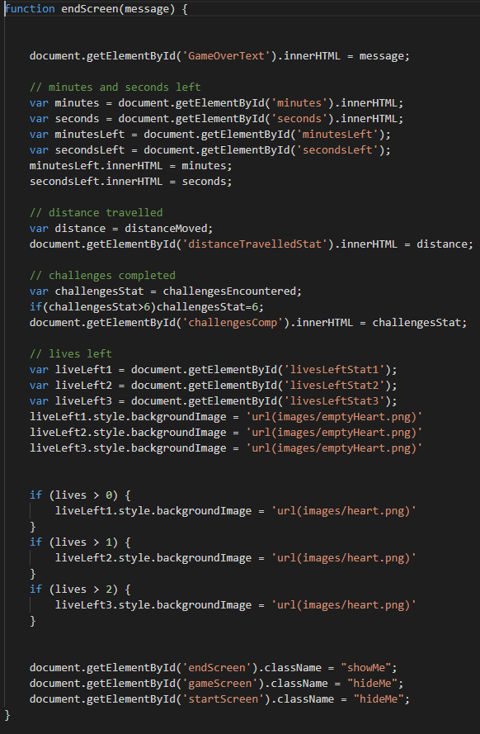
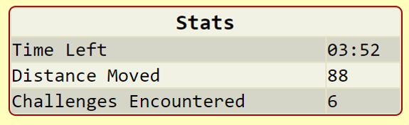
Player Statistics
Time left
Distance travelled
Number of challenges completed
Time left – fetches the inner HTML of the timer and puts it onto table.
Distance Moved – each time the character moves a square, the distance is incremented.
Challenges encountered – when the random challenge function is run, it will increment the value.
Display and style hearts
Calculate how many hearts need to be red
Hide the game screen and start screen, but show end screen

Slide 8
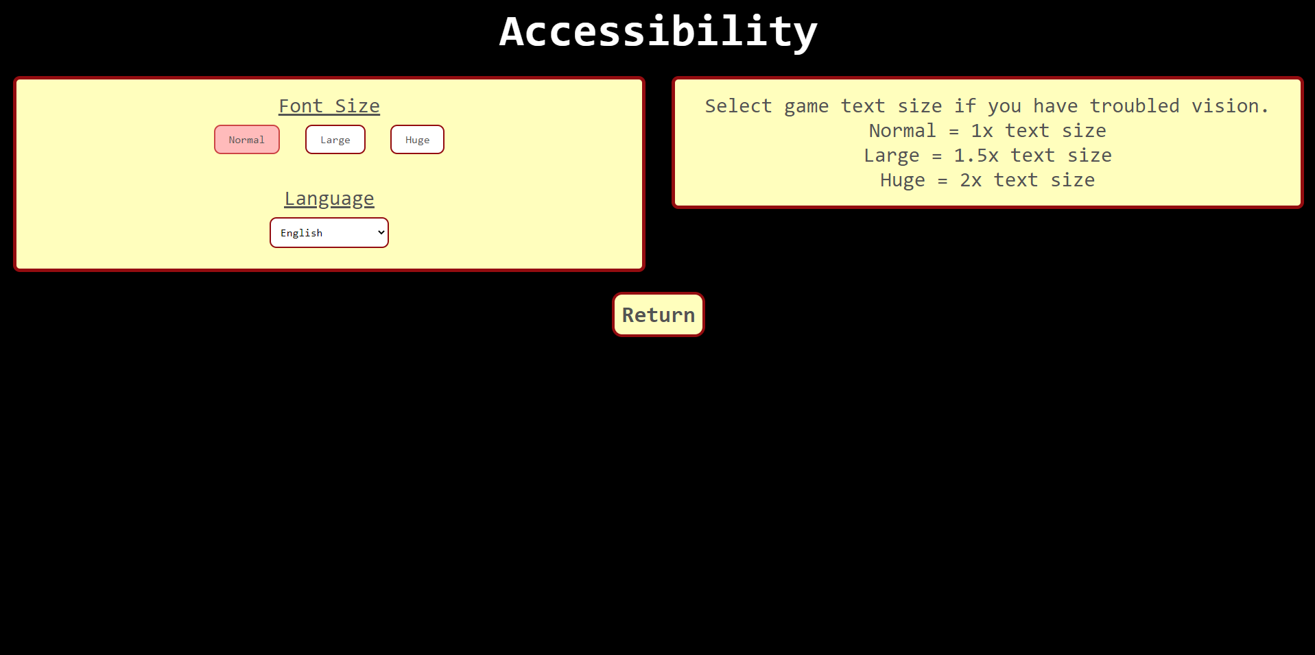
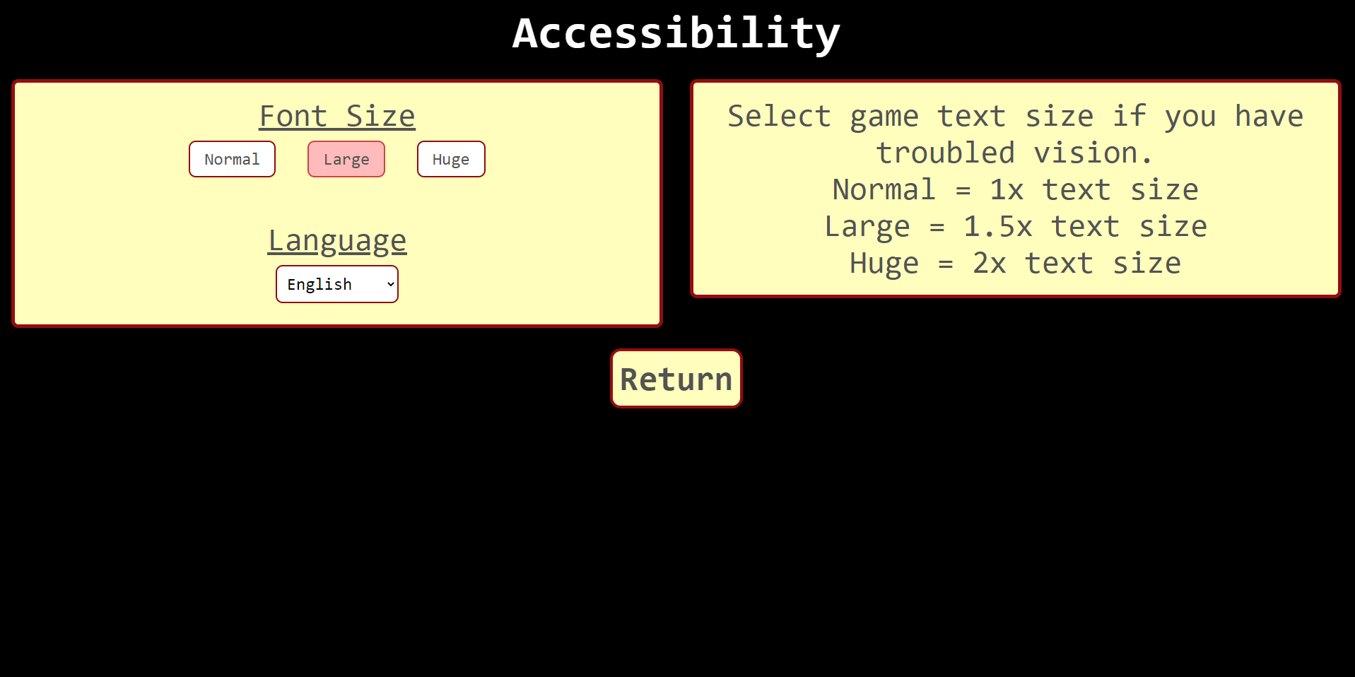
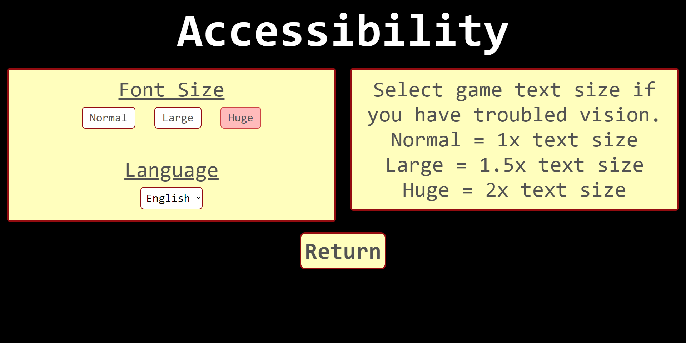
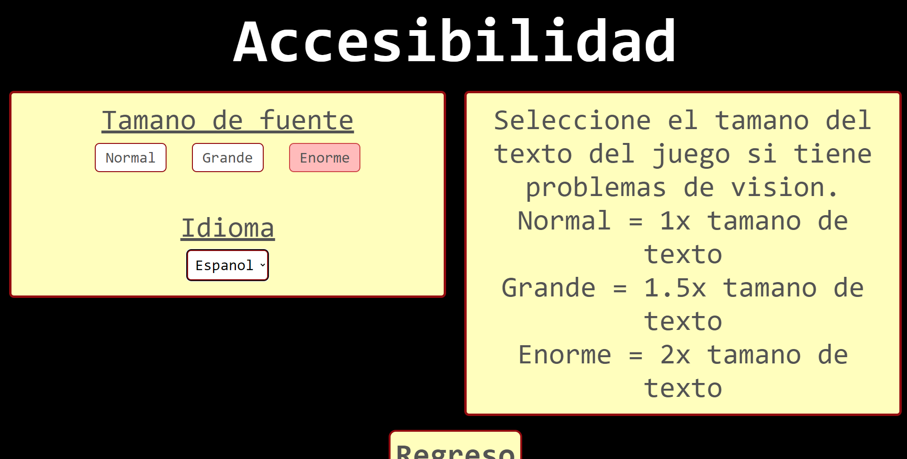
Accessibility features
Img 1. Normal Text Size
Img 2. Large Text Size
Img 3. Huge Text Size
On the accessibility page, the user has the option to pick between a normal, large or huge font size. This is to help people with troubled vision. Furthermore, there is an option to play the game in Spanish, in case they cannot read English.
Img 4. Spanish Text

Slide 9
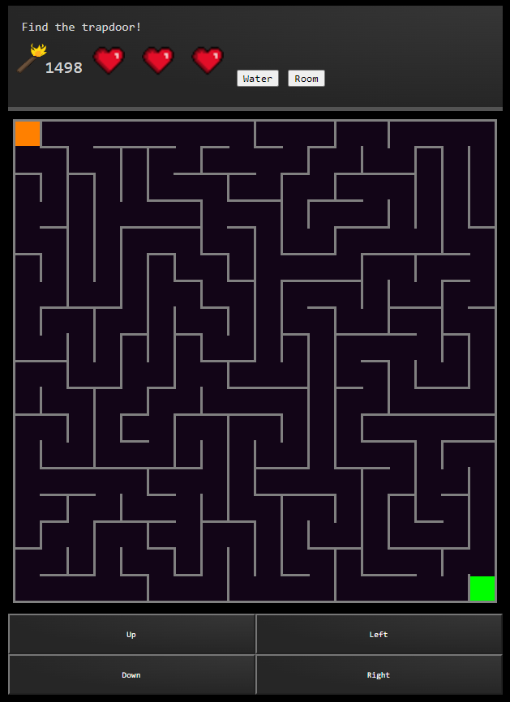
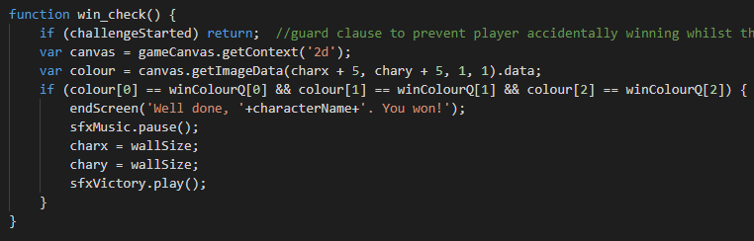
Top Features
Another one of the top features in the game would be the sound design. As sound can really change how a user will experience something, it is important to have good sounds. When in the maze, music is looped to keep the game entertaining. Furthermore, when the user clicks a button or even when they lose or win, corresponding sound effects are played.
The top feature in Oubliette is the maze generation. Every time the player hits play, a new maze is generated depending on the selected difficulty.
Main game music paused
Victory sound effect played

Slide 10
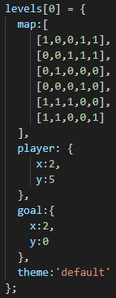
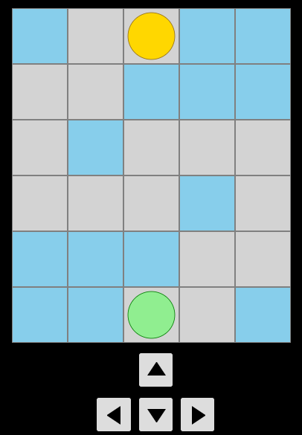
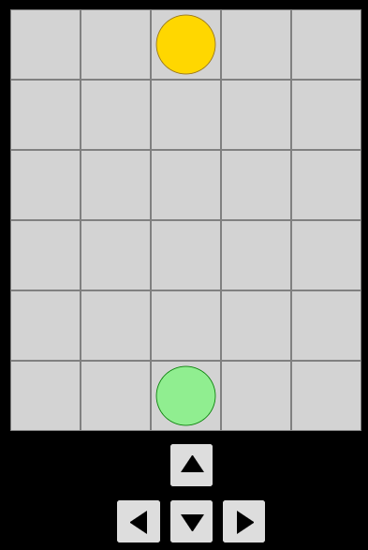
Top Features (2)
Another top feature of the game is the Pressure Plate Challenge – the maze within the maze. The challenge is formed by using a 2d array as shown in 'Img 1' - the map array is filled in with 0s and 1s. The 0s and 1s are mapped to floor tiles and walls tiles respectively.
The buttons below the maze traverse the character by simply +/- the y co-ordinate for up and down buttons and +/- the x co-ordinate for left and right buttons
When the player is traversing the maze, if he moves from a floor tile to a wall tile, he will 'fall down a trapdoor' and be reset to player starting position of [2,5]
Img 2. Pressure Plate Challenge, visible dummy plates
Img 3. Pressure Plate Challenge, actual gameplay. CSS colour of walls and floors are both lightgray
Img 1. Code showing the layout of the maze and start and end points

Slide 11
References and copyright declaration.
Torch icon: Charlie Ogilby
Heart icons: Charlie McClements
Challenge 1 art: Charlie McClements
Plates Challenge Art: Charlie McClements
Spider challenge spider image: https://www.pikpng.com/downpngs/wiowbT_tarantula-spider-pixel-art-clipart/ (free to use)
Landing screen video: https://www.pexels.com/video/lighted-candle-855262/
All copyright conditions have been satisfied.

