Slide 1
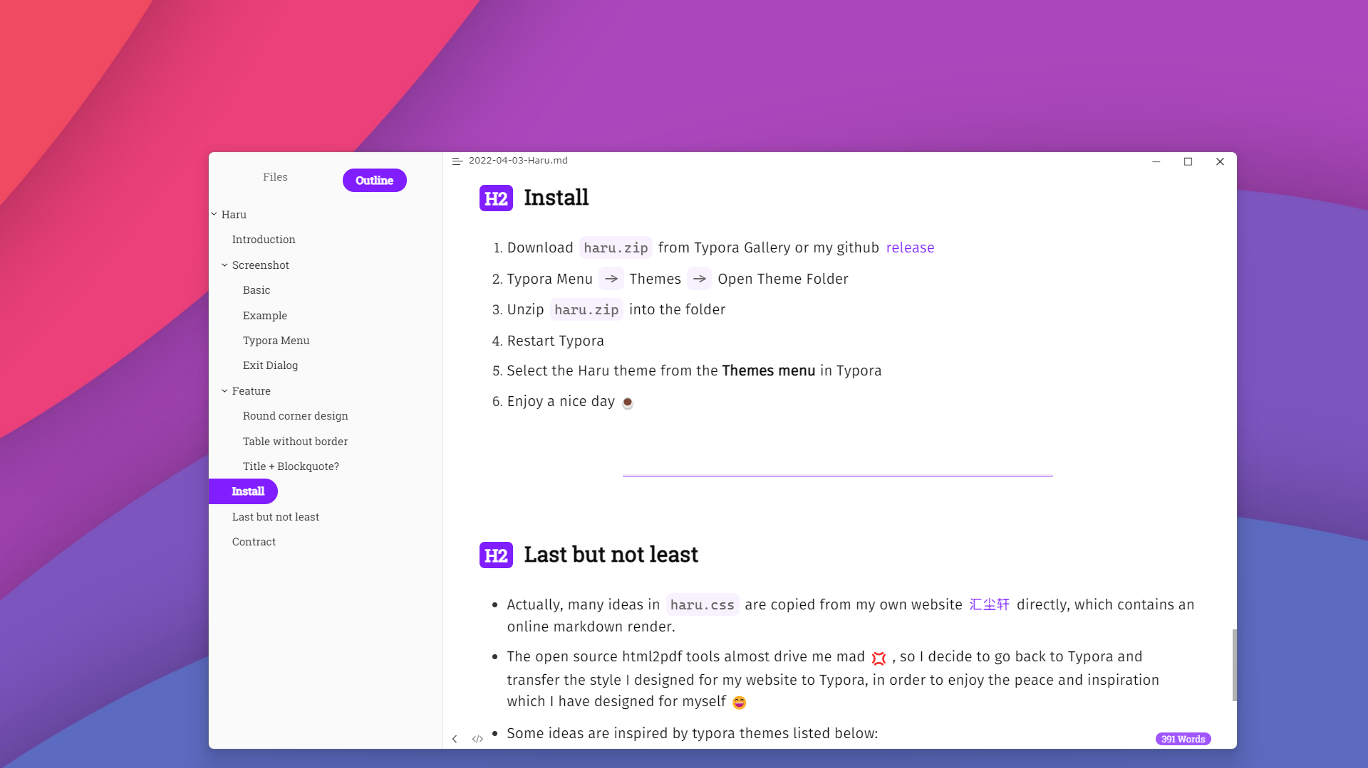
Typora theme
Haru

