Slide 1


FleetHacker
Media Compliance
Reviewer
Offline Windows software for recurring media reviews across user home shares.
Charlie McPherson
Notes:
I built FleetHacker to make recurring reviews of images and videos easier to manage. The application keeps a local catalog and lets a reviewer inspect and classify each item.
https://github.com/Charlie22911/FleetHacker/blob/v0.3.3-preview/README.md
Cover artwork is conceptual. The icon is from the FleetHacker application.

Slide 2
The same images come back every week
8,000+
138,000
user home shares in scope
estimated reviewer-hours
per year
Hundreds of thousands
of images reviewed each week
Figures describe the existing review workload.
Notes:
Our recurring review covers more than 8,000 user home shares. Reviewers see hundreds of thousands of images each week, with many of the same files returning. The 138,000 reviewer-hours is an annual baseline estimate for the current workflow.
Source: Our current review workload estimates.

Slide 3
An extension filter follows the filename
ext:.jpg
This Explorer filter looks for names ending in .jpg.
photo.jpg
photo.dat
Appears in the results
Missed by that filter
The files can contain the same JPEG bytes. FleetHacker can optionally check file headers for supported media with unexpected extensions.
Notes:
This example is about an explicit extension filter. Explorer also offers other search modes. Changing the filename suffix does not change the file bytes. FleetHacker’s optional renamed-media check reads a small file header for ordinary files with unrecognized extensions and can increase reads on network shares.
https://learn.microsoft.com/en-us/windows/win32/search/-search-3x-advancedquerysyntax
https://learn.microsoft.com/en-us/windows/win32/properties/props-system-fileextension
https://github.com/Charlie22911/FleetHacker/blob/v0.3.3-preview/README.md

Slide 4
From a home share to a review queue
01
Scan the source
Choose a local folder or network share and keep the catalog on a local drive. An interrupted scan can resume.
02
Build the catalog
FleetHacker records locations and fingerprints, then saves previews for the review queue.
03
Record the decision
Review an image or video, add notes, and save its classification. Retain evidence or export a report when needed.
Notes:
Use the catalog to resume scanning and continue review. A media source can be local, mapped, or a UNC share. The active SQLite catalog belongs on local storage. The application keeps decisions and previews in the catalog and does not modify source media as part of scanning or Evidence capture.
https://github.com/Charlie22911/FleetHacker/blob/v0.3.3-preview/README.md
https://github.com/Charlie22911/FleetHacker/blob/v0.3.3-preview/Core/Scan.cs
https://github.com/Charlie22911/FleetHacker/blob/v0.3.3-preview/Core/Database.cs

Slide 5
Verified matches keep their review
Example across two scans
EARLIER SCAN
LATER SCAN
SAVED DECISION
photo.jpg
archive-copy.jpg
Compliant
Original share
Another share
New location recorded
A sampled fingerprint flags a possible match. A full SHA-256 match lets FleetHacker reuse the saved review when the earlier decision is clear.
Notes:
On a rescan, the application can attach a newly verified location to the previously reviewed item. Full SHA-256 verifies the content match for this reuse workflow. When a comparison cannot be verified or saved reviews conflict, the application preserves those decisions and keeps the new item separate for review.
https://github.com/Charlie22911/FleetHacker/blob/v0.3.3-preview/Core/RescanReviews.cs
https://github.com/Charlie22911/FleetHacker/blob/v0.3.3-preview/Core/Database.cs

Slide 6
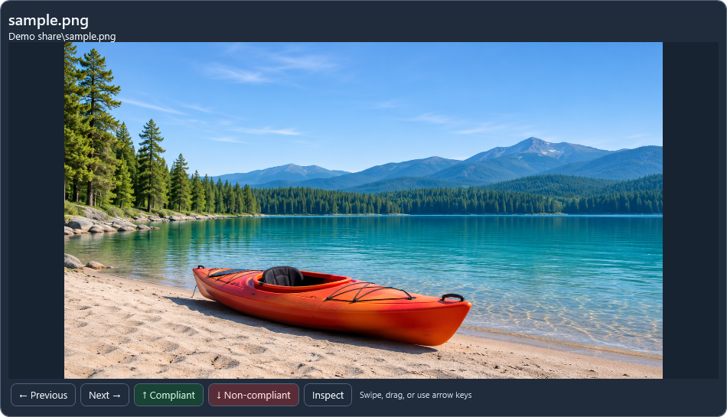
The reviewer makes the decision
Use Quick Review to browse and classify one image at a time.
Left / Right
Previous or next
Up
Compliant
Down
Non-compliant
For items that need follow-up, keep notes, retain a selected original as encrypted evidence, and export a report.
Quick Review with a sample image
Notes:
Swipe, drag, or use arrow keys on the focused image. Left and Right move to another item. Up and Down submit a review decision. The reviewer makes the policy judgment. Evidence capture retains encrypted originals. Ordinary catalog metadata and thumbnails are separate from that encryption.
https://github.com/Charlie22911/FleetHacker/blob/v0.3.3-preview/README.md
https://github.com/Charlie22911/FleetHacker/blob/v0.3.3-preview/App/QuickGestures.cs
https://github.com/Charlie22911/FleetHacker/blob/v0.3.3-preview/Core/Evidence.cs
Interface capture uses a synthetic sample image and fictional filenames.

Slide 7
Less time rechecking the same files
Focus on what needs a decision
13,800
Reuse verified reviews and spend more time on new, changed, or unresolved media.
reviewer-hours per year
Keep a record for follow-up
Illustrative scenario assuming 10% fewer manual review hours against the 138,000-hour baseline.
Use saved decisions, locations, and notes to explain what was reviewed.
github.com/Charlie22911/FleetHacker
Notes:
The example multiplies our 138,000-hour baseline by 10 percent to show the scale of a possible improvement. The realized benefit depends on the verified reuse rate and reviewer time in practice.
Source for baseline: Our current review workload estimate.
https://github.com/Charlie22911/FleetHacker

