Slide 1
PHYS3151_assignment3
Group3
Wong Chor Sing (3035790769)
Wong Tsz Yau Martin (3036060625)

Slide 2
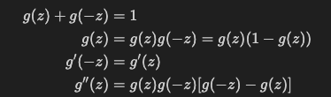
Q1

Slide 3
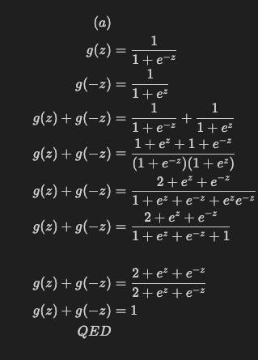

Slide 4
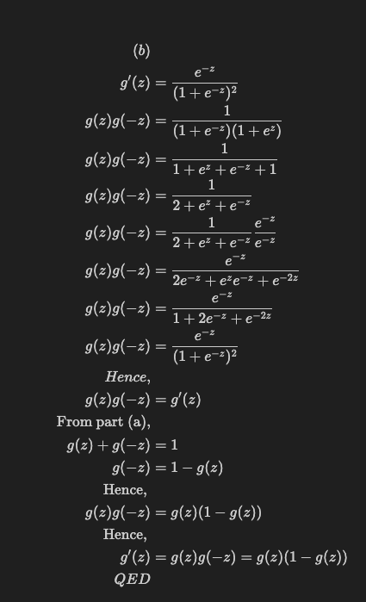

Slide 5
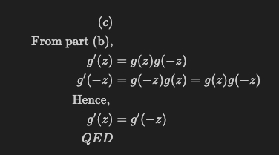

Slide 6
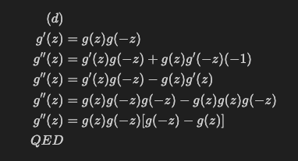

Slide 7
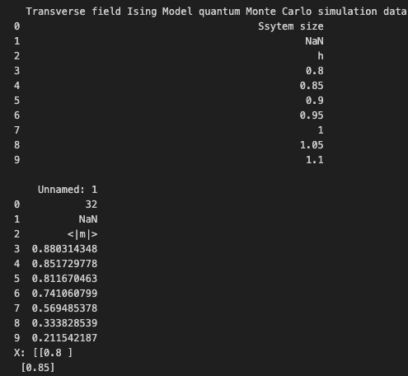
Q2
Load the data

Slide 8
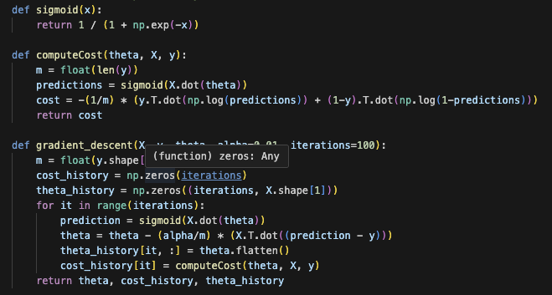
Standard Logistic regression function

Slide 9
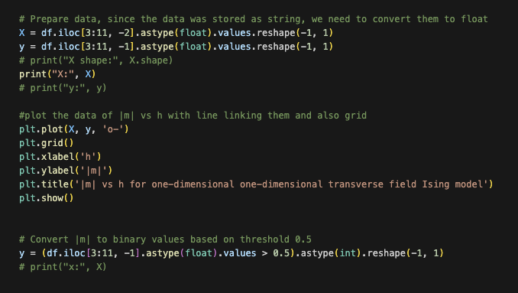
Data processing and Cleansing

Slide 10
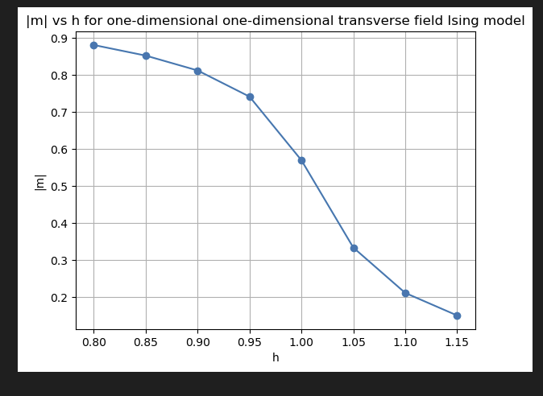

Slide 11
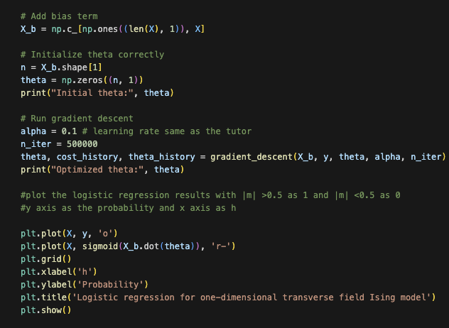
Perform Gradient descent

Slide 12
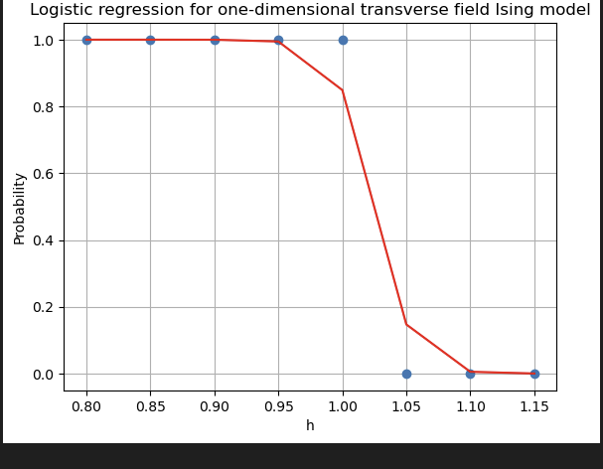


Slide 13
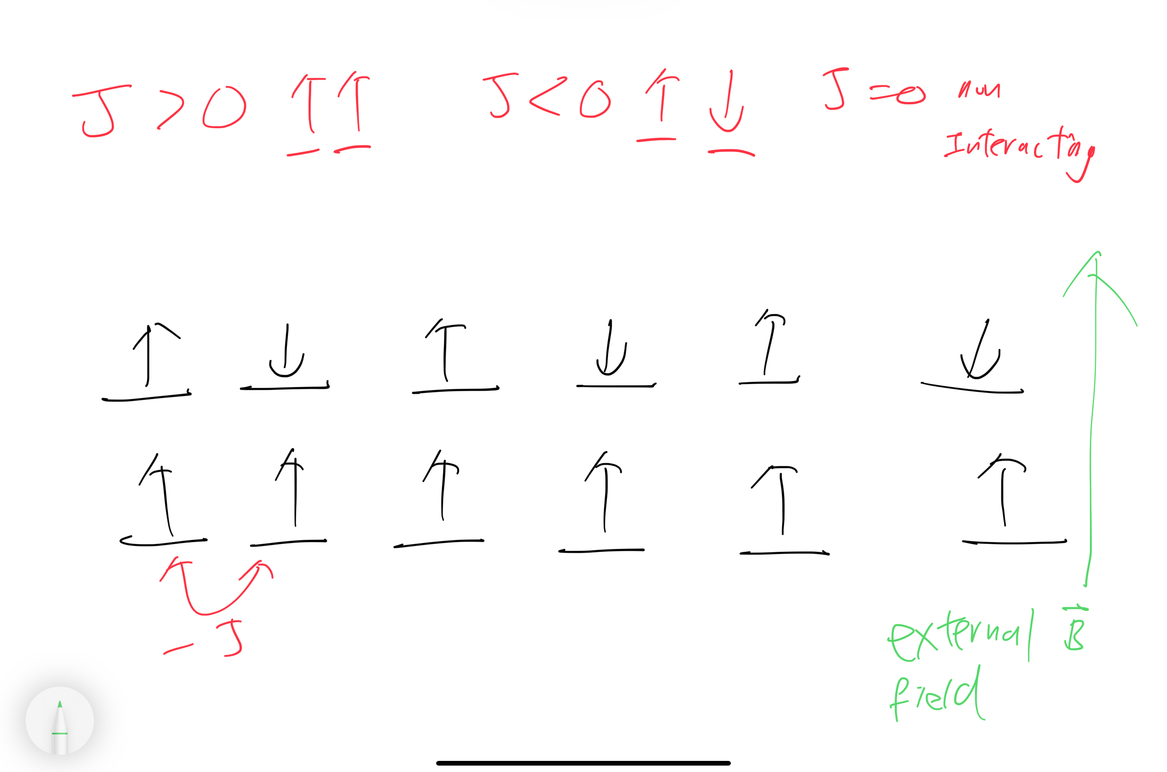
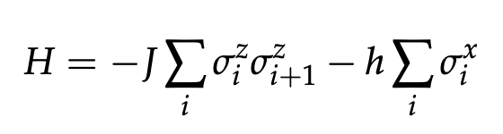
What is transverse field Ising model?

Slide 14
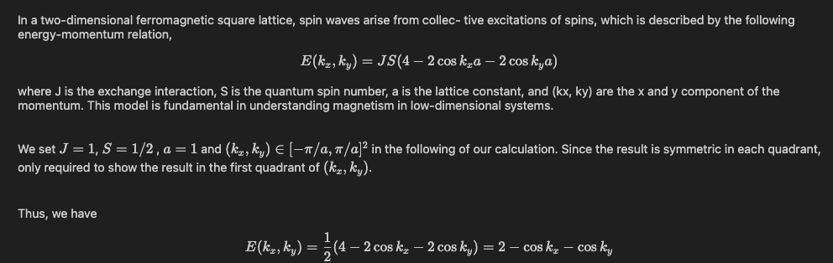
Q3

Slide 15
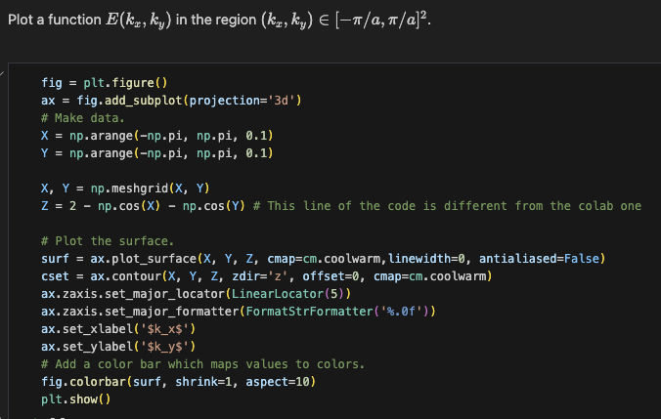
Part (a)

Slide 16
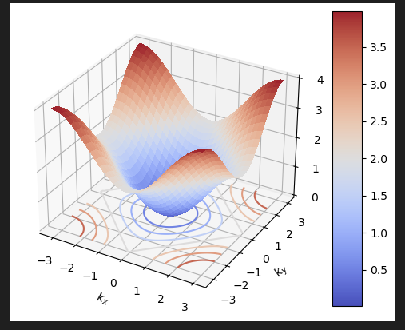

Slide 17


Part(b) Data processing
Parameter adjustment
Training points on kx_list and ky_list
Energy boundary to determine the occupancy
Features

Slide 18
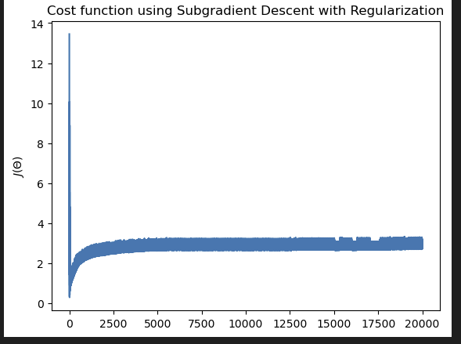
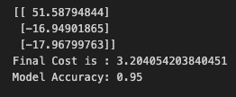

Slide 19
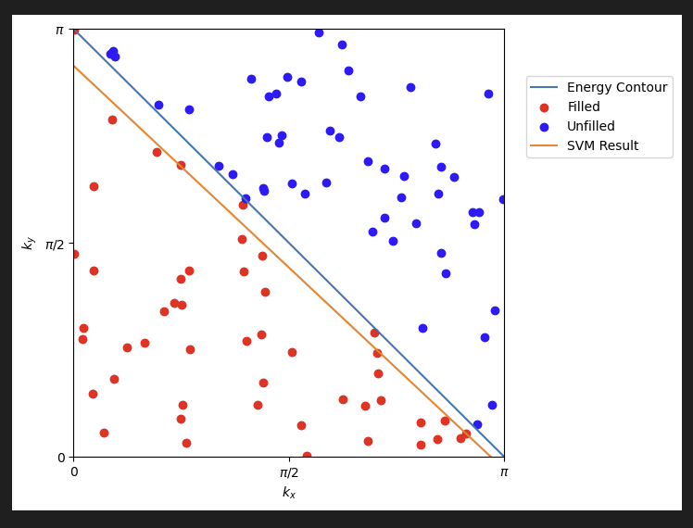
Result of SVM
N = 100

Slide 20
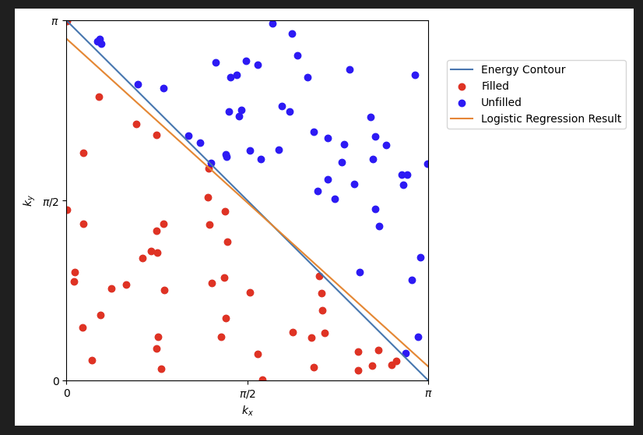

Result of logistic regression
N = 100

Slide 21


Part(c)
Parameter adjustment
Change features

Slide 22
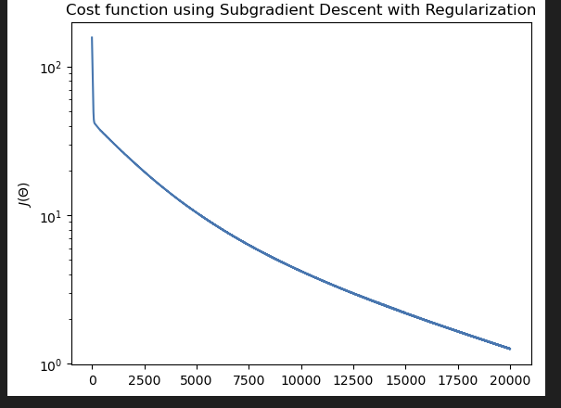
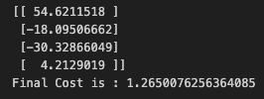
Result of SVM

Slide 23
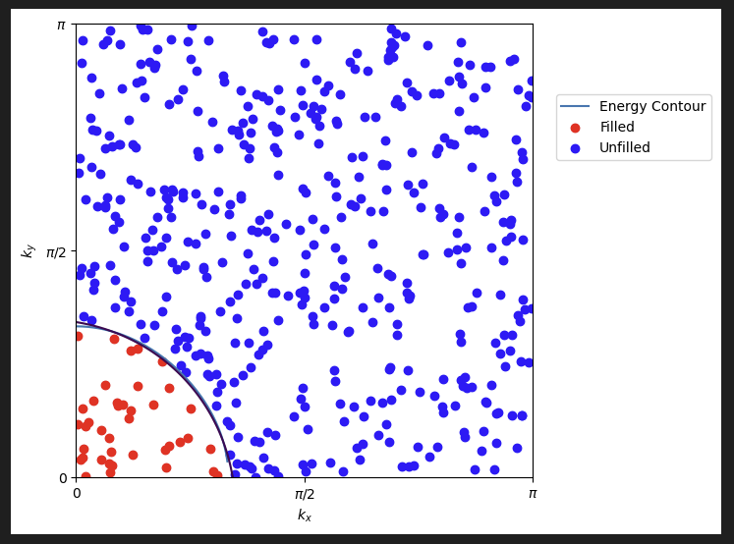
Result of SVM
N = 500

Slide 24
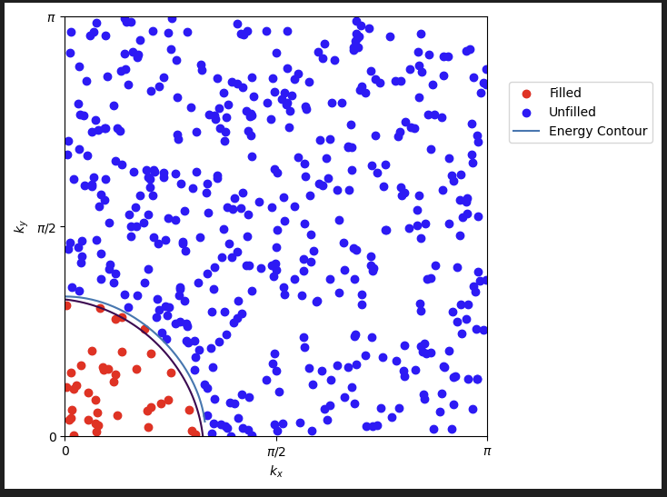

Result of Logistic Regression
N = 500

Slide 25
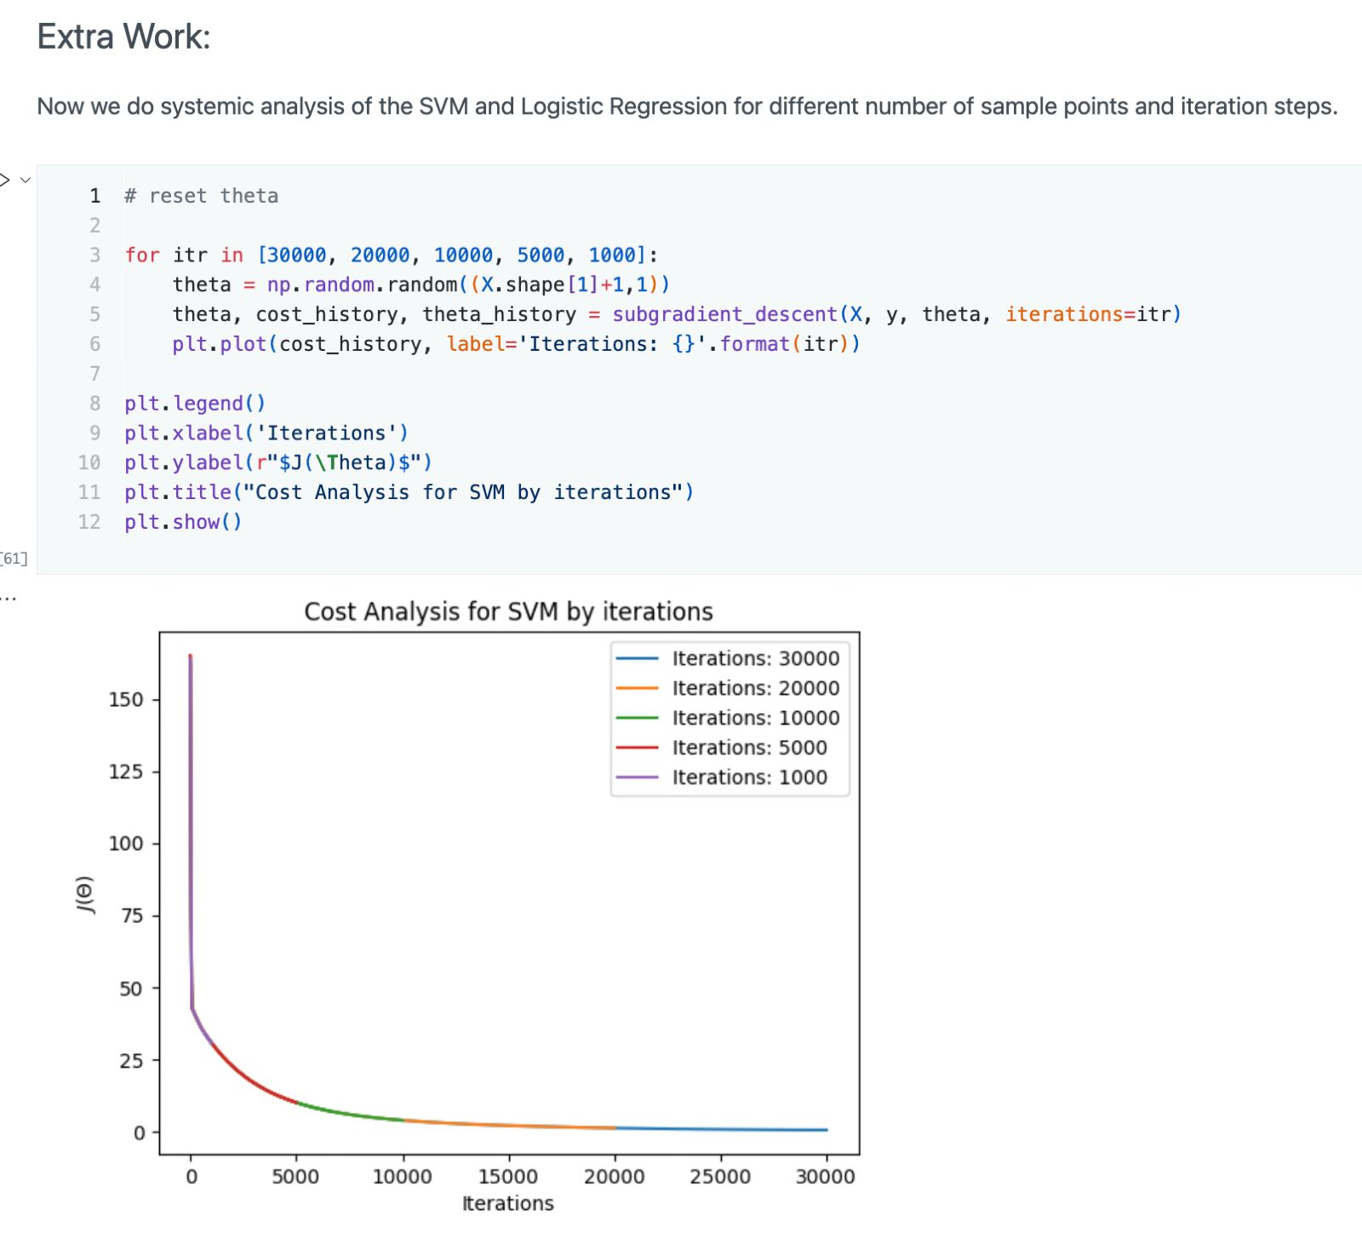

Slide 26
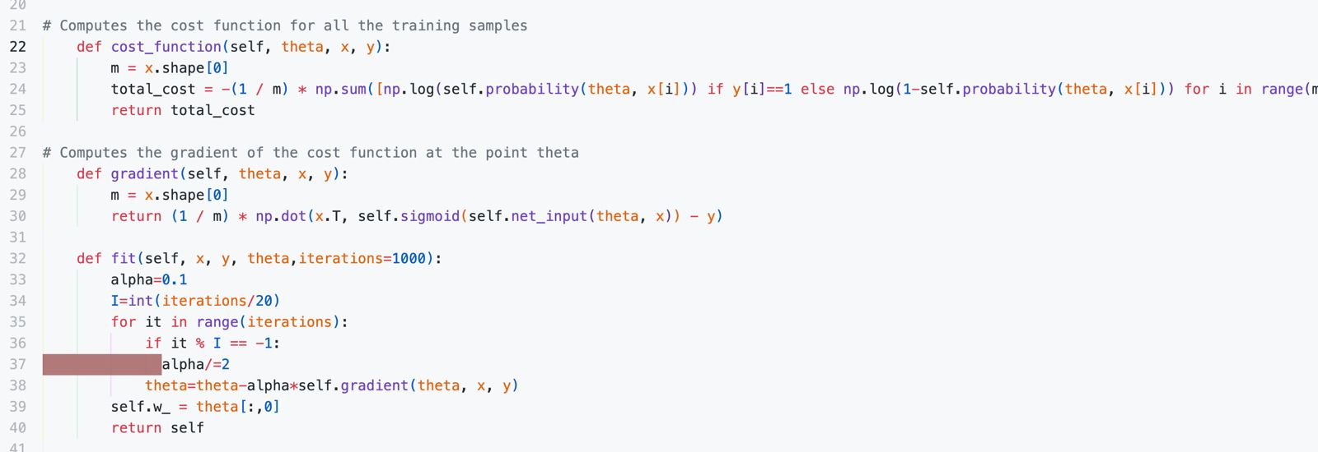
Issue with the function designed
We are restricted to use only the function in the Jupiter notebook according to the project documentation
BUT…

