Slide 1

Riding with Uber: Is There a Road to a Five Star Rating?
Charlize Gutierrez-Lopez

Slide 2
Data
Original Dimensions: 150000 rows by 21 columns.
Variables of Interest
Date
Time
Vehicle Type
Average Vehicle Time at Arrival
Booking Value
Ride Distance
Customer Rating
Many variables, dropped the irrelevant ones.
NAs due to Incomplete Rides, which led to NAs for Customer Rating.
57,000 rows were dropped.
Notes:
The main questions that this project will answer are:- Are higher customer ratings associated with specific ride characteristics?- Which variables show a correlation with customer satisfaction?
lot of numerical data., however, it was all character, so had to convert to numerical.

Slide 3
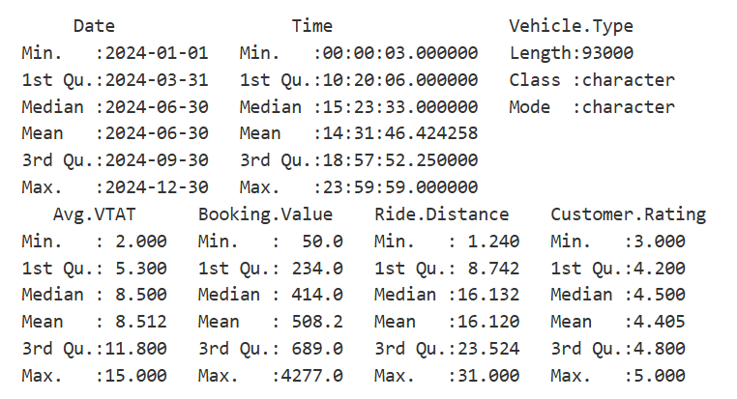
Interesting Statistics
Findings:
  Mean customer rating is high.
  Extremely high booking value of 4277.
  Everything else is very standard and seems evenly distributed.

Slide 4
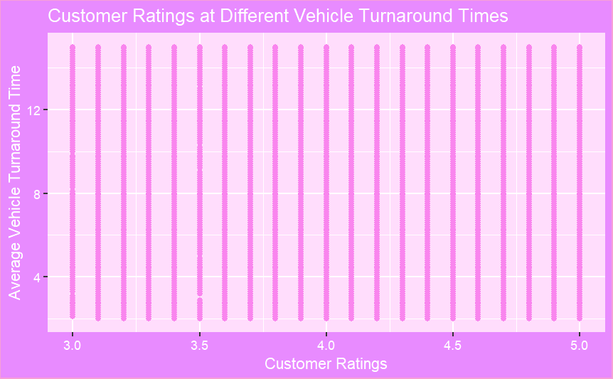
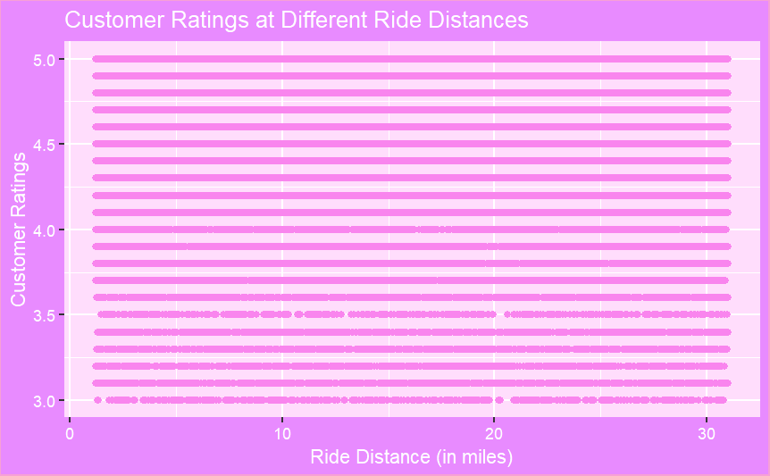
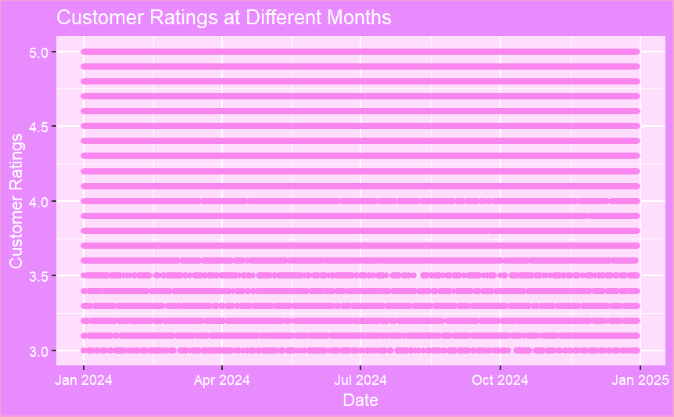
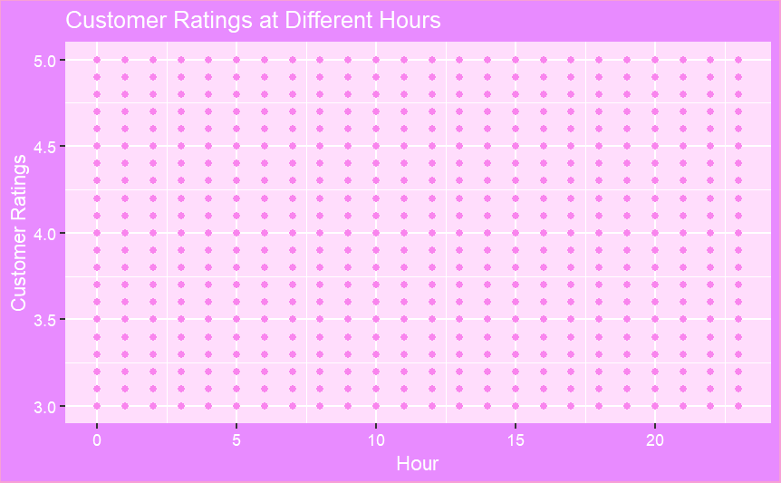
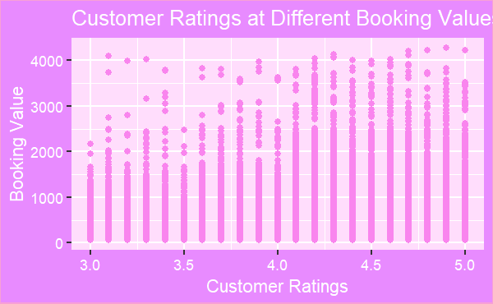
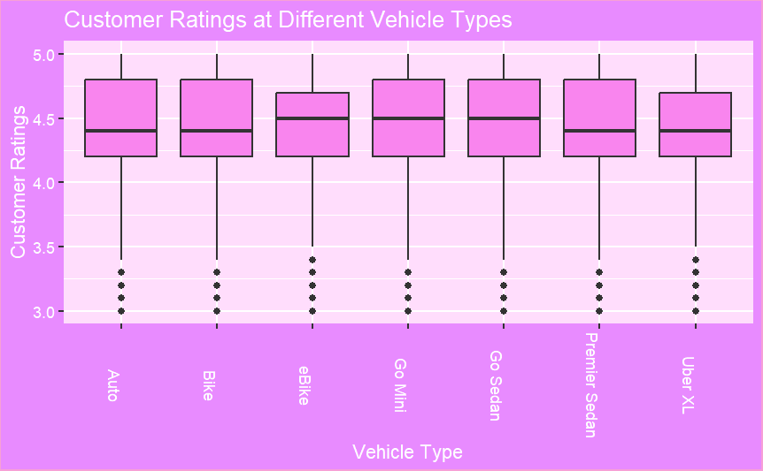

Slide 5
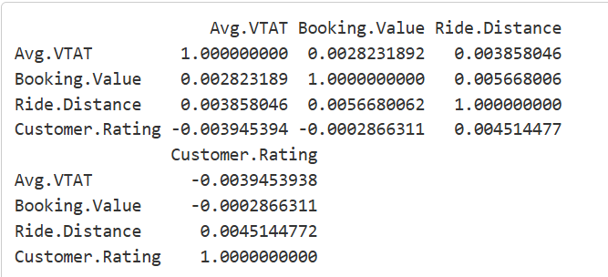
Results
Date, Time, Vehicle Type, Average Vehicle Time at Arrival, Booking Value, Ride Distance, Customer Rating have no significant impact on consumer ratings in this dataset (lack of correlation).
Future Work: Analyzing correlation between Customer Ratings and Pickup/Drop off locations.

