Slide 1
Library System Project
CS4398 - Group 4
Eyman Ahmad
Joseph Antholzner
Charlie Cox
Bryan Patrick King Schilhab
Project repository link - https://github.com/CharlieCoxAustin/GroupAssignment2

Slide 2
Team Collaboration
Our collaboration started this past Monday, where we met and started discussing the assignment. After working through our textual analysis and making our class diagram, we decided to split up the work as follows:
Charlie has strong java skills, so he volunteered to do a bulk of the programming work.
Joe has 9 years of experience as a tester and test lead with General Motors, so I tackled the test cases.
Bryan and Eyman agreed to work together on the diagrams.
We met again Wednesday and each one of us were pretty much done with our parts. The meeting still lasted about 5 hours, as we spent time evening reviewing and modifying what each other had done. By the end of the night, we were pretty much done with only a few more tweaks needed, so we decided to meet again on Thursday to review and practice presenting, and worked out the final issues with the different parts.

Slide 3
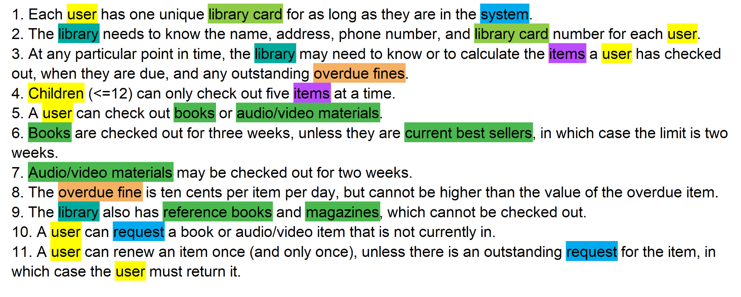
Textual Analysis

